Slide 1
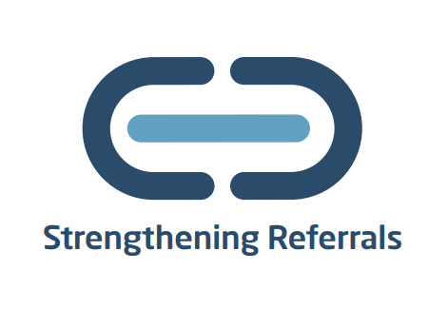
ReferKent
Making referrals simple, easy and secure
Notes:
Last year we launched an online referrals system that aimed to mitigate the action of signposting. The system aims to make referrals simple safe and secure between a network of organisations who onboard to the system. It was recognised that signposting was not always the best option to help people as some people may feel unconfident about calling an organisation they don’t know, and it was never clear if when sign posting that that person was actually getting the onward support.
A working group made up of different stake holders came together to generate ideas on how to mitigate the action of sign posting and the ReferKent system was the result.

Slide 2
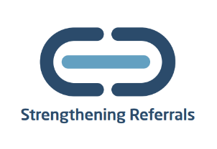
ReferKent
Making referrals safe, easy and secure!
Many people seeking support were subjected to signposting, often from one organisation to another. This left them feeling deflated and falling further into hardship. ReferKent takes the pressure off the individual to reach out.
www.kent.gov.uk/referkent
Notes:
At first the organisations that we targeted were to help provide advice and guidance in relation to financial hardship, but we have since expanded to accommodate for many different types of advice and support services. Having mental health services onboard has been one of our priorities as money worries and mental health often interlink and so now we have a number of mental health services onboard.
I’m just going to take you to our webpage where I can take you to the system and show you how you can find out more about the system.

Slide 3
Primary Users
Can add other own agency users to the system
Can add and edit own agency details
Can view agency activity

Slide 4
Notes:
130 organisations 650 users, 1168 referrals made, and many more in the process

Slide 5
Web Referral Form
Advise that basic customer information about participating in debt advice journey is shared with Creditor if consent given
Optional for Creditor to include a customer ref
Notes:
Agent referrals are driven by a simple web referral form.

Slide 6
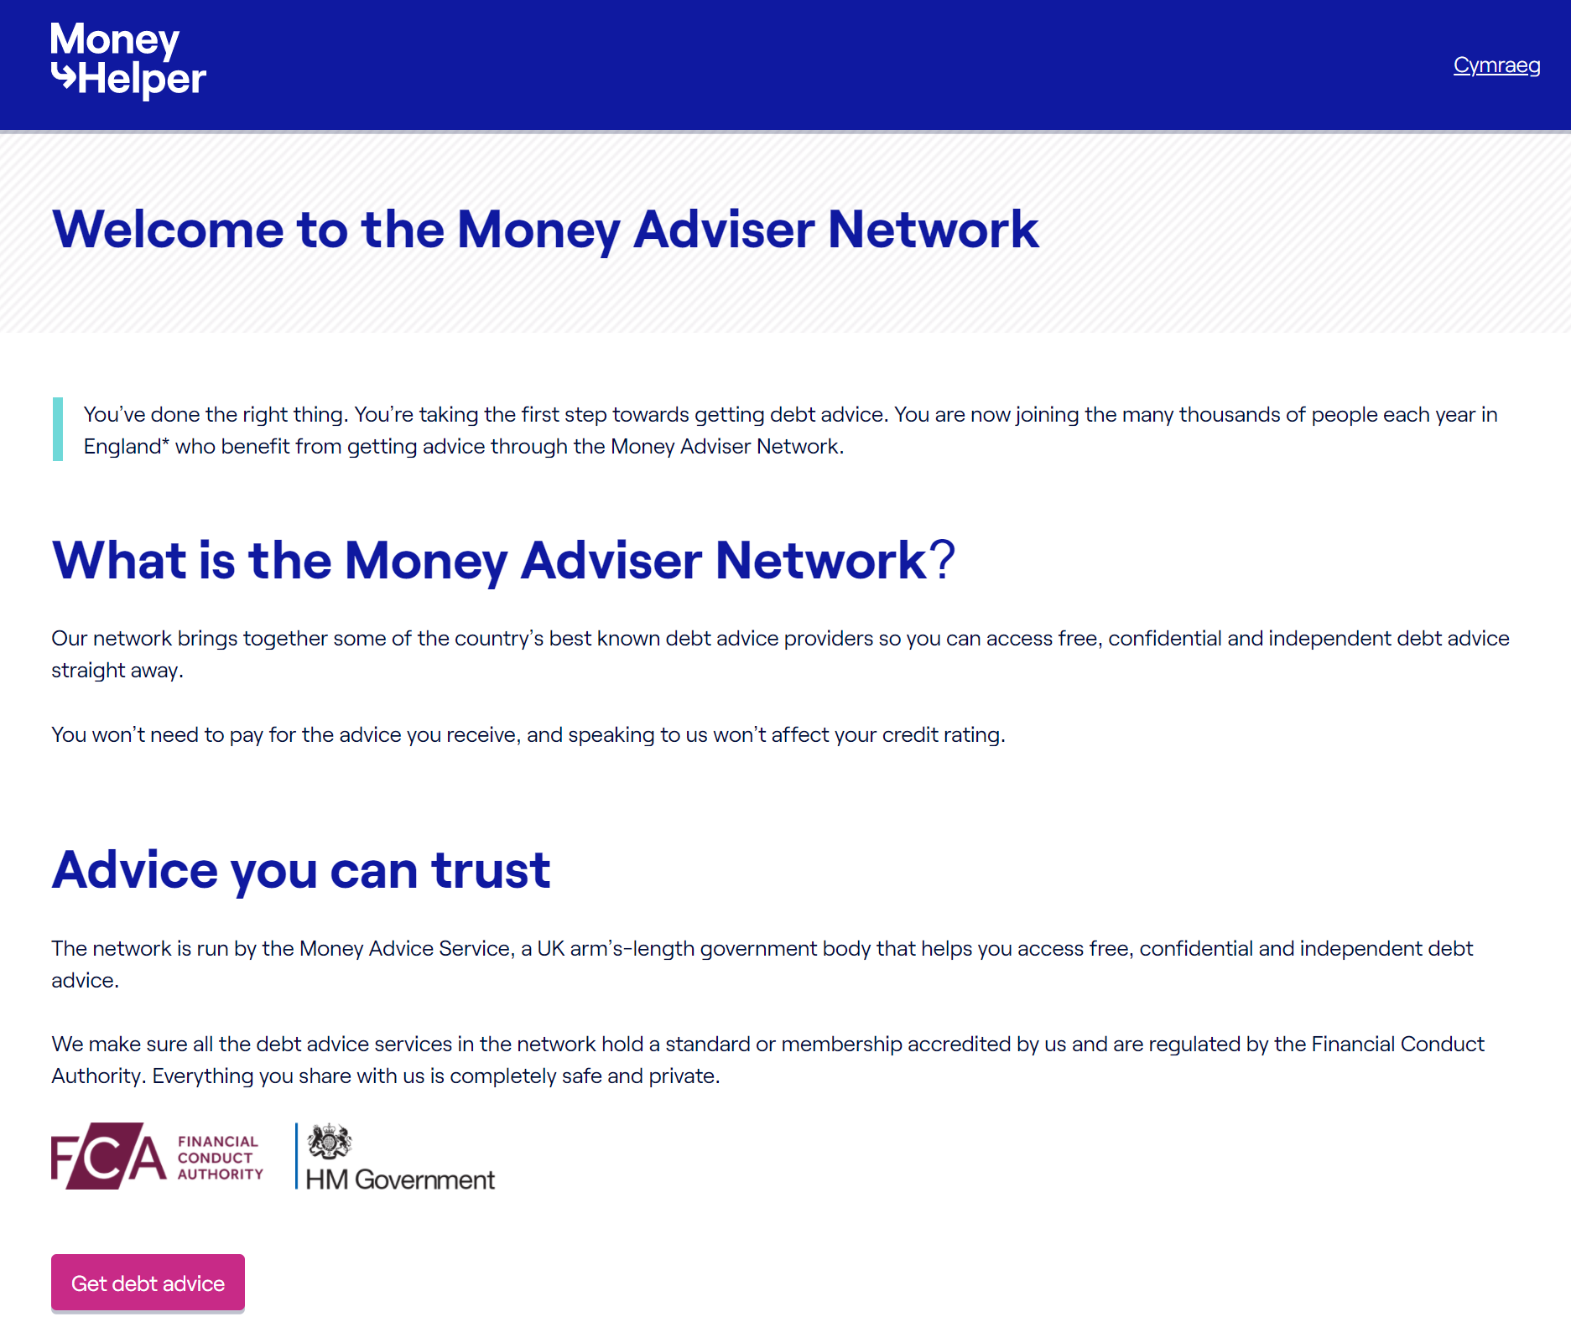
Money Adviser Network – customer self referral form
Customers can self serve and request an immediate or scheduled call back from a debt adviser
Or can opt to ‘self-help via on-line debt advice tools
Suitable for all customer communication channels (Websites, letters text messaging)
Notes:
There is a self-referral option also…..

Slide 7
Money Guiders Enrolment Sessions
Feeling confident in giving money guidance
20 hours online learning
City and Guilds accreditation
Access to an online hub
Free to access
Any questions email referkent@kent.gov.uk

Slide 8
Q&A
To onboard e-mail: ReferKent@kent.gov.uk
or click Join ReferKent as an Agency (office.com)

