Slide 1
The ESTHER Philosophy
Housing , Health and Social Care
9 March 2020
Anne Tidmarsh
Director Partnerships KCC and
Design and Learning Centre
for Clinical and Social Innovation

Slide 2
Design & Learning Centre for Clinical & Social Innovation
Co-Designing Better, Safer, Cheaper and Different Care
An Innovation Space for Professionals, Citizens, businesses & academics
Finding the right solutions to make a real difference
Removing organisational & professional barriers
Notes:
Supporting the 2 million people in Kent, Medway and Beyond
A better and cheaper way!

Slide 3
Designing Care for Health and Social Care that is:
Better, Safer, Cheaper and Different
INNOVATION & TECHNOLOGY
Co-designing solutions with citizens and professionals in less than a year
Learning – freedom to innovate
Co-implementing locally after evaluation
Empowering the citizen – moving away from professionally dominated towards person-centred care and co-production
Utilising the digital revolution
Delivering the Innovation Facility for 1.8 million citizens on behalf of the Kent and Medway Health system in collaboration with Kent Surrey Sussex Academic Health Science Network
Digitally Enabled ESTHER
LEARNING & DEVELOPMENT
EXTERNAL & INTERNATIONAL FUNDING
CO-PRODUCTION & CO-IMPLEMTATION,
ENGAGEMENT & RESEARCH

Slide 4
Design and Learning Centre for Clinical and Social Innovation: engaging on many levels especially citizens and communities
Citizens
Communities
Health and Social Care commissioners
Providers – medical, mental health, social care sector and voluntary sector
Public Health
Academia
Businesses including Small Medium Enterprises
Digitally Enabled ESTHER

Slide 5
First developed in Sweden 1997
Bilateral goal
Creating care that is better, safer and uses resources more efficiently
Beneficial for the individual AND professional
Designs high impact solutionsF
Meets the challenges facing Health & Social Care
Innovative use of technology especially digital
Creates the workforce of the future
Meets the Challenges facing health & social care
Works with
Global Partners
Innovative use of technology especially digital
Website: designandlearningcentre.com Follow us on Twitter: @KentDLC

Slide 6
Works with
Global Partners
Designs high impact solutions
Meets the challenges facing Health & Social Care
Innovative use of technology especially digital
Creates the workforce of the future
What matters to you?
Not just
What is the matter with you?
Co-designing care, both at individual and system levels
Personalisation and Quality Improvement
Meets the Challenges facing health & social care
Innovative use of technology especially digital
Website: designandlearningcentre.com Follow us on Twitter: @KentDLC

Slide 7
5 Levels of Continuous Quality Improvement Changing culture and strategy for better outcomes
Bringing together culture and strategy with better outcomes
M
ESTHER
Café
MDT
PCN
Coach
Team
Ambassador
Professional
Trainer
ICP
Website: designandlearningcentre.com Follow us on Twitter: @KentDLC

Slide 8
ESTHER Journey in Kent
t
Implementing the philosophy with dedicated resources since 2016 across Kent – care providers, social care and health
ESTHER is included as one of the personalisation delivery methods for Kent and Medway Health system and we are working with the Kent and Medway Integrated Care Partnerships .
The NHS and Social Care Workforce Board and Health Education England are supporting the roll out
To date we have: 80 Coaches and 2042 Ambassadors
Delivered 3 ESTHER inspiration events
Working with the national NHS Personalisation delivery team and with the social care based Think Local Act Personal team ( TLAP).
Seen as best practice by the Chief Social Worker in England
Digitally Enabled ESTHER

Slide 9
Evolving ESTHER
We have adapted ESTHER for our system, with the aim to aim culture and strategy for better outcomes by developing:
ESTHER Ambassadors
Aimed at health and social care staff at all levels, care sector, citizens, community services
• ESTHER Ambassadors understand and promote awareness of the ESTHER Philosophy
• Be part of the ESTHER network (virtual and face to face networks) which aims to:
Improve the experience for ESTHER
Create a common language across the whole system
Sharing and learning from good practice
• Act as change and digital champions
ESTHER Ambassadors wear an ambassador badge to demonstrate that they understand the philosophy
ESTHER ambassador overview can be completed via e-learning or attend a face to face session, either option does not take longer than 2 hours
Digitally Enabled ESTHER

Slide 10
Works with
Global Partners
ESTHER Cafes
Cafes working at community level / Primary Care Networks
Participants MDT + stakeholders
Proposing quality improvements and reporting good experience
Ownership at community / PCN level
Reporting to Integrated Care Partnerships ( ICPs) including system change proposals
Cafes can also take place in individual organisations
Designs high impact solutions
Meets the challenges facing Health & Social Care
Innovative use of technology especially digital
Creates the workforce of the future
Meets the Challenges facing health & social care
Innovative use of technology especially digital
Website: designandlearningcentre.com Follow us on Twitter: @KentDLC

Slide 11
ESTHER Engagement
ESTHER Roadshow
Engaging ESTHER by visiting and speaking with communities
Target areas, spend time going to local venues and talking to people and connecting with community roles
Approach allows us to work with hard to reach communities and recruit to our ESTHER network
ESTHER Cafes
Refreshing our approach to include a toolkit and simulation cafes
Themed ESTHER cafes, which include technology sessions
Place Based Wellbeing
The “Breaking Barriers” collaborative led by Lord Patel of Bradford is working with us developing a “Playbook “for community based prevention and wellbeing. The engagement of ESTHERs is key to this in the development and implementation of the good practice.
Digitally Enabled ESTHER

Slide 12
ESTHER Engagement
The Kent and Medway Health system set us a challenge to find new and innovative solutions with a focus on local care to support people with:
Asthma
Cardio Vascular Disease
Chronic Obstructive Pulmonary Disease
Diabetes
Approach
4 engagement events across Kent and Medway – different times of the day in local
venues
Electronic Survey
Visiting community groups to get feedback
Event at the start of February with 130 people (citizens, health, care providers, staff, community services, leisure facilities) to explore different solutions and vote on the bets ideas and agree how they need to be implemented
Elaine and I would just like to say thank you for arranging the excellent workshop today. We found it very useful, informative and well organised. Time well spent. Best Wishes Bill’
Digitally Enabled ESTHER

Slide 13
Empower Care EU project – Technology Lab and Digital Leads
Working with our care providers to implement digital
Development of e-learning and virtual platforms to engage people
Design and Learning Centre
Clinical and Social Innovation
Horizon scanning for examples of good practice
Innovation Events and Methodology
Work with Industry and Academia to develop technology ideas
ESTHER Café to focus on digital and learn from ESTHERs
Skills development
Various technology projects: carers app, digital medication,
WLT
September 2019

Slide 14
Digital Support for our ESTHER Network
Connecting ESTHERs and providing a virtual way in which they can engage in our work. We also use this network for ESTHER coaches to share learning, information and improvement projects.

Slide 15
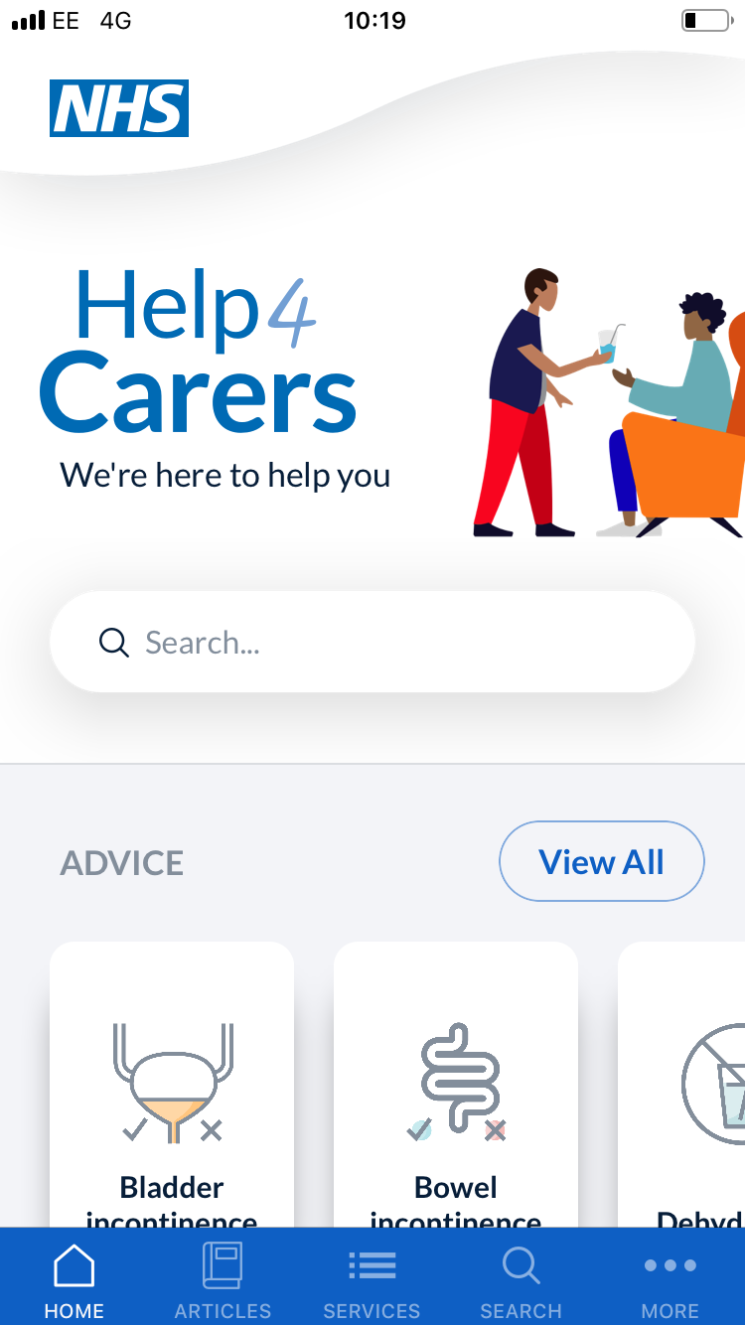
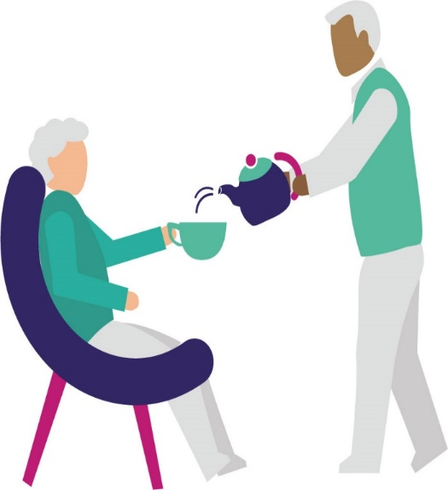
Carers App
Care workers and unpaid carers provide an invaluable role supporting the health and wellbeing of people across Kent and Medway.
The carers app contains the fundamental care elements to keep ESTHERs well and out of hospital, signposting to services where appropriate
Digitally Enabled ESTHER
Mouth Care
Fluid
Nutrition
Skin
Dehydration

Slide 16
Further Information & Contact
Further information:
Website: https://designandlearningcentre.com/
Get live Updates as they happen by following us on Twitter: @KentDLC
Email: designandlearningcentre@kent.gov.uk

