Slide 1
Home Improvement Agency
Services that aim to help people feel safe, comfortable and independent in their own homes for as long as possible.
Donna Crozier – Operations Manager, Peabody South East

Slide 2
Our Services
Free advice and information to help people maintain independent living within their own home.
Disabled Facilities Grants
Decent Home Loans
Winter Warmth Grants
Help and assistance to access charitable grants and funding
Handyperson Services
Health & Housing Coordinators
Home Straight – Hoarding service
PADs – Parkinson's, Alzheimer's, Dementia service
Notes:
As you can see from this slide these are the services that the Home Improvement Agency offer. One or two of these are initiatives that have developed as a result of the increase to the Better Care Fund budget and I will cover these schemes in the following slides.

Slide 3
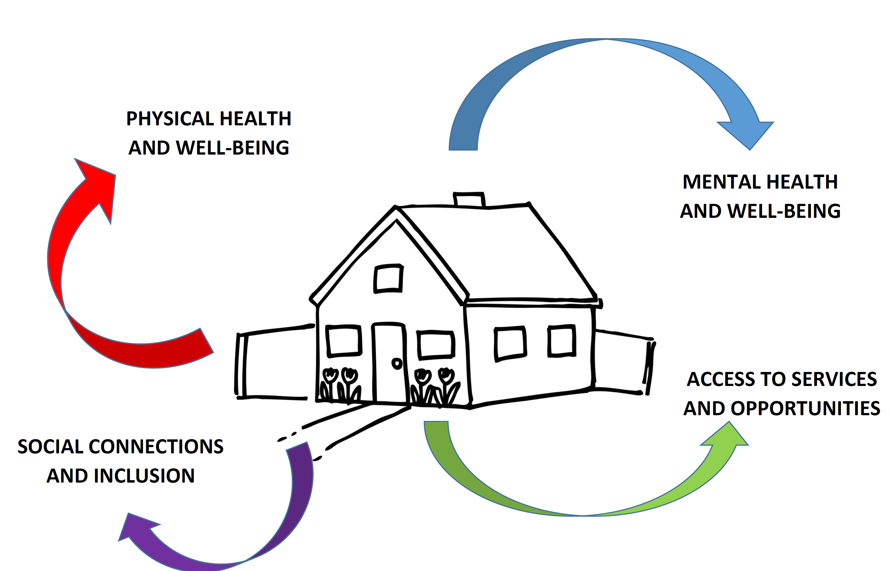
Recognition of importance of housing to good health and wellbeing: 2016-2020 Integration and BCF
Notes:
I am probably preaching to the converted when I say that we have an:
Ageing population – people are living longer.
There is a need for real person centred co-ordinated care
Growing evidence base on the contribution that housing makes to good health and wellbeing. Long recognised by environmental health and housing practitioners.
Poor housing, costs the NHS at least £1.4 bn per yr. Plus the costs to local government and social care.
Suitable housing can help people remain healthier, happier and independent for longer, and support them to perform the activities of daily living that are important to them – washing and dressing, preparing meals, staying in contact with friends and family.

Slide 4
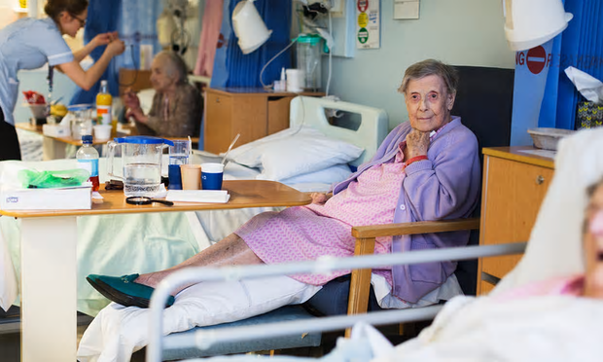
I just want to go home…
Notes:
Most people in hospital just want to go home, however the reality is that quite often they are unable to discharge home safely and timely as there are housing related issues that need addressing prior to discharge. Recognition of these issues lead to the first Health & Housing Coordinator service being developed in partnership with LA’s using enhanced BCF monies . Tunbridge Wells Hospital was our pilot hospital with the first service starting in November 2016, the service expanded with Coordinators now at Darent Valley, Maidstone and in May 2018 Ashford , and I am pleased to say that the QEQM at Margate will be covered from November this year.
Common every day issues that significantly delay or complicate a safe discharge;
Safeguarding issue raised
“I don’t have anyone to help me get about at home”
“I can’t answer the door”
“I'm frightened of falling”
“My bed is upstairs”
“My house is cluttered”
“My house is cold”
“My loo is upstairs”
“I'm homeless and I cant go back to where I was”

Slide 5
How do we all work together to make it happen?
Referral to HHC
HHC hospital assessment - on acute site
Home access visit
Action HHC Discharge plan
Referrals to community services
Practical work to home by handyperson to enable discharge
Post discharge home visit
Action longer term interventions;
Housing
DFG adaptions
Hoarding
Notes:
How does the service work ?
Health & Housing Coordinators form part of the Rapid Transfer Service within the acute sites.
Referrals are made to the Health & Housing Coordinator. HHC also attends ward rounds and wash up meetings. Picking up referrals
HHC visits patient on the ward to discuss and establish issues/barriers.
Home access visit completed prior to discharge, identifies issues and works to put measures in place to start to remedy problems.
Referrals and signposting made to community based services as necessary. Practical tasks undertaken by the Handyperson Enablement Service.
Post discharge – Home visit looking at longer term interventions and solutions., such as DFG, Hoarding, Disrepair issues etc.

Slide 6
Patient & Peabody HHC
Community services, family, patient social network
LA Housing
Community Health & Social Care
Discharge Team & NHS services
Engage everyone at the start of the journey home
Notes:
It is so important to engage everyone at the start of the journey to plan a coordinated and joined up approach.

Slide 7
Case Study - Mr X, 64 year old gentleman admitted following a fall
Issues:
Property unkempt and in need of a deep clean
No heating or hot water
Infrequent contact with family
Quick fix actions for discharge:
Deep clean organised and paid for by Local Authority discharge assistance grant.
Temporary repairs arranged for heating and hot water, self-funded by the patient.
Contacted family who agreed to assist in any way they could and maintain regular contact.

Slide 8
Case Study - Long term actions and outcomes for Mr X:
Referral to the Local Authority for a downstairs wet room to be completed as a Disabled Facilities Grant
Referral to Local Authority for assistance with replacement boiler.
Referral to Peabody Handyperson for grab rails to be fitted
Blue Badge application completed
Life line, Keysafe and Falls sensor installed
Referral to Kent Fire & Rescue for smoke detectors and fire safety advice
Application for Attendance Allowance completed
Regular cleaner organised

Slide 9
Kent 2018-19 the figures…
938 people with housing related issues referred for assistance to discharge
518 home access visits pre discharge
894 assisted discharges
246 post discharge home visits
Notes:
These are the Kent figures for 2018/19

Slide 10
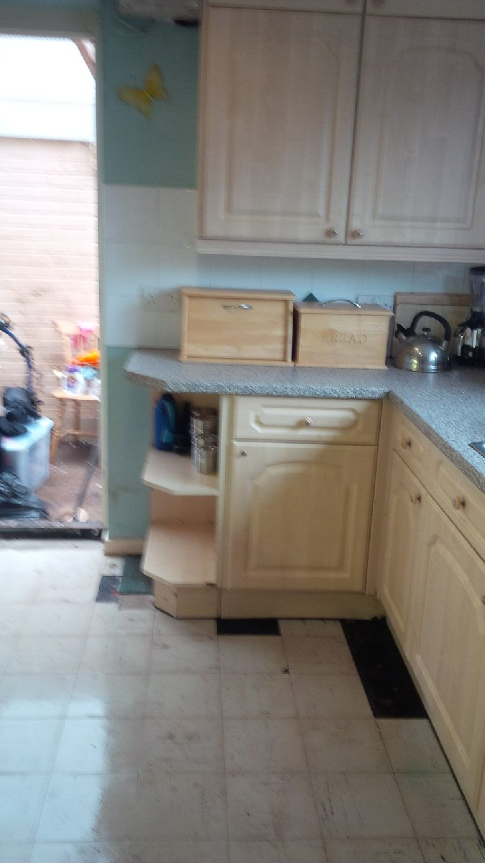
14%
of people assisted with discharge needed a deep clean due to clutter and hoarding
Notes:
Hoarding was one area that was significantly highlighted as a barrier for hospital discharge and also one that was recognised as not something that could be dealt with easily or quickly.
Engagement with our Local Authority partners lead to the development of our Home Straight service. Offering assistance and support for vulnerable people to address clutter and hoarding within their home especially where it impacts on a persons physical health or where the house has significant disrepair issues that cannot be addressed due to the clutter within.
Initially the service started in Tunbridge Wells local authority area and has since expanded with Home Straight Coordinators now available in Folkestone & Hythe and Dartford and Gravesham districts.

Slide 11
Mrs X Testimonial
“A fall was all it took to be found out, between five and seven years of not being able to control hoarding, waist high almost everywhere knowing I was doing it. In my mind coping with it, I must sort this out, leave it, and do it tomorrow. Oh what a relief along came Jayne and her team. I was treated with so much respect, and kind words of support and encouragement. I admitted straight away that my life had got out of control. Five skips later and I’ve got my living space back. Help I needed desperately had arrived. First to give me a safe walk way then a declutter. I’m so grateful for Jayne’s continued support. If you have this issue/problem please seek help, I’m truly thankful to Jayne and her team.
Notes:
This is a testimonial from the customer whose pictures were displayed on the previous slide and who was supported by the Home Straight service. This lady had had a fall within her home and was unable to get up, she was due to go to her friends for dinner which was a regular occurrence and when she hadn’t arrived the friend went in search of her. The friend was shocked at the condition of the property and totally unaware of how Mrs X had been living. Mrs X was so embarrassed about the condition of her home she simply wouldn’t allow anyone to visit her, she always went to them.

Slide 12
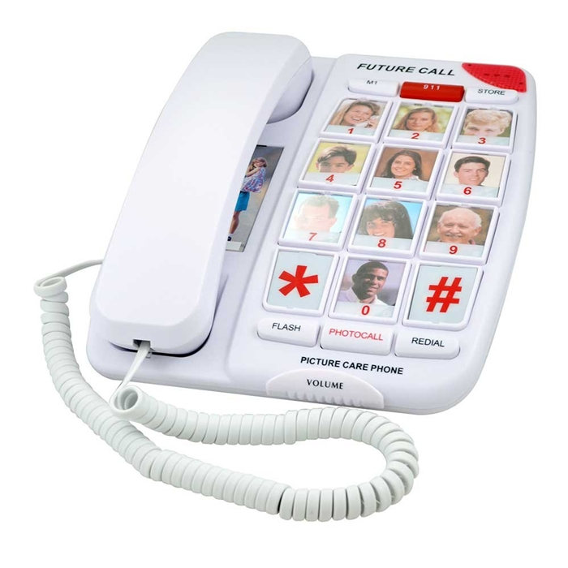
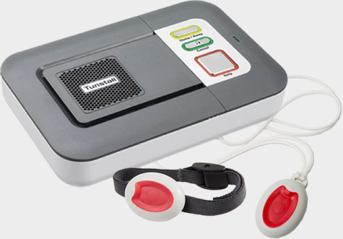
Parkinson's, Alzheimer's, Dementia Service (PAD’s)
Notes:
A new service currently available in Folkestone & Hythe LA area only;
Offering to fund bespoke pieces of equipment and items where a customer cannot afford to fund them or they are not available via health or social care.
Examples are:
Plate Guard, Gel Mats, Colour coded crockery, Large Button Telephones, Safe sockets, sensory pads and cushions, Lifeline funded for a 1 year period, footprint tracker funded for a 1 year period. Changes to home décor, floor coverings, walls, curtains etc.
Referrals can only be accepted from a health professional

Slide 13
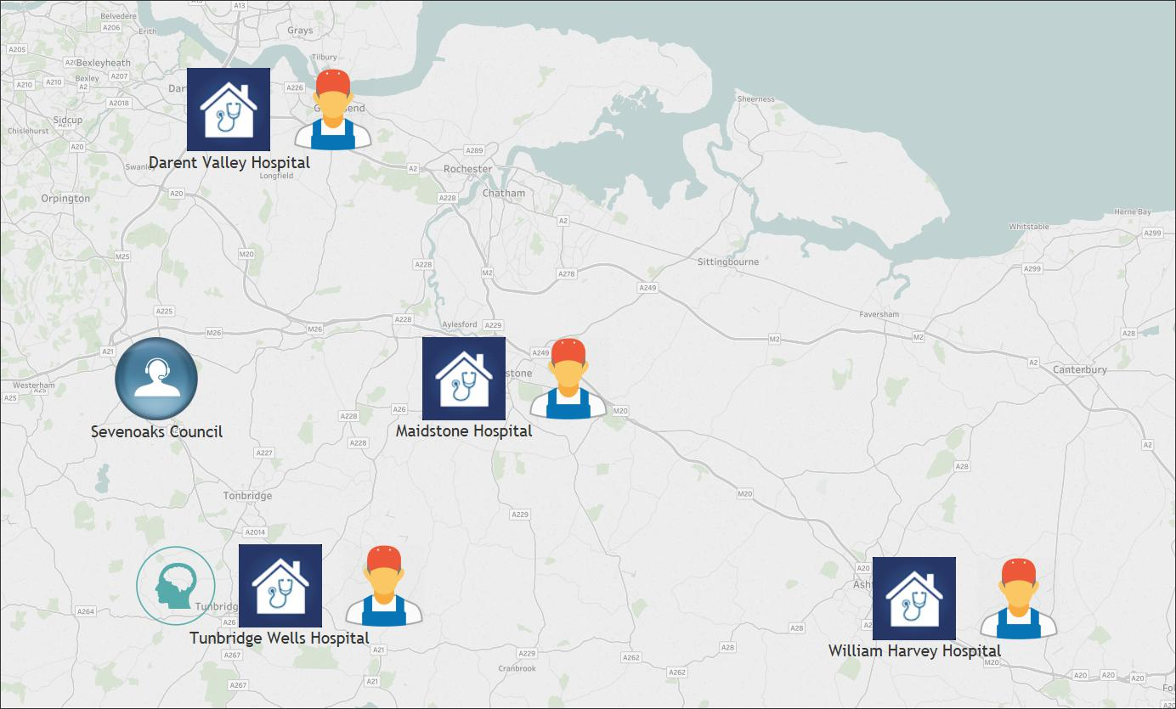
The Service Today

Slide 14
We are all on a journey;
Continuing to build on our effective network
Thinking differently
Challenging each other
Bringing specialist knowledge

Slide 15
Thank You for Your Attention
Do You Have Any Questions?

