Slide 1

Adapting the PRS for accessibility
Amos Kimani, Policy and Public Affairs Executive

Slide 2
Session Objectives
Describe the PRS accessibility campaign and its motivations
Update of our efforts so far and the aims of the campaign
An opportunity to solicit your views

Slide 3
What is the accessibility campaign
Increasing landlords’ awareness about Disabled Facilities Grants (DFGs)
Increasing local authorities’ promotion of the grants to private landlords
They are awarded to fund the installation of adaptations such as grab rails, ramps, stairlifts and shower installations

Slide 4
NLA motivations
Ageing demographic and the role that landlords can play to address the shortage of supply
Only seven percent of DFG awards go to private tenants
Opportunity to influence the narrative about landlords and their value to wider society

Slide 5
Progress so far
Policy workshops at meetings in London, Manchester, Southampton and Bournemouth
Hosted a roundtable to explore our research findings
We have highlighted the project to the Ministry for Housing, Communities and Local Government
Notes:
Share the tenant results before proceeding to the next slide

Slide 6
Campaign outputs
Report highlighting, current barriers, examples of good practice, and the role of landlords
Best practice guidance from the landlord’s perspective endorsed by sector stakeholders
We will be engaging with political stakeholders to raise awareness and support for change

Slide 7
Stakeholder engagement
Roundtable with various stakeholders to develop a consensus on possible solutions
Terms of reference will be framed by findings from our member survey
Research identifies current practices, supply-side bottlenecks, challenges and incentives

Slide 8
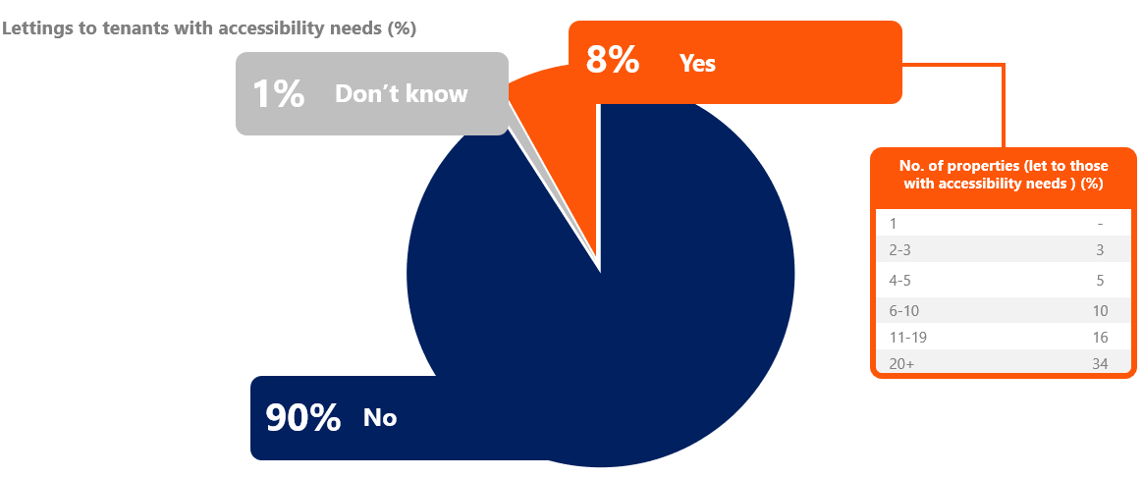
Initial survey findings- who is doing what?

Slide 9
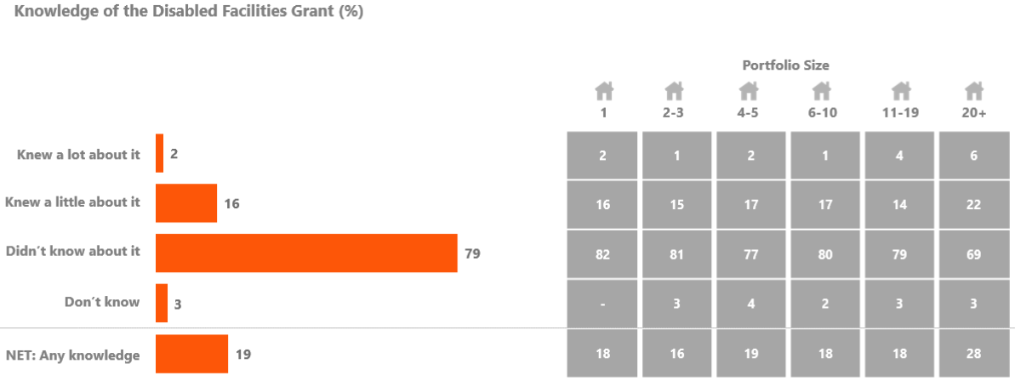
Initial survey findings- knowledge of DFGs

Slide 10
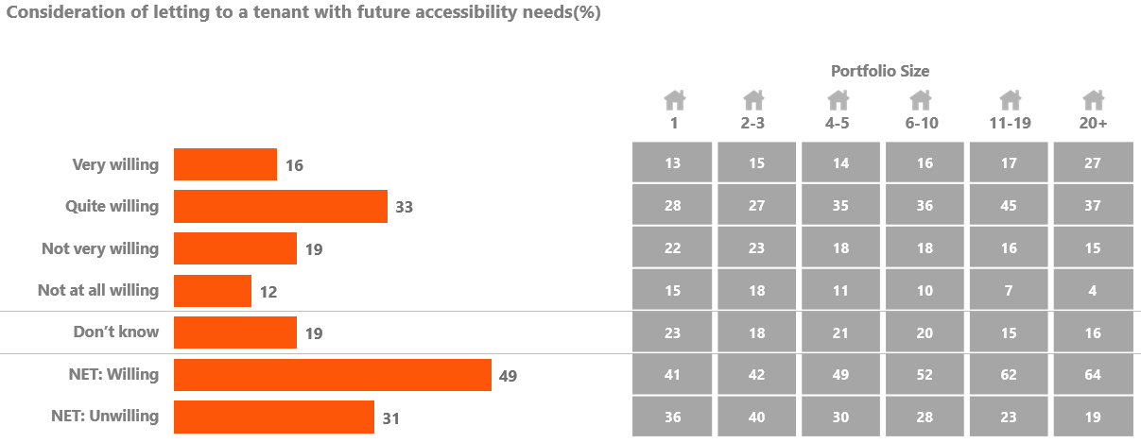
Initial survey findings- landlord willingness

Slide 11
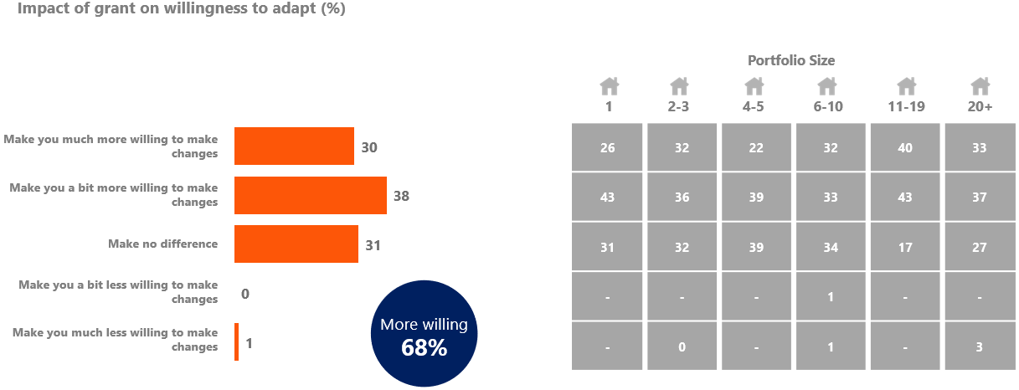
Initial survey findings- landlord willingness with access to DFGs

Slide 12
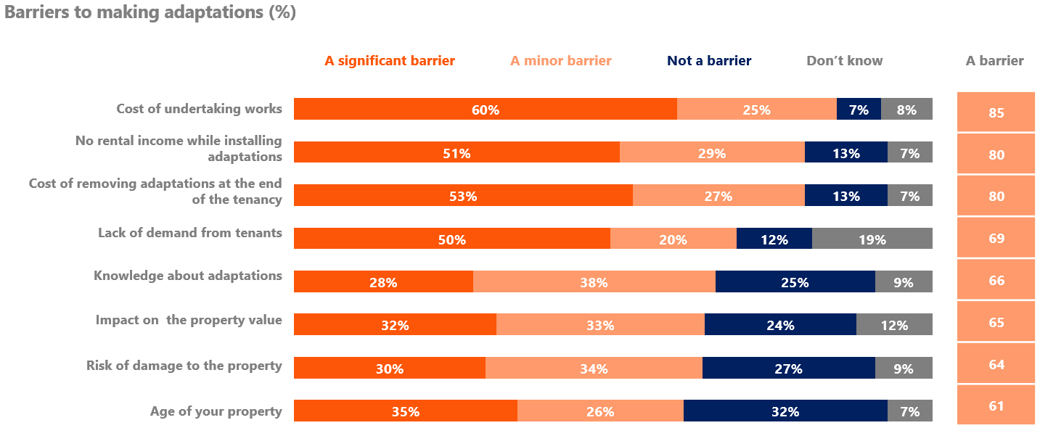
Initial survey findings- barriers to adaptations

Slide 13
Campaign outcome
Small scale pilots with local authorities and large portfolio landlords
The pilots would provide an overview of a property adaptations which are used as case studies

Slide 14

Thank you
Any questions?
Notes:
Feedback forms

Slide 15

Contact Us
National landlords Association
Skyline House
2nd floor, 200 Union Street
London
SE1 0LX
Tel: 0207 840 893
Email: policy@landlords.org.uk
Website: www.landlords.org.uk

