Slide 1
Disabled Facilities Grants
- where have we come from?
- where are we going?

Slide 2

What shall we do about Joyce?
  Home owner
  90 years
  lives alone
  minor stroke

Slide 3
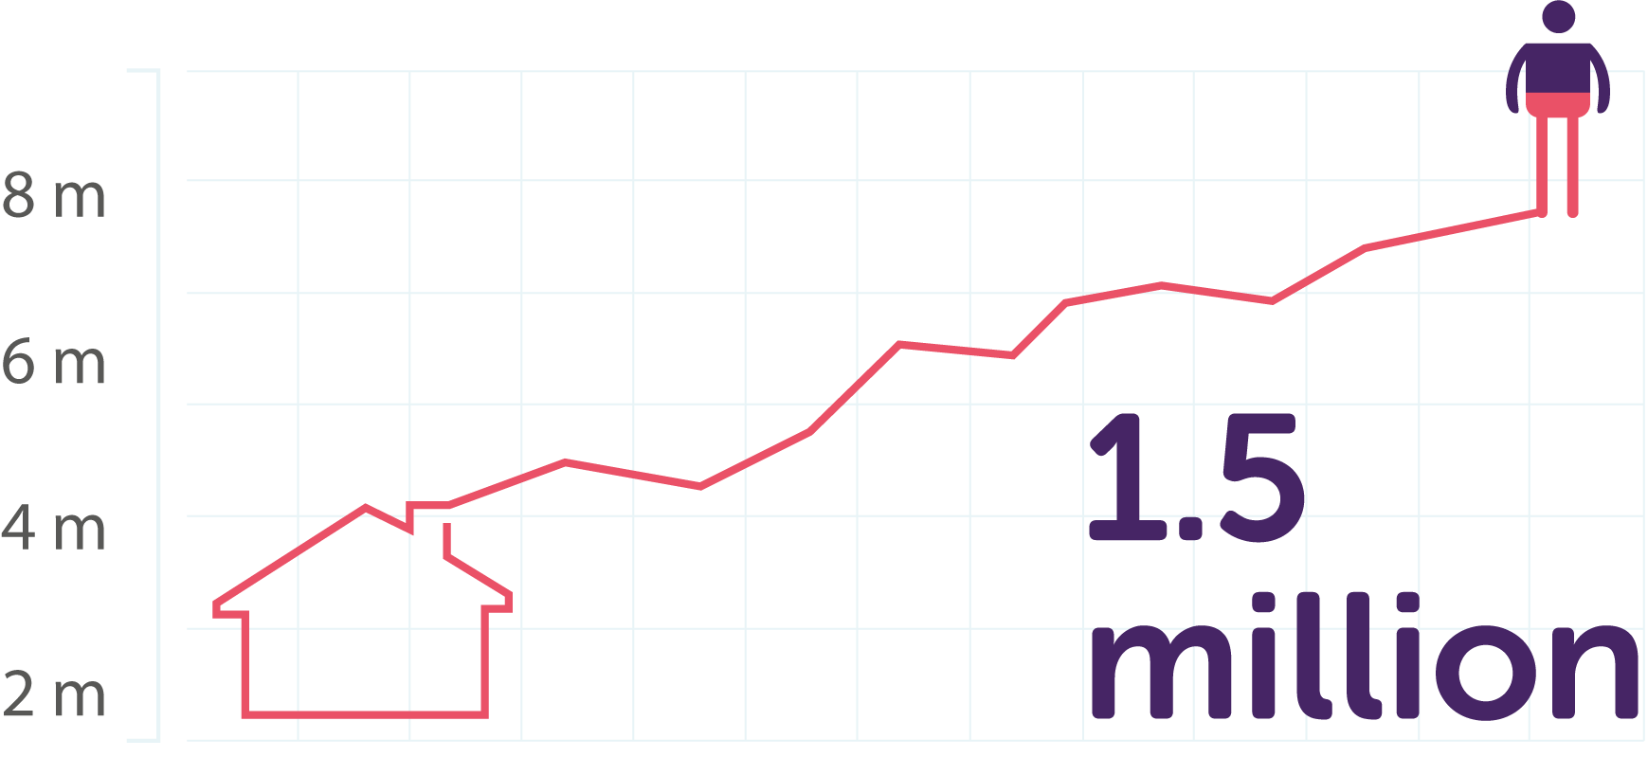
Homes headed by someone aged 85 and over are the fastest growing household*
By 2025 there are projected to be 1.5 million households headed by someone aged 85 or over – an increase of 54% from 2015*
*Source: Ageing Better calculations based on: Department for Communities and Local Government (2016), ‘2014-based Household Projections: England, 2014-2039’.

Slide 4
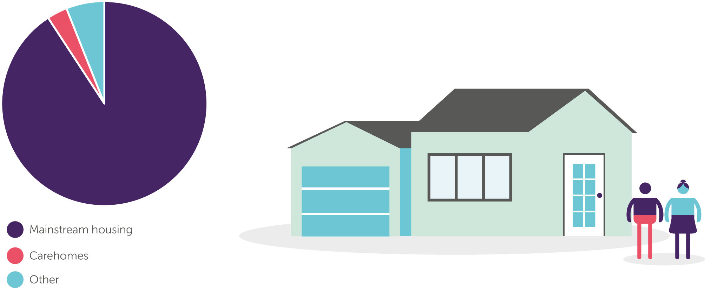
More than 90% of older people live in mainstream housing
80% of the homes we need by 2050 are already built
Only 7% of homes meet basic accessibility features

Slide 5

Funding - Figures
Funding: Department of Health & Social Care​
Policy: Ministry of Housing, Communities and Local Government
2015/16 - £220m
2016/17 - £394m
2019/20 - £505m
2020/21 - £???m

Slide 6



Funding - Rationale
Using DFG to support prevention/early intervention
Increased DFG funding linked to care home savings
​
Using DFG to support timely discharge from hospital
  85,000 DFGs
  8,500 saved care home placements
      and the evidence………….?

Slide 7



Policy context
Care Act
Prevention Green Paper
Social Care Green Paper
BCF Review
DFG Review
Spending Review
…………and Brexit!

Slide 8
Care Act
“Integrated services built around an individual’s needs are often best delivered through the home. The suitability of living accommodation is a core component of an individual’s wellbeing and when developing integrated services, local authorities should consider the central role of housing within integration...”(para 4.90)
Care Act Guidance: The Guidance emphasises that the local authority must promote this integration with health/health related services (i.e. including housing) (para15.7) in all its activities.
Notes:
Focus on wellbeing, prevention and integration

Slide 9
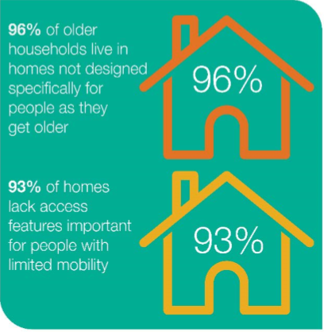
Prevention
“In the 2020s, home adaptations, assistive technology and supported housing will be more important than ever; helping people to stay independent for longer and supporting those with complex needs including serious mental illness, learning disabilities and autism to lead good quality lives in communities.
[There is] an opportunity to shape this emerging market and test new ideas and innovations”.
Prevention Green Paper July 2019

Slide 10
Better Care Fund
The Government is committed to the aim of person-centred integrated care, with health, social care, housing and other public services working seamlessly together to provide better care. This type of integrated care is the key to strong, sustainable local health and care systems which prevent ill-health (where possible) and the need for care, and avoid unnecessary hospital admissions.
The DFG capital grant must be spent in accordance with an approved joint BCF plan, developed in keeping with this Policy Framework and Planning Requirements that will follow.
  BCF Policy Framework 2019-20

Slide 11

Spending Review
One year ‘spending round’ – multi-year ‘spending review’ in 2020
DHSC – 3.1% increase in real terms (with £1billion for social care, adults and children)
Focus on outcomes to inform future spending decisions
Consultation on mandatory accessible standards for new build

Slide 12
DFG Review
CLG Select Committee
“The evidence we received suggested that beneficiaries found the process slow and cumbersome, had little say in the adaptations and doubted that it was always good value for money.”
MHCLG “should review the operation of the DFG, and in particular the extent to which its administration and operation is hampered by the split in responsibility between district and county councils and between housing and social care departments in unitary authorities.”

Slide 13
Joining it up - strategically
A Housing & Health Partnership Board as a condition of funding
Each BCF/HWB to report separately on DFG funding
New metric – number of people helped to remain independent at home
Better local and national outcome measures

Slide 14
Joining it up - operationally
Integrated teams
Preventative strategies based on needs analysis
Single point of access
‘Good conversations’ and appropriate pathways
Flexible use of funding - the Regulatory Reform Order

Slide 15
Funding
New distribution formula to allocate DFG funds
Align the DFG means-test with social care eligibility
Increase maximum grant
Include support with moving as an eligible cost
A further 5-year funding programme

Slide 16
Tenure
National adaptations protocol for registered providers
Effective DFG delivery for private rented sector
Advice, information and handyperson services for self-funders

Slide 17

Where are we heading?

Slide 18
Integration – the reality
“The Better Care Fund should have been used to support local housing and health initiatives but this has only happened in a few areas.”
National stakeholder, BBI HOMES Report 2018
“ There are real challenges to collaboration………it is hard to look at wider determinants of health…..when [staff] are putting out fires daily and delivery has suffered.”
National stakeholder, BBI HOMES Report 2018

Slide 19
Integration - the challenge
“ A modern adaptations service embraces and uses the skills and experience of a wide range of disciplines.
The individual end user and her or his carers should experience a seamless, joined-up service. (para 1.7)
The starting point, and continuing focus, of those seeking to provide a high quality adaptation service will be the experience of the disabled person and their carers”. (para 1.8)
‘Home Adaptations for Disabled People: A detailed guide’ Care & Repair England 2013

Slide 20
An Integrated Approach
Person contacts Home Mods Team
Triage and Assessment
Outcome based package of assistance
DFG and other funding approved
Contractor carries out works

Slide 21
Primary Prevention
Lifetime
Homes
Decent Homes
Adaptations
Adapts
Register
Planning
Policy
Secondary Prevention
I need help to stay living independently in my own home
Healthy Housing Services
Help to
Move
Home
Repairs
Major
Adapts
Asst
Tech.
Equip-
ment
Re-ablement
Care & Support
Property Person
Outcome
I can continue living independently in my own home
Institutional Care

Slide 22

What’s in a name?
Disabled Facilities Grant
Home Improvement Agency
Adaptations Service
Enabling Independence Service

Slide 23




Implementing change
Regulatory Reform Order
Eliminate the means-test
Increase maximum grant
Housing options and support with moving costs

Slide 24




Practical issues
Integration – KISS
Assessments – where’s the OT?
Small but essential – a handyperson?
Home safety assessments
– Trusted Assessors?

Slide 25
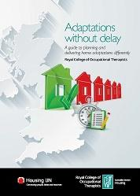
Adaptations without delay
To maintain independence
To sustain quality of life
To support an ability to live safely, independently and well

Slide 26
Universal, targeted, specialist
Situation | Adaptation
Straightforward | Simple/off the shelf/retail solution
Straightforward | Standard structural/minimal disruption
Complex | Customised/non-structural
Complex | Specialised structural
Notes:
Specialist The person’s situation is complex and the solution is a personalised non-structural or specialist structural adaptation.
Targeted The person’s situation is simple and straightforward but support is required to identify a solution. The solution is a standard structural or a non-structural adaptation.
Universal The person’s situation and the solution is simple and they can be signposted to retail options and/or supported to install simple adaptations

Slide 27
The difference this makes
“Adaptations made a new person of me, because I’m not upset. I’m not angry, being able to come up and down when I want.”
It means independence. I don’t have to ask for help. I find it very difficult to ask for help. I mean, everyone has busy lives. They haven’t got time to be bothering with you. If you can manage yourself then that’s half the battle.”
‘Homes that help’, Centre for Ageing Better 2018

Slide 28

What happened to Joyce?
Hospital – 4 weeks
Care home
Loss of independence
Quality of life?

Slide 29
The challenge
For people: information and advice; joined up services; outcomes which work
For stakeholders (local authority, health, VCS): effective and sustainable partnerships
For budget holders: demonstrating impact and measuring outcomes

Slide 30
Dave Eldridge, London and South East Regional Manager
davee@foundations.uk.com

