Slide 1
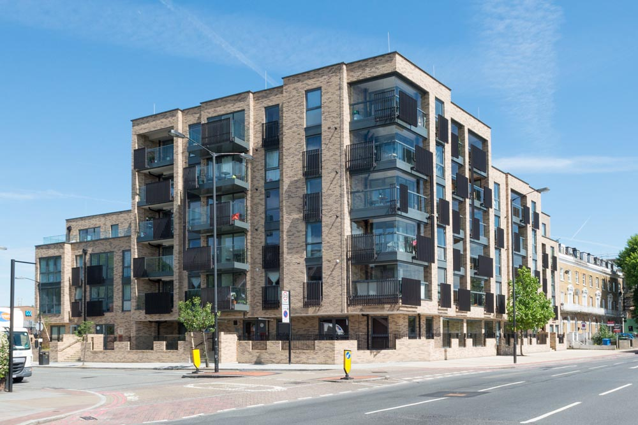

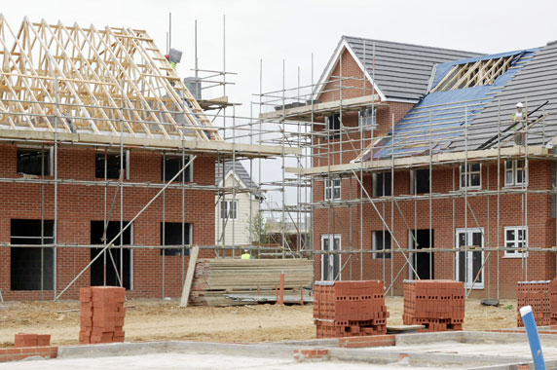
Accommodation Strategy 2019
Five years on… relaunching a renewed strategy
Sharon Dene and Simon Mitchell
Strategic Commissioning
Notes:
HOLDING SLIDE

Slide 2
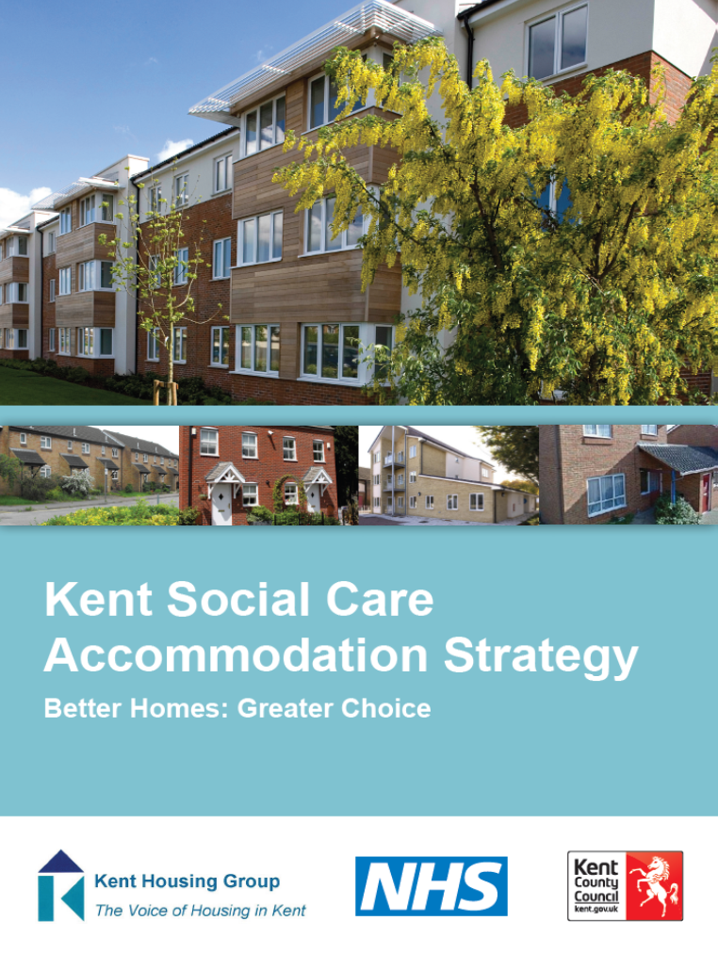

2014 Strategy Overview
Launched in July 2014
Right beds in the right place
Increase in extra care housing
Increase in dementia specific care homes
Increase in nursing homes
Increase in supported accommodation
Less reliance on care homes

Slide 3

What if anything has changed?
Stakeholder thoughts
Planning applications
Market Response/Intervention
Progress
Relevant changes in legislation or policy
Resident voice / opinion
Brexit?
Availability of Land

Slide 4
What do we know has changed?
Residential Nursing
Notes:
LD: There has been specific focus on people with learning disabilities to have less reliance on care homes and more supported accommodation developments. Placements in residential care in 2014 was 1,250 with 200 people living out of County. In 2018, there are 1,029 people living in residential care with 188 of those living out of County. The numbers of people living in supported housing (including shared housing and independently with support in mainstream housing) increased from 1,245 to 1,424.

Slide 5
What do we know has changed?
Notes:
LD: There has been specific focus on people with learning disabilities to have less reliance on care homes and more supported accommodation developments. Placements in residential care in 2014 was 1,250 with 200 people living out of County. In 2018, there are 1,029 people living in residential care with 188 of those living out of County. The numbers of people living in supported housing (including shared housing and independently with support in mainstream housing) increased from 1,245 to 1,424.

Slide 6
What do we know has changed?

Slide 7
2019 Project Scope and Plan
  To update analytics within the strategy and to show any trends in performance since 2014
  To update and include a wider scope of client groups and accommodation and support provision
  To ensure the strategy is fit for purpose and aligned with all other Kent County Council and District / Borough Council strategies
  To develop and publish a Market Position Statement aligned to the outcomes and strategic priorities for the current and potential market providers in Kent

Slide 8
Stakeholder Engagement programme
Stakeholder Group | Period
Kent Housing Group Kent Planning Officers Group | February – April 2019
District / Borough Councils CCG’s | February – April 2019
Healthwatch and Residents (Kent’s future older people) | tbc
Provider and Developer Markets | March – April 2019
Approval (Cabinet Committee) | Summer 2019

Slide 9
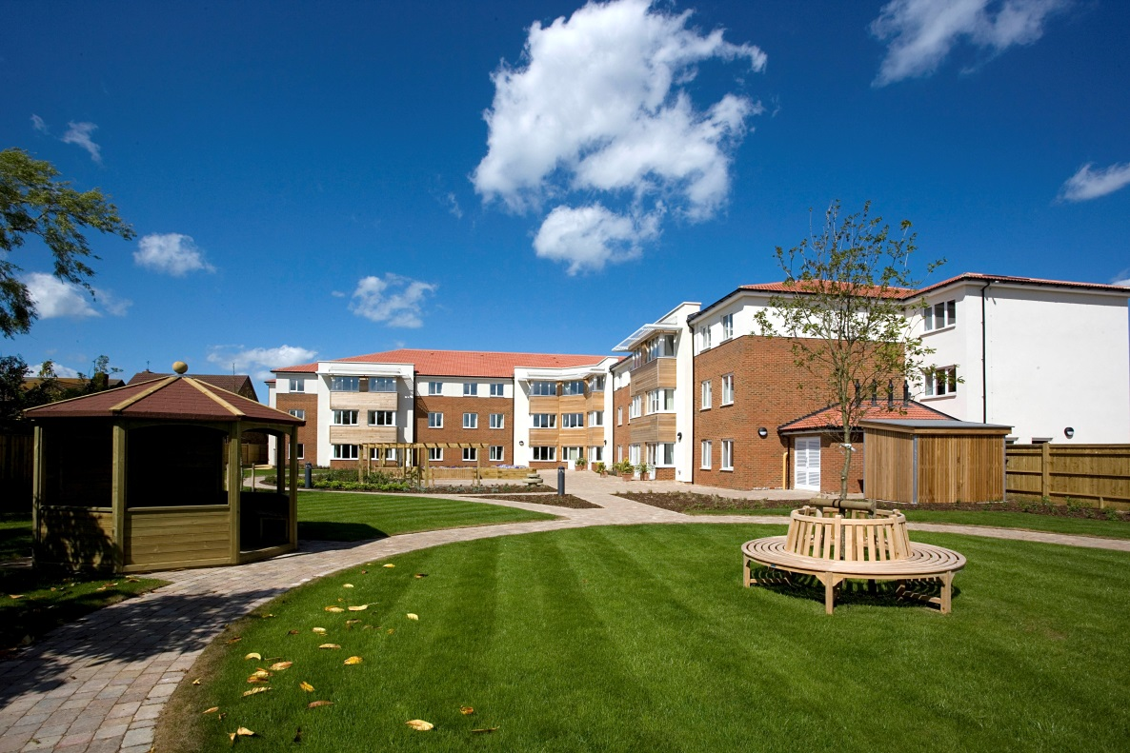
King Edward Court ,Herne Bay
Thank you
Sharon Dene and Simon Mitchell
Strategic Commissioning

Slide 10
Older People’s Accommodation
Housing with Care
Kent Housing Group 7 February 2019

Slide 11
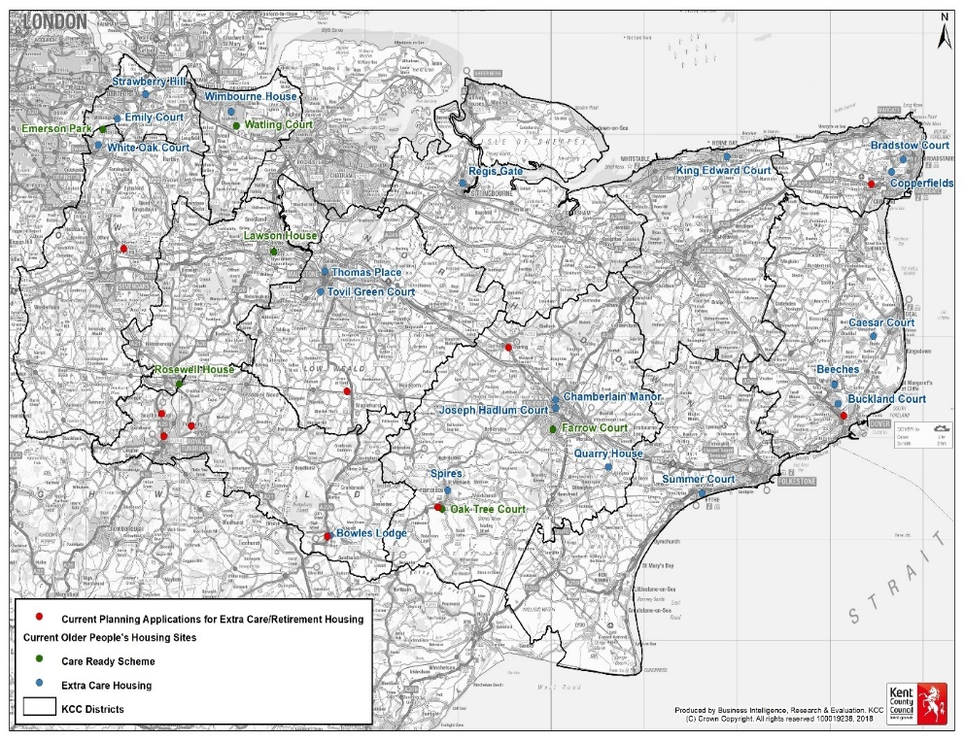
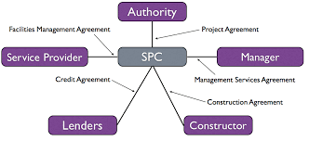


Current Arrangements
19 operational Extra care schemes in Kent (950 units)
12 schemes
7 schemes through;
Land deals
KCC commitment to fund background support services
Care Ready
342 units
6 schemes

Slide 12

Workshop Summary
Who attended
Health (CCG, GP Federation)
KCC Commissioning/Property
Ashford Borough Housing
Theme 1 – Older Persons Housing
More than Extra Care
Onsite health services/hub to support local care.
Housing/Services for people with higher needs.
Recuperative care services needed.
Incentive to free under occupied provision.
Adaptable, safe, home for life.
Theme 2 - Cohort
Start with the most acute provision in terms of cohort design (NH)
Understand individual drivers
Age 75+ (exceptions allowed)
Isolation and loneliness indicators
Housing need required
Care needs must be present.
Affordability for the individual.
General Feedback
Positive atmosphere/joint commitment
Willingness to ‘do something different’
Next iteration of Accommodation Strategy.
Needed now!
Theme 3 – Funding
Revenue funding not an issue for Health?
Funding from secondary care?
Creative with s106 contribution.
Next Steps
Further meeting – land, need, health contribution.
Identify data sources that can support development of a proposal.
Seek engagement with EKHFT.

Slide 13
Key Issues/Opportunities
Under developed middle market
Council’s financial position
Increased demand for older people’s accommodation
Developer interest
Future Aspirations for Older People
Potential changes to Housing Benefit
Land Availability
Developing new delivery arrangement
Refresh Accommodation Strategy and KHG Strategy
Current ‘housing with care’ capacity

Slide 14
Business Case Development – Treasury Green Book Guidance
Currently going through KCC governance.

Slide 15
Estimated Demand
There is currently no consistent approach to forecasting Extra Care. 2031 demand was estimated by using two methods:
  A ratio of 25 per 1,000 for people over the age of 75 who might otherwise be living in residential care (More Choice, Greater Voice 2008)
  The Single Forecasting System (SFS) model developed by Strategic Commissioning Analytics works
There is need to expand Extra Care Housing supply. To keep up with population growth, 2,500 units (4,000 upper threshold) are required by 2031.
Notes:
A ratio of 25 per 1,000 for people over the age of 75 who might otherwise be living in residential care (More Choice, Greater Voice 2008 document and is the most frequently quoted source for estimates of demand) https://www.housinglin.org.uk/_assets/Resources/Housing/Support_materials/Reports/MCGVdocument.pdf
The Single Forecasting System (SFS) model developed by Strategic Commissioning – Analytics works (built upon 2011 census data and the 2017 population forecast and applies graded ratios by age for over 65s)
In summary, both approaches suggest is that there is need to expand Extra Care Housing supply. It is recommended that the SFS modelling is used as the target figure and the 2008 ‘More Choice, Greater Voice’ figure is used as the upper threshold. To keep up with population growth, 2,500 units (4,000 upper threshold) are required by 2031.

Slide 16
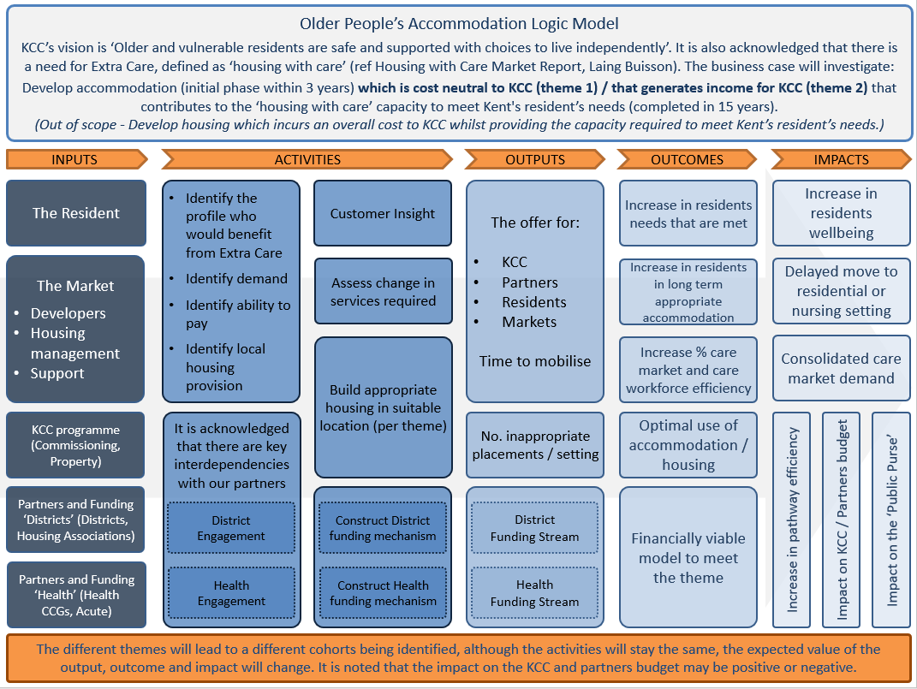
The Logic Model

Slide 17

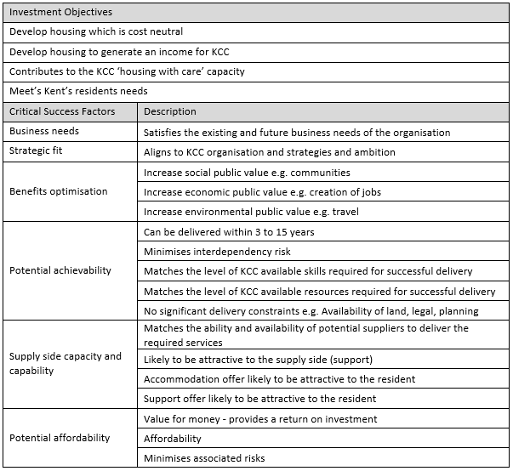
Long List > Short List
HM Treasury Green Book the Options Framework
Score and SWOT options against investment objectives and critical success factors
Scoping
Preferred Way Forward
Discounted
Carried Forward
Service Solutions
Preferred Way Forward
Discounted
Carried Forward
Service Delivery
Preferred Way Forward
Discounted
Carried Forward
Implementation
Preferred Way Forward
Discounted
Carried Forward
Funding
Preferred Way Forward
Discounted
Carried Forward

Slide 18
The Economic Case – Quantifying benefits – KHG Involvement
Provide an alternative to more institutional model of care
Promote Independence
Improved pathways for single occupancy/homelessness
Supporting people with Dementia and Nursing Needs
Local information and data
Offer a home for life.
Reduce social isolation

Slide 19
DRAFT - Stakeholder Engagement programme
Pending SOC approval going through .
Stakeholder Group | Period
Kent Housing Group Kent Planning Officers Group | February – April 2019
District / Borough Councils CCG’s | February – April 2019
Healthwatch and Residents (Kent’s future older people) | tbc
Provider and Developer Markets | March – April 2019

Slide 20

Thank you
Steve Lusk
Strategic Commissioning

