Slide 1
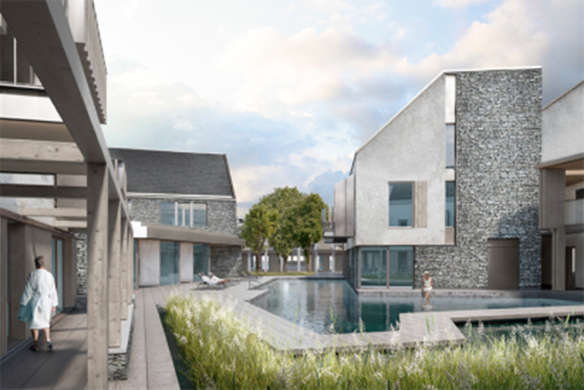
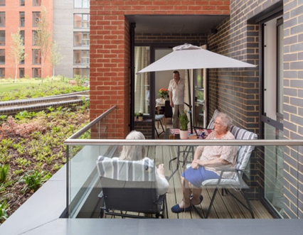
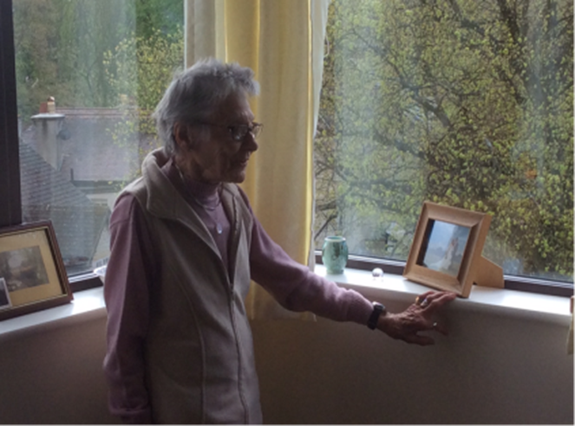
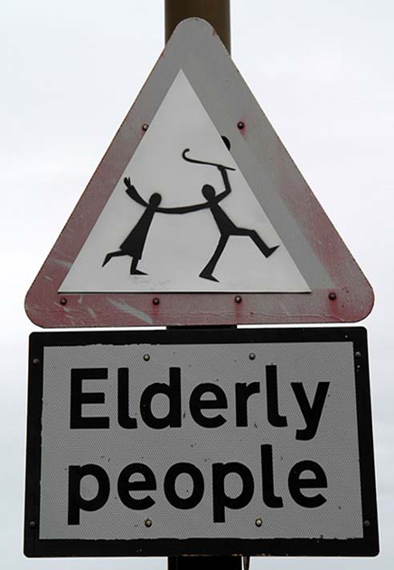
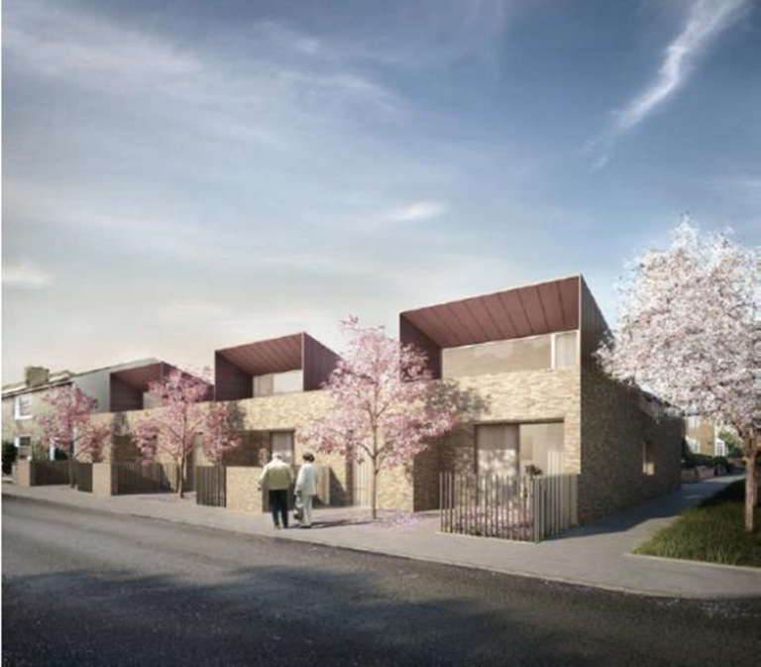
Action Plan toward an exemplar environment for living, learning and ‘Ageing Well’ in Ebbsfleet Garden City

Slide 2
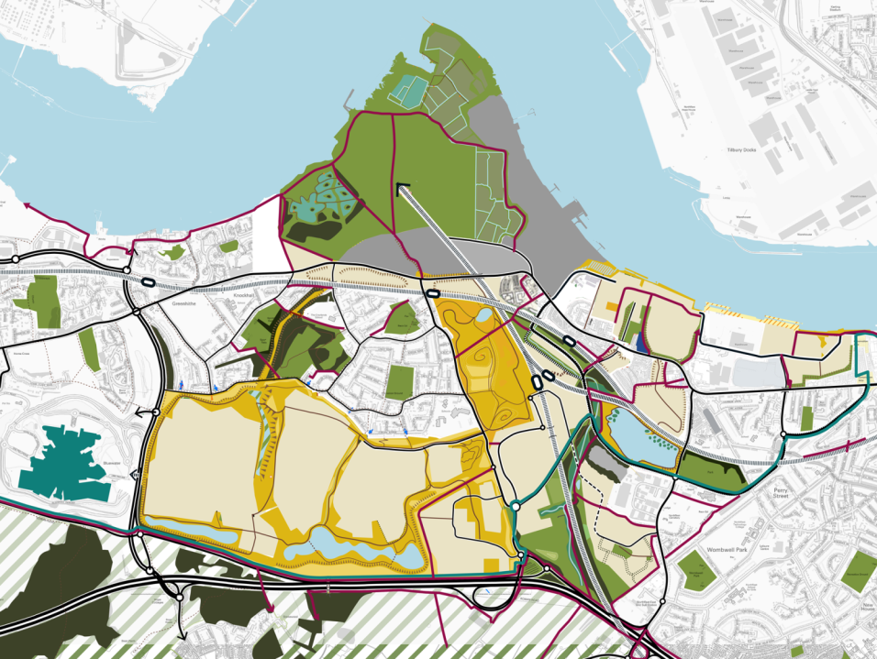
1st New Town in Kent
1st Garden City in UK for 100 years
15,000 new homes
Up to 30,000 new jobs

Slide 3
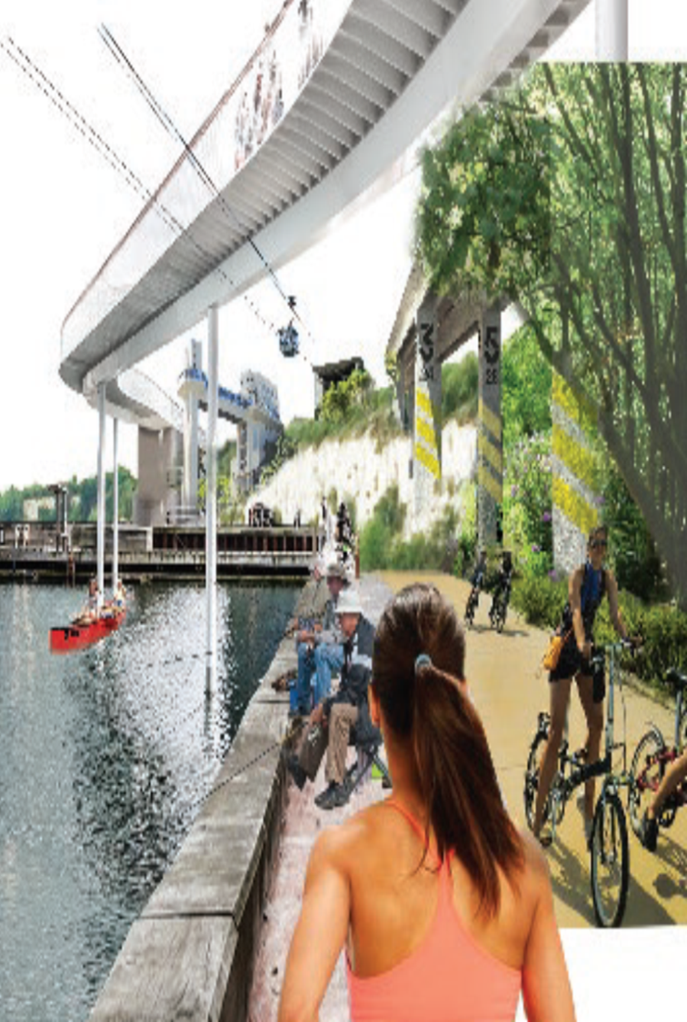
NHSE Healthy New Town Programme Objectives
To shape new towns, neighbourhoods and communities to promote health and wellbeing, prevent illness and keep people independent
To radically rethink delivery of health and care services in areas free from legacy constraints, supporting learning about new models of integrated care
To spread learning and good practice to other local areas and other national programmes
Innovation
Learning
Collaboration

Slide 4
Toward an ‘Ageless Ebbsfleet’ ‘joint ambition’;
To use the Ebbsfleet Garden City, Healthy New Town opportunity to explore the potential to deliver a new place which is designed, and managed to meet everyone’s needs, now and in the future, reflecting local needs and aspirations.
Building on our joint understanding that one housing solution would not suit all – we will work collaboratively to deliver a range of opportunities across all tenures and typologies, and in particular consider the potential for an inter-generational community that could meet a variety of needs, uses and users in a holistic form.
To work together to explore the potential of innovation, particularly through the use of technology to promote a more active, connected and healthier community.
To collaborate across the public and private sectors to attract inward investment to Ebbsfleet Garden City which will increase the pace of specialist housing delivery and support a framework of learning and evaluation which will enable lessons to be translated across Kent, other Healthy New Towns and Garden Settlements.
To collaborate as a partnership group to include; Kent CC, Dartford BC, Gravesham BC, Dartford, Gravesham and Swanley CCG and Ebbsfleet Development Corporation to identify appropriate sites to bring forward intergenerational housing, including using our own or combining sites where possible.

Slide 5
Summary of Action Plan Progress toward an exemplar for ‘Ageing Well in Ebbsfleet’
Establishing Need or Demand for specialist housing
Housing Lin ‘Shop’ report commissioned
Complete August 2018
Defining Inter-generational in Ebbsfleet Context
Roundtable discussions with developers and stakeholders
SWA commission to develop intergenerational housing model
Explore the potential for Technology to support healthy ageing
Roundtable discussion to explore potential of bid to Industrial strategy
Age of No retirement leading facilitation of partnership bid to Innovate UK
Define healthy Homes and neighbourhoods
Identify potential Land opportunities for demonstration
Partnership committed to developing a joint narrative and vision to promote Ebbsfleet Garden City as an exemplar for delivery and learning in Healthy Ageing
Ebbsfleet Partners consider site opportunities in their portfolio
Ebbsfleet DC considering site purchases for specialist housing
Design for Homes commissioned to develop HomesPlus
HomesPlus promoted as a national HNT benchmark

Slide 6
The VOP working group have suggested an intergenerational housing offer to meet a wide variety of needs and opportunities
Intergenerational
Right-sizer
Adapted / Adaptable
Alms Houses / bungalows
Wheelchair
Co-housing
Level 2 Accessible
Retirement Village
Age exclusive Lifestyle
Extra Care
Close care
Assisted Living
Sheltered
Hospital
Dementia care
Nursing home
Hospice
Residential home
Transitional step up or step down
Key workers including carers
Disabled and vulnerable groups
Health students and PRS

Slide 7
Mainstream
Specialist
Very Specialist
Proposed interventions across the 3 housing options for VOP
Include Level 2 accessibility levels to all homes through planning and use of Homes Plus (Quality mark for healthy and good quality homes).
Work with developers to explore opportunities for right-sizing homes.
Work with developers to deliver 31 identified wheelchair homes and seek to expand where possible.
Consider using off-site contributions to customise or adapt homes existing homes.
Work with partners and Housing Lin to identify local need and aspirations.
Pursue joint ambition for specialist housing in EGC based on the concept of an intergenerational community – learn from national and international best practice.
Work with partners to identify appropriate sites.
Identify potential commissioners and developers across a range of types and tenures.
Consider integrating disabled housing with older specialist.
Consider how step down housing could relieve stress on DVH – identify opportunities for provision of step-down housing.
Consider opportunities to use digital technologies to help older people remain in their homes for longer – avoiding need for very specialised.
Consider how very specialised care could be integrated within an inter-generational community.
Consider opportunities and actions to help make EGC a ‘dementia friendly city’

Slide 8
Care Ready
With Support
Complex Care
Full Care Pathway in Extra Care Housing
Independent but preparing for increased need.
Using facilities to socialise preventing isolation and loneliness.
Active healthy living.
Intergenerational living , nursery or school included in the design and active involvement.
GP Practice , shops , gym, art classes etc.
Care provided tailored to individual need.
Digital support including AI and robotics and providing night time in-reach cover.
Night time support on ongoing basis as and when needed not only for emergencies.
Support and Care to cover disabled as well as older people housing.
Reablement facilities for prevention of admission or hospital discharge in care suites.
Dementia care reflected in the design and the support provided.
Care Suites providing nursing care and dementia nursing care.
Consider how very specialised care could be integrated within an inter-generational community.
Intensive 24/7 care and nursing rehabilitation.
Full care pathway available in independent housing facilities.

Slide 9
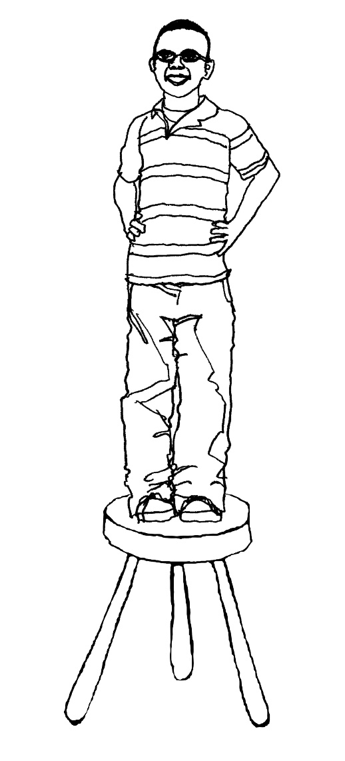
The three components of successful intergenerational housing
• Design and quality of homes
• Integrated communal facilities
• Long term investment and support
Sarah Wigglesworth Architects

Slide 10
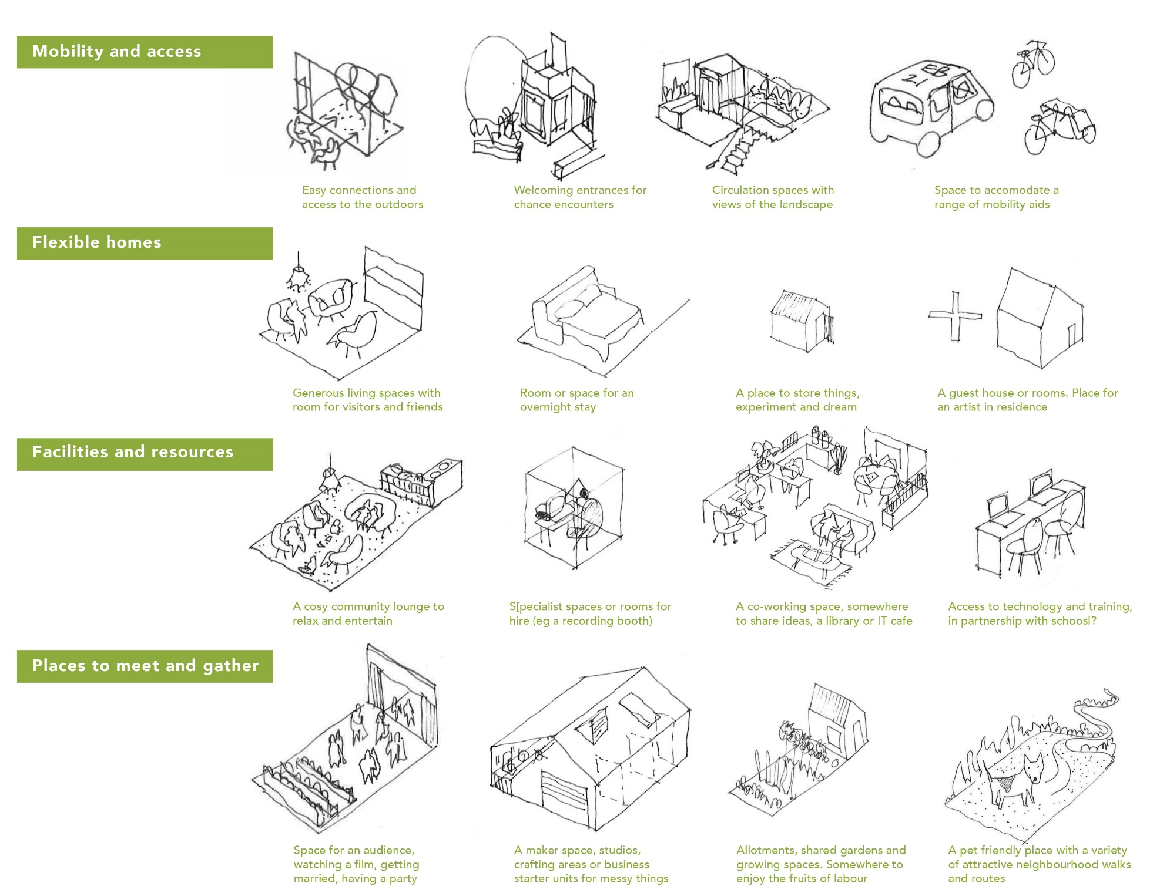
Sarah Wigglesworth Architects

Slide 11
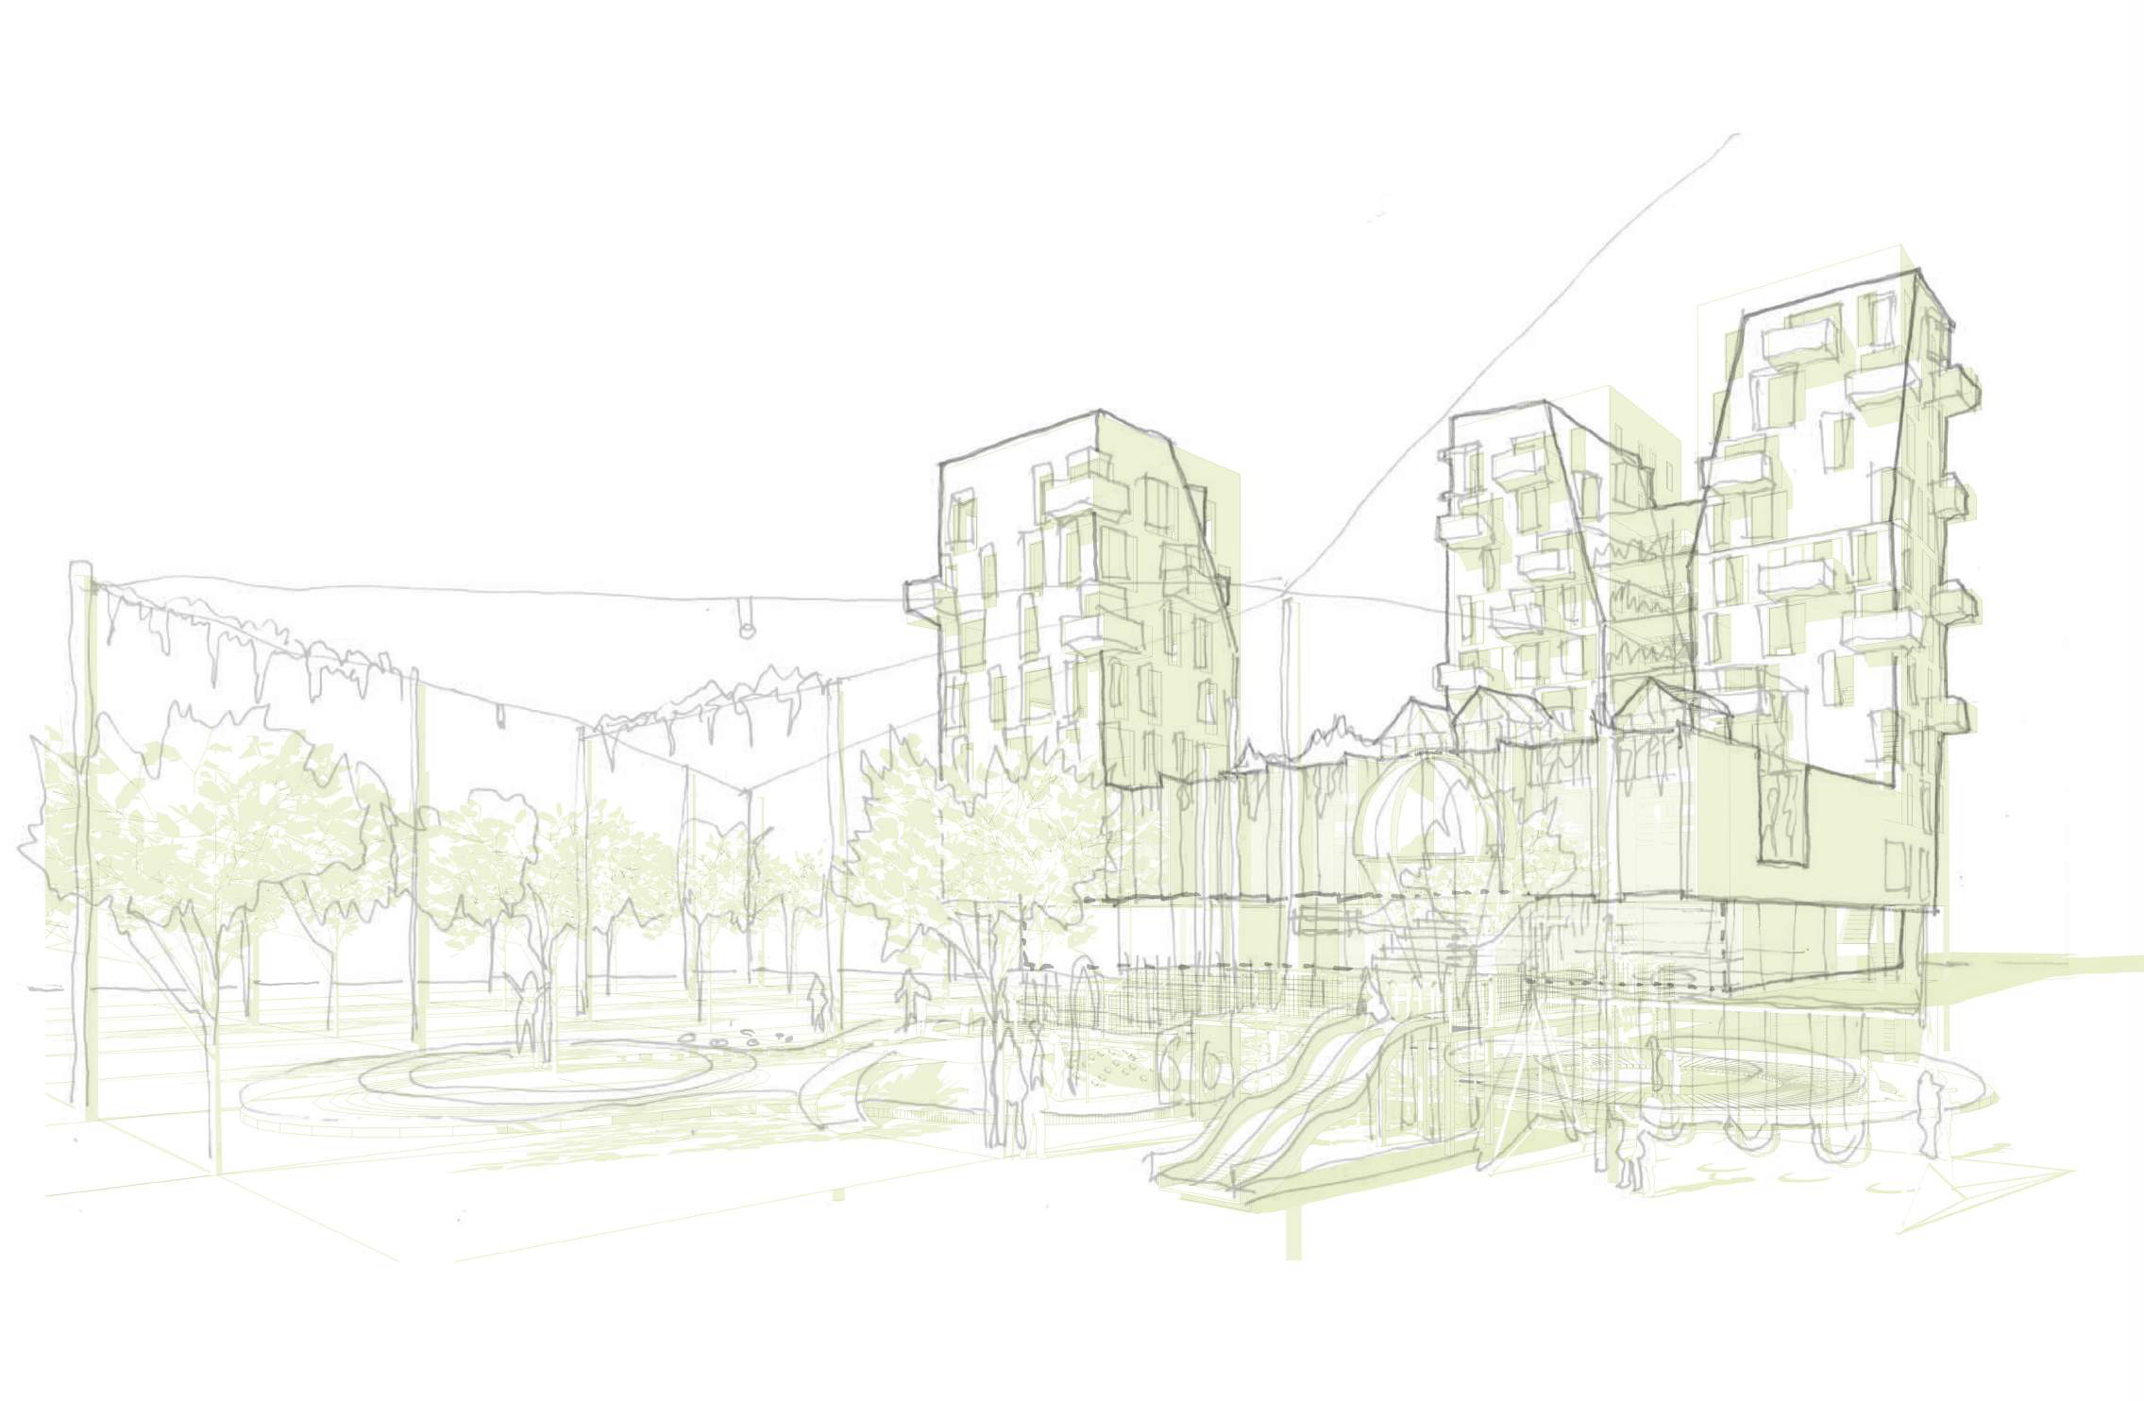
Sarah Wigglesworth Architects
Notes:
11

Slide 12
Sarah Wigglesworth Architects

Slide 13
Sarah Wigglesworth Architects

