Slide 1
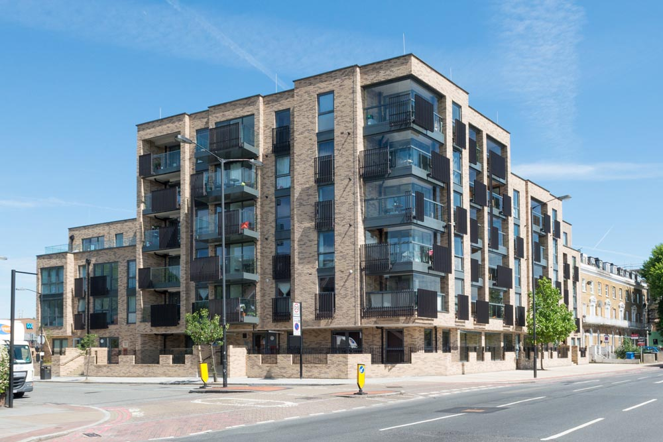

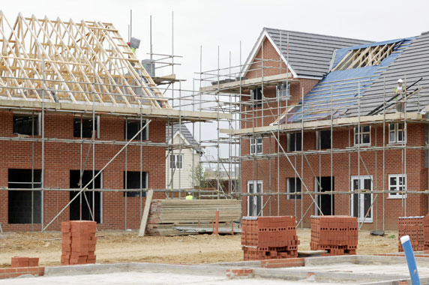
Accommodation Strategy 2019
Five years on…
a renewed strategy
Simon Mitchell
Strategic Commissioning

Slide 2
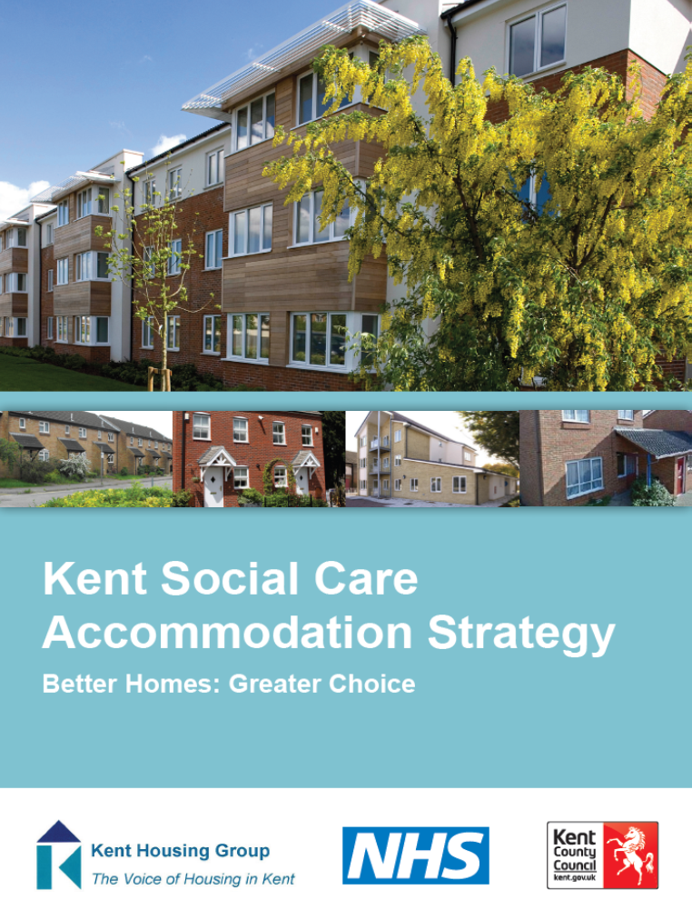

2014 Strategy Overview
Right beds in the right place
Increase in extra care housing
Increase in dementia specific care homes
Increase in nursing homes
Increase in supported accommodation
Less reliance on care homes

Slide 3

The outcomes of the Strategy?
Feedback from engagement with Stakeholders:
Useful as a reference point for Districts, Providers and Developers
Set priorities
Too focussed on older people – minimal impact for people with disabilities
Varying degrees of impact across county in furthering / development of Extra Care Housing

Slide 4
What has changed in the last 5 years?
Brexit?
Resident voice / opinion
Planning applications
Relevant changes in legislation or policy
Availability of Land
£
£
£
£
AUSTERITY

Slide 5
What do we know has changed?
Residential Nursing
These charts represent the total number of beds available in the county (not the number of placements)

Slide 6
What we know has changed – Older People

Slide 7
What we know has changed – Physical Disability

Slide 8
What we know has changed – Mental Health

Slide 9
What we know has changed – Learning Disability

Slide 10
What we forecast will change…

Slide 11
What we forecast will change…

Slide 12
Performance against the Outcomes
Right beds in the right place
  A number of varying factors across the County by District and Care Group
Increase in extra care housing
  Yes. Since 2014 almost 1000 Extra Care homes have been completed
Increase in dementia specific care homes
  More care homes catering for those with Dementia – though not specifically a care home for those with Dementia.
Increase in nursing homes
  Yes. As the CQC data shows the total number of Nursing beds available has increased
Increase in supported accommodation
  Yes. There has been an increase in Supported Accommodation
Less reliance on care homes
  Yes. As the KCC data shows there has been a steady decline in the number of people placed in residential or nursing care homes

Slide 13
Implementing the new strategy
Need to build in accountability for all stakeholders in delivering the new strategy.
Strategy needs to be overseen and owned by a stakeholder body, that takes quarterly and annual reports of delivery against the strategic outcomes.

Slide 14
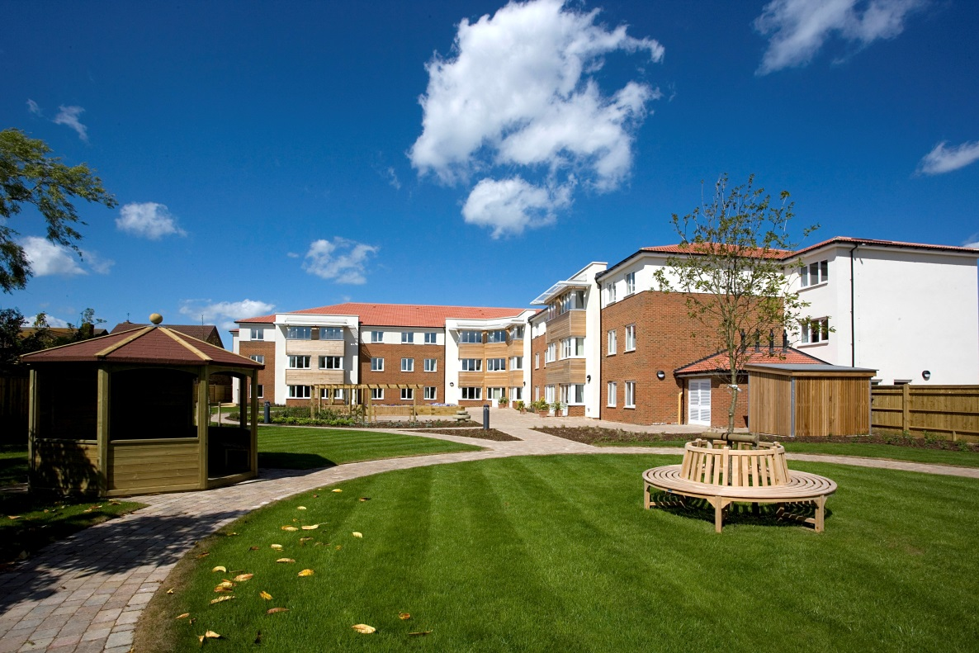
King Edward Court ,Herne Bay
Thank you
Simon Mitchell
Strategic Commissioning

