Slide 1
I-Construct Innovation in Construction Jemma Little, HGP Kent Housing Group 15th May 2019

Slide 2
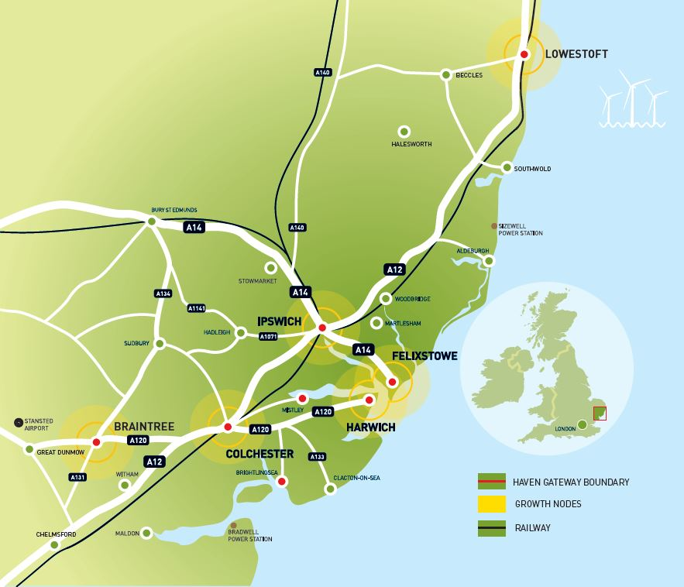
I
About Us
Formed in 2001 by a partners across North Essex and South Suffolk to promote the area as a distinct economic sub region based upon its strong links with the Haven Ports of Felixstowe and Harwich.
Our Vision is to:
To work with partners to facilitate the delivery of an inclusive economy for the Haven Gateway area’s residents, workers and businesses by capitalising on its location as a key international gateway and realising its potential for significant growth through an additional focus on innovative sectors, knowledge-based employment and the provision of appropriate housing and infrastructure and skills.
Today, the Partnership still embraces Ports and Logistics but now supports its partners, through evidence backed advocacy and project work, to drive economic growth more generally in support of the New Anglia and South East Local Enterprise Partnerships.

Slide 3
I
Our Partnership Board

Slide 4
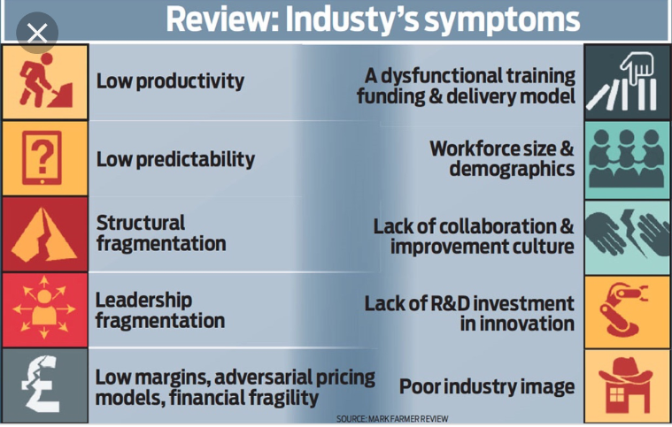
Context for I-Construct
The I-Construct project’s aims are:
To drive innovation and productivity in the construction sector in the South East Local Enterprise Partnership area
To enable timely delivery of high quality and sustainable housing, commercial and infrastructure development
To generate economic growth in construction and related priority growth sectors such as ICT, Advanced Manufacturing and Engineering and Renewable Energy.
The project was developed to support the delivery of national policy and SELEP’s Strategic Economic Plan and address the sector’s serious structural issues and opportunities shown in the:
Farmer Review – Modernise or Die
Housing White Paper – Fixing our Broken Housing Market
Industrial Strategy – Productivity and Grand Challenges
Letwin Review – Build Out Rate Review

Slide 5
I-Construct Project Summary
I-Construct is a £7.5m, 3 year ERDF (European Regional Development Fund) supported project focussed on innovation and jobs growth in the construction industry and its supply chain across the whole of the South East Local Enterprise Partnership (SELEP) region.
The three main elements of the project are:
the creation of a hub building and centre of excellence for construction linked to BRE national network
a business support programme and grant scheme for SMEs (Small and Medium Enterprises) to enable SMEs to offer innovation in housing and infrastructure delivery
the creation of an innovation and supply chain network for client groups, industry and wider stakeholders
legacy of job creation, permanent hub and network, technology adoption and improved productivity
We have in principle funding approval from MHCLG, subject to securing planning permission for the hub building. The project start date is planned for summer 2019 with a formal launch in the autumn.
The Haven Gateway Partnership is leading the project and we are working with four delivery partners: Braintree District Council; BRE; Colchester Institute and Daedalus Environmental Ltd.
SELEP’s Housing and Development Group is providing strategic advice and linking us into wider SELEP work on accelerated housing delivery and development.

Slide 6
I-Construct Focus
1. Raising Awareness of Opportunity
Working with partners to build awareness of the long term development pipeline and market demand
Building awareness of the need for innovation/chnage, quality, new skills and wider support for SMEs
FE and HE student enterprise and “get into construction markets” programme
Sharing learning and promoting the work of the I-Construct community
2. Creating Market Opportunities for SMEs
Working with major site promoters/developers in the public, affordable housing and private sectors to provide routes to market for SMEs, to give them scale-up and innovation opportunities
Supply chain development and procurement readiness support for SMEs and clients/commissioners
Access to Finance and innovative finance/JVs including working with Homes England
Supporting new product/service launches and support to try new technologies
3. Improving Viability and Productivity of SMEs
Acceleration of delivery via off-site construction and pre-manufactured solutions
Adoption of BIM Level 2 – Building Information Modelling
Improving quality via adoption of ICT, Renewables, Off-site and Quality Design;
New business models, business growth strategy and links to skills especially future skills, sustainability and diversity

Slide 7
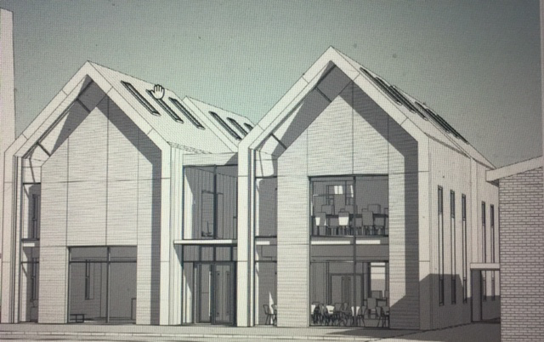
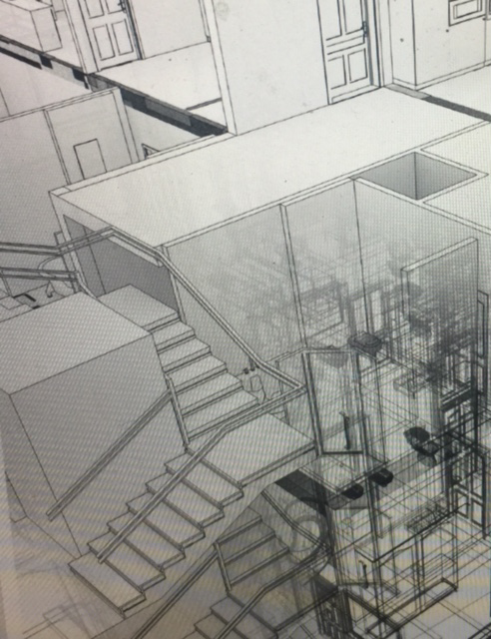
How you can get involved
Collaborative approach is key and we would welcome your input.
Help shape the workshop programme around a site/location or initiative
Help us promote I-Construct and feed your ideas into the project
Join the network and take part - speak, network, share ideas, and make things happen
Collaborate and co-host e.g. let us work with your supply chain
Add our resource to your plans and leverage more impact
Promote your work, share your future plans and develop your supply chain
Visit us as we build the hub and hold your events and meetings there
Work with us to create virtual hub/s for industry to cluster around
Get in touch to talk further ahead of our launch

Slide 8
Thank You and Questions
We need you to be part of I-Construct
So please do get in touch:
Jemma Little
Innovation and Funding Manager T: 01206 713618 │ M: 07912310066 │
E: jemma.little@haven-gateway.org

