Slide 1
Kent Estates Partnership: An Overview

Slide 2
Content ….
Partnership background
Funding streams
Projects we support

Slide 3
1. About KEP
EST.
Vision
Partners
In 2016 to take forward Kent’s One Public Estate Phase 4 bid.
“An integrated, flexible and affordable Public Estate”
Central Gov
Local Gov
NHS
Blue Light Services
HE/FE Sector

Slide 5
One Public Estate
2.1. Funding
95% of councils participate in scheme
Objective: Housing, Jobs, more integrated services, reduced running costs & capital receipts
£37m in funding distributed in rounds 4-6
KEP successful in rounds 4 & 6, securing £618,000 in revenue grant funding

Slide 6
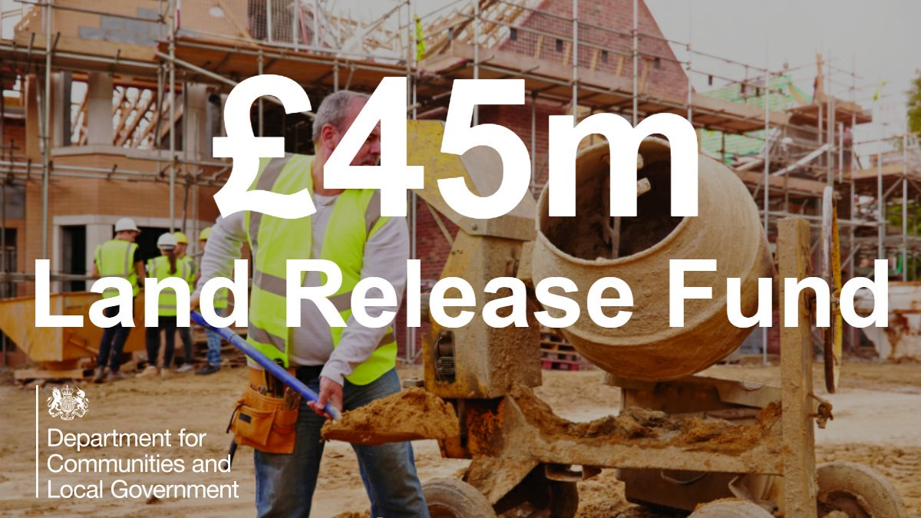

Slide 7
Land Release Fund
2.2. Funding
£45 million fund
Specifically targeted at schemes that release local authority owned land for housing before 2020
Innovative models of delivery prioritised
KEP successfully secured £658,000 capital grant funding in the first funding round to support an MBC project

Slide 8
3.1. KEP Supported Projects: OPE Phase 4

Slide 9
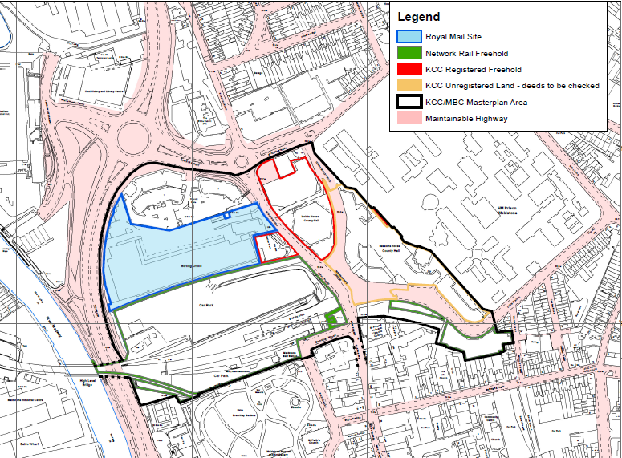
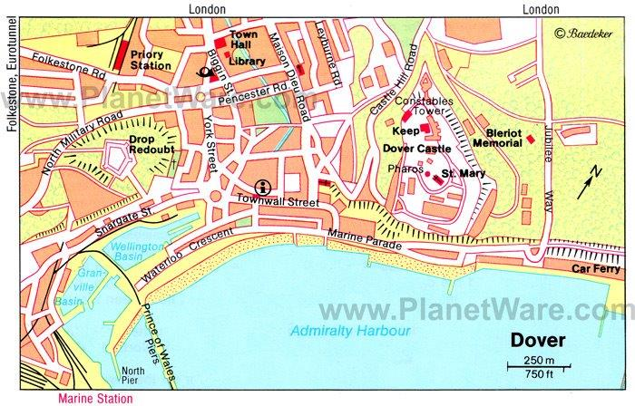
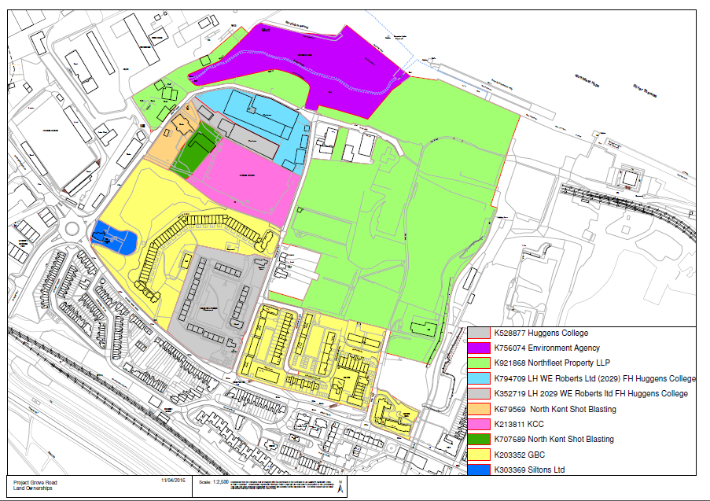
Maidstone East Civic Quarter
Dover Discovery Centre
Ebbsfleet Grove Road

Slide 10
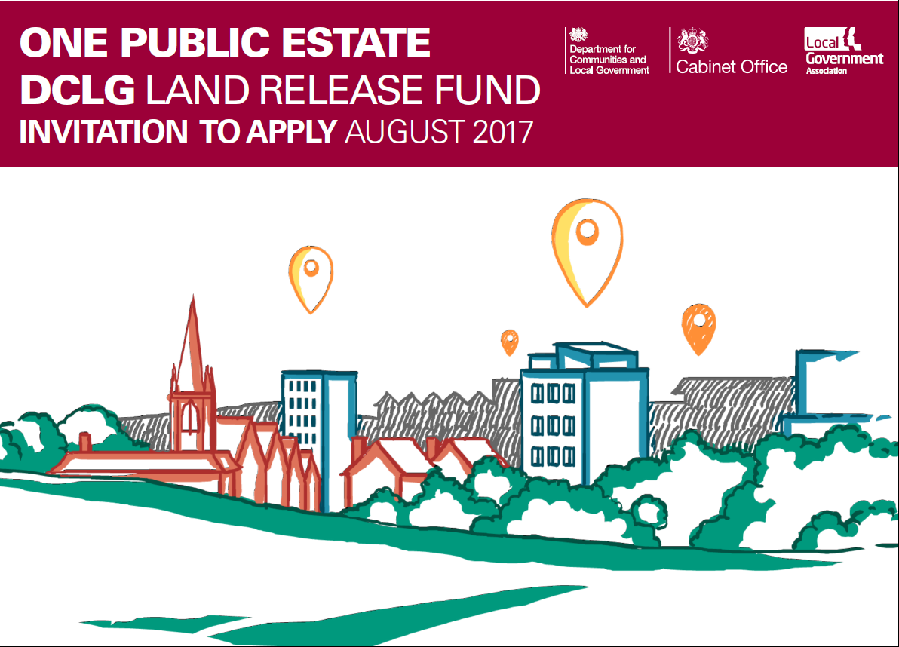
3.2. KEP Supported Projects: OPE Phase 6

Slide 11
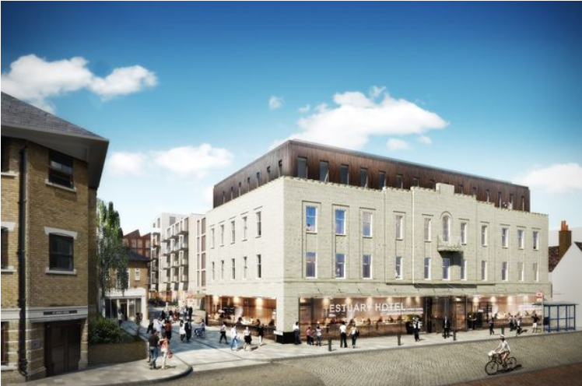
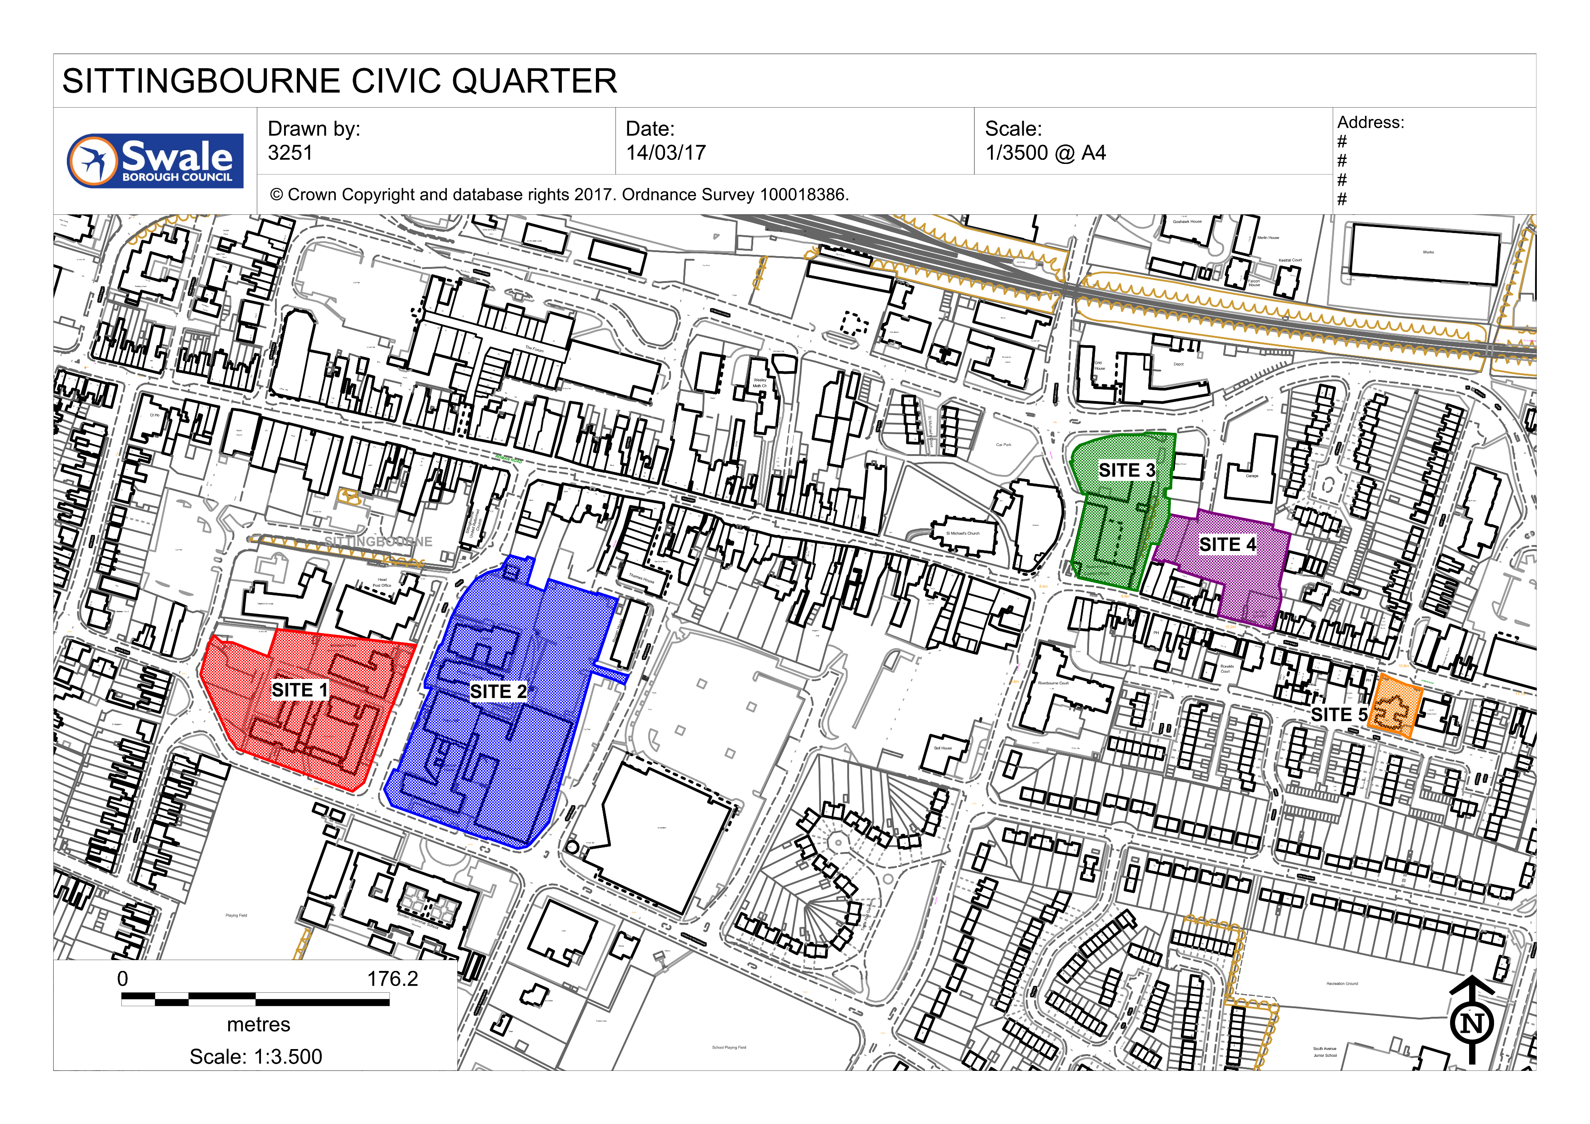
Dartford Town Centre
Sittingbourne Civic Quarter
West Kent Partnership

Slide 12
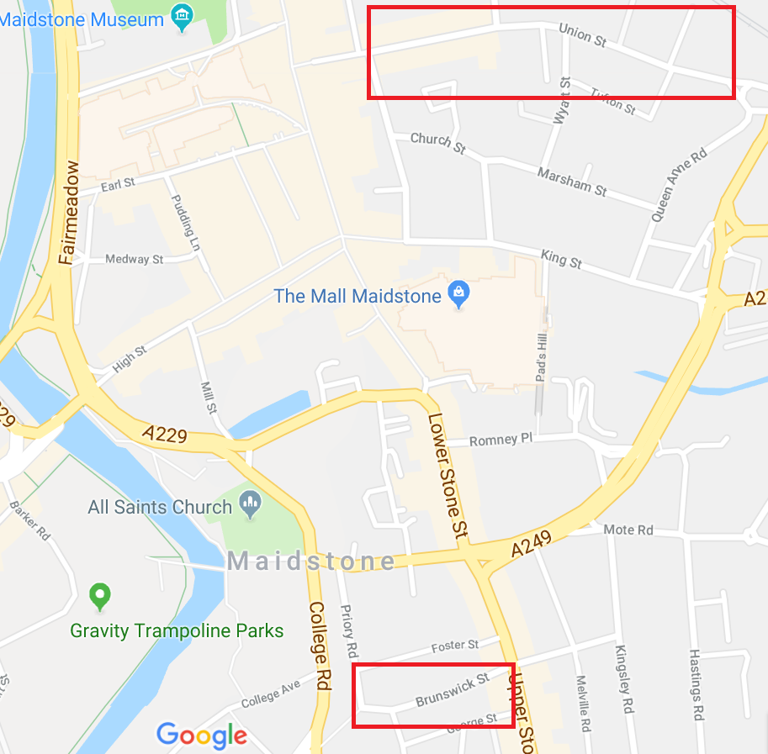
3.3. KEP Supported Projects: Land Release Fund
Brunswick St & Union St

Slide 13
For More Information please……
Email:
Kentestatespartnership@kent.gov.uk
Or Visit:
www.kentestatespartnership.com

