Slide 1
Kent Housing Group
‘The Voice of Housing in Kent’
Housing & Development?
Brian Horton - Strategic Housing Advisor
Meeting KHG – May 2018

Slide 2
Building the Future
Accelerating Housing Delivery in the South East
In July 2014, SE LEP published its wider Growth Deal ambitions in a joint publication with localist think tank Localis launched by Lord Heseltine.

Slide 3
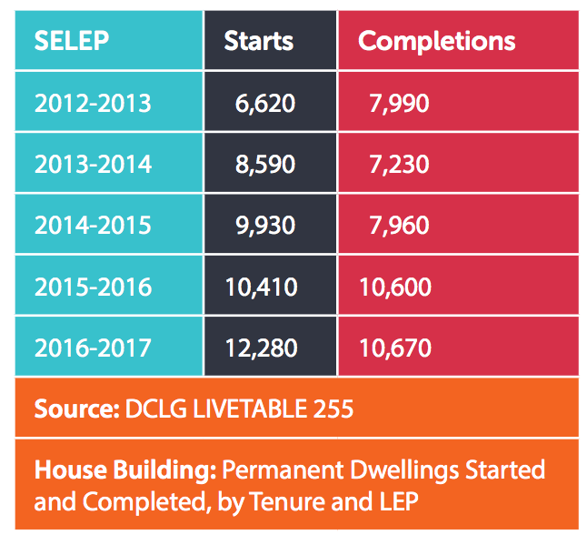
Housing Delivery
The SELEP area has seen Housing Completions rise from 7,990 in 2012/13 to 10,670 in 2016/17, an increase of 33% in the rate of delivery.
The collective work of both private and public sector developers is making a demonstrable difference, with Housing Starts growing from 6,620 in 2012/13 to 12,280 in 2016/17, an increase of 85%.

Slide 4
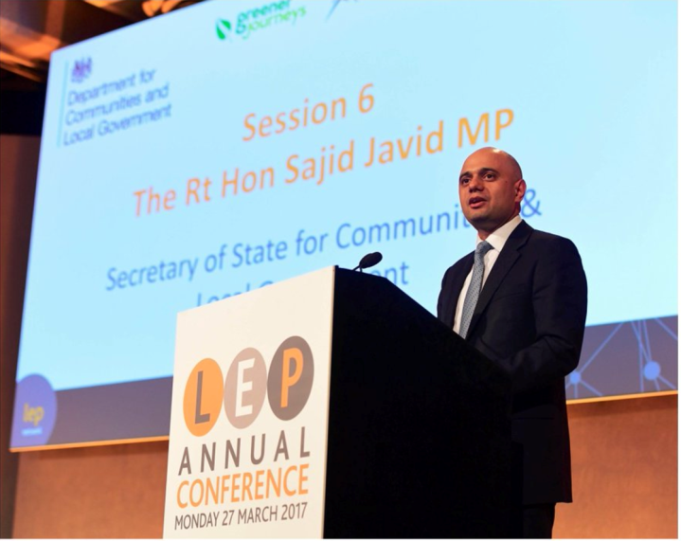
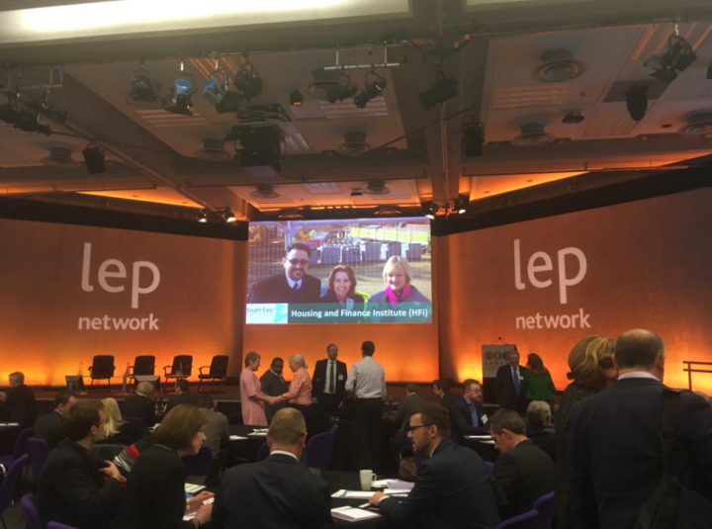
Housing Business Ready?
At the LEP network Annual Conference in 2017 the Secretary of State for Communities & Local Government praised the work of the SELEP highlighting the success in thinking beyond the boundaries of its growth deal, and in particular for being awarded ‘Housing Business Ready’ status by the HFi.
Speaking about SELEP, the then Secretary of State said: “It’s working with councils, planners, developers and regulators to make sure utilities and infrastructure are provided where they’re needed right across the region. The unique nature of a LEP means it can do this across traditional local authority boundaries and across both the public and private sector.”

Slide 5
SELEP HFi Housing Business Ready…
HFi works with local authorities to identify solutions to accelerate housing delivery to respond to locally defined housing growth ambitions.
SELEP have sponsored HFi to work with a number of local authorities in the SELEP operating area – including Ashford and Maidstone
With a fresh cohort of coastal authorities in 2016/17 Hastings, Tendring and Southend joined Thanet in achieving the Housing Business Ready accreditation.
HFi have recognised SELEP as a Housing Business Ready LEP and SELEP remains the only LEP nationally to hold this accreditation.

Slide 6
Our focus to date…
Bring together all parties (including HCA, councils, developers, housing associations) involved to drive development forward Working collaboratively to promote housing and commercial development growth, assembling evidence, identifying obstacles and finding solutions
Support Growth Ambitions SELEP provide support and advocacy to areas with ambitious growth plans including North Essex Garden Communities, Ebbsfleet Garden City and Otterpool Park
Encourage and support councils to bring forward their local plans Build on the series of SELEP sponsored Housing Business Ready programs with housing and planning authorities to highlight the contribution that the local authorities can play in promoting accelerated housing delivery
Review the performance of utility companies Working collaboratively with HFi, DES, Kent Developers Group, Essex Developers Group and other interested parties to build on the SE Infrastructure Pilot
Promote best practice Supporting events and meetings to share best practice and information to support all to the standard of the best, this has helped in widening opportunity for joint working with business through the now fully established SELEP Housing and Development Group and Developers forums across the SELEP area
Look across LEP boundaries Looking at the plans and proposals of neighbouring LEPs and their impact in preparing for accelerated growth
Promote the accelerated delivery Homes SELEP is working in partnership with the Homes England, HFi, NHF and other partners to raise awareness of the opportunities to accelerate housing delivery.

Slide 7
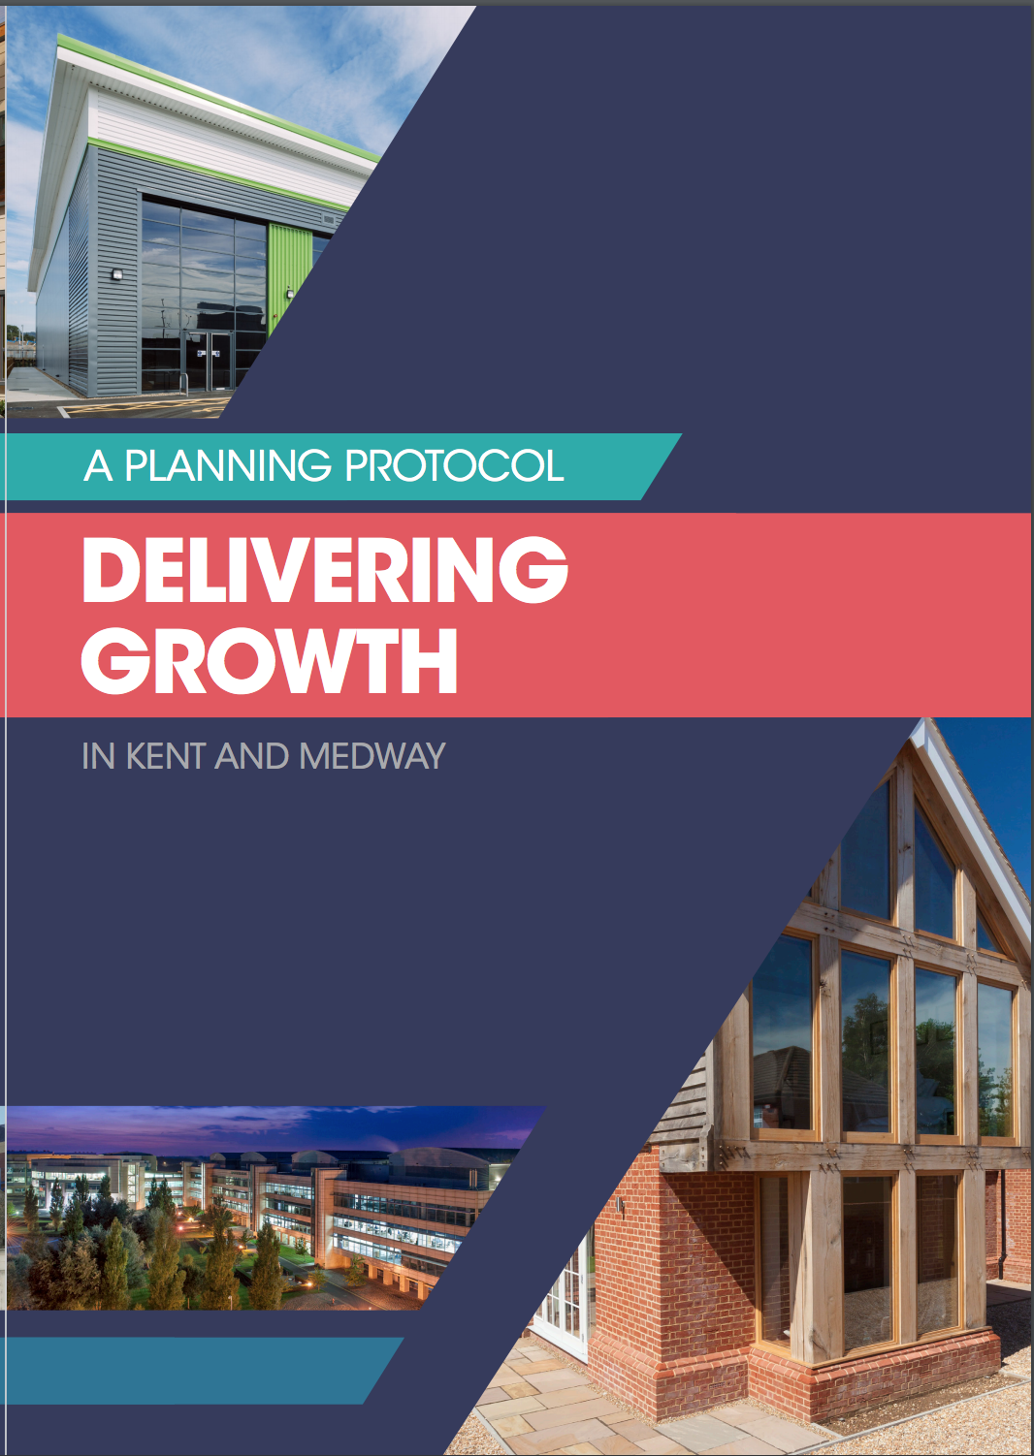
County Level Planning Protocols…
Council planners and developers can often seem at odds when it comes to the planning system, particularly in meeting the housing shortage
However, across Kent and East Sussex, the Developers, Local Authorities and the LEP have come together to draw up a shared commitment to boost housing and jobs growth through improved performance and joint working
Chief planners and developers have engaged with Council Leaders and Chief Executives with a shared narrative about the issues they both face and potential solutions, which make it an attractive option.
The LEP has also worked with colleagues to promote similar protocols in neighbouring counties. "We are currently working with colleagues in Essex to prepare their own protocol," "This is proving contagious..."

Slide 8
Emerging Actions – new Housing & Development Working Group & Refreshed SEP
Building on success to date, SELEP has formalised its working group arrangements and the renewed Housing & Development Working Group is working to identify and inform further opportunities to boost housing and development
The refreshed Strategic Economic plan (SEP) will ambitiously articulate SELEP’s growth priorities and where the LEP can genuinely add value
Industrial Strategy – A focus on Housing and Construction
Refresh SEP Emerging Priorities:
Accelerated Delivery, Offsite Construction, SME’s, Construction Skills, Garden Settlements and HIF…

Slide 9
Kent Housing Group
‘The Voice of Housing in Kent’
Questions…
Meeting KHG – May 2018

