Slide 1
Local Care
Local care is a new model of delivery of integrated health and care services close to where people live.
It is a collective commitment of the health and care system in Kent and Medway to fundamentally transform how and where we will support people to keep well and live well.
Cathy Bellman, Local Care Lead, K&M STP

Slide 2
New Models of Care: Understanding our population allows us to apply different approaches
Patient Cohorts
Very High
Relative Risk
MDT working
High Relative Risk
MDT working
Moderate Relative Risk
Co-ordinated self care
Low Relative Risk
Promoting wellbeing
Our Approach
Most vulnerable/ frail/ elderly/ multiple co-morbidities
( 5.9% Population)
Multi-Disciplinary Team Working-(MDT Working)
* See below
Relatively fit and
coping with
Health complaint
(16% population)
Health Condition
Management
Supported
Self-care and PREVENTION
Generally well
(78% population)
* On average 6% of population = 80% acute expenditure on emergency admissions

Slide 3
The Local Care workstream has identified the population of elderly people with complex conditions as the first priority to improve quality and outcomes at lower cost.
– At a whole-population level, this amounts to;
6% reduction to A&E attendances,
8% reduction to non-elective admissions and
24% reduction to non-elective bed days in 2020/21
– Implementing this model in full for those 154,743 people
in Kent could bring;
35% reduction to A&E attendances and non-elective admissions

Slide 4
Kent and Medway’s future local care model
Consistent high-quality acute care
We aim to:
prevent ill health
intervene earlier
support wellbeing and independence
deliver integrated care closer to home.
Care co-ordination
Integrated health and social care at home
Dementia nurses
Therapists
Mental health
Diagnostics
Single point of access
Rapid response
Prevention and self care
Community pharmacists
Acute mental health care
Source: K&M STP
Notes:
Use these slides to answer the three set questions ….

Slide 5
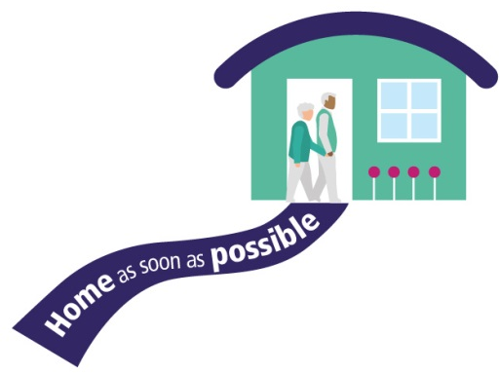
Our eight ambitions for Dorothy and those like her
Implementing local care
Notes:
Our ultimate aim for older people is to support their needs better and stop them going into hospital.
We know that every day in Kent and Medway around 1,000 people are in a hospital bed when they don’t need to be or want to be.
Some of the reasons why older people stay too long in hospital are:
they have to wait for care to be in place to support them going home
they need a social care assessment or an occupational health assessment
or they need a residential home place.
To illustrate how we would like to improve care and treat more people at home, we’ve created ‘Dorothy’, an example patient. By demonstrating what we think her care should look like, we can look at how our proposed model might work.
So imagine Dorothy is 79, and frail. She has type 2 diabetes, Chronic Obstructive Pulmonary Disease (COPD), memory loss and depression. She lives with her husband Bill, who also has type 2 diabetes, and is her main carer.
We have eight ambitions for Dorothy and people like her which are:
helping Dorothy to look after herself
organising her care better
keeping her safe in her home
joining-up the team looking after her
having one number for her to call for help, advice or support
responding rapidly to her at home when she becomes unwell and needs it
making sure Dorothy can get home from hospital quickly and safely
giving Dorothy, her GP and the people looking after her better access to expert advice and faster access to her test results in the community
The following eight slides will explore these further …

Slide 6
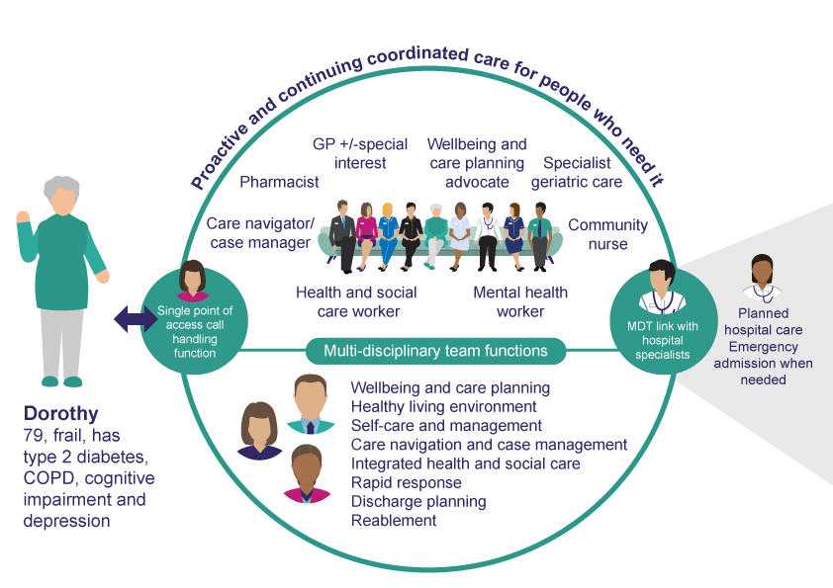
How our model will work
Notes:
This will be achieved by the single point of access, an integrated health and social care MDT, liaison with specialist services and other supporting services
Local care already happening in places across Kent e.g. Encompass, Thanet Primary Care Homes
Between now and 2021 all of Kent and Medway having implemented all of care models
Starting in different places
Localities providing services to 30 to 50k
29 in total
Groups 1, 2, 3

Slide 7
Multi-Disciplinary Team (MDT)
A core MDT team includes:
Our Integrated Case Management (ICM) Approach
Health and social
care coordinator
Social Care representative / social worker
Pharmacist
Mental Health worker
Shared IT is essential to communicate effectively
Social Prescribing
GP
Care plan
Community nurse
/ LTC Nurse
Nurse Specialist
Geriatrician
Agreed with patient/carer
Administrator
Allied Health Professional
Additional members which vary locally:
Integrated Discharge
Team
Fire and
rescue
Acute
specialists
Local Government i.e. housing
Police

