Slide 1

Accommodation Strategy refresh
May 2018
Christy Holden
Strategic and Corporate Services
Notes:
HOLDING SLIDE

Slide 2
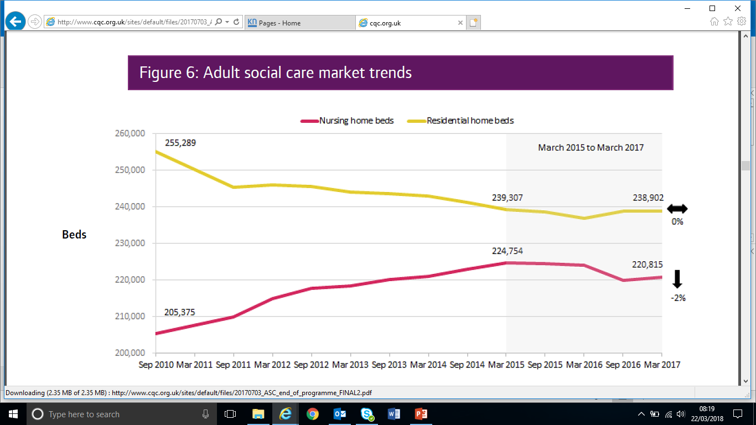
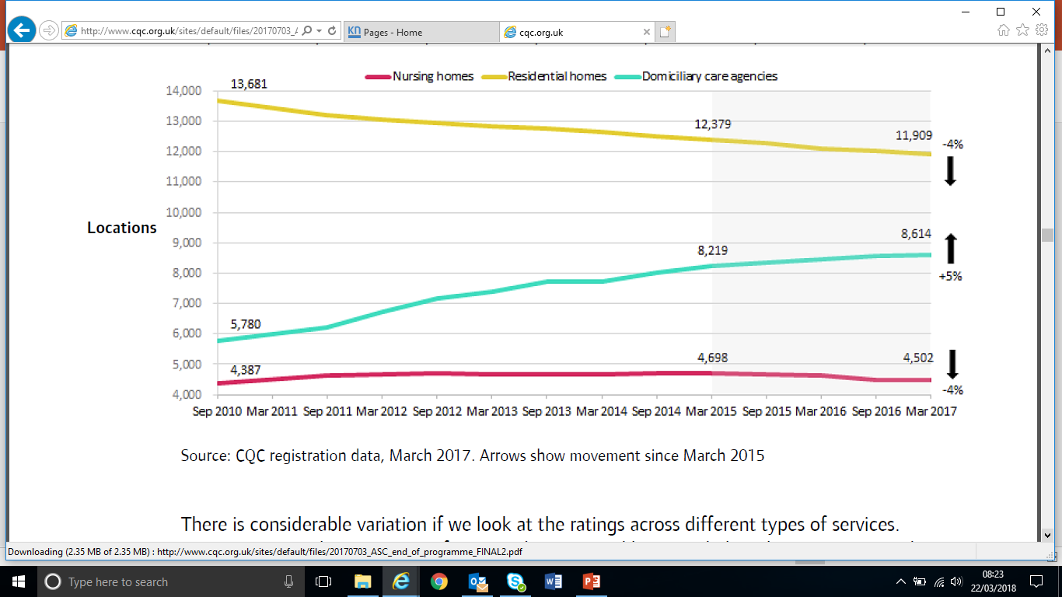
National trends (CQC 2014-2017)
The national picture (all client groups) shows a reduction of the number of residential care home beds and an increase of nursing home beds, which supports the conclusions of the Kent Accommodation Strategy. It also shows an increase in home care agencies further supporting the developments of supported housing (including Extra Care Housing)

Slide 3
Care Home Movement – Older People - Kent
 | Total Care Homes 2014 | Beds | Av Size | Total Closed | Beds closed | Av Size | Total Opened | Beds Opened | Av Size | Total Homes* | Total Beds* | Av Size | Total Closed | Beds closed | Av Size | Total Opened | Beds Opened | Av Size | Total Homes | Total Beds
 |  | 2014 | 2014 |  |  |  |  |  |  | Oct-17 | Oct-17 | Nov-17 |  |  |  |  |  |  | Jan-18 | Jan-18
Ashford | 20 | 772 | 39 | 3 | 55 | 18 | 1 | 60 | 60 | 18 | 832 | 46 | 0 | 0 | 0 | 0 | 0 | 0 | 18 | 832
C4G | 52 | 1703 | 33 | 11 | 217 | 20 | 2 | 120 | 60 | 43 | 1686 | 39 | 1 | 90 | 90 | 0 | 0 | 0 | 42 | 1596
DGS | 41 | 1690 | 41 | 6 | 189 | 32 | 2 | 37 | 19 | 37 | 1478 | 40 | 2 | 32 | 16 | 0 | 0 | 0 | 35 | 1446
SKC | 77 | 2224 | 29 | 14 | 314 | 22 | 1 | 79 | 79 | 63 | 2092 | 33 | 4 | 87 | 22 | 0 | 90 | 90 | 59 | 2095
Swale | 17 | 680 | 40 | 1 | 36 | 36 | 0 | 0 |  | 16 | 634 | 40 | 0 | 0 | 0 | 0 | 0 | 0 | 16 | 634
Thanet | 49 | 1362 | 28 | 6 | 162 | 27 | 0 | 0 |  | 43 | 1423 | 33 | 4 | 129 | 32 | 0 | 0 | 0 | 39 | 1294
WK | 79 | 3164 | 40 | 13 | 375 | 29 | 6 | 450 | 75 | 72 | 3242 | 45 | 2 | 59 | 30 | 2 | 157 | 79 | 72 | 3340
Total | 335 | 11595 | 35 | 54 | 1348 | 25 | 12 | 746 | 62 | 292 | 11387 | 39 | 13 | 397 | 31 | 2 | 247 | 82 | 281 | 11237
CQC data over 18 month period (2013-2014) showed average size of home registering was 57 beds and de-registering was 28 beds
Average Care Home Size in Kent:
2014 = 35
2016 = 36
2017 = 39
2018 = 40
Av. Size opening = 66
Av. Size closing = 26
West Kent ^
Ashford ^
DGS v
C4G v
Thanet v
SKC v
Swale v
No. of care home beds in planning at end of 2017 597
No. of care home beds under construction at end 2017 145
The Accommodation Strategy predicted closures where there is an over-supply – further this relies on the development of Extra Care Housing with appropriate care and support which has currently stalled due to Future Funding consultations

Slide 4
Refresh 2017/18
Updated documents referenced
Updated case studies and research
Inclusion of the Transforming Care Programme and Housing Plan
Additional information on Kent’s Children (and detail on Care Leavers)
Refreshed forecasts based on updated supply, demand, additional population and demographic, local influences and some professional judgments on the impact on investment in prevention and community provision commissioning
Review of the web links to ensure current
Updated definitions in the glossary

Slide 5
Initial Updated Forecasts (65+)
Extra Care
New Supply
 | 2021 | 2026 | 2031
Ashford | 102 | 108 | 63
Canterbury | 140 | 140 | 73
Dartford | 70 | 70 | 34
Dover | 111 | 110 | 62
Gravesham | 74 | 67 | 28
Maidstone | 133 | 140 | 73
Sevenoaks | 103 | 93 | 43
Shepway | 109 | 110 | 57
Swale | 105 | 115 | 61
Thanet | 127 | 128 | 70
Tonbridge Malling | 101 | 96 | 49
Tunbridge Wells | 101 | 98 | 56
KENT TOTAL | 1,276 | 1,275 | 669
General Frailty
New Supply
 | 2021 | 2026 | 2031
Ashford | -58 | -16 | 45
Canterbury | -174 | -84 | 50
Dartford | -59 | -30 | 22
Dover | -108 | -50 | 42
Gravesham | -56 | -26 | 20
Maidstone | -100 | -43 | 50
Sevenoaks | -77 | -31 | 31
Shepway | -144 | -69 | 37
Swale | -83 | -27 | 42
Thanet | -174 | -81 | 49
Tonbridge Malling | -65 | -32 | 33
Tunbridge Wells | -97 | -44 | 38
KENT TOTAL | -1,195 | -533 | 459
Net increase in provision – need to work alongside each other
Stalling of ECH due to the ‘Future Funding Consultation’ has seen CPT (County Placements Team) reporting more demand recently of General Frailty residential care

Slide 6
Initial Updated Forecasts (65+)
Dementia Residential
New Supply
 | 2021 | 2026 | 2031
Ashford | 16 | 34 | 61
Canterbury | 78 | 88 | 70
Dartford | 33 | 33 | 31
Dover | 51 | 63 | 58
Gravesham | 13 | 14 | 27
Maidstone | 47 | 56 | 69
Sevenoaks | 4 | 15 | 41
Shepway | 69 | 74 | 53
Swale | 26 | 46 | 58
Thanet | 65 | 77 | 68
Tonbridge Malling | 31 | 33 | 47
Tunbridge Wells | 38 | 44 | 52
KENT TOTAL | 471 | 577 | 635
Nursing
New Supply
 | 2021 | 2026 | 2031
Ashford | 68 | 96 | 115
Canterbury | 66 | 107 | 131
Dartford | 46 | 56 | 60
Dover | 64 | 93 | 113
Gravesham | 38 | 41 | 53
Maidstone | 89 | 114 | 132
Sevenoaks | 48 | 60 | 78
Shepway | 52 | 86 | 102
Swale | 59 | 98 | 111
Thanet | 51 | 94 | 129
Tonbridge Mall | 69 | 74 | 88
Tunbridge Wells | 53 | 74 | 99
KENT TOTAL | 703 | 993 | 1,211
Significant increases needed in dementia services and nursing provision (to include dementia nursing)

Slide 7
Revised Definition of ECH for discussion
Whist there is no one single definition of Extra Care, it can be described as:
‘In general terms, extra care housing is related to sheltered housing but with higher level support and care to help residents live independently (for example where the likely alternative might be a residential care home). Component elements could include:
adaptable accommodation above Lifetime Home standards so the accommodation changes with the needs of the individual (ie able to take ceiling track hoists, fully wheelchair accessible with adjustable height kitchen design)
access to at least one hot meal a day through communal dining whether through full restaurant or bistro café design, depending on local facilities in the area
access to personal care services 24 hours a day, either on site or within a reasonable response time
flexible care provision with the ability to meet an individual’s night time needs as well as emergency or ‘checking in’ service
means-tested charges for care including a charge for the 24 hour background support sometimes referred to as a Wellbeing Charge
access via a panel process with an over-riding nominations agreement between partners.
(Kent Social Care Accommodation Strategy – 1.3 refresh)’.

Slide 8
Definition of “Care Ready” for discussion
Older Persons housing designed using the HAPPI principles with fewer on-site communal facilities promoting:
1. Good space, accessibility and flexibility within the dwellings for a mix of needs
2. Good natural daylight in the home and shared spaces reducing the risk of falls
3. Balconies and Outdoor Space for the residents to enjoy
4. Adaptability and Care Ready design to provide for the future needs of an ageing population
5. Circulation Space with the external layout and landscaping to encourage interaction and supporting independence for the residents.
6. The scheme being in close proximity to local amenities and facilities with varied social, leisure and retail facilities as well as local hubs and shared facilities.
7. Good use of the natural environment
Energy efficiency and sustainable design so the homes are well insulated with good natural ventilation
Use of telecare and telehealth, ability to have on-site care teams, not 24 hours a day
10.Storage for belongings, mobility scooters and bicycles:
11.Good navigation for a mix of needs around the development
12.Access to 24 hour support, either through on-site non-care support
or through modern call system

Slide 9
Stakeholder review programme
Stakeholder Group | Date of approval
Kent Housing Group | Feb – April 2018
Kent Planning Officers Group | April 2018
East Kent CCG | May 2018
West/North Kent CCG | TBA
OPPD Service Directorate | 5 April 2018
DCALDMH Service Directorate | TBA
Commissioning Oversight Group | TBA
Strategic Commissioning Group | TBA
ASC Cabinet Committee | TBA
Re-launch | July 2018

Slide 10
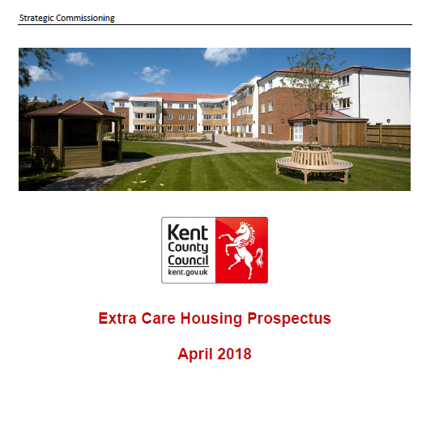

https://procontract.due-north.com/Advert?advertId=5c44f918-6549-e811-80eb-005056b64545&p=8691483f-2f3d-e711-80e1-005056b64545
Kent Business Portal – www.kentbusinessportal.org.uk

Slide 11
Delivery options
The commissioning strategy and business case will appraise two options as set out below. Market engagement will be framed around securing the provision of circa 1,000 ECH places across the County as soon as possible which could be split in to packages.
Option 1
  One entity under one arrangements finances, builds, and maintains the place of residence as well as provides the care services. This could be a prime contractor or a consortium. Consideration should be given to whether or not the entity will provide care in the wider community.
Option 2
  Separate arrangements are made for the provision of the place of residence (finance, build and maintain) from the provision of the care services. Consideration will be given to whether or not the care provider is the provider of care in the wider community.

Slide 12
Key Milestones
Activity | Date
Prior Information Notice | April 2018
Provider Prospectus | April 2018
Market Engagement | June 2018
Commissioning Plan and Business Case | June/July 2018
Partner Engagement | Summer 2018
Finalise Scheme Locations | Summer 2018
Procurement Process | September 2018 – March 2019
Contract Awards | April 2019
Mobilisation, Transition and Transformation | May 2019 +
Scheme go live dates

Slide 13
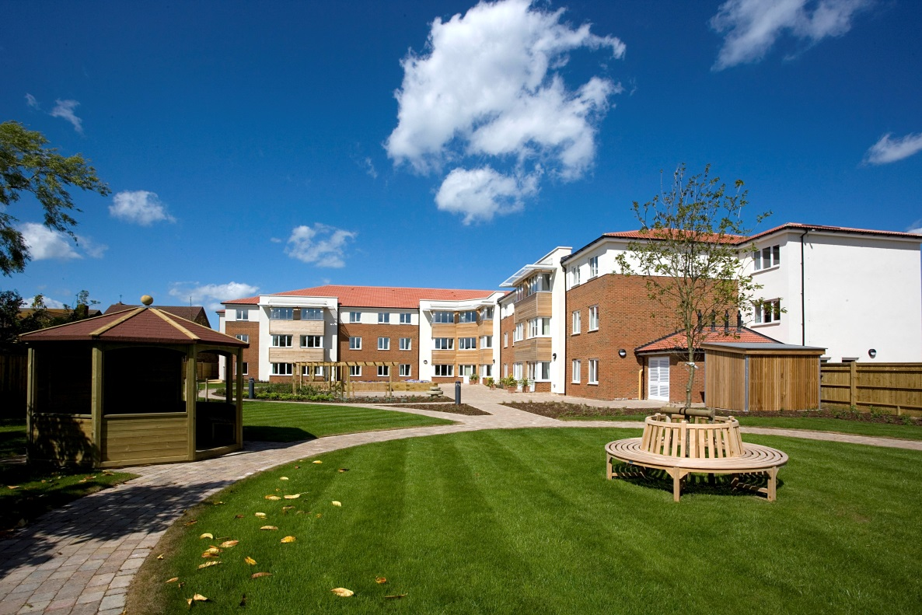
King Edward Court ,Herne Bay
Thank you
Christy Holden – christy.holden@kent.gov.uk – 07920 780623
Senior Commissioning Manager

