Slide 1
Intelligence gathering and getting an investigation started

Slide 2
What is intelligence?
Intelligence
Archaic: information in general; news
Notes:
the ability to acquire and apply knowledge and skills.
"an eminent man of great intelligence"
synonyms:intellectual/mental capacity, intellect, mind, brain, brains, brainpower, powers of reasoning, judgement, reason, reasoning, understanding, comprehension, acumen, wit, sense, insight, perceptiveness, perception, perspicaciousness, perspicacity, penetration, discernment, sharpness, quickness of mind, quick-wittedness, smartness, canniness, astuteness, intuition, acuity, alertness, cleverness, brilliance, aptness, ability, giftedness, talent; informalbraininess
"a man of great intelligence"
antonyms:stupidity
a person or being with the ability to acquire and apply knowledge and skills.
plural noun: intelligences
"extraterrestrial intelligences"
2.
the collection of information of military or political value.
"the chief of military intelligence"
synonyms:information gathering, surveillance, observation, reconnaissance, spying, espionage, undercover work, infiltration, ELINT, cyberespionage, humint; informalrecon
"a former agent for British military intelligence"
people employed in the collection of military or political information.
"British intelligence has secured numerous local informers"
military or political information.
"the gathering of intelligence"
synonyms:information, facts, details, particulars, data, figures, statistics, knowledge, report(s); Moreinformalinfo, gen, dope, deets
"the lack of intelligence received from the Eighth Army"
archaic
information in general; news.
Origin
late Middle English: via Old French from Latin intelligentia, from intelligere ‘understand’ (see intelligent).
Translate intelligence to
Use over time for: intelligence
Translations, word origin, and more definitions

Slide 3
Where does the intelligence come from ?
Notes:
Where do we start
Who’s accessing the data? LA/HA etc
Intrusive material. Material gathered about an individual(s) who is not the subject of the investigation
Do you think it is surveillance ?
Who’s account are you using to gain access?
How many times do you visit the page?
What do you plan to do with the information you gather?
Should I take screen prints?
Do you record your searches?
Don’t forget Twitter and the others there are many!!
Record activities and notify us so we can keep a record in case we are inspected

Slide 4
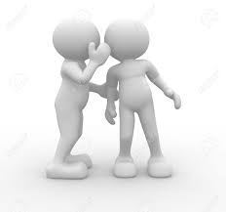
Have you heard about?
Notes:
Covert Human Intelligence Sources
A resident informs you of a potential problem being committed by another resident. We all love a curtain twitching nosey neighbour
What to do/Not do :-
Ascertain if they are prepared to provide further information and preferred method of contact
Make a written record including if the individual is known to you/known to be reliable
Do not make any promises and or say you will feed data back to the informant
Do not task the informant with doing anything especially if it’s illegal

Slide 5
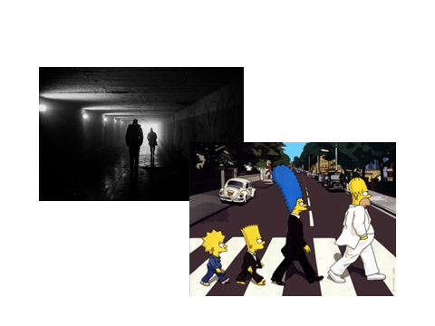
Intelligence vs Evidence
Notes:
There is a significant difference between what is Intelligence and what is evidence. The way in which we collect that information is the same but how we present it in a case is very different.
Often the intelligence will lead the investigator to make other enquiries that will be evidential and in some cases there is a need to ensure that the Intelligence and its source are kept safe. This is known as a “Sterile corridor” it is the grey murky world of Intelligence gathering. When we receive some information we have to ask the person who has provided the information whether they are prepared to be witnesses and maybe go to court. We will “Sanitize” the information so that the source cannot be identified.
IF we are not able to sanitize the information to protect the source then we may decide that it cannot be used, that means we cannot use it in any way and cannot use it to follow other lines of enquiry.

Slide 6
Investigation Where do I start?
What is the issue you want to investigate?
What outcome do you want to achieve?
How can you reach that goal?
Do you have the necessary resources?

Slide 7
3 R’s
R
RETAIN
R
RECORD
R
REVEAL
Notes:
All investigations are governed by the Criminal Procedures & Investigations Act 1998 (CPIA) Every Investigation has to comply with CPIA. (Disclosure) It requires Investigators to
RECORD - All information and evidence obtained during the investigation, it expects Investigators to divergently follow ALL reasonable lines of enquiry.
RETAIN – That information and record it in a schedule as unused or as part of the prima facie case, (statements, testimony, exhibits etc)
REVEAL – This is what has to be declared to the prosecutor, everything has to be disclosed as unused material or case papers.
Except when. The information is so sensitive or there is a real threat of harm to the evidence or witness then it can be regarded as “Sensitive” or “Highly Sensitive”
If the material is sensitive it is down to the prosecutor as to whether it should be disclosed or not, if it is not then the prosecutor will need to make a file note to that effect. If the defence decide that this information does exist and demand that it is disclosed then it will be down to a senior Judge to make that decision in a Public Interest Immunity hearing. These are held in closed chambers and the judge will decide whether it can be used or not and will balance the risks of disclosure to those of a fair trial (Article 6). If the prosecution is ordered to disclose the information they either do that or withdraw the case from listing. NFA.
The only exception to this is Highly Sensitive information, this is when there is a real risk to life, National security, Operational tactics only in these cases will there be a hearing between a high court judge and a senior crown prosecutor ONLY. Usually in such instances the case would be withdrawn prior to such hearings.

Slide 8
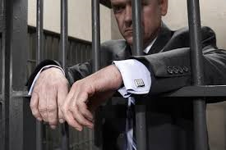
THE END.
Notes:
Be aware things change

