Slide 1
Regional Forum for Kent and the South East
Hosted by Ashford Borough Council
Welcome
Tracey Kerly
Chief Executive
Ashford Borough Council

Slide 2
Facts about Ashford
Did you know?
Number 1 business location in Kent
123,300 people live in the borough
15% increase in population over the past decade
Third fastest growing town in the South East
47% growth in jobs since 1997
Did you know?
Number 1 business location in Kent
12Did you know?
Number 1 business location in Kent
123,300 people live in the borough
15% increase in population over the past decade
Third fastest growing town in the South East
47% growth in jobs since 1997
3,300 people live in the borough
15% increase in population over the past decade
Third fastest growing town in the South East
47% growth in jobs since 1997
Did you know?
Number 1 business location in Kent
123,300 people live in the borough
15% increase in population over the past decade
Third fastest growing town in the South East
47% growth in jobs since 1997
Did you know?
Number 1 business location in Kent
124,300 people live in the borough
15% increase in population over the past decade
Third fastest growing town in the South East
47% growth in jobs since 1997
782 affordable homes built/bought back into use in the last 5 years
First authority in the south east to be declared ‘Housing business ready’
Chilmington Green permission for 5,750 homes
Cheesmans Green permission for 1200 homes
Notes:
TRACEY - starts with Ashford’s significant growth.

Slide 3
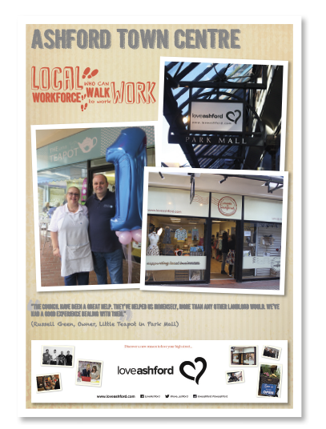
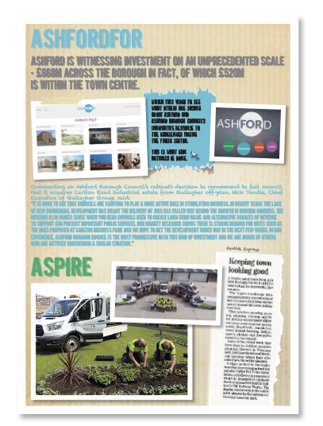
Notes:
You’ll recall our original submission that detailed the way in which we have responded to the challenge of reduced central government funding. You’ll recall that we have developed the successful AshfordFor campaign, which is delivering £668m of investment in the borough.

Slide 4
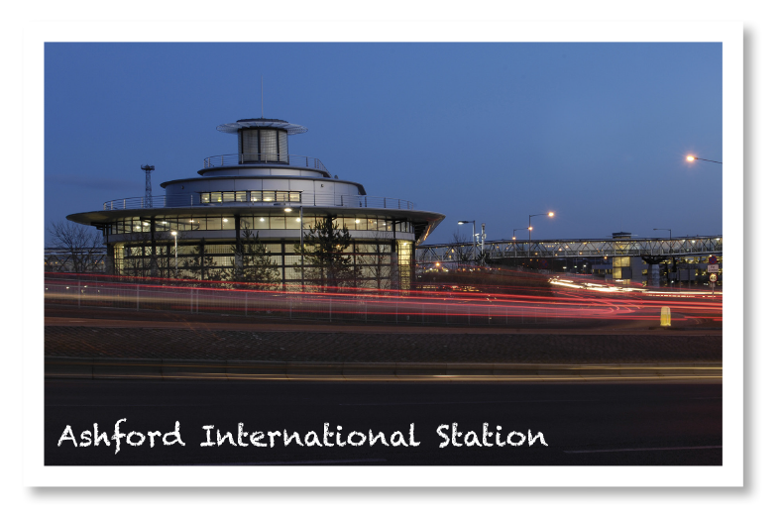
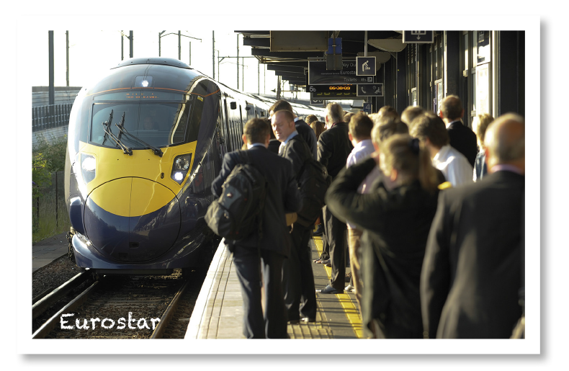
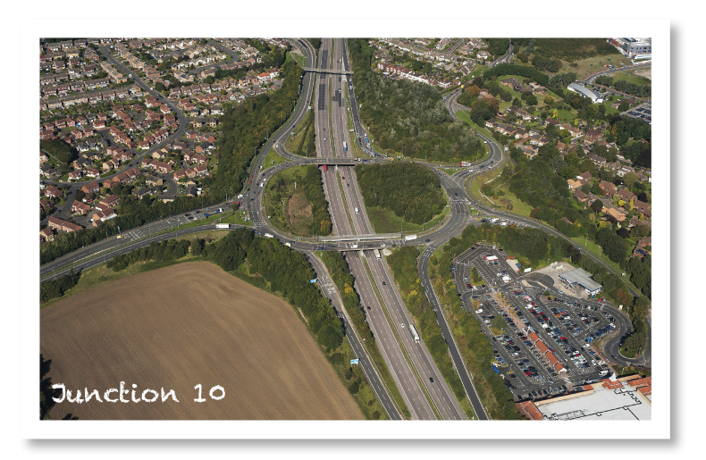
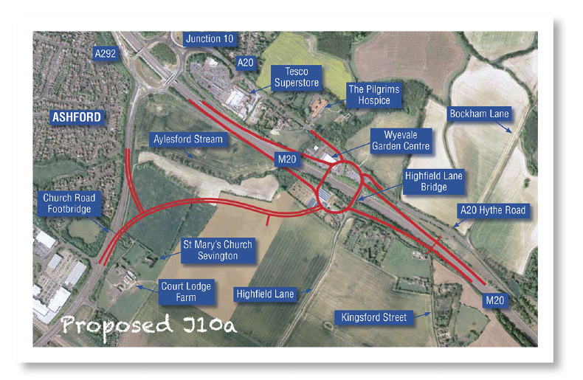
International Town status on track
The road to success
Notes:
But it’s not just Ashford that we are delivering for. We are proud of the role that we play in the south east and as such we have a wider focus. With our unrivalled connectivity, we have embraced the opportunity to play a major role in securing infrastructure that will help our residents and businesses make the most of Ashford’s location.
Being just 38 minutes from London and 1hr 52minutes from Paris, we have lobbied hard to secure infrastructure solutions that will not only benefit Ashford and unlock its potential even further, but benefit the whole of the south east region. The Ashford ‘spurs’ project was critical to our future success. We market ourselves through the AshfordFor brand as the UK’s international town and when we were told that the new fleet of Eurostar trains would not be able to stop at Ashford International this was perceived as a big threat. A signalling solution had to be found.
Originally it was thought there would be a gap in services where the new fleet Working in partnership with Kent County Council, Network Rail and of course Eurostar we have managed the situation to ensure that there was no break in service, only a partially reduced service to two services, from three services, per day. Co-ordinating a project of this scale requires Leadership. With all partners round the table, funding solutions have been sourced via the South East Local Enterprise Partnership and the Homes and Communities Agency. Work is under way and the new trains will be able to stop at Ashford International in February.
J10a was granted permission by Chris Grayling, the secretary of state for transport, on 1st December 2017. We have campaigned for years for the delivery of extra road transport capacity to cater for Ashford’s future needs. J10a of the M20 is another piece of the borough’s integrated transport infrastructure jigsaw that is now in place. The project was a nationally significant infrastructure project and we really think that it will be a catalyst for economic and commercial development in Ashford, creating job opportunities and improving our road network.

Slide 5
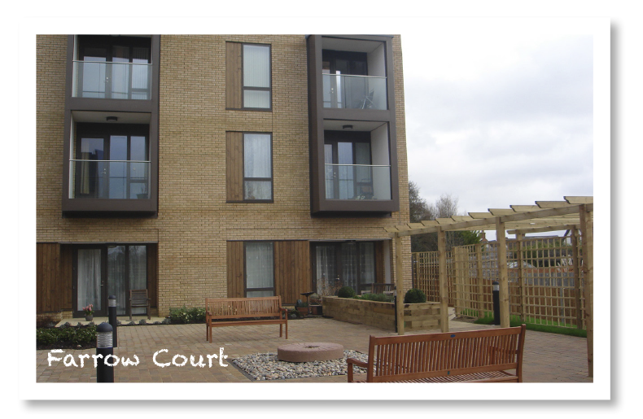
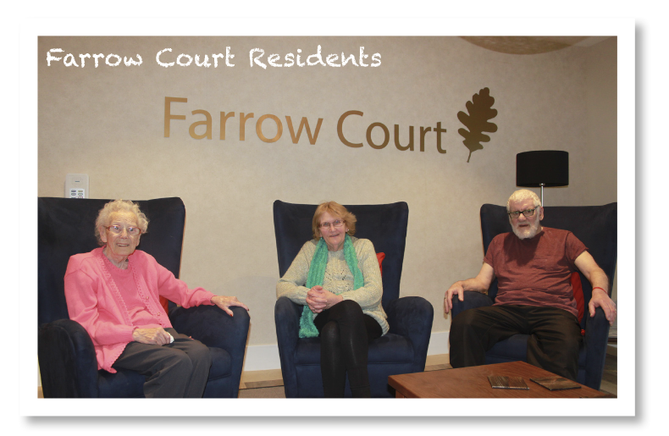
Flagship housing scheme
Another county first
Notes:
And although we have the Big 8, there are another dozen major projects queuing up behind them – such as the £16m redevelopment of Farrow Court sheltered housing scheme, which is truly dementia friendly. Now delivered, it has 104 new homes including 12 units of accommodation for those with learning disabilities and eight recuperative care units, meaning people can leave hospital and stay in Farrow Court while a care package or adaptations are put in place to enable them to return to their own home.
We were also the first local authority in Kent to work in partnership with an investment management company, Cheyne Capital, to use their Social Impact Fund to deliver an Independent living scheme for older people at Repton Park in Ashford. This scheme will use institutional investment funds to unlock the delivery of the scheme that was delayed when central government imposed the 1% rent reduction on all local authorities, depriving the housing revenue account of £10m over a four-year period.

Slide 6
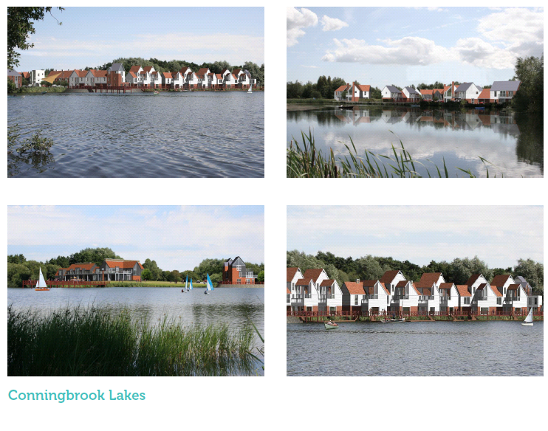
Conningbrook Lakes 300 New Lakeside homes with 85 acre Country park.

