Slide 1
Kent Support and Assistance Service (KSAS)
Mel Anthony
Tony Care
Notes:
Introduction

Slide 2
Kent Support and Assistance Service
Our Purpose
KSAS is a discretionary local welfare service provided by
Kent County Council (KCC).
We offer crisis support and assistance to residents within KCC’s boundaries to help alleviate an applicant’s hardship or prevent a further crisis.
Advice and signposting to local services or organisations that can help the immediate crisis and find longer term solutions is a standard part of the offer.

Slide 3
Kent Support and Assistance Service
Who is eligible?
Applicants must meet all of the following criteria:
• Aged 16 or over;
• Living within KCC’s boundaries or placed outside of Kent with the duty
of care remaining with a Kent local authority;
• Claiming a means tested benefit or working and in receipt of a low income (below £16,200).
In addition, one or more of the following circumstances must apply:
• An emergency crisis has put the person and household at risk;
• The person will be setting up home after living in supported housing,
an institution, or in a care setting;
• The person or household needs help to stay in their own accommodation rather than going into supported housing, an institution, or a care setting.

Slide 4
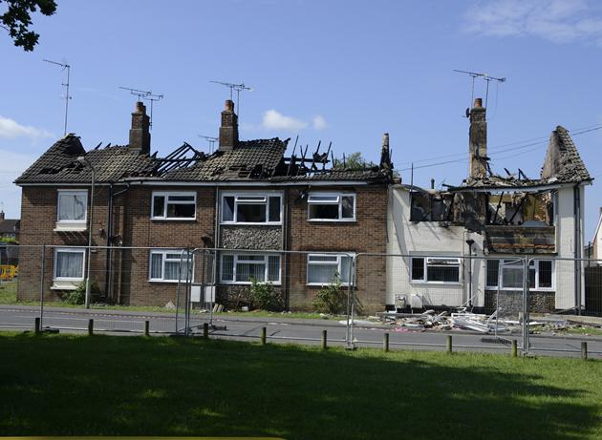
When things go wrong……
KSAS forms an important part of Kent’s civil emergency plans

Slide 5
Kent Support and Assistance Service
What we will provide
All applicants will receive signposting to advice and guidance.
Specialist Assessment Officers verify identity, confirm eligibility and assess the circumstances presented to determine the assistance that can be provided. If eligible, KSAS may provide:

Slide 6
Kent Support and Assistance Service
What we cannot help with
Support will not be awarded for the following goods and services:
• Housing costs, such as repairs and improvements, rent and deposits, or other fees for accommodation
Running costs of any motor vehicle
• Distinctive or branded school uniforms and sports clothes or equipment
• Council tax, utility costs (i.e. telephone, water and sewerage)
• Medical, surgical, optical, aural or dental services
• Pet costs (e.g. vet invoices and food)

Slide 7
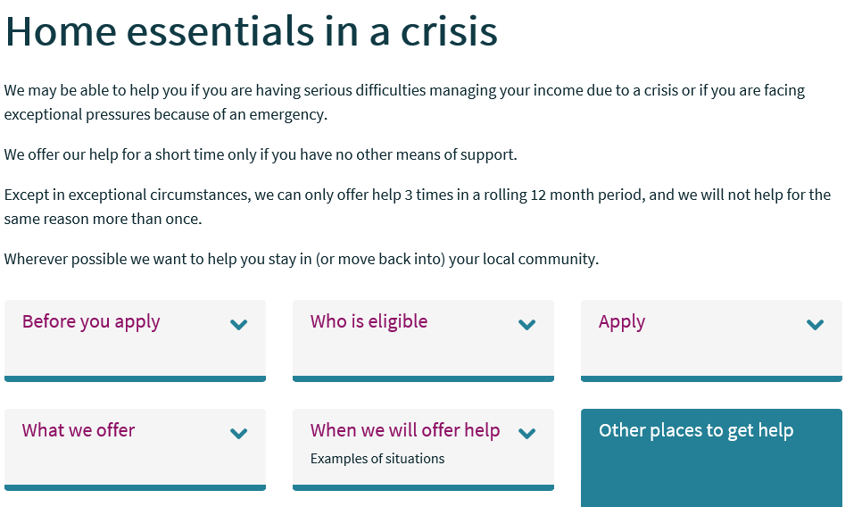
Kent Support and Assistance Service
How to apply – www.kent.gov.uk/ksas
The home page for KSAS. Applicants are given a host of information prior to applying including
Other sources of help
Eligibility – including example scenarios
Details of the offer
How to apply
The quickest and easiest way to apply is online. An average of 84% applications are made this way.
Applicants should have ready their National Insurance Number, details of anyone else in the household and any household income, including benefits before they apply.

Slide 8
Kent Support and Assistance Service
Applying online

Slide 9
Kent Support and Assistance Service
2017/18: Useful statistics
7,504 applications received
Awarded (45%) / Declined (55%)
Food and Household Items each represent 37% of applications.
However, Household Items equate to 45% of total spend.
Average monthly spend on awards was £40.3k
54% of applicant households contain children.
39% of households are single applicants.

Slide 10
Kent Support and Assistance Service
Challenges and Trends
Food, energy and clothing applications are affected at key times:
School holidays - start with a dip in applications and rise before school resumes with the impact of finding school uniform costs and non renewal of Child Tax Credits.
Christmas - applications decline late December followed by a sharp increase in January
Weather changes – Autumn and Winter equals increases in energy support. Mild weather is the reverse. Weather extremes also affect applications.
The main challenge faced this year has been the Universal Credit rollout across Kent.
Looking forward to 2020, we anticipate the migration of legacy benefits will impact on the service.

Slide 11
Kent Support and Assistance Service
Value for Money
Case study - Mr EP
82-year-old man.
In convalescence home following hospitalisation;
Suitable permanent property secured;
Could not move into the property as no essential items.
KSAS Support
Application assessed within 24hrs.
Bed, bedding and fridge provided £225.
Cost Avoided
Convalescence home bed.
Blocked hospital bed.
KSAS Support
Bed, bedding and fridge provided - £225
Costs Avoided
Convalescence home bed – £702 per week**
Hospital bed blocked - £400 per day in 2017*
*https://www.linkedin.com/pulse/stay-hospital-bed-uk-costs-400-per-day-we-sure-bryce-travers
** Laing Buisson Care of Older People UK Market Report 28th Edition, 2017

Slide 12
Kent Support and Assistance Service
Any questions?
www.kent.gov.uk/ksas
melanie.anthony@kent.gov.uk
tony.care@kent.gov.uk

