Slide 1
Introduction to entitledto’s homelessness prevention tool
Presentation to Kent Housing Options Group
21st June 2018

Slide 2
About entitledto

Slide 3
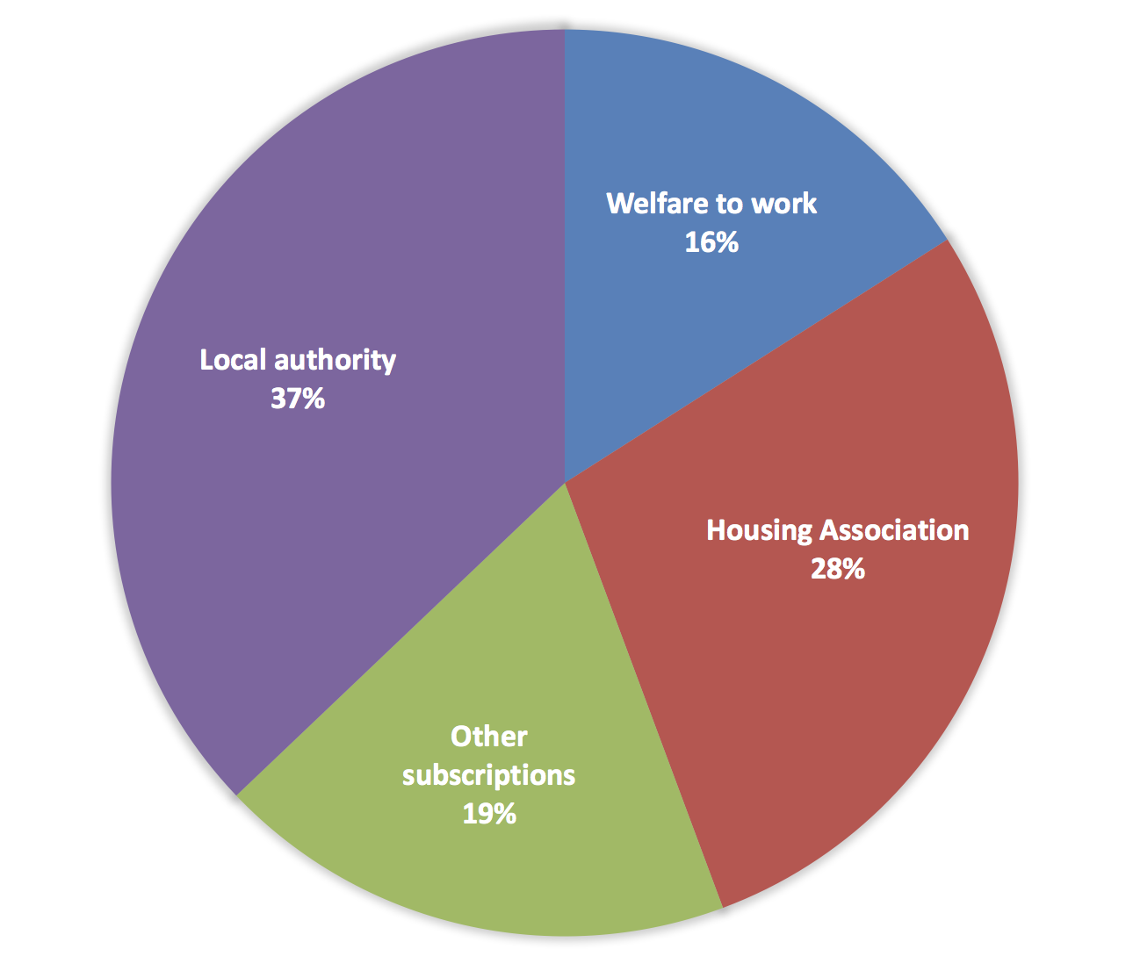
Areas of operation
Over 190 clients in a range of sectors

Slide 4
Our clients

Slide 5
Kent CC and entitledto
Kent CC have subscribed to our benefit calculator since 2013
Licence originally for calculator only on Kent CC site. At entitledto’s suggestion, contract being upgraded to individual LA sites
We will treat Kent Housing Group as an existing client, so costs lower
West Kent HA also existing client

Slide 6
Briefly …. our current products: income maximisation, budgeting and related tools

Slide 7
Public benefits calculator

Slide 8
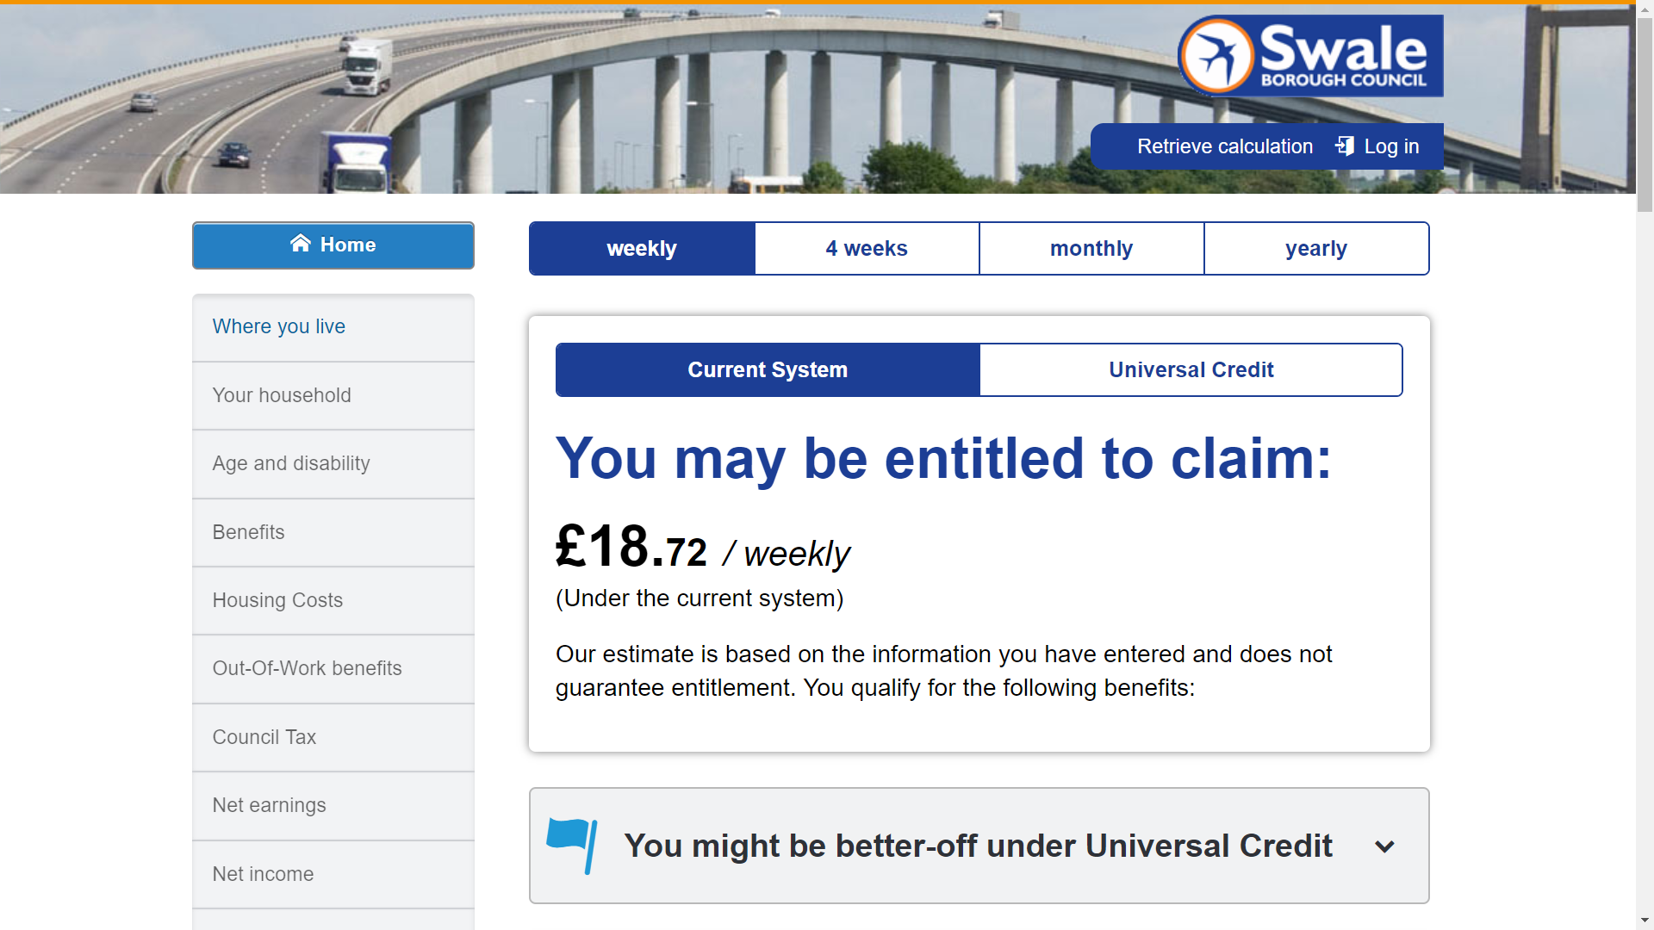

Slide 9
Better off calculator

Slide 11
Budgeting tool

Slide 13
Affordability calculator

Slide 15
Main purpose of this demo ….homelessness prevention tool

Slide 16
Background
Complex and changing benefits system
New statutory obligation to provide support under the Homelessness Prevention Act
It’s difficult to provide support on housing choices where complicated entitlements are involved
Universal Credit causing greater indebtedness and greater demand for services

Slide 17
Better information for clients
Local Authorities need to evidence how they have helped applicants in housing need
Case law states that LAs should exercise their housing duty through accommodation in the nearest possible affordable area (Westminster council case)
"The provision of up to date, comprehensive, tailored advice and information will play an important part in delivering the housing authority’s strategy for preventing homelessness.” See https://www.gov.uk/guidance/homelessness-code-of-guidance-for-local-authorities/chapter-3-advice-and-information-about-homelessness-and-the-prevention-of-homelessness

Slide 18
The Homelessness Prevention Tool systematically analyses options
Expenditure: helps minimise spending through comparing to standard amounts
Income: help maximise benefit income and shows the benefits of working
Location: shows affordable areas taking into account LHA rates and the benefit cap

Slide 19
Reduce spending tab

Slide 20
Increase earnings tab

Slide 21
Move home tab

Slide 23
Next steps
Run a trial. We will need to ensure the trial site is set up how you want it. All feedback welcome!
Define your requirements. One site and one system? Many sites and many systems? Any customisations?
Consider our quote: we can give you a ‘menu with prices’ if you are not sure

Slide 24
Contact details
Email: phil@entitledto.co.uk
Website: www.entitledto.co.uk/organisations
Telephone: 07816 638590

