Slide 1
ENGAGING WITH AGENTS IN THE PRS
DAVID VOTTA M.A.R.L.A
KENTS REGIONAL REPRESENTATIVE FOR ARLA PROPERTYMARK

Slide 2
Agenda.
About me
What is ARLA propertymark???
Video Clip
Government proposals and how it effects the housing market from an agents perspective
Agents, Landlords and housing teams under constant scrutiny
Open forum on how we can work together for a positive housing market.

Slide 3
DAVID VOTTA M.A.R.L.A

Slide 4
WHAT IS ARLA PROPERTYMARK???

Slide 5
WHAT IS ARLA PROPERTYMARK???
ARLA Propertymark: ARLA is the abbreviation of the Association of Residential Letting Agents, the largest professional body which sets and regulates the standards and levels of professionalism of its members.
ARLA protects and guides consumers, helping tenants and landlords to find and manage their treasured homes. We work to raise professional standards among letting agents from single branch independents to large national groups, promoting education and qualifications within the sector. Over 9,000 letting agents are ARLA Propertymark Protected, meeting higher standards than the law demands.

Slide 6
Video clip
https://youtu.be/i-OxZmafo64
Internet access required.

Slide 7
Government proposals
The tenant fee ban

Slide 8
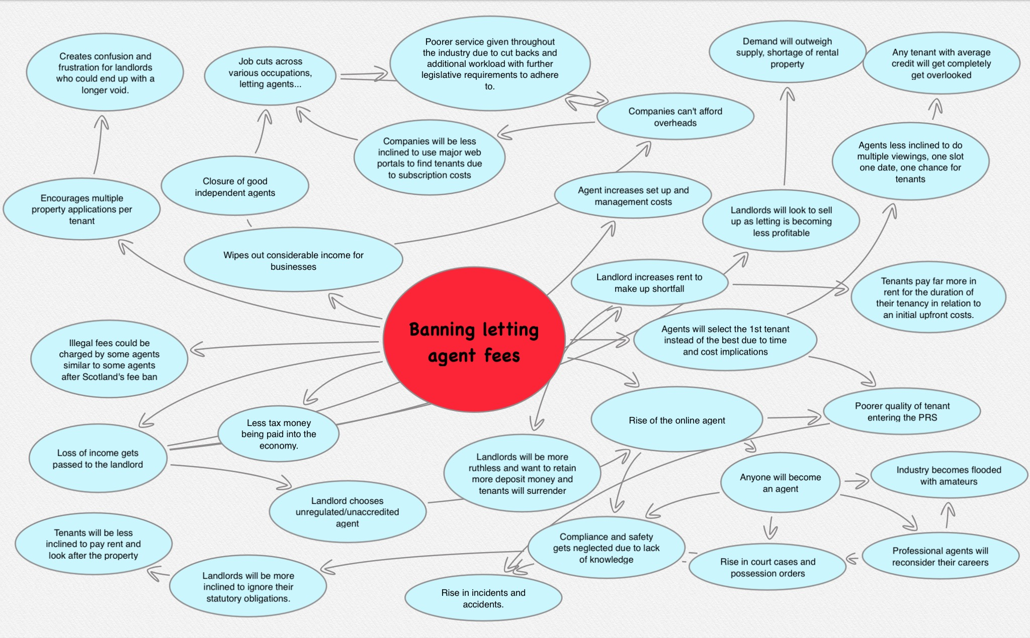

Slide 9
Government proposals
The Tenant Fee Ban
Section 24 of the Finance Act 2015 (Landlord taxation)

Slide 10
Axe the tenant tax. Support the movement

Slide 11
Government proposals and implementations
The Tenant Fee Ban
Section 24 of the Finance Act 2015 (Landlord taxation)
The Homelessness reduction act 2017

Slide 12
The Homelessness reduction act 2017. How has this affected you?

Slide 13
Government proposals and implementations
The Tenant Fee Ban
Section 24 of the Finance Act 2015 (Landlord taxation)
The Homelessness reduction act 2017
Three year tenancies

Slide 14
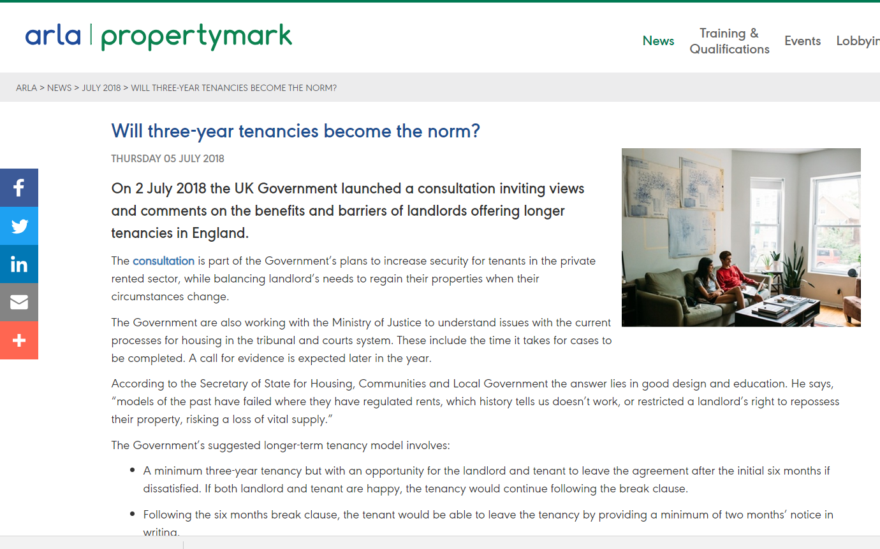
Three year tenancies
Is that really what tenants want in the PRS? (Agent and housing teams view.)
Positives
Negatives
The reality.

Slide 15
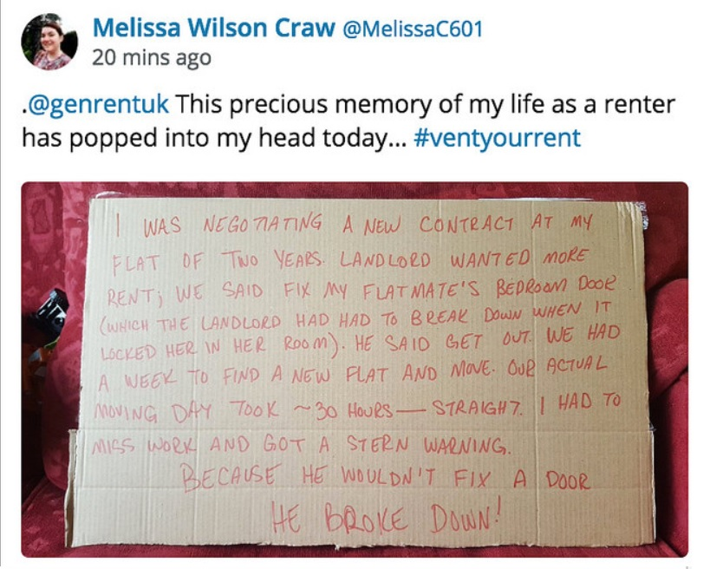
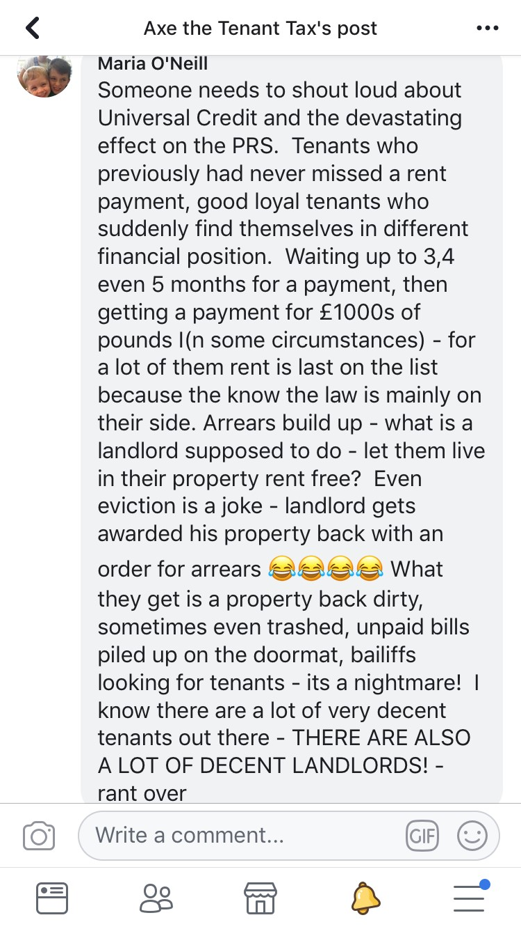
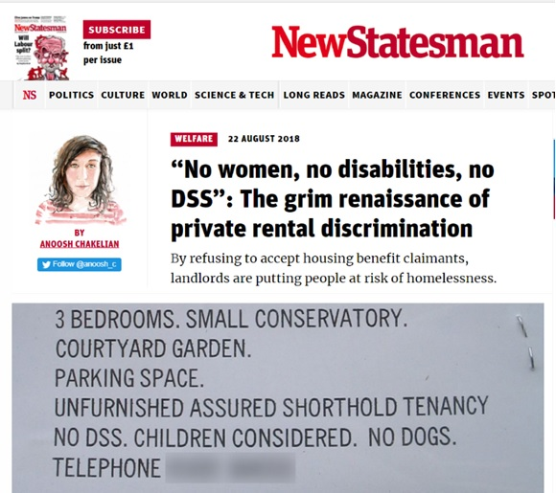
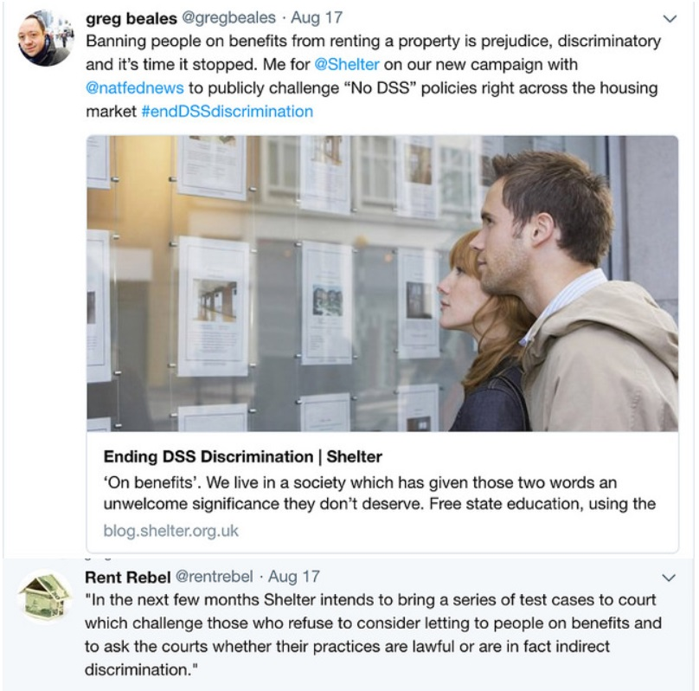
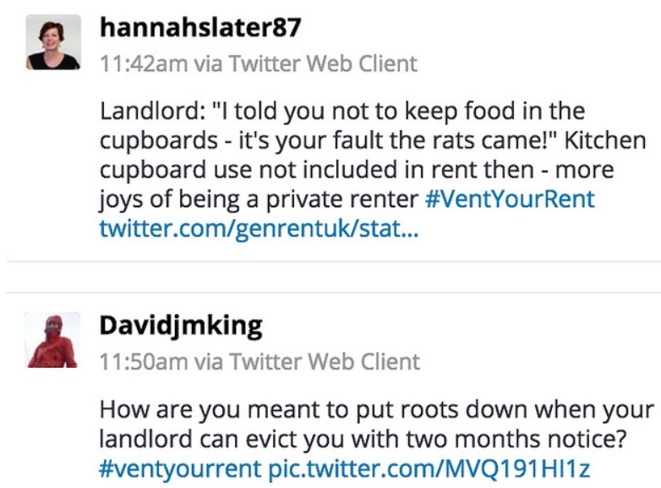
Agents, Landlords and housing teams under constant scrutiny (Attack)

Slide 16
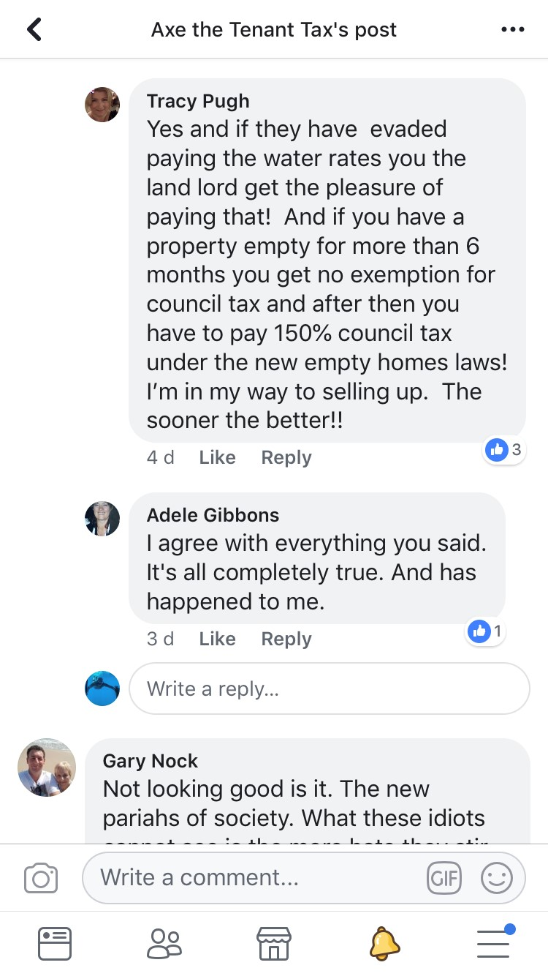
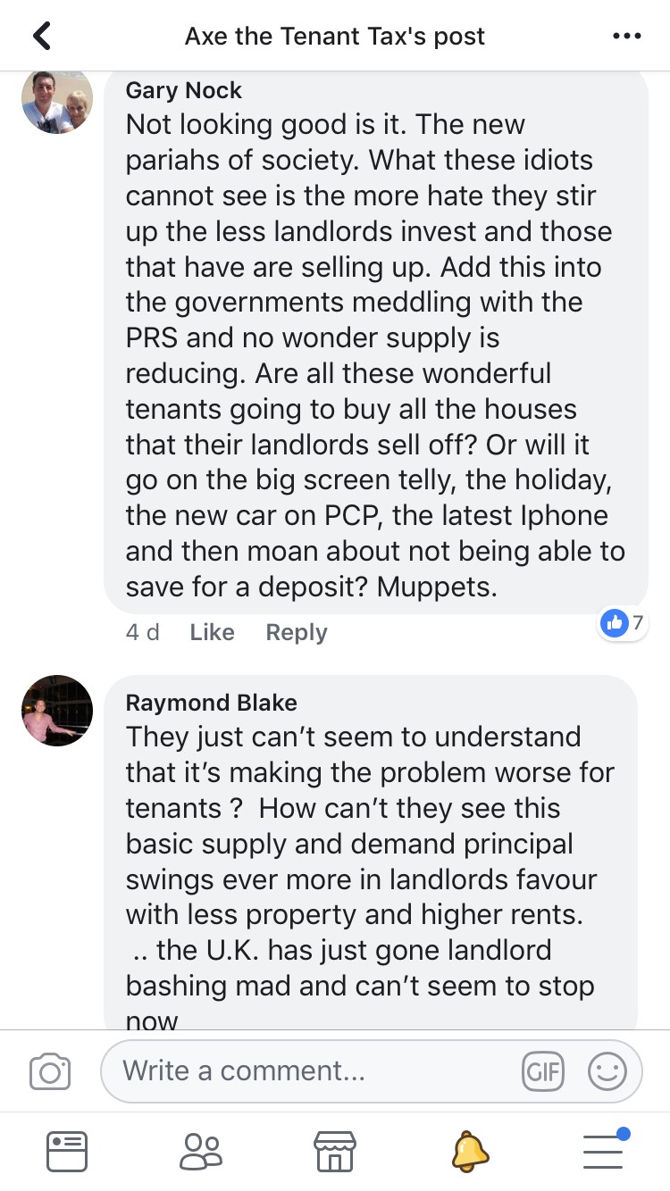
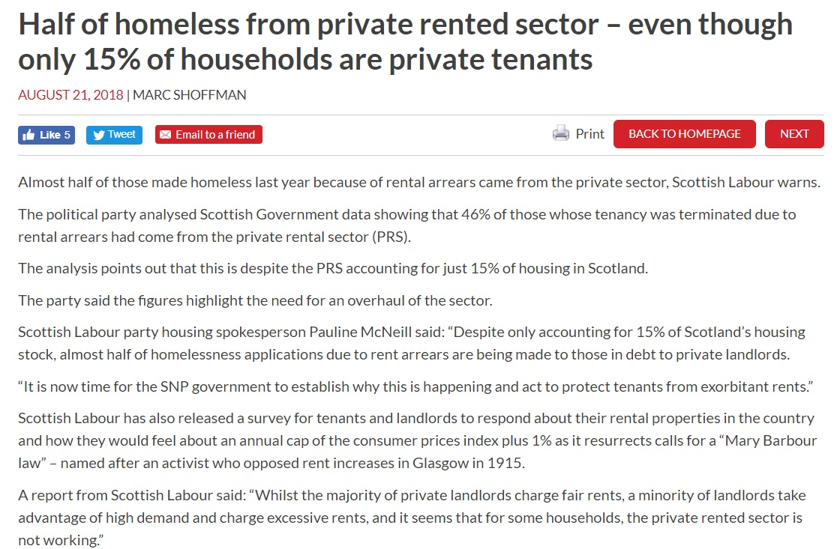
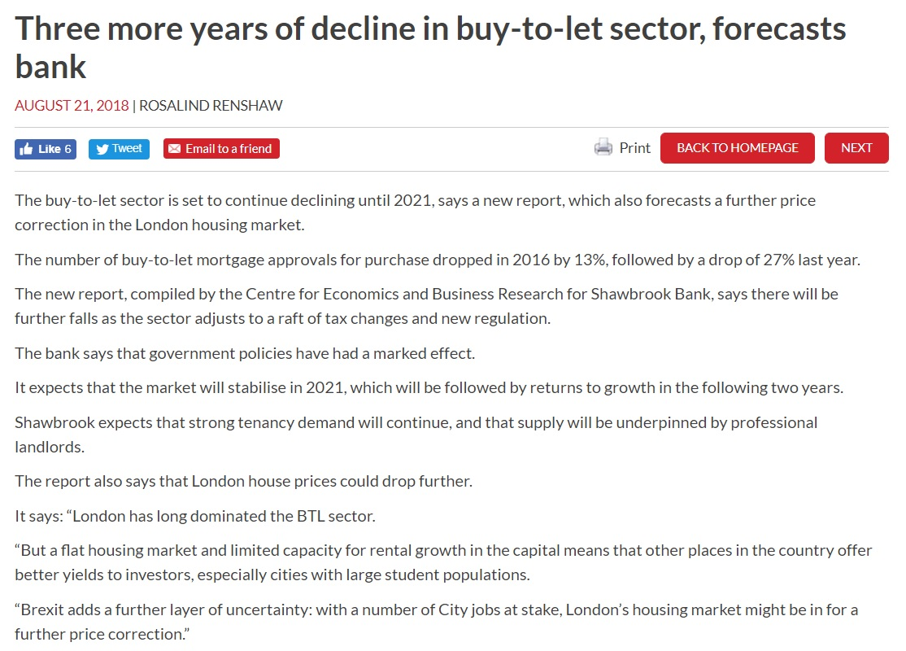
Agents, Landlords and housing teams under constant scrutiny (Defence)

Slide 17
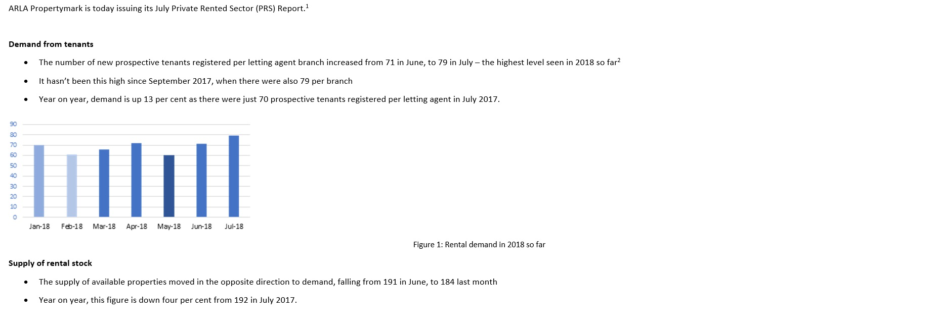

Slide 18
Open forum and discussion points.
How can we work together and engage in providing a better framework?
TSO officers, short staffed, under resourced
Claw back
Enforcement on rogue landlords & Agents, Whistleblowing hotline with feedback
Fines and prosecutions, how many are done vs Complaints? TSO say 6%
Selective licensing schemes have they benefitted or sent landlords underground? Fines and prosecutions?
Supporting professional agents
CAB and their role causing a negative impact and treating Landlords unfairly.
KCC Marketing budget together to inform landlords of legislative changes, if not prepared then use an ARLA agent and referral schemes.
PRS scheme could the local authority put a scheme in place to guarantee rents and tenants, for example paramount property services.
50-70% increase in landlords selling up their properties over the last two years.
Rehousing is an issue due to the rents now being so high 35-70% above LHA rate.
Housing genuine circumstances due to ill health is a struggle due to agents turning people away.

Slide 19
Teamwork makes the dreamwork!!!
Thank You

