Slide 1
Commissioning Services for Vulnerable Homeless People
Kent Housing Group
5 February 2018

Slide 2
National context
The national picture is of an increase in homelessness in the general population
Pressure on the NHS continues to rise
The Homelessness Reduction Act is coming
Universal Credit roll out is underway
Future funding of supported housing is due to change
Restructure of the NHS and inception of CCGs; STP is now underway
Community Rehabilitation Companies are now established

Slide 3
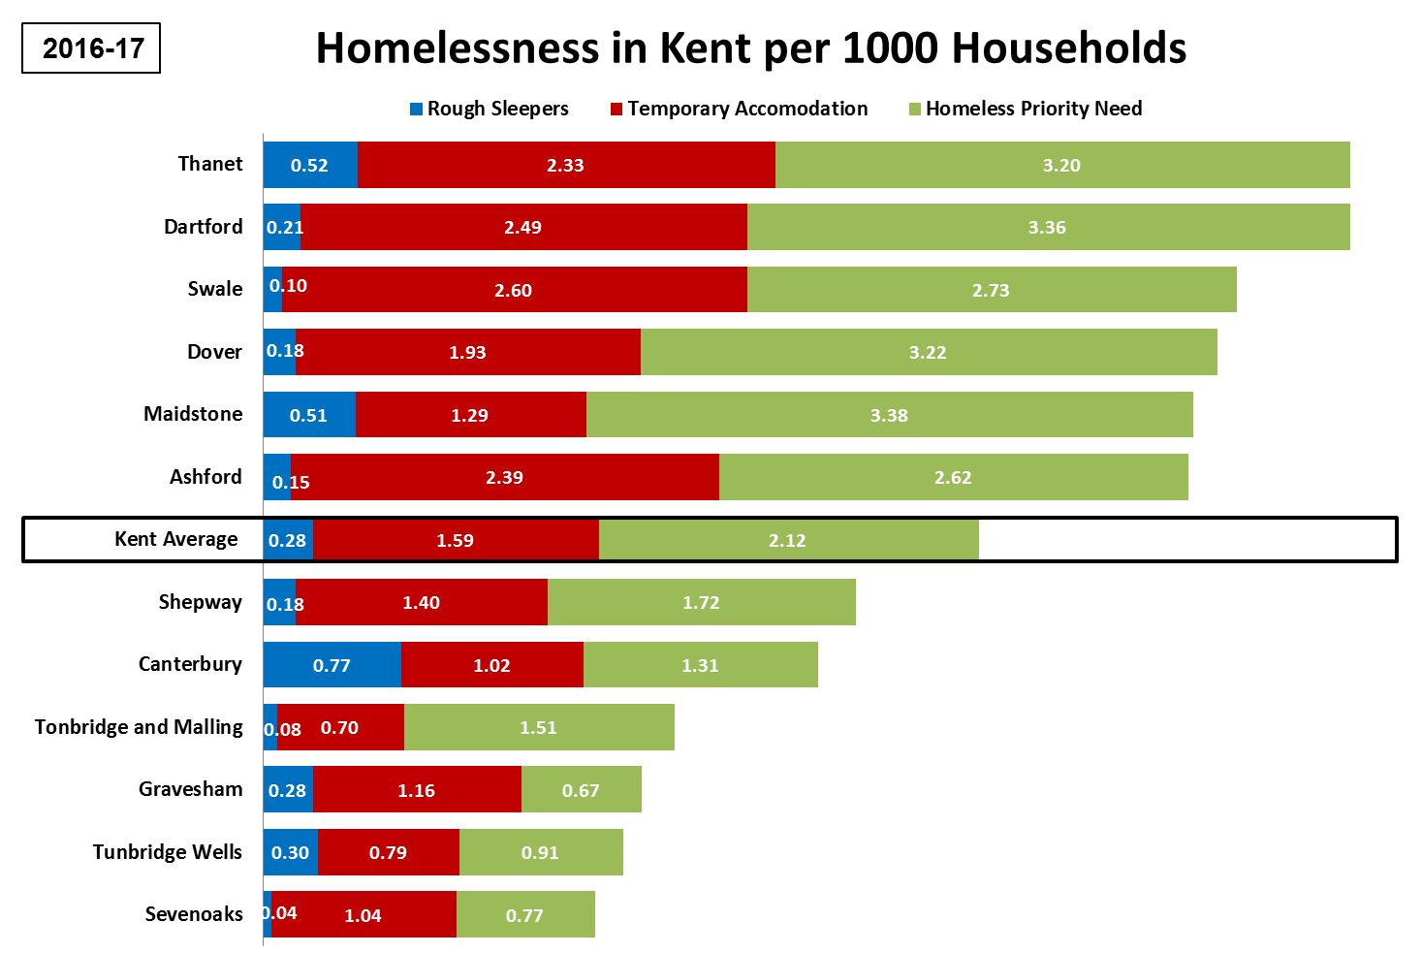

Slide 4
Kent County Council commissions a range of housing related support services (HRS) for vulnerable homeless adults and young people, including offenders. The service models used are floating support, outreach and accommodation based services. The council pays for the support delivered in these services rather than bricks and mortar. Broadly, these services are in the legacy position they were in 2003 when Supporting People went live. In adults services, the current models and funding arrangements are outdated and no longer fit for purpose. Services operate in isolation, without networks and lack the flexibility to offer new and innovative interventions and approaches required by those with the most complex needs, e.g. Housing First, Psychologically Informed Environments and Trauma Informed Care. Young people services need to be reshaped so that they prioritise care leavers and homeless 16/17 year olds to support 16/17 protocol, whilst enabling the county council to meet its corporate parenting duties. Together, these preventative services support a broad range of public sector agencies including, social care, police, public health, NHS and CCGs.
Background

Slide 5
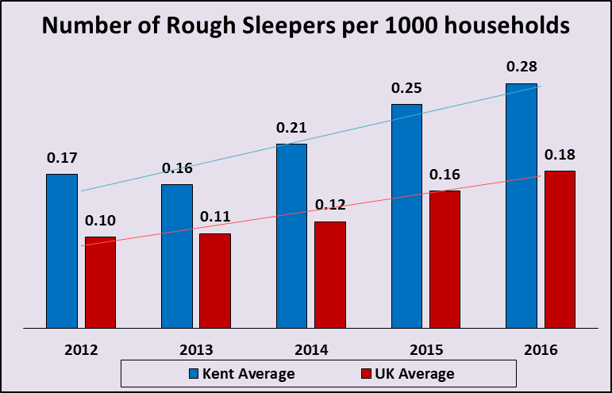
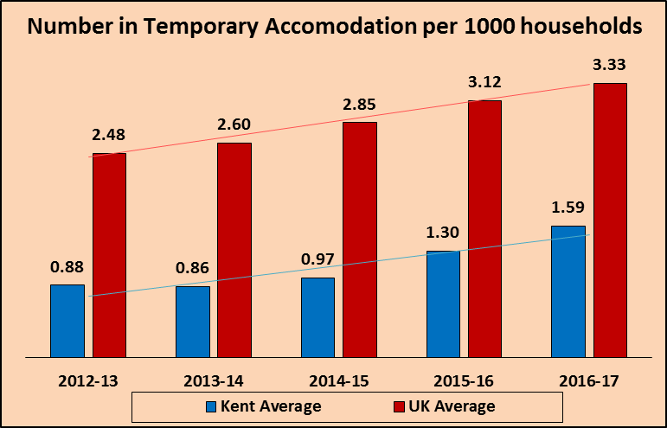
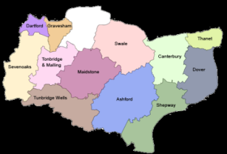
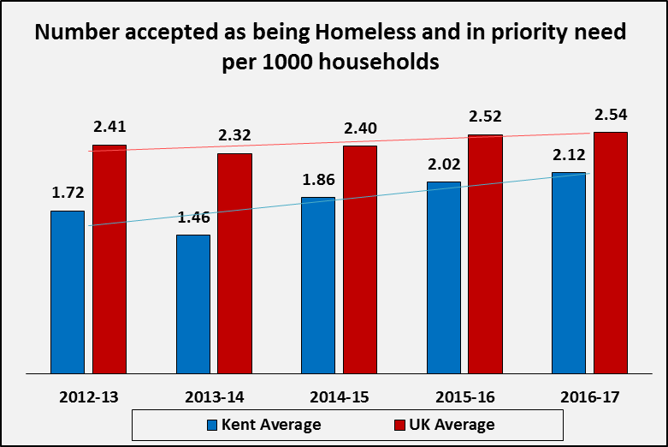
Kent
Service Name | No. Contracts in Kent | Total Contracted capacity | Total Contract Value 16-17
Generic Floating Support | 2 | 1015 | £1,249K
YP Floating Support | 2 | 138 | £2,12K
BME Floating Support | 2 | 42 | £83K
Rough Sleeper Outreach | 2 | 74 | £1,32K
Homeless Supported Housing | 20 | 340 | £2,686K
Offender Supported Housing | 9 | 80 | £629K
Teenage Parent Supported Housing | 5 | 29 | £273K
YP Supported Housing | 18 | 306 | £2,321K
Total | 60 | 2024 | £7,589K

Slide 6
Current housing related support for adults include: - 20 short term supported housing services, providing 340 bed spaces of accommodation in hostels and shared houses - 9 Offender short term accommodation services providing 80 bed spaces - 4 floating support services delivering community based support to 1,057 households at risk of homelessness - 2 rough sleeper outreach services supporting 74 entrenched rough sleepers. Housing related support for young people include: - 23 short term accommodation services providing 335 bed spaces of accommodation - 2 floating support services delivering community based support to 138 young people at risk of homelessness - a supported lodgings service With the emphasis on YP services about to change, there is a need to reshape services to support vulnerable homeless adults who are 18+
Current Services

Slide 7
Planning Recovery from Homelessness
Risk Assessment, Support Plans and Outcomes
Economic Wellbeing
Enjoy and Achieve
Be Healthy
Stay Safe
Positive Contribution
Maximise Income
Participate in training/ education
Manage physical health
Maintain accommodation
Develop confidence and choice
Reduce Debt
Participate in informal learning
Manage mental health
Secure settled accommodation
Obtain Paid Work
Establish contact with external groups
Manage substance misuse
Comply with statutory orders
Establish contact with Family
Use technology to maintain independence
Avoid harm/causing harm to others

Slide 8
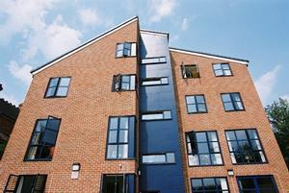
Supported Accommodation - Colebrook Road,
Tunbridge Wells
Hostel for vulnerable single homeless people with support needs
Purpose built; landlord Moat Homes, support provider Lookahead
13 bedrooms, communal spaces, laundry, training facilities, office
Open referral arrangements
Staff on duty 24 hours – complex cases, high level of need
Residents are supported through a range of outcomes, identified on personal support plans and regularly reviewed
E.g. understand and abide by tenancy, secure permanent accommodation, resettlement into the community in a settled way of life, access employment, education
Resettlement support to those who move on; outreach to those on the waiting list

Slide 9
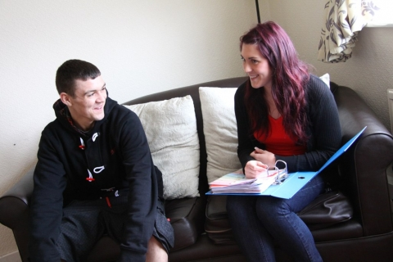
Floating Support - Sanctuary Support
Avoiding eviction
Resettlement post care/institutional/support setting
Securing an appropriate tenancy / occupancy
Tenancy sustainment
Promoting understanding of occupancy obligations
Maintaining safety & security of home
Budget management skills
Claiming benefits/maximising income
Dealing with official correspondence
Accessing health and wellbeing services
Facilitate access to education/training/work
Link to community based assets
Establish/re-establish appropriate links with family and friends
Address offending behaviours
Promotion of a healthy lifestyle

Slide 10
Rough Sleeper Outreach - Porchlight
Gain tenancy/accommodation
Access appropriate services according to need
Improve physical/mental wellbeing, and improve personal & social functioning
Claim benefits/maximise income
Facilitate access to education/training/work
Link to community based assets / organisations
Enable people to establish/re-establish appropriate links with family and friends
Address offending behaviours
Facilitate initial access to health services
Promotion of healthy lifestyle

Slide 11
Engagement and consultation
Engagement events began in January 2016
Best practice examples, locally, nationally
Meetings with district reps and other partners throughout Spring/Summer 2017
Stakeholder engagement events in November 2017
Now consulting on commissioning options Public Consultation opened 22 January – 4 March
http://www.kent.gov.uk/homelessnessconsultation

Slide 12
What we learned….
You said…
Single point of access and referral
Longer contracts to lend stability and allow for innovation
Use community assets more
Improved void awareness
Deliver more flexible recovery models of support
Focus on strengths based personalised outcomes for people
Pool other sources of funding
Continuity of support for people throughout their recovery journey
Clarity of pathway from access to exit
Continue to engage with stakeholders throughout process
Consolidate contracts whilst retaining local flavour

Slide 13
Commissioning Options
Option 1: Recommission services in the existing way
Benefits of doing this: | Negative things about doing this:
Minimal disruption of services Current services deliver good outcomes for people | Some areas in Kent might continue to not have enough services It won’t allow us to join up services easily for people that need lots of different types of support
Option 2: Join up services on an area basis
Support services funded by KCC in an area would join up and work together
Benefits of doing this: | Negative things about doing this:
A single point of access so people don’t have to have lots of assessments Funding could be joined together and used by housing, health, community safety and criminal justice organisations. This means they could deliver a wrap-around service to people, meeting all their support needs | If money can only be used in one area, it means we won’t be able to be flexible and put more resources into other areas if they need more (e.g. if there are more people that start needing support) This might pose challenges for people using the services if they need to move between different areas in Kent
Option 3: Join up services into single county-wide provision
support services funded by KCC would join up and work together across the whole of Kent.
Benefits of doing this: | Negative things about doing this:
Consistent standard of support all over Kent A single point of access so people don’t have to have lots of assessments Resources could be used across Kent where needed depending on demand | A possibility that the contract is awarded to a large organisation which could impact the work of smaller organisations

Slide 14
Next steps – ambitious timeline!
Public Consultation Online Questionnaire Public space drop ins Service user focus groups Support staff focus groups | Ends 4 March
Co-Design Workshops Models Collaboration Outcomes Measurement | 19 – 27 February
Procurement of new service begins | May 2018
Contract Award | July 2108
New services in place | 1 October 2018

Slide 15
Don’t forget - Public consultation and events open til 4 March Find out all about it here http://www.kent.gov.uk/homelessnessconsultation Not signed up for our weekly bulletin? - email: supportingpeopleteam@kent.gov.uk

