Slide 1

Frank Czarnowski
Notes:
Not selling PlaceShapers
Update
PlaceShapers journey and Kent Housing Group
Collaboration – powerful – achieve more than alone
Contribution – get out what you put in
Obvious – underpins value of PlaceShapers and Kent Housing Group

Slide 2
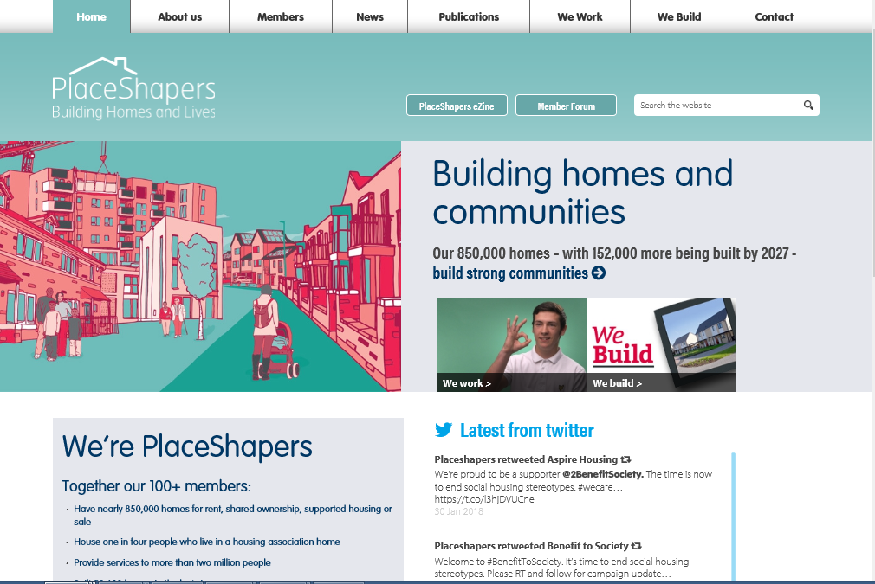
Notes:
National network of 119 community based housing associations.
More than 25% of people who live in a housing association home in England
Our services are used by more than two million people.
Board of 10
Joining is easy and cheap – but requires commitment.
CEO application – Board approval
PlaceShapers are distinctive. We build more than homes - we shape communities and unite around shared values as a voice for change.
A voice for change – therein lies a story

Slide 3
Notes:
2007
My predecessor - Former Chair KHG
External landscape – mergers – Housing Corporation going – development partners – regulatory framework – Future Shape of the Sector Commission
Change
A voice for change – how to get heard
Care about – share – want to do
KHG - Voice of Housing in Kent’ ‘Kent perspective’
South East focussed

Slide 4
Notes:
■ There is definitely a place for good community based HAs who will engage from the top in effective partnership working. Where they succeed they are very highly valued
■ HAs of all sizes are capable of providing excellent services that LAs want
■ To achieve this they must be prepared to focus their efforts on defined geographical areas where they have sufficient resources and presence to make a difference
■ Size is not a determinant of success. Big is not necessarily best. This is consistent with previous research results
■ Mid-sized community based housing associations are important developers of new housing. Their good relationships with LAs, other agencies and people living in the communities where they work can help them to develop more difficult sites.

Slide 5
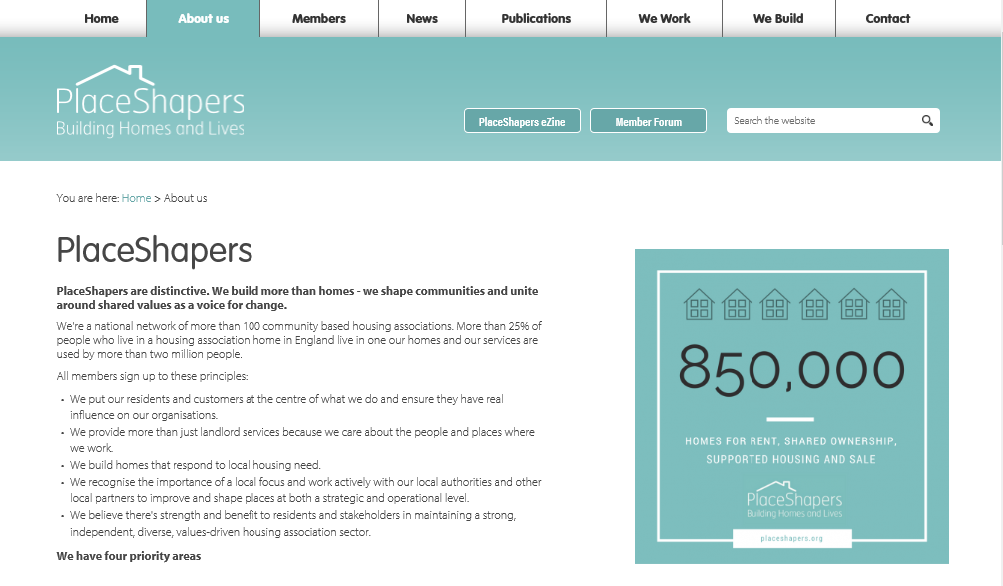
Notes:
2008 PlaceShapers launched
We put our residents and customers at the centre of what we do and ensure they have real influence on our organisations.
We provide more than just landlord services because we care about the people and places where we work.
We build homes that respond to local housing need.
We recognise the importance of a local focus and work actively with our local authorities and other local partners to improve and shape places at both a strategic and operational level.
We believe there's strength and benefit to residents and stakeholders in maintaining a strong, independent, diverse, values-driven housing association sector.
We Build We Work We Care We Share
National

Slide 6
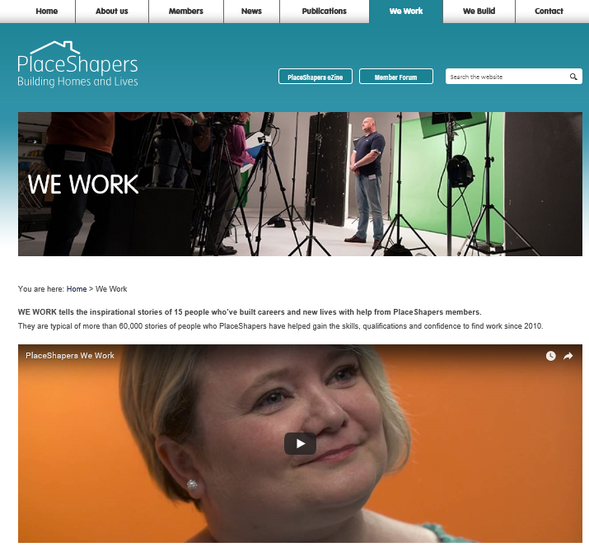
Notes:
Shaping communities – lots of HAs do training and employment – untold story
Demonstrating impact
WE WORK tells the inspirational stories of 15 people who’ve built careers and new lives with help from PlaceShapers members.
They are typical of more than 60,000 stories of people who PlaceShapers have helped gain the skills, qualifications and confidence to find work since 2010
Our business is providing affordable homes and services that build local communities. Supporting people into work saves public money on welfare and health budgets, and boosts wellbeing.
We don’t just build homes, we build lives.
Govt priorities – local politicians

Slide 7
Notes:
Political priority no. 1
PlaceShapers punch their weight
Some think we don’t build new homes – just community stuff - wrong
PlaceShapers build smaller schemes to complement the contribution of volume housebuilders
Over a 10-year period, PlaceShapers are ramping up to deliver an additional 152,000 new homes by 2027, almost doubling our recent output.
This included an internet-based survey of 118* PlaceShapers’ CEOs with 102 returns, an 86% response rate.

Slide 8

Notes:
We Care: Welfare reform & poverty: Supported housing: Health & housing integration: 2018 publication - June
We Share: Policy development; Partnership engagement; Value for Money and efficiency; Learning from others:
Supported Housing funding – call for evidence – contribution – select cmte – influential – Kent perspective – consultation 10 people
Regulator of Social Housing – fees advisory panel – quarterly liaison
Tenant engagement – housing minister – NHF offer to tenants – crowded space – lead / follow – TPAS -
PlaceShapers involvement – not boast – dream – C and C - communications teams
Future Shape of the Sector Commission – better inside the tent

Slide 9
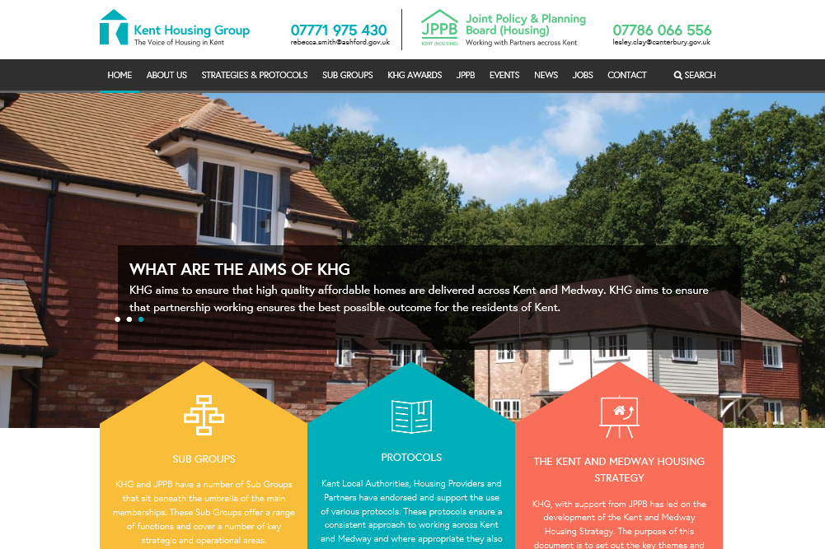
Notes:
‘Voice of Housing in Kent’ ‘Kent perspective’
Same – bigger collaboration / different – need your own voice
KHG – important for West Kent – board responsible for strategic direction – housing strategy – Adult accommodation strategy –
Protocols – rural housing – Build Local 2012 – rural housing protocol
CEO report

Slide 10


Our vision is to be the leading community provider of affordable homes in Kent
Notes:
Vision – ignore 1st half
Community provider of affordable homes in Kent
PlaceShapers and KHG are fantastic collaboration vehicles for us at West Kent to realise vision
We will contribute – and get out much more than we put in
Decade ago – sensed that something was missing – helped to create PlaceShapers
Today - if KHG didn’t exist we at West Kent would want to invent it.

