Slide 1
Michael Cleaver
Director, The Housing Forum
Working with NHBC
Notes:
Cover with picture mainly white sent to the back
1 speaker from THF

Slide 2
our work
current sector issues
initiatives
Working with NHBC
Notes:
Cover with picture mainly white sent to the back
1 speaker from THF

Slide 3
our work
current sector issues
initiatives
Working with NHBC
Notes:
Cover with picture mainly white sent to the back
1 speaker from THF

Slide 4
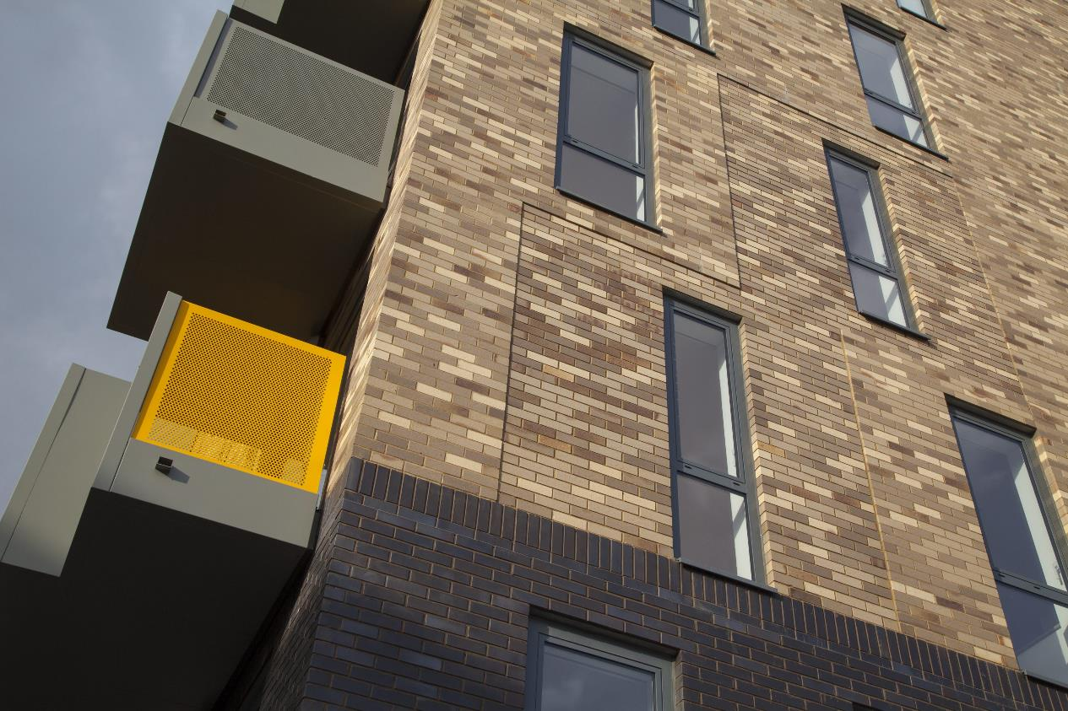
A unique cross-sector membership organisation, which seeks improvement in the quality and number of homes built, with a particular focus on affordable homes.
Notes:
Quote central panel

Slide 5
Members
Housing Providers
Developers, Housebuilders & Contractors
Specialist
Consultants
Local Authorities
Birmingham City Council
Hull City Council
Kent Housing Group
- Ashford Borough Council
- Canterbury City Council
- Dartford Borough Council
- Dover District Council
- Gravesham Borough Council
- Kent County Council
- Maidstone Borough Council
- Medway Council
- Sevenoaks District Council
- Shepway District Council
- Swale Borough Council
- Thanet District Council
- Tonbridge & Malling Borough Council
- Tunbridge Wells Borough Council
Greater Manchester Combined Authority
- Bolton Metropolitan Borough Council
- Bury Council
- Manchester City Council
- Oldham Council
- Rochdale Borough Council
- Salford City Council
- Stockport Metropolitan Borough Council
- Tameside Metropolitan Borough Council
- Trafford Council
- Wigan Council
Clarion Housing Group
Cross Keys Homes
East Thames Ltd
ELM Group
emh Group
Family Mosaic/Peabody
Guinness Partnership
Hexagon Housing Association
The Hyde Group
Newlon Housing Trust
Octavia
PA Housing
Places for People Group
Rochdale Boroughwide Housing
Saxon Weald
Southern Housing Group
Sovereign Housing Association
Swan Housing Group
Thames Valley Housing Association
Town & Country Housing Group
Wandle Housing Association
Waterloo Housing Group
whg
Worthing Homes
Bouygues UK
Bugler Developments
Durkan
Galliford Try
Hill Group
Ian Williams
Keepmoat Regeneration part of the ENGIE Group
Kier Living
Kind & Company Builders
Mears New Homes
Osborne Homes
Rydon Group
Sanctuary Maintenance Contractors
TSG Building Services Limited
Wates Living Space
Wates Residential
Willmott Partnership Homes
Airey Miller
Arcadis LLP
Arcus
Ark Housing Consultancy
Baily Garner
BLP Insurance
BM3 Architecture
bptw partnership
calfordseaden LLP
Conisbee
Foot Anstey LLP
Hawkins\Brown Architects
HTA Design LLP
Hunters
Levitt Bernstein
Martin Arnold
MDA Consulting Ltd
NHBC
Pollard Thomas Edwards
PRP
Robust Details
Rund Partnership Ltd
Silver
Trowers and Hamlins LLP
Waind Gohil + Potter Architects
Waterstons
Greater London Authority (GLA)
- London Borough of Barking & Dagenham
- London Borough of Barnet
- London Borough of Bexley
- London Borough of Brent
- London Borough of Bromley
- London Borough of Camden
- London Borough of Croydon
- London Borough of Ealing
- London Borough of Enfield
- London Borough of Hackney
- London Borough of Hammersmith & Fulham
- London Borough of Haringey
- London Borough of Harrow
- London Borough of Havering
- London Borough of Hillingdon
- London Borough of Hounslow
- London Borough of Islington
- London Borough of Lambeth
- London Borough of Lewisham
- London Borough of Merton
- London Borough of Newham
- London Borough of Redbridge
- London Borough of Richmond upon Thames
- London Borough of Southwark
- London Borough of Sutton
- London Borough of Tower Hamlets
- London Borough of Waltham Forest
- London Borough of Wandsworth
- Royal London Borough of Greenwich
- Royal London Borough of Kensington & Chelsea
- Royal London Borough of Kingston upon Thames
- City of London
- City of Westminster
Suppliers, Manufacturers & Service Providers
Aggregate Industries
British Gypsum Forticrete
Fusion Building Systems
Luceco
ORCA LGS Solutions
Polypipe Group
SE Controls
Structural Timber Association
Switch2 Energy Limited
Tobermore Concrete Products
Travis Perkins Managed Services
Worcester Bosch
Investors
Legal & General Property
Octopus QSH
South East Midlands Local Enterprise Partnership (SEMLEP)
Notes:
Full image with black heading bar

Slide 6
Events
Notes:
Full image with black heading bar

Slide 7
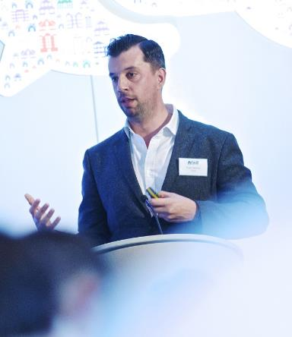
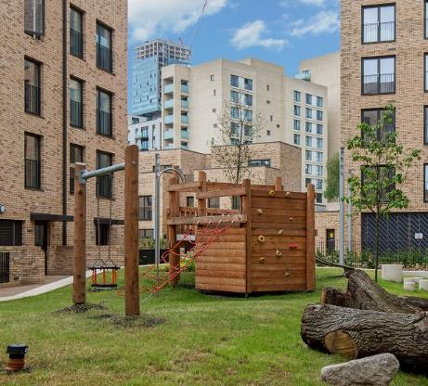
Events
National Conference - 23 May - London
Development Partnership Forums
Affordable Housing Group with NHBC
Regional Forums
Innovation Forums
Chief Executive Roundtables
Specialist Topic Seminars
Leadership Seminars
Notes:
Quad images on right

Slide 8
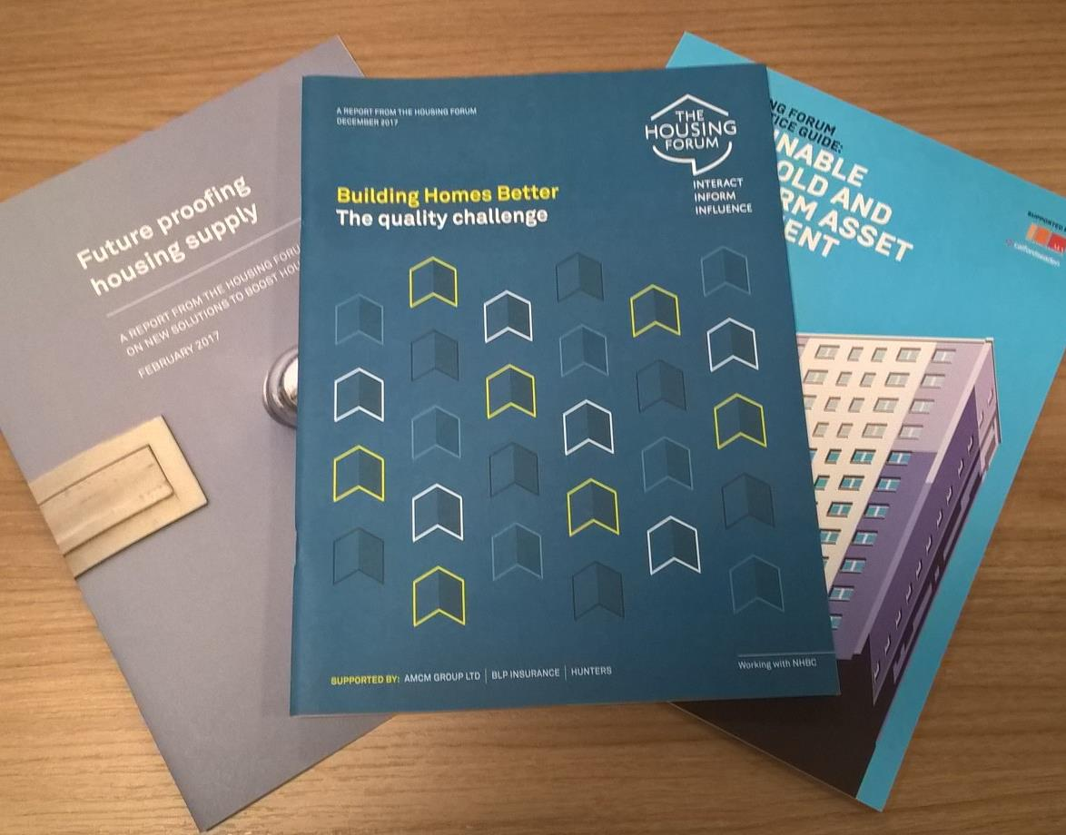
Working Groups & Best Practice
Notes:
Full image with black heading bar

Slide 9
Influencing
MCHLG, GLA and Homes England observers at Board
Chief Exec on CLC working group
Round tables and advice notes to Ministry and senior civil servants
Promoting the industry and highlighting the cross-sector issues facing it
Work with Build Offsite and BIM4Housing to promote smart housing agenda
Notes:
Quad images on right

Slide 10
our work
current sector issues
initiatives
Working with NHBC
Notes:
Cover with picture mainly white sent to the back
1 speaker from THF

Slide 11
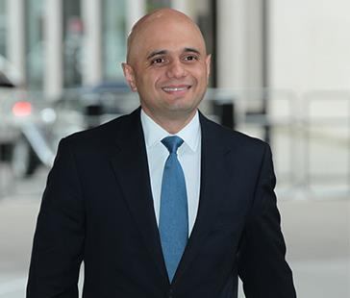
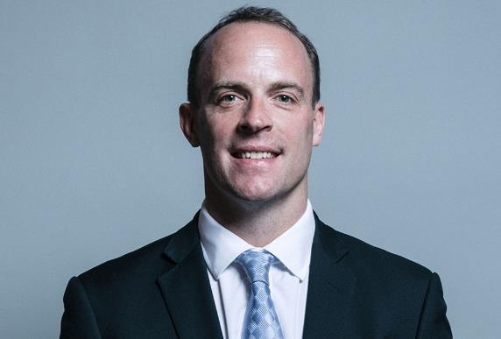
political
Notes:
Half page image on right

Slide 12
economic
Notes:
Half page image on right

Slide 13
social
Notes:
Half page image on right

Slide 14
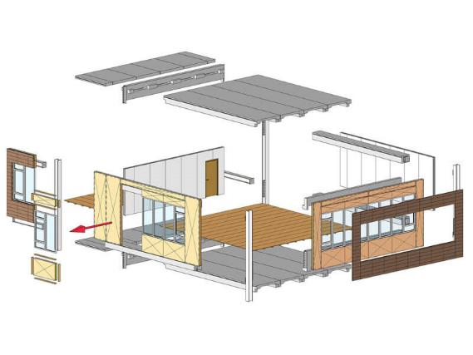
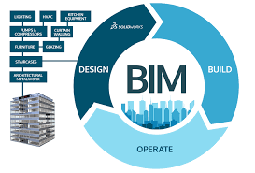
Technological
Notes:
Half page image on right

Slide 15
our work
current sector issues
initiatives
Working with NHBC
Notes:
Cover with picture mainly white sent to the back
1 speaker from THF

Slide 16
Preventing Building Failures
Future of Retirement Housing
Coproduction and New Models of Regeneration
BIM4Housing
Notes:
Quote central panel

Slide 17
Thank you.
michael.cleaver@housingforum.org.uk
@thehousingforum
www.housingforum.org.uk
Working with NHBC
Notes:
Cover with picture mainly white sent to the back
1 speaker from THF

