Slide 1
Kent Housing Group 3 October 2018
Andrew Scott-Clark
Director of Public Health

Slide 2
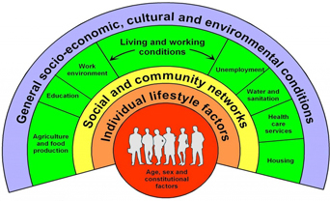
Social Determinants of Health

Slide 3
One You Kent: Health improvement services
Background
Lifestyle choices compound each other often, which leads to poorer health earlier in life
Key priorities for us are smoking, diet, exercise and excessive alcohol consumption
One You brand recognises people holistically, not as just smokers or obese
Brand for social prescribing of Lifestyle Interventions
Great to see KHG recognise One You brand in the presentation ceremony recently and are truly collaborative.

Slide 4
Other PH Priorities
1) Making Every Contact Count
An approach to behaviour change that utilises the millions of day to day interactions that organisations and people have with other people to encourage change in behaviour that have a positive effect on health & wellbeing of individuals, communities and populations.
2) Smoking and obesity: NHS Sustainability Transformation Plans
In order to reduce the prevalence of smoking, obesity and related ill health e.g. diabetes and cardiovascular disease
3) Physical activity increase and Reducing excessive alcohol consumption.
4) Air quality: Both indoors and outdoors.
Working with colleagues in GET, Medway and Districts on an Energy and Low Emissions Strategy
5) Suicide Prevention/Parity of Esteem
Kent is an outlier for rate of suicides
Continue to build on Release the Pressure Campaign
Mental First Aid Training being rolled out far and wide
6) Improving LD Outcomes
- LeDeR

