Slide 1
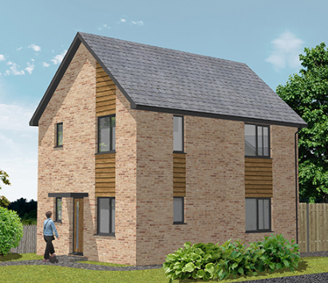
SMART SHARING FROM TCHG Colin Lissenden, Development Director
Town and Country Housing Group

Slide 2
BRIEF HISTORY
Born as High Weald Housing Association in 1990. LSVT from Tunbridge Wells buying circ 5,000 homes
First 10 years were spent:
Investing in catch up repairs
Processing RTB purchases
Trying to develop with strict banking covenants
Town and Country Housing Group

Slide 3
Since 2000
Released from original loans and secured finance from Nationwide to grow.
Expanded area of operation to cover Kent.
Established regional satellite in East of County.
Now
9,500. 5,000 of which have been built by TCHG.
Very low management and maintenance costs due to low average age of our homes and regional focus.
Continue to see our mission as providing as many affordable homes as possible.
Town and Country Housing Group

Slide 4
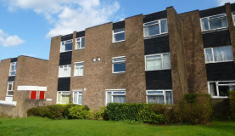
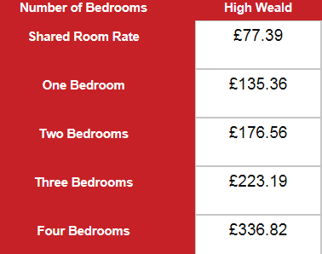
REGIONAL CONTEXT
Tunbridge Wells single person under 35 £77pw.
Cheapest 1 bed social home. £101pw.
Town and Country Housing Group

Slide 5
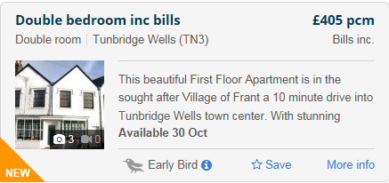
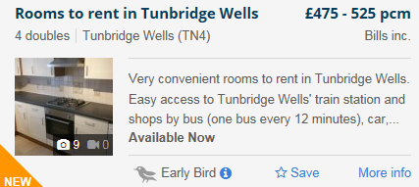
POSSIBLE OPTIONS
Initiative to support links with private sector.
Cheapest sharing offer in private sector. £85pw
56 available 27 September 2017
Average £130 pw
30% percentile £110 pw
Town and Country Housing Group

Slide 6
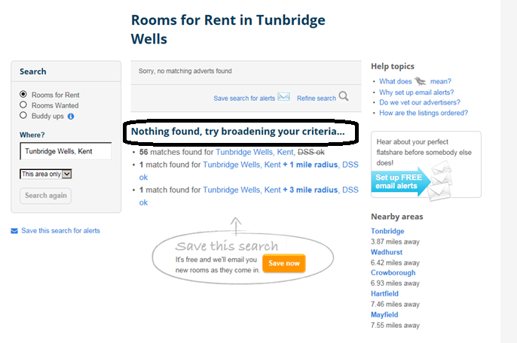
Town and Country Housing Group

Slide 7
POSSIBLE OPTIONS
Convert current homes into shared units.
Rent would be valued at £77 pw given the market.
Very limited homes available to convert fairly.
Older persons stock unsuitable to convert due to archiac ? Standards and local nimbyism.
Wanted to avoid HMO provision due to :
Limited exit strategy
Strain on management costs.
Town and Country Housing Group

Slide 8
POSSIBLE OPTIONS
Build our own.
Again didn’t want HMOs.
Needed a strong exit strategy.
Wanted a product which could be adopted within S106 provision.
Opportunity to design a fair product.
£3k more to build compared to a standard 2 bed house.
Town and Country Housing Group

Slide 9
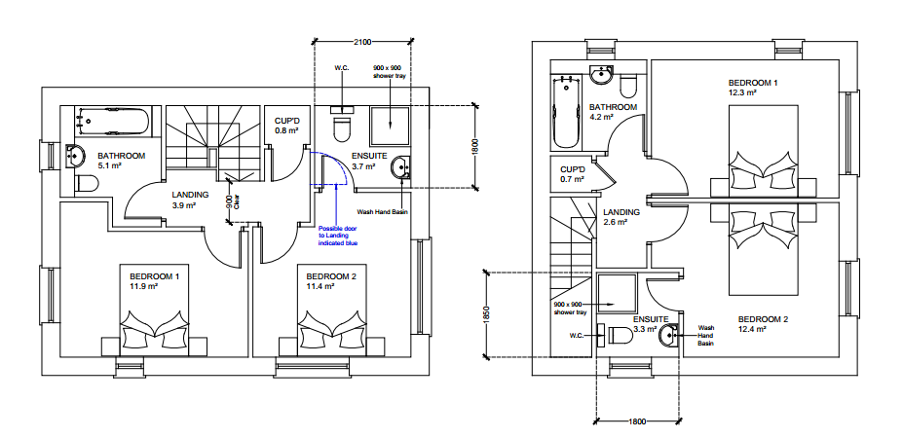
SMART SHARING
Specification upgrades.
Flooring provided throughout.
Oven, hob and extractor provided.
No other white goods.
Service charges minimised.
Free WIFI*.
Town and Country Housing Group

Slide 10
MANAGEMENT, MAINTENANCE & FINANCIAL ASSUMPTIONS
2 lets, 2x management costs.
Lifecycle costs remain unchanged.
Voids and bad debts @ 4.5%.
Response repair assumption doubled.
Discount rate unchanged due to exit strategy.
Town and Country Housing Group

Slide 11
HOUSING SUPPORT
General Housing Support provided. Treat people like adults.
Employment and skills support via TCHG Foundation and other agencies, also support provided for independent living.
Charities engaged to support furniture and white good requirements. Including lawnmowers!
6 month AST provided. Once over 35 tenancy will end and move on, support provided.
LA engaged to support exit strategy.
No ambition to evict.
Not temporary housing, but not permanent either.
Need to assess case by case should employment be secured.
Town and Country Housing Group

Slide 12
FINANCIAL CASE
Don’t do it! You are purposefully reducing your potential income in an already challenging environment.
Needs Investment/Subsidy
Use of land assets
Grant subsidy
S106
Justification via social value benefits. The added social value for building a smart sharing home compared to a 2 bed affordable rent house is circ. £25k (HACT).
Town and Country Housing Group

Slide 13
CURRENT AND FUTURE AMBITIONS
This is a pilot but with the deadline of April 2019 fast approaching.
We will review as we go.
We have 7 on site and in construction. 3 more due to start this year. 5 with grant, 2 via S106 delivery.
First homes due March 2018.
Plan is for 10 per year. Cost model should reduce as the design is now part of our standard house type project.
FINAL POINT.
This may not work for you, but no action, is not an option.
Town and Country Housing Group

