Slide 1
Kent Housing Group Excellence Award nomination
West Kent Hospital Discharge Scheme
a partnership between
Tonbridge & Malling B.C., Tunbridge Wells B.C., Sevenoaks D.C., Maidstone and Tunbridge Wells NHS Trust & Family Mosaic

Slide 2
I just want to go home…. working together we are enabling this to happen…

Slide 3
The Health & Housing Coordinator, Danielle, at the heart of Tunbridge Wells Hospital Integrated Discharge Team.

Slide 4
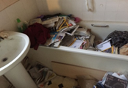
Practical interventions
Before and after……..
Declutter and clean then bathboard provided to aid with independent living.

Slide 5
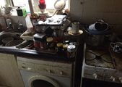
Practical interventions
Before and after……..
Declutter and clean then engage with local agencies e.g. Age UK and Good Neighbour Scheme to assist with ongoing cleaning.

Slide 6
Partnership Working

Slide 7
Its working.…

Slide 8
Its working.…

Slide 9
Kent Housing Group Excellence Award nomination
West Kent Hospital Discharge Scheme
Thank you for shortlisting us and listening!

