Slide 1

The Rental Exchange
Notes:
Title slide [uses Title Slide (Background Image) layout]
The brand mark and data art graphic on this slide layout are set up at the correct size and position and should not be altered.
The presentation title appears in Arial (Experian Dark Blue); other presentation details should be in Arial (Grey) and separated by a single line space, as shown in this example. It is important to ensure that the title and supporting text is always fully legible on an image background.
The background image has been placed in the slide layout master as a ‘background fill’; this can be edited by right-clicking the background image area and choosing ‘Format Background…’ from the context menu to replace the image. The full-colour brand mark and data art graphic must always appear on a light-coloured background with maximum legibility; image backgrounds should be carefully selected with this in mind.

Slide 2
What is the Rental Exchange?
“There are millions of people who are excluded from affordable credit because they don’t have a credit history.
For the financially excluded, this is a Catch 22 situation: without a credit score applicants are declined by mainstream providers and are considered riskier customers, but the only way to build a credit score is to access some form of credit, such as a mortgage or credit card.”
Notes:
Back in 2010 the Big Issue Invest wanted to look at why Social Housing Tenants tend to pay the most for products & services in the UK.
There were 2 main reasons for this:
Tenants having a thin credit file due to pay as you go mobile phones, smart meters, post office accounts which therefore meant Credit Reference Agencies held no information on them
Tenants that do have credit agreements having a poor credit score
Working in partnership with the Big Issue Invest, Experian want to help combat this unfair exclusion and provide equality for home owners & renters in the uk.
Currently mortgage payers see their payments on their credit report and therefore can be at a huge advantage.

Slide 3
Millions of Social Housing Tenants in the UK face financial, digital and social exclusion.
One major cause of this is an information gap in their credit history, which can exclude low-income people from affordable credit.
They are more likely to be declined or pay a higher price for credit and other basic goods and services.
What is the Rental Exchange?
Notes:
Back in 2010 the Big Issue Invest wanted to look at why Social Housing Tenants tend to pay the most for products & services in the UK.
There were 2 main reasons for this:
Tenants having a thin credit file due to pay as you go mobile phones, smart meters, post office accounts which therefore meant Credit Reference Agencies held no information on them
Tenants that do have credit agreements having a poor credit score
Working in partnership with the Big Issue Invest, Experian want to help combat this unfair exclusion and provide equality for home owners & renters in the uk.
Currently mortgage payers see their payments on their credit report and therefore can be at a huge advantage.

Slide 4

What is the Rental Exchange?
1. The primary purpose is to assist financially excluded tenants, by using rental payment information to enhance credit scores and helping tenants to access more affordable mainstream credit and services.
2. The scheme also enables tenants to build an ‘online’ proof of identity, important when applying for forms of credit /insurance or when accessing government services.
3. For social landlords - opportunity to reward tenants for paying rent on time and help tenants to access cheaper credit and services.

Slide 5


What is a Credit Report?
Your credit report is a financial CV
It details credit you have taken out such as credit cards, loans and mortgages, along with your repayment history, any court judgments or bankruptcies against you.
Information on the following items is shown in your credit report:
  - Profile Details
  - Credit Accounts
  - Electoral Roll
  - Aliases
  - Financial Associates
  - Public Records
  - Previous searches of your report
Notes:
Contents slide [uses Contents Slide layout]
The brand mark and data art graphic on this slide layout are set up at the correct size and position and should not be altered.
The slide title appears in Arial (Experian Dark Blue); the contents list is in Arial (Grey), as shown in this example. Contents list items are numbered and continuous lines in an individual listed item will align with the text in the previous line.
The date and footer info can be edited across all slides by using the ‘Header and Footer’ settings on the ‘Insert’ ribbon (do not edit these manually on the individual slides).

Slide 6
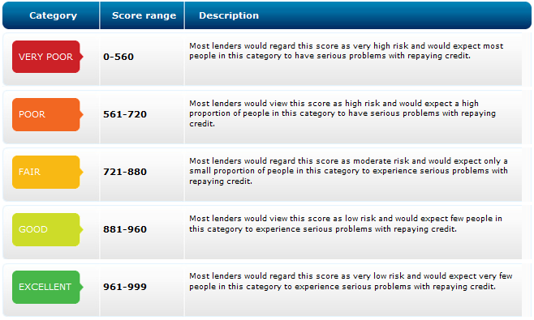
What is a Credit Report?
Before deciding whether or not to offer you credit, many organisations take your credit report, plus the details you give the lender on your application form to generate a credit score. This is a single figure that indicates how likely you are to repay what you owe.
Usually, the higher your score, the easier you will find it:
- To borrow
- Achieve better rates and deals
- Get better access to contracts
e.g. mobile phones/utilities
- Access Government services
Notes:
Contents slide [uses Contents Slide layout]
The brand mark and data art graphic on this slide layout are set up at the correct size and position and should not be altered.
The slide title appears in Arial (Experian Dark Blue); the contents list is in Arial (Grey), as shown in this example. Contents list items are numbered and continuous lines in an individual listed item will align with the text in the previous line.
The date and footer info can be edited across all slides by using the ‘Header and Footer’ settings on the ‘Insert’ ribbon (do not edit these manually on the individual slides).

Slide 7
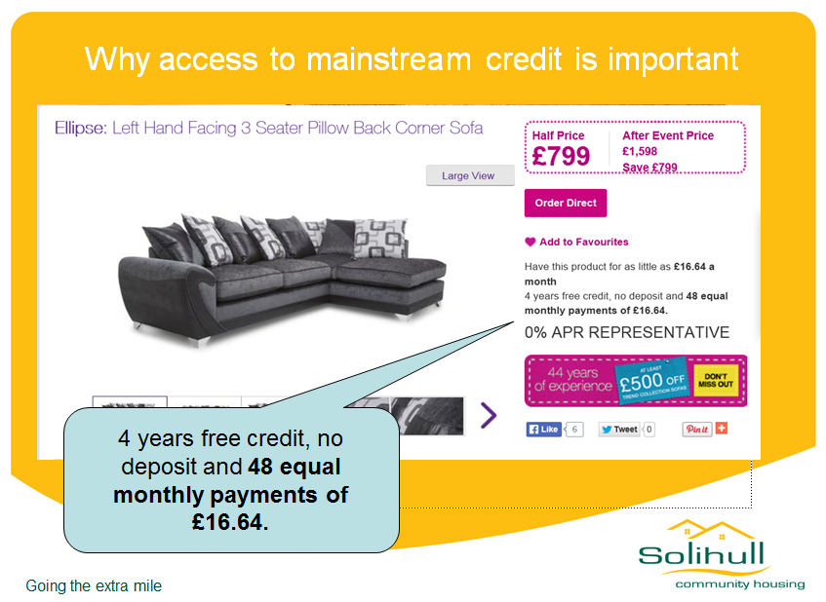
A quote for a sofa for someone with a good credit score
Notes:
Contents slide [uses Contents Slide layout]
The brand mark and data art graphic on this slide layout are set up at the correct size and position and should not be altered.
The slide title appears in Arial (Experian Dark Blue); the contents list is in Arial (Grey), as shown in this example. Contents list items are numbered and continuous lines in an individual listed item will align with the text in the previous line.
The date and footer info can be edited across all slides by using the ‘Header and Footer’ settings on the ‘Insert’ ribbon (do not edit these manually on the individual slides).

Slide 8
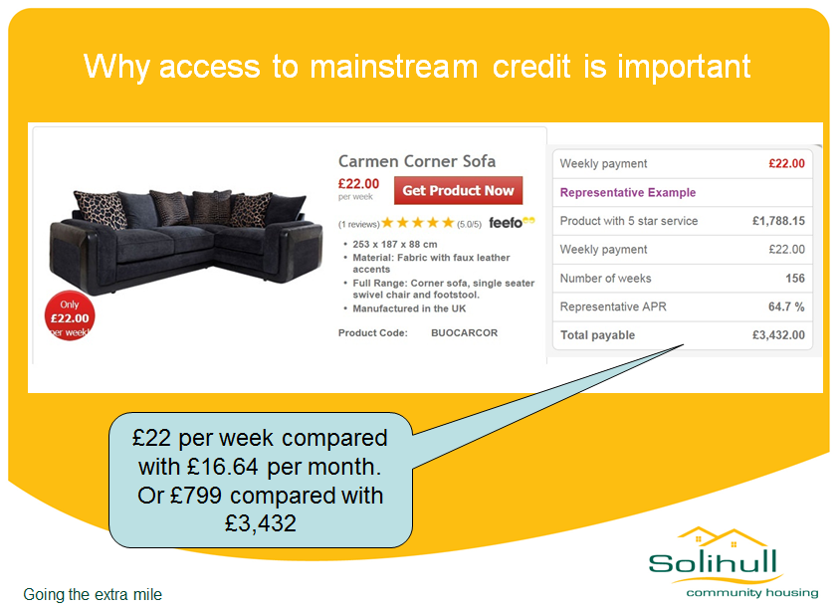
A quote for a sofa for someone with a poor credit score or thin credit file
Notes:
Contents slide [uses Contents Slide layout]
The brand mark and data art graphic on this slide layout are set up at the correct size and position and should not be altered.
The slide title appears in Arial (Experian Dark Blue); the contents list is in Arial (Grey), as shown in this example. Contents list items are numbered and continuous lines in an individual listed item will align with the text in the previous line.
The date and footer info can be edited across all slides by using the ‘Header and Footer’ settings on the ‘Insert’ ribbon (do not edit these manually on the individual slides).

Slide 9
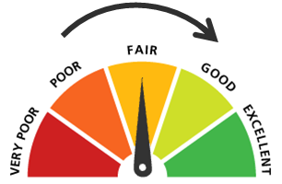
For Social Housing Tenants -
what does this mean?
A sample (c 432,000) of the rent payment records already shared with the Rental Exchange, from social housing providers, were added to a version of Experian’s credit scoring tool in a simulated credit bureau environment in order to assess the impact the information would have on credit scores.
Key findings:
63% of tenants have no significant arrears on their rent and their credit scores would improve as a result of incorporating rental data.
35% of tenants are on full Housing benefit and therefore would see no effect on their credit score but digital authentication would benefit
2% would see a reduction in their credit score- because of late rent payments
Notes:
Contents slide [uses Contents Slide layout]
The brand mark and data art graphic on this slide layout are set up at the correct size and position and should not be altered.
The slide title appears in Arial (Experian Dark Blue); the contents list is in Arial (Grey), as shown in this example. Contents list items are numbered and continuous lines in an individual listed item will align with the text in the previous line.
The date and footer info can be edited across all slides by using the ‘Header and Footer’ settings on the ‘Insert’ ribbon (do not edit these manually on the individual slides).

Slide 10
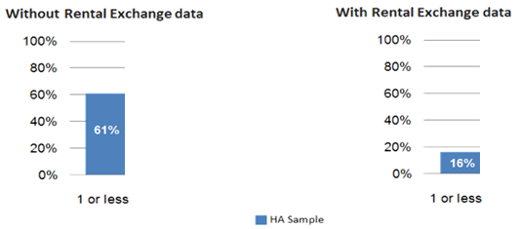

Electronic Proof of ID- Digital Authentication
Many lenders and other online service providers routinely use and rely on identity verification services that use credit history information as evidence of name and address and up to 61% of social housing tenants currently fail electronic identity checks to qualify for a range of basic, but vital services.
84% of tenants will be able to prove their identities, with rental payment information added to credit reports, compared to only 39% without.
Notes:
Contents slide [uses Contents Slide layout]
The brand mark and data art graphic on this slide layout are set up at the correct size and position and should not be altered.
The slide title appears in Arial (Experian Dark Blue); the contents list is in Arial (Grey), as shown in this example. Contents list items are numbered and continuous lines in an individual listed item will align with the text in the previous line.
The date and footer info can be edited across all slides by using the ‘Header and Footer’ settings on the ‘Insert’ ribbon (do not edit these manually on the individual slides).

Slide 11
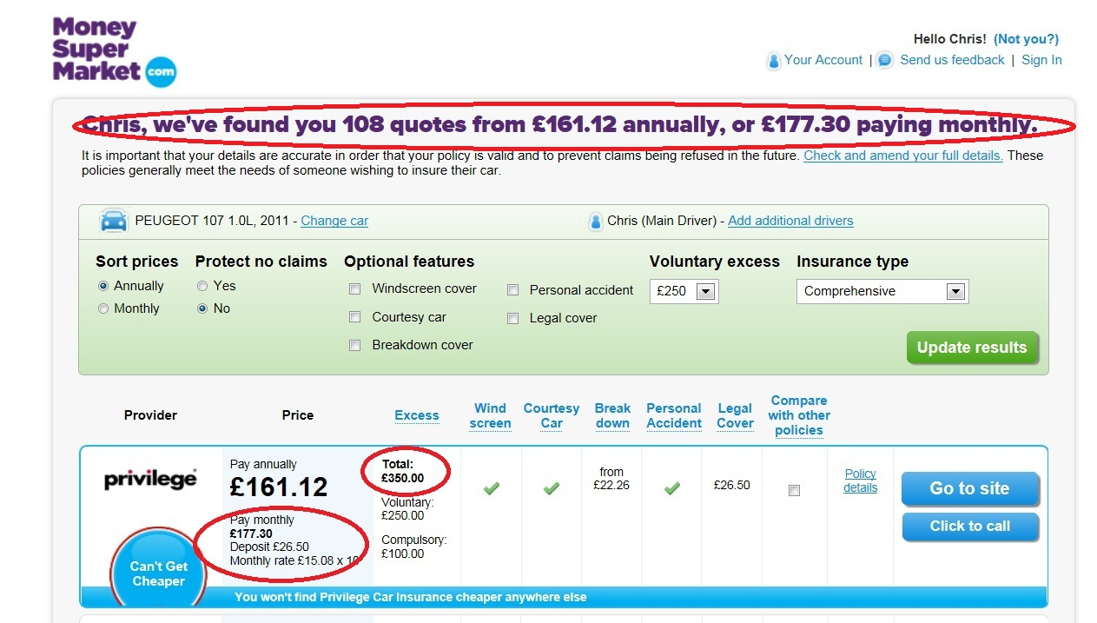
An Insurance quote with Digital Authentication
Notes:
Contents slide [uses Contents Slide layout]
The brand mark and data art graphic on this slide layout are set up at the correct size and position and should not be altered.
The slide title appears in Arial (Experian Dark Blue); the contents list is in Arial (Grey), as shown in this example. Contents list items are numbered and continuous lines in an individual listed item will align with the text in the previous line.
The date and footer info can be edited across all slides by using the ‘Header and Footer’ settings on the ‘Insert’ ribbon (do not edit these manually on the individual slides).

Slide 12
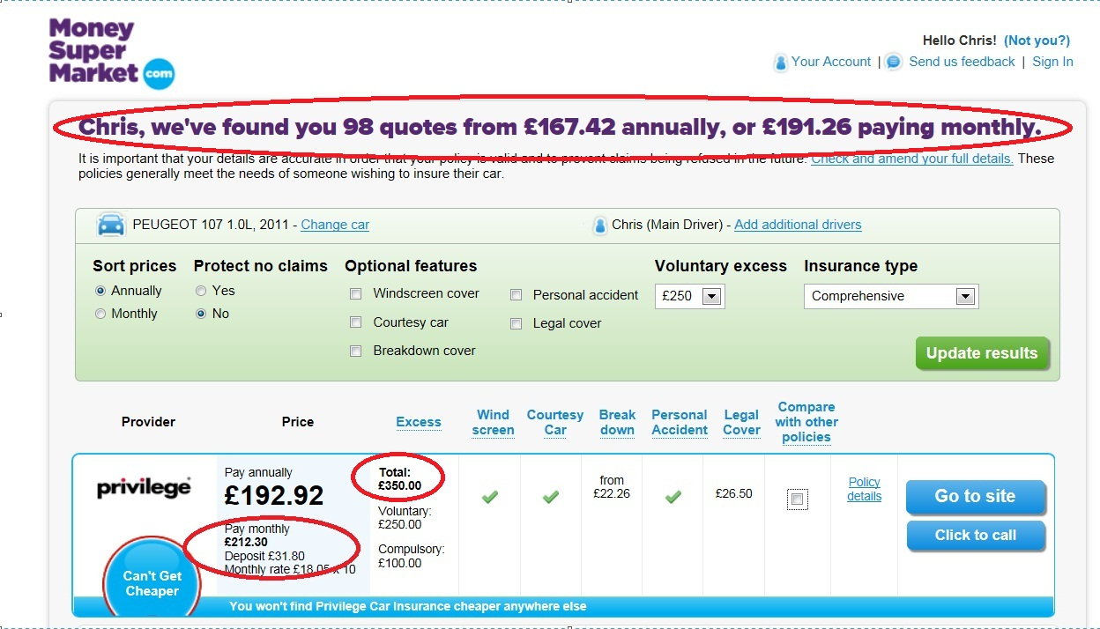
Without Digital Authentication - £30-£35 more
Notes:
Contents slide [uses Contents Slide layout]
The brand mark and data art graphic on this slide layout are set up at the correct size and position and should not be altered.
The slide title appears in Arial (Experian Dark Blue); the contents list is in Arial (Grey), as shown in this example. Contents list items are numbered and continuous lines in an individual listed item will align with the text in the previous line.
The date and footer info can be edited across all slides by using the ‘Header and Footer’ settings on the ‘Insert’ ribbon (do not edit these manually on the individual slides).

Slide 13

The Story so far…
Since the Rental Exchange launched in 2012:
119 Organisations have joined The Rental Exchange
Over 1.3 million rental records are live within Experian
225 organisations in the process of joining
Now launched within the Private Sector
Notes:
Contents slide [uses Contents Slide layout]
The brand mark and data art graphic on this slide layout are set up at the correct size and position and should not be altered.
The slide title appears in Arial (Experian Dark Blue); the contents list is in Arial (Grey), as shown in this example. Contents list items are numbered and continuous lines in an individual listed item will align with the text in the previous line.
The date and footer info can be edited across all slides by using the ‘Header and Footer’ settings on the ‘Insert’ ribbon (do not edit these manually on the individual slides).

Slide 14





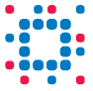

Data Protection Considerations
Explanation Requirement
The ICO recognise that tackling social, financial and digital exclusion issues through enabling tenants to use their information in a way that helps them is not something that should be prevented by the DPA, subject to tenants being provided with a very clear explanation of how this will benefit them.
Benefit Recognition
The unequivocal benefit to tenants is recognised by DPA ‘legitimate interests’ provisions (Data Protection Act 1998 Sch2 paragraph 6).
The Rental Exchange is based on protecting tenants’ data while at the same time enabling them to ensure organisations can use this data to support their application.
Notes:
Contents slide [uses Contents Slide layout]
The brand mark and data art graphic on this slide layout are set up at the correct size and position and should not be altered.
The slide title appears in Arial (Experian Dark Blue); the contents list is in Arial (Grey), as shown in this example. Contents list items are numbered and continuous lines in an individual listed item will align with the text in the previous line.
The date and footer info can be edited across all slides by using the ‘Header and Footer’ settings on the ‘Insert’ ribbon (do not edit these manually on the individual slides).

Slide 15
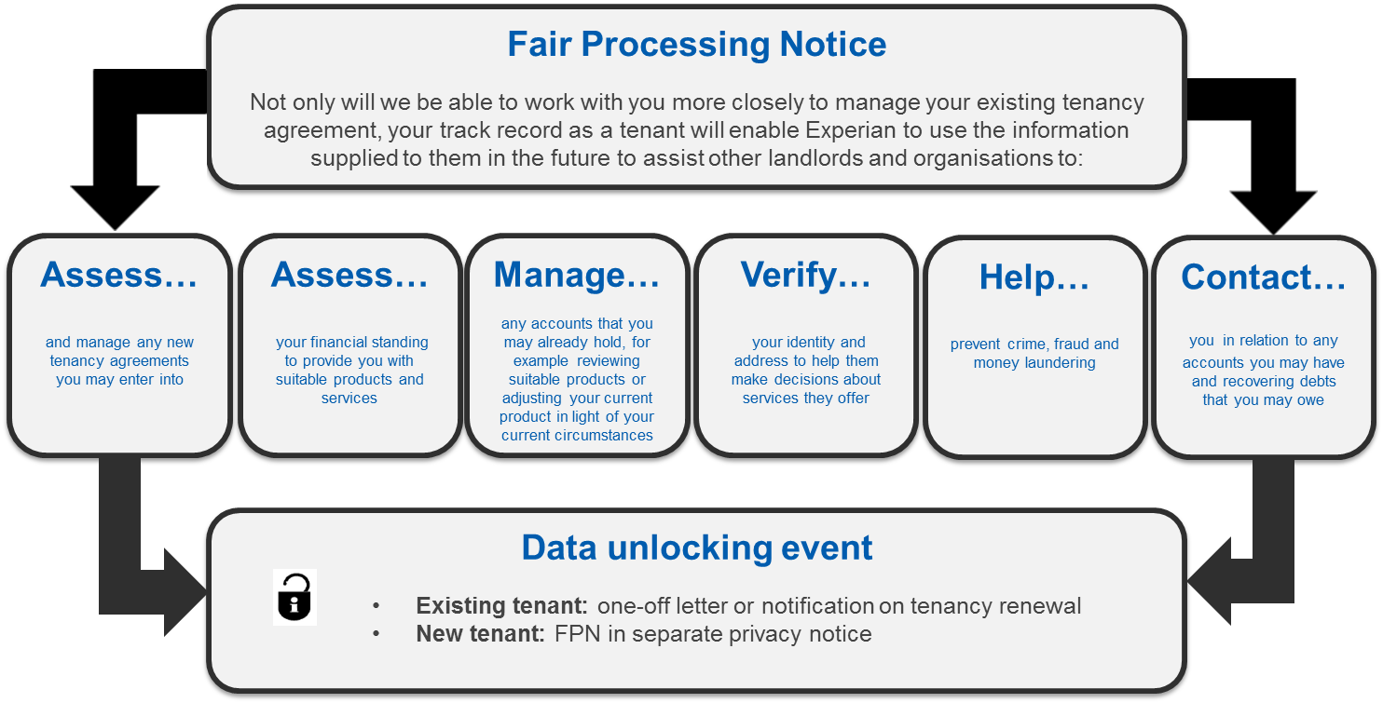
Fair Processing Notice
Notes:
Contents slide [uses Contents Slide layout]
The brand mark and data art graphic on this slide layout are set up at the correct size and position and should not be altered.
The slide title appears in Arial (Experian Dark Blue); the contents list is in Arial (Grey), as shown in this example. Contents list items are numbered and continuous lines in an individual listed item will align with the text in the previous line.
The date and footer info can be edited across all slides by using the ‘Header and Footer’ settings on the ‘Insert’ ribbon (do not edit these manually on the individual slides).

Slide 16

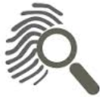

Benefits to Tenants
⬆
The majority of tenants pay their rent on time, so this information can enhance credit scores - the Rental Exchange provides an opportunity for tenants to improve their credit rating without having to take on any further debt.
Rental Exchange enables tenants to build an online proof of identity and this is important when applying for a utility supplier, a mobile phone provider or when online shopping.
If a tenant is unable to pay their rent, it is unlikely they are suitable for a loan or other payment agreement, therefore the Rent Exchange supports responsible borrowing and lending and helps people avoid becoming over-indebted.
Notes:
Contents slide [uses Contents Slide layout]
The brand mark and data art graphic on this slide layout are set up at the correct size and position and should not be altered.
The slide title appears in Arial (Experian Dark Blue); the contents list is in Arial (Grey), as shown in this example. Contents list items are numbered and continuous lines in an individual listed item will align with the text in the previous line.
The date and footer info can be edited across all slides by using the ‘Header and Footer’ settings on the ‘Insert’ ribbon (do not edit these manually on the individual slides).

Slide 17

Benefits to Housing Providers
Supporting Financial Inclusion
Reward tenants for paying rent on time and help tenants to access cheaper and more affordable credit and services.
The Rental Exchange can act as an incentive to pay rent on time
Notes:
Contents slide [uses Contents Slide layout]
The brand mark and data art graphic on this slide layout are set up at the correct size and position and should not be altered.
The slide title appears in Arial (Experian Dark Blue); the contents list is in Arial (Grey), as shown in this example. Contents list items are numbered and continuous lines in an individual listed item will align with the text in the previous line.
The date and footer info can be edited across all slides by using the ‘Header and Footer’ settings on the ‘Insert’ ribbon (do not edit these manually on the individual slides).

Slide 18
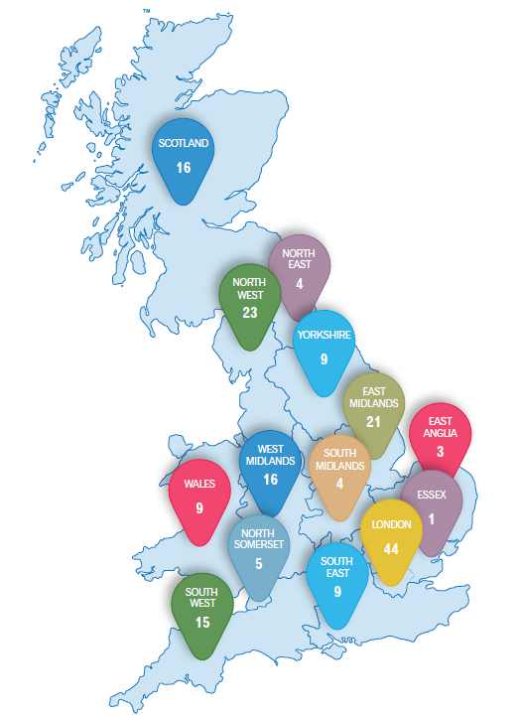












Designed and driven by the sector
Independent Advisory Group
Notes:
Contents slide [uses Contents Slide layout]
The brand mark and data art graphic on this slide layout are set up at the correct size and position and should not be altered.
The slide title appears in Arial (Experian Dark Blue); the contents list is in Arial (Grey), as shown in this example. Contents list items are numbered and continuous lines in an individual listed item will align with the text in the previous line.
The date and footer info can be edited across all slides by using the ‘Header and Footer’ settings on the ‘Insert’ ribbon (do not edit these manually on the individual slides).

Slide 19
Live Rental Exchange Members
Alliance Homes Limited
Shropshire Town & RuraL
Arches Housing Limited
Arhag Housing Association Limited
NIHE
Aster Group Limited
Together Housing Group Limited
Family Mosaic Housing
Genesis Housing Association Limited
Wolverhampton City Council
Walsall Housing Group Limited
Sovereign Housing Association Limited
Yorkshire Housing Limited
ASRA Housing Association Limited
City West Housing Trust Limited
Spectrum Housing Group Limited
East Midlands Housing Group
One Vision Housing Limited
The Wrekin Housing Trust Limited
Solihull Metropolitan Borough Council
Eastlands Homes Partnership Limited
Halton Housing Trust Limited
Golden Gates Housing Trust
York City Council
Longhurst & Havelok Homes
Wiltshire Council
V2C
Black Country Housing Group Limited
Seven Vale
St Albans City and District Council
Spire Homes Limited
Friendship Care and Housing Limited
City South Manchester Housing Trust
bpha Limited
Bracknell Forest Homes Limited
Group Cynefin
United Communities
Cadwyn
Cardiff Community Housing
Carterfi Conwy
Cartrefi Cymunedol Gwynedd
Charter Housing
City of London Council
Coastal Housing
Coastline Housing Limited
Colne Housing Society Limited
Curo Places Limited
Devon and Cornwall Housing Limited
East Lothian Housing
Eastbourne Homes
Elderpark
Elim Housing Association Limited
Family HA Wales
Freebridge Community Housing Limited
Gentoo Group Limited
Gloucester City Homes
Grand Union
Gwalia
Hafod
Hastoe Housing Association Limited
Notes:
Contents slide [uses Contents Slide layout]
The brand mark and data art graphic on this slide layout are set up at the correct size and position and should not be altered.
The slide title appears in Arial (Experian Dark Blue); the contents list is in Arial (Grey), as shown in this example. Contents list items are numbered and continuous lines in an individual listed item will align with the text in the previous line.
The date and footer info can be edited across all slides by using the ‘Header and Footer’ settings on the ‘Insert’ ribbon (do not edit these manually on the individual slides).

Slide 20
Live Rental Exchange Members
Helena Partnerships Limited
Herefordshire Housing Limited
Home Group Limited
Ipswich Borough Council
Knightstone Housing Association
Knowsley Housing Trust - Firstark
Lambeth Council
Lewes District Council
Linc Cymru HA
London & Quadrant Housing Trust
Luton Borough Council
Luton Community Housing Ltd
Melton Borough Council
Metropolitan
MHS Homes
Monmouth Housing Association
Muir Group Housing Association
NCHA
New Charter Homes Limited
North Devon Homes Limited
Northampton Borough Council
Northward
Notting Hill
Paragon Community Housing Group
Phoenix Community Housing Association
Poplar HARCA Limited
Raven Housing Trust Limited
Red Kite Community Housing Limited
Renfrewshire Council
Rhondda Housing
Rockingham Forest
Rooftop Housing Group Limited
Rugby Borough Council
Salvation Army HA
Sandwell Council
Selwood Housing Society Limited
Sevenside
Shepherds Bush Housing Association
Shoreline Housing Partnership Ltd
South Derbyshire District Council
South Yorkshire Housing Association
St Leger
Stockport Homes Limited
Stonewater
Swan Housing Association Limited
Tamar Housing Society Limited
Tamworth Borough Council
Thames Valley Housing Association
The Cambridge Housing Society The Riverside Group Limited
Town and Country Housing Group
Trafford
Trident Housing Association Limited
Two Rivers Housing
United Welsh
Vectis Housing Association Limited
Watford Community Housing Trust
Wealden District Council
Wealden District Council
Yorkshire Coast Homes Limited
Notes:
Contents slide [uses Contents Slide layout]
The brand mark and data art graphic on this slide layout are set up at the correct size and position and should not be altered.
The slide title appears in Arial (Experian Dark Blue); the contents list is in Arial (Grey), as shown in this example. Contents list items are numbered and continuous lines in an individual listed item will align with the text in the previous line.
The date and footer info can be edited across all slides by using the ‘Header and Footer’ settings on the ‘Insert’ ribbon (do not edit these manually on the individual slides).

Slide 21
Notes:
Closing slide [uses Holding Slide layout]
This slide can be used as a ‘closing’ slide and should not include any additional text or graphics. The same slide layout is used as a presentation opening slide. The brand mark and data art graphic on this slide layout are set up at the correct size and position and should not be altered.

