Slide 1
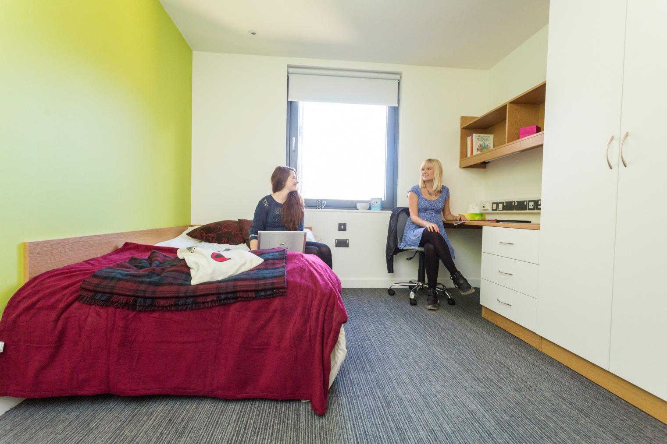
Shared accommodation – learning from student sector

Slide 2
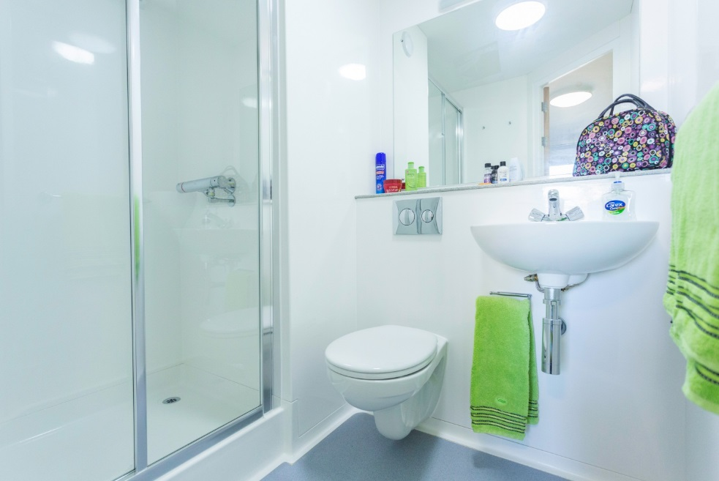
Bedrooms
En-suite or shared
En-suites less disputes, more desirable
But higher cost initially
Need any adapted rooms?

Slide 3
Living spaces
Larger bedroom – less communal space?
HMO guidance - kitchen / diner 11.5 sq m 1-5 people, 19.5 sq m 6-10
TV & licence?
Oxford Brookes – shared space for 10 - Ellis furniture

Slide 4
Inventories & check-outs
Manual or online
Student responsibility to do and return within 7 days or ok (in tenancy / licence)
Deposit scheme

Slide 5
Room checks
Who by?
How often?
Suggested rota?
Bedrooms once a term. Communal areas every 2 weeks
Access to rooms in tenancy

Slide 6
What is included
Bedroom – fitted furniture?
Kitchen - white goods, plus toaster, kettle, iron (PAT test – more reliable than people’s own?)

Slide 7
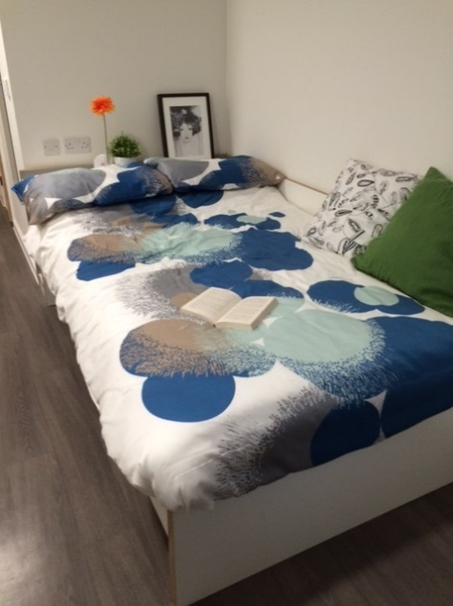
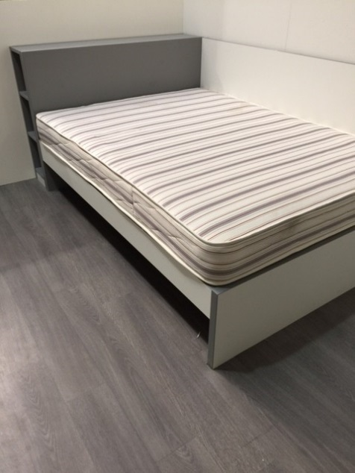
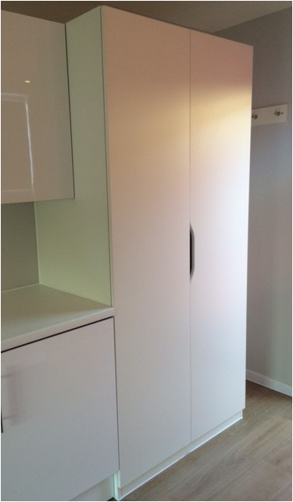
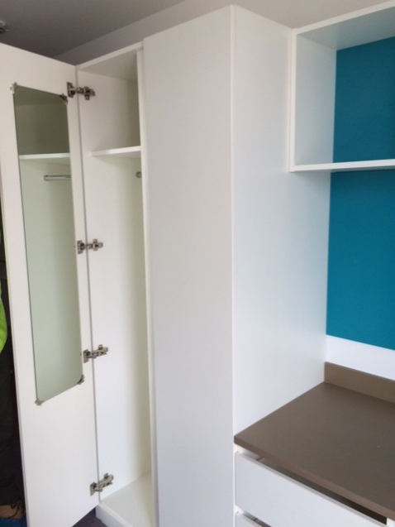
Design out issues
Headboard – side panel – less painting
Wardrobe & drawers - no handles
Carpet tiles or amtico – less costly than carpet?

Slide 8
Guests
Any restrictions
How do you manage?
Financial penalty
Try to manage physically – access cards, small double beds?

Slide 9
Bills & council tax
Include in rent? (high bills if not paying directly) – friction?
Use sharing website like Glide
Wifi

Slide 10
Sharing housemates
Selection processes?
Same or mixed sex preference?
Alcohol free
Quiet house
Personality matching allocation
Mediation
Room moves options
University of Exeter

Slide 11
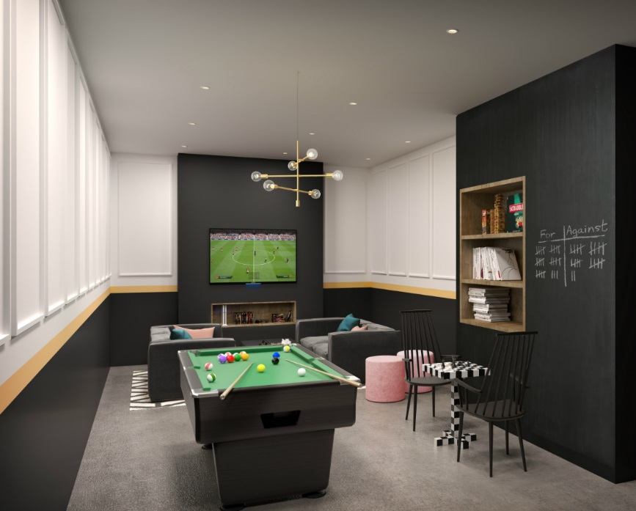
Making it add up
Financially larger schemes work better – over 400 beds
Apportionment of staff and checks – e.g. gas check
Best costings – managed laundry rather than machines?
Build to rent market

Slide 12
Potential Kent scheme
Student accommodation scheme - Broadstairs
Campus might be shutting
Any interest – ursula.harris@canterbury.ac.uk

