Slide 1
Integrated Care Organisation Operational Development Update
Sue Baldwin: Head of Planning & Delivery

Slide 2
INTEGRATED CARE ORGANISATION LOCALITY MODEL
ACUTE
GENERAL PRACTICE - CARE COORDINATION
LOCALITY HUB
URGENT RESPONSE SUPPORT and
INTEGRATED INTERMEDIATE CARE
LONGER TERM MANAGEMENT
HOSPITAL CARE
MIG Shared Record
Primary Care Team
Care Co-ordinator/Case Management
-Care Homes Support
-Domiciliary Care Support
-Learning Disability
MIG Shared Record
PLANNED CARE
East Kent wide Community Services
Acute Services (General & Mental Health) Integrated Discharge Team
SECAmb 999
NHS 111
Care Navigation
Out of Hours Medical Services
KCC Out of Hours
Equipment Services / KCC Fast Track Equipment Provision
Minor Surgery
Community
Dental Services
Dated: 05.08.2015

Slide 3
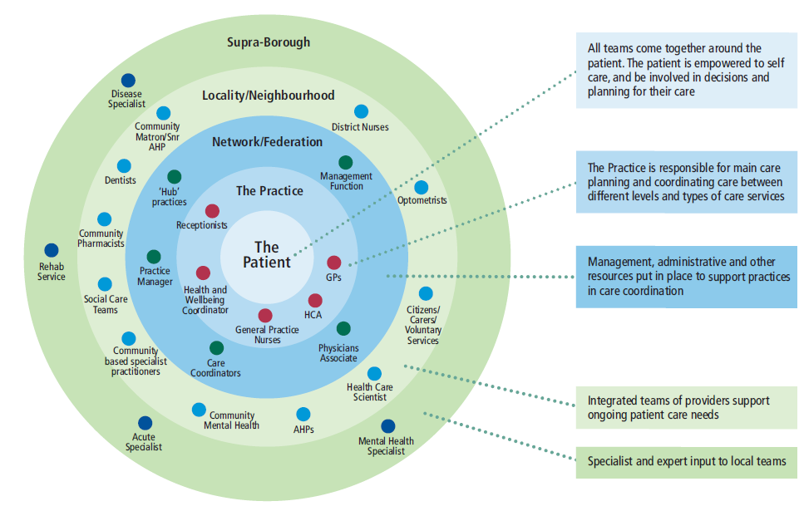
Key questions – New ways of working: How will clinicians/practitioners work together in the future?

Slide 4
Supporting Work Streams
Multi-Disciplinary (MDT) Working
Information, Management & Technology
Health, Housing & Social Care
Prevention & Self Care
Locality Urgent Care & Rehabilitation/Enablement Response
Managed Care Pathways
End of Life Improvement

Slide 5
Multi-Disciplinary (MDT) Working
MDTs provide a systematic process for ensuring patients receive the ensure the patient receives appropriate clinical and non-clinical care in the community.
A named professional provides on-going support and care, reducing the reliance on Practices
Practices will also have access to Care Navigators and Primary Care Mental Health Workers, and in time, more direct access to Consultants

Slide 6
Information, Management & Technology
Medical Interoperability Gateway (MIG) implementation:
Provider access to GP record & GP access to provider record
Interoperable Care Plans
Interoperability of GP Clinical Systems:
Black Pear operational in 2 hubs and planned roll out in others
Hub access to all GP records within a locality
Mobile Working Implementation to accelerate development of locality service model:
Mobile working software on tablets (for General Practice staff and associated members of integrated primary care team) – direct access to patient record e.g. request a prescription at the point of care and complete referrals electronically without delay
Patient online consultation functionality planned roll out for April 2017:
Provides online triage to sign post patients and encourage self help, will increase number of online consultations
Reduces demand on practice and increases efficiency, whilst ensuring patients are seen by the correct clinician

Slide 7
Health, Housing & Social Care
Environmental Assessment - co-designed by health and housing to formalise links and support better working between health and housing.
KCC and SKC CCG have jointly proposed a
commissioning strategy for provision of short term
beds, awaiting committee process.
Housing Forum November 2016, brought together Health and Housing sector to increase awareness of options available to improve health through good housing
Finalising a Memorandum of Understanding in relation to Housing between Health, Social Care and District Councils

Slide 8
Prevention & Self Care
Age UK Personalised Integrated Care Programme – SKC awarded bid to provide programme locally. The Programme promotes independence and prevents avoidable hospital admissions for people with long term conditions. Programme launch January 2017.
Care Navigation - aligning roles of current resources (SKC’s Health Trainers and Care Navigators) to provide equitable support across SKC CCG. Re-launch of service to coincide with launch of Age UK Personalised Integrated Care Programme
SKC’s Public Health Priorities are identified. Task and finish groups being arranged to take work forward, including Healthy Weight Plan
Inequalities – worked with a local drop in centre to put in additional services to support this vulnerable group and also offered flu vaccinations – working with local practices to support them with their vulnerable patients
Migrant Health - will be rolling out an APP for migrants to assist with understanding of and how to use health services. Education package being delivered for general practice, by Doctors of the World on understanding migrant health and their needs

Slide 9
CARE NAVIGATION
MDT Referral
General Practice
Referral
from others
Self
Referral
CARE NAVIGATOR
Fit Age UK/Care Navigator Criteria
Age UK
PIC
Assessment Needed?
Signed up to programme?
Yes
No
Yes
Can refer in or back to Care Navigator
Assess need & Develop Plan
Assess need & Develop Plan
Can refer in or back to PIC
Support through:
Direct Intervention
Behaviour Change
Trusted Assessor equipment/ telecare
Volunteer takes plan forward with client
Additional support through other services/agencies
Signpost to Relevant Services
Plan completed.
Discharge to ongoing support if required
District Council Support
Age UK
Turning Point
Social Care
Porchlight
Health Trainers
(Life Style Advisor)
Housing
Financial Support
Intermediate Care Team
Community Nursing Team
Shaw Trust
DWP
MH Support
DWP
CAB

Slide 10
Locality Urgent Care & Rehabilitation/Enablement Response
Integrated Intermediate and Urgent Care pathway in place across South Kent Coast
University of Kent supporting the evaluation
CCG & KCC now discussing opportunities for an Alliance Contract for the pathway
Education package delivered for Kent Enablement at Home (KEaH) staff to identify the deteriorating service user and also domiciliary care providers
Education package being delivered to domiciliary care staff in early identification of the deteriorating service user
Currently scoping opportunities to further develop urgent care locally

Slide 11
End of Life Improvement
Multi-agency policy and strategy now agreed and signed off
East Kent carer and patient packs are in circulation
Planning to submit a bid for the use of technology – Careflow – to enable care coordination between staff caring for the patient
End of life “Care at Home Service” specification completed.
Just in Case Boxes to support timely care for symptom management as now available Review of urgent palliative care medication provided by community pharmacists has been agreed. Medication will now be provided as aligned with Just in Case Boxes

Slide 12
Thank you
Any questions ?

