Slide 1
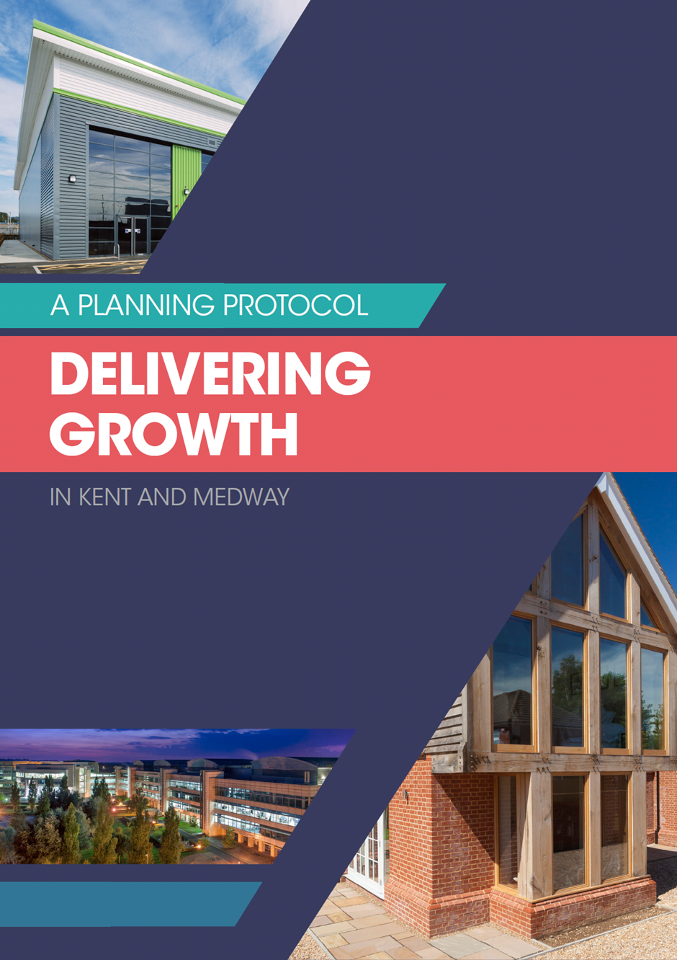

Slide 2
Kent Planning Protocol

Slide 3
Kent Planning Protocol

Slide 4
Kent Planning Protocol

Slide 5
Kent Planning Protocol
.

Slide 6
Kent Planning Protocol

Slide 8
Kent Planning Protocol
What does this mean to me?
Not binding
You could do nothing
Carry on as you are
But this is a real opportunity
We need to deliver, there is a crisis
Generally accepted through the Growth and Infrastructure framework

Slide 9
Kent Planning Protocol
Good Practice
Not about reinventing the wheel
Good practice across Kent
How can we learn from others
Is everything we do perfect?
We can sit there, carry on as before but would it not be good to learn?
Improve?

Slide 10
Kent Planning Protocol
Cooperation
Kent and Medway are renowned for cooperation, working together
Recognised by our neighbours and government
We keep selling our acheivements
Others copying us
Look at the relationships we have across Districts, KCC and with our stakeholders
Can we use that to improve?

Slide 11
Kent Planning Protocol
The Challenge
190,000 homes and 135,000 jobs required across Kent and Medway by 2031
Remember that includes jobs, very important
Training required to understand
Resources required
That is why we are all here

Slide 12
Kent Planning Protocol
How?
Look to best practice, not only in Kent but elsewhere
Learn and adapt
Most importantly obtain buy in from the top
Ownership
Strive to deliver, to be the best
We are already

Slide 13
Kent Planning Protocol
The developers are great!!!!
As mush about developers as Districts, County and consultees
We need to improve
Applications
Consultations
Consideration
Quality development
Help with that training

Slide 14
Kent Planning Protocol
Way forward
Working with planners, private and public and developers
Establish best practice
Engage with all
Consultees
KCC
Get our act in order
Work together

Slide 15
Kent Planning Protocol
Lest we forget!!!!
Do not forget Commercial Development!!!!!

Slide 16
Kent Planning Protocol

Slide 17
Kent Planning Protocol

