Slide 1
Tackling poverty through housing and planning policy in city regions
Will Eadson
Aidan While
Ashford, 9th September 2016

Slide 2
Workshop 1
Housing and poverty - what are the challenges and how are these being addressed?

Slide 3
Research objectives
Aim = explore the scope for, and value of, embedding 'poverty reduction, affordable housing and inclusive growth' in housing and planning at the city-regional level
Objectives:
Understand logics of housing and planning policy
Explore how devolved funding and powers are being used
Identify where city regions can add value (or not)
Explore options for future freedoms and flexibilities

Slide 4
Our approach
Evidence review
Analysis of documents
Stakeholder interviews (c.45)
Policy workshops in five areas

Slide 5
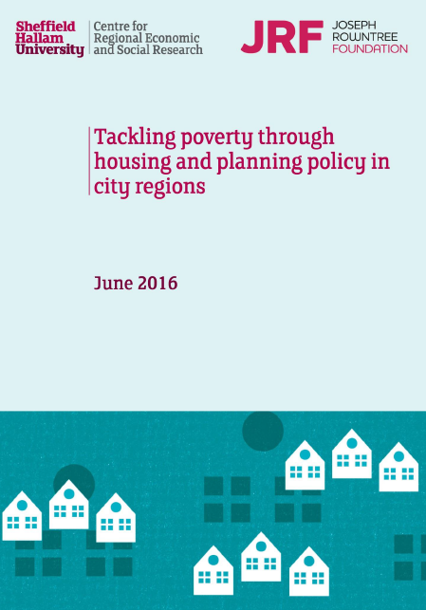
What does the evidence say?
National policies on housing and planning are reducing capacity of housing to buffer against poverty
City regional policy reflects national emphasis on accelerating supply + supporting growth
Limited appetite to address factors that link housing and poverty at CR level
Missed opportunities to ensure growth is more inclusive?
http://www4.shu.ac.uk/research/cresr/sites/shu.ac.uk/files/tackling-poverty-housing-planning-city-regions.pdf

Slide 6
Session 1: What are the housing challenges faced by low income households?

Slide 7
National policy marginalising housing need?
Key policy aims post 2010:
Increase supply through planning reforms (e.g. NHB), new housing delivery vehicles (e.g. Housing Zones) and new forms of finance (e.g. Build to Rent)
Support access to home ownership (e.g. Help to Buy, Starter Homes, RTB)
Tackle dependency and reduce spend (removal of subsidies for social rented housing, affordable rents, decreased levels of LHA/HB)
Make more efficient use of social housing (reduced security of tenure, Pay to Stay, RSRS)
'A lot of people that are poor will not be helped by [the Housing and Planning Act 2016] whatsoever' (London).

Slide 8
But new opportunities for tackling poverty?
'Devolution revolution':
Creation of LEPs and combined authorities
Growth Deals
Devolution Deals
'Metro mayors' (Cities and Devolution Bill)
New powers around H&P (Mayoral call-in + CPO powers, spatial frameworks, CIL etc)

Slide 9
The link between housing and poverty

Slide 10
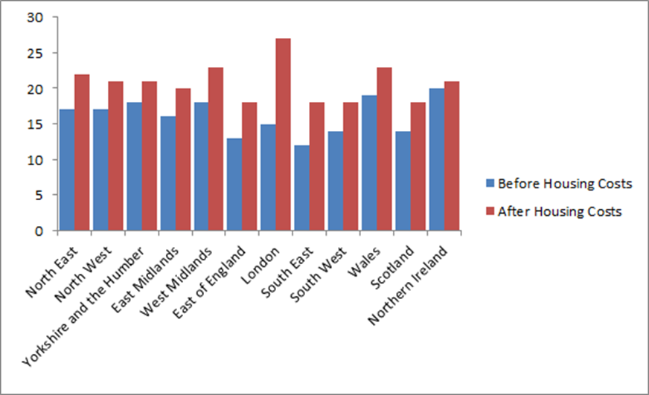
Housing costs impact on poverty
Source: DWP, 2015

Slide 11
And housing reforms cut incomes
 | Average loss per affected h'hold/individual £ p.a.
HB: 18-21 year olds | 2,600
Benefit cap | 2,350
‘Pay to stay’ | 1,850
LHA cap in social rented sector | 750
⁽¹⁾ Additional post-2015-16 impact of pre-2015 reform
Sources: HM Treasury, Impact Assessments and Sheffield Hallam estimates based on official data

Slide 12
For discussion (1)
How are housing market(s) changing across the LEP area? How does this affect housing opportunities for low income families?
What are the housing challenges facing low income households? How does these vary across different groups? And at what scale?
What is the impact of national policy on i) housing markets and ii) low income households?

Slide 13
Session 2: To what extent does housing and planning policy at the city regional level support poverty reduction, affordable housing and inclusive growth?

Slide 14
SEPs: A narrow growth agenda?

Slide 15
Innovation (of a sort) in SEPs + Growth Deals
Regulating the PRS: Using Housing Benefit as a lever to enforce quality (Lancashire and South East); establish commercial vehicle to acquire and manage stake in PRS (Lancashire)
Subsidising housing costs: Using LGF to subsidise rents for affordable housing (Leeds CR)
Housing finance: Launching a REIT to raise investment for affordable housing (Buckinghamshire TV)
Large scale housing-led regen: Growth Deal outlines plans to refurbish 4,500 homes (Humber)
Supporting employment: Linking ex-offenders to job opportunities in construction (Heart of the South West)
Promoting local labour in construction: Developing local supply chain and workforce through procurement frameworks (Leeds CR)

Slide 16
Innovation across city regions (1)
New strategic partnerships: GM's MoU gives housing providers strategic role; commits to tackling poverty; cuts across policy areas (e.g. health and housing).
Direct delivery/ Joint ventures:
Birmingham CC's Municipal Housing Trust (BMHT) built 1,000 homes for rent and 7,100 for sale 2010-15. Scope for scaling up?
Liverpool CC exploring Rent to Buy model
Bristol CC looking to set up a housing company to deliver council + HA housing plus shared ownership as well as housing for sale, with profits used to subsidise lower cost housing.
Reducing housing + fuel costs: Leeds CR investing in off-site manufacture.
Tackling fuel poverty: Leeds CR/WYCA investing £10m in Better Homes programme to improve energy efficiency in PRS.

Slide 17
Innovation across city regions (2)
Area regeneration: Leeds CC Neighbourhood Approach = street-by-street multi-agency programme to tackle empty homes, inspect 100% of PRS properties, deliver wider physical improvements + support residents through initiatives such as employment support, energy efficiency advice, fire safety checks and benefits advice.
Improving quality in PRS:
Lancashire devolution discussion exploring possibilities with DWP for reducing LHA payments for properties that fail to meet minimum space standards.
South East used a £2 million LGF to tackle 'problem’ PRS/HMO housing e.g. converting 40 HMO ‘spaces’ into eight houses.
Aligning policy areas/public service reform:
GM looking to scale up Hospital Discharge and Readmission Prevention pilot (HA staff in hospitals); housing elements in Health and Social Care plan
Leeds undertaking Health Impact Assessment to inform co-design of health + housing intervention with CCGs

Slide 18
The limits of devolution?
Policy: National policies e.g. Starter Homes do not meet local needs or undermine local activities e.g. bedroom tax + cut in social rents
Caution: City regions ask for what they can get
Geography: City region not always appropriate spatial scale e.g. for tackling poor quality PRS
Politics: Different political affiliations plus tensions with cross-boundary working e.g. greenbelt development
Institutional capacity: Difficult to tackle complex issues while institution building alongside staff cuts in LAs
Austerity: Limits scope for action and determines priorities e.g. maximisation of receipts from land sales
Asks knocked back: Request for full devolution of HCA funding not granted (yet).

Slide 19
CR as a bulwark to national policy?
'Talk of devolution almost always seems to assume it would end up in a more left wing social democratic solution...The experience in London is that it hasn’t necessarily ended up being more socially democratic ...it depends on the people they elect... but we’re setting up over the next few years the emerging city regions with elected mayors like Bristol, Manchester who are going to be Labour trying to get powers out of the Tory government, that’s interesting'.

Slide 20
For discussion (2)
What are the current housing and planning priorities in the South East LEP area? To what extent are they likely to support 'poverty reduction, affordable housing and inclusive growth'?
What innovations/good practice in the South East LEP area? And could you adopt examples from elsewhere?
What stops you from doing more?

