Slide 1
Tackling poverty through housing and planning policy in city regions: Workshop 2: Future freedoms and flexibilities
Will Eadson
Aidan While
Ashford, 26th September 2016

Slide 2
Research objectives
Aim = explore the scope for, and value of, embedding 'poverty reduction, affordable housing and inclusive growth' in housing and planning at the city-regional level.
Objectives:
Understand logics
Explore how devolved funding and powers are being used
Identify where city regions can add value (or not)
Explore options for future freedoms and flexibilities

Slide 3
Our approach
Evidence review
Analysis of documents
Stakeholder interviews (c.45)
Policy workshops in five areas

Slide 4
Devolution: new funds + freedoms and flexibilities
New forms of financing housing development e.g. housing investment funds (GM) + grant funding (East Anglia)
Greater flexibility in terms of access to, and use of, HCA funding
Land commissions / joint asset boards to manage the identification and disposable of public land and assets
Land remediation funds to bring forward brownfield development (West Midlands)
Enhanced city regional powers over planning (e.g. call in powers over planning applications, mayoral development corporations, CPO powers)
Spatial strategies/ frameworks to support the delivery of strategic housing and employment sites across the city-region
Powers to raise funds for transport and infrastructure (Business rate supplement, CIL)

Slide 5
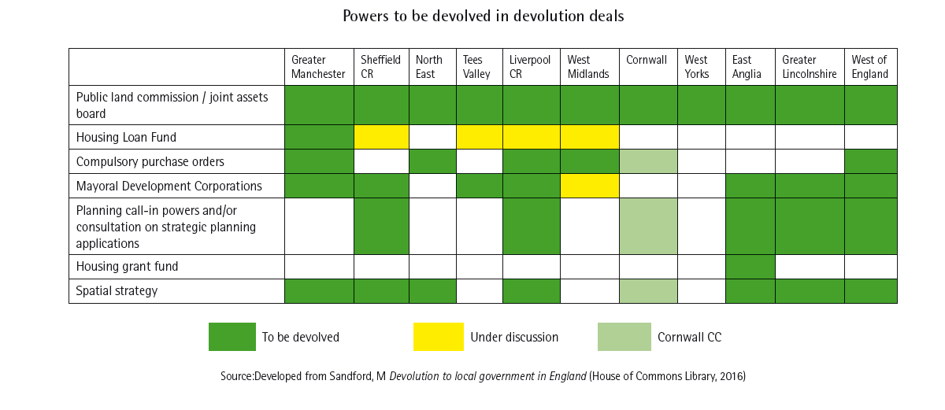
New devolved powers
Taken from Hunter (2016) devo-housing: the emerging agenda

Slide 6
More radical asks (1): London Housing Commission
Exempting London from the National Planning Policy Framework (NPPF) and giving mayor’s London Plan same status as the NPPF; power to force boroughs to change plans if not identifying enough land for housing.
Allowing the London Housing Committee to set planning fees for London.
Permitting GLA and boroughs to borrow more for housebuilding and infrastructure.
Devolving stamp duty on the same model as business rates to local authorities.
Allowing boroughs to levy discretionary tax on developers that fail to meet agreed building targets and also to create their own landlord licensing schemes.
Notes:
I

Slide 7
More radical asks (2): The view of stakeholders
Capturing land value uplift: Some interest e.g. GM exploring options similar to powers for New Towns to purchase land at use value and benefit from the uplift.
Land value tax: 'biggest missed opportunity' or limited relevance for areas with low land values?
Rent regulation: Interest in using rent regulation e.g. as lever to encourage investment in energy efficiency; but concerns about large-scale disinvestment.
Devolution of Housing Benefit: Some support for 'benefits to bricks' approach but only in context of stable and long-term settlement (CTB = how not to do it)
Devolution of land and property taxes:
Support in high value areas (London) but concern about race to bottom + competition for development elsewhere
Interest in linking increase in Stamp Duty for PRS landlords to fund stock improvements (Leeds CR)
Additional planning powers to tackle land banking: The Leeds City Region LEP has put forward a proposal in its devolution submission to acquire stronger compulsory purchase order (CPO) powers

Slide 8
Capturing land value uplift
Recapture of unearned element of rise in land values that results from change in land use or public investment
Existing measures (s106 and CIL) increasingly less effective for realising planning gain
Other options:
Market maker role: Buying land at existing use value (backed by credible threat of CPO) and selling once planning permission granted or as serviced land
Land value tax
Indirect mechanisms for capturing value uplift:
Business rates supplement; TIF; devolving land and property taxes; mayoral CIL; and hypothecated payroll taxes.

Slide 9
Land value tax (1)
An annual levy on the capital or rental value of land
Could replace Council Tax and Business Rates
No serious attempt to introduce LVT but interest in 'mansion tax' as abridged form (1% levy on properties over £2m)
Reforming council tax: Wales introduced new Council Tax band I
Some form of LVT exists in over 700 cities
NSW = tax on vacant land, holiday homes, investment properties and commercial properties

Slide 10
Land value tax (2)
Pros | Cons
Stabilise house prices | Difficulties in valuing land separately from buildings (30% not in Land Registry)
Dampen speculation + asset booms without disincentivising development | Penalises asset-rich and cash poor - 'Devon pensioner'
Capture gains from public investment | Large numbers of 'losers' in marginal seats
Avoids the pitfalls of one-off 'betterment' taxes | Linked to value of land not no. of households using services (if replaced CT)

Slide 11
Rent regulation
Growing interest in some form of rent control
Rent caps rare but some form of rent stabilisation common overseas:
Netherlands: 72 per cent of private rented dwellings have a regulated rent which is increased annually based on a points system which assesses the quality of each property
Germany recently introducing the Mietpreisbremse (Rental price brake) in larger cities which limits rents on new properties to 10 per cent above existing rental benchmarks
Critics (and some evidence) suggests it can discourage investment in sector/stock; reduce access to BTL finance; reduce mobility of tenants; and benefit wealthier households.
..but modelling of different rent control models in the UK suggests that impacts on rents and, subsequently, the size of the PRS would likely be modest (Clarke et al., 2015)

Slide 12
Learning from overseas
Ending right-to-buy (Scotland)
Land value taxes (Denmark, NZ, USA)
Rent regulation e.g. Mietpreisbremse in Berlin (also USA, Switzerland, Denmark, Austria, Belgium, Finland)
Stronger public sector role as 'market makers' in land assembly, infrastructure development and sale of serviced land (Germany, Netherlands)

Slide 13
For discussion (1)
What innovations/good practice in the South East LEP area (focusing on poverty reduction, affordable housing and inclusive growth)? And could you adopt examples from elsewhere?
What stops you from doing more?
Notes:
Focus on here and now.

Slide 14
For discussion (2)
To what extent could existing 'freedoms and flexibilities' be used to support poverty reduction and affordable housing? Is there scope for 'stretch' of these powers to to do this?
What further freedoms and flexibilities does the South East need to more directly address poverty through housing and planning policy?
What should the priorities be in terms of future city regional housing and planning strategies, programmes and funding?
What would stop you from achieving this? Where does government need to give way?

Slide 15
For discussion (3)
Pick two of those ideas and explain how they might work in the SELEP area (in an ideal world):
- How would the intervention work?
- How much might it cost? (ballpark)
- Who would deliver it?
- Who would benefit? In what way?
- What support would you need from central government or other agencies? Where does it need to give way?
- What barriers are there to achieving this?
- Any unintended or undesired consequences?

