Slide 1
Rentplus: An Overview
Kent Housing Group
25 January 2017

Slide 2
Rentplus: Why?
Saving for a deposit continues to be one of the biggest obstacles to home ownership
Desire for home ownership is high - 86% of people would like to own their own home - but are locked out due to the need for a deposit. Shelter figures show that nearly half of renters are unable to save for any deposit at all, and a further 25% are only able to save £100 or less a month.
There needs to be a more flexible approach to tenure and ownership; creative solutions are required to solve the housing crisis
Traditional affordable housing solutions are not delivering at pace and scale; housing market uncertainty means we need to sustain momentum to maintain confidence and delivery
Affordable rent to buy offers an accessible route to home ownership for those who are currently excluded, with the opportunity to rent, save & own
Rentplus offers an opportunity for local households who ‘just manage’

Slide 3
Rentplus: background
Developed by a regional developer, a local authority and a housing association to address the issues identified with access to, and the quality of, affordable housing
Established 2012 in the South West and now growing at scale across the country
3 completed schemes in Devon, Dorset & Cotswolds with a pipeline of 12,000 already identified and being progressed.

Slide 4
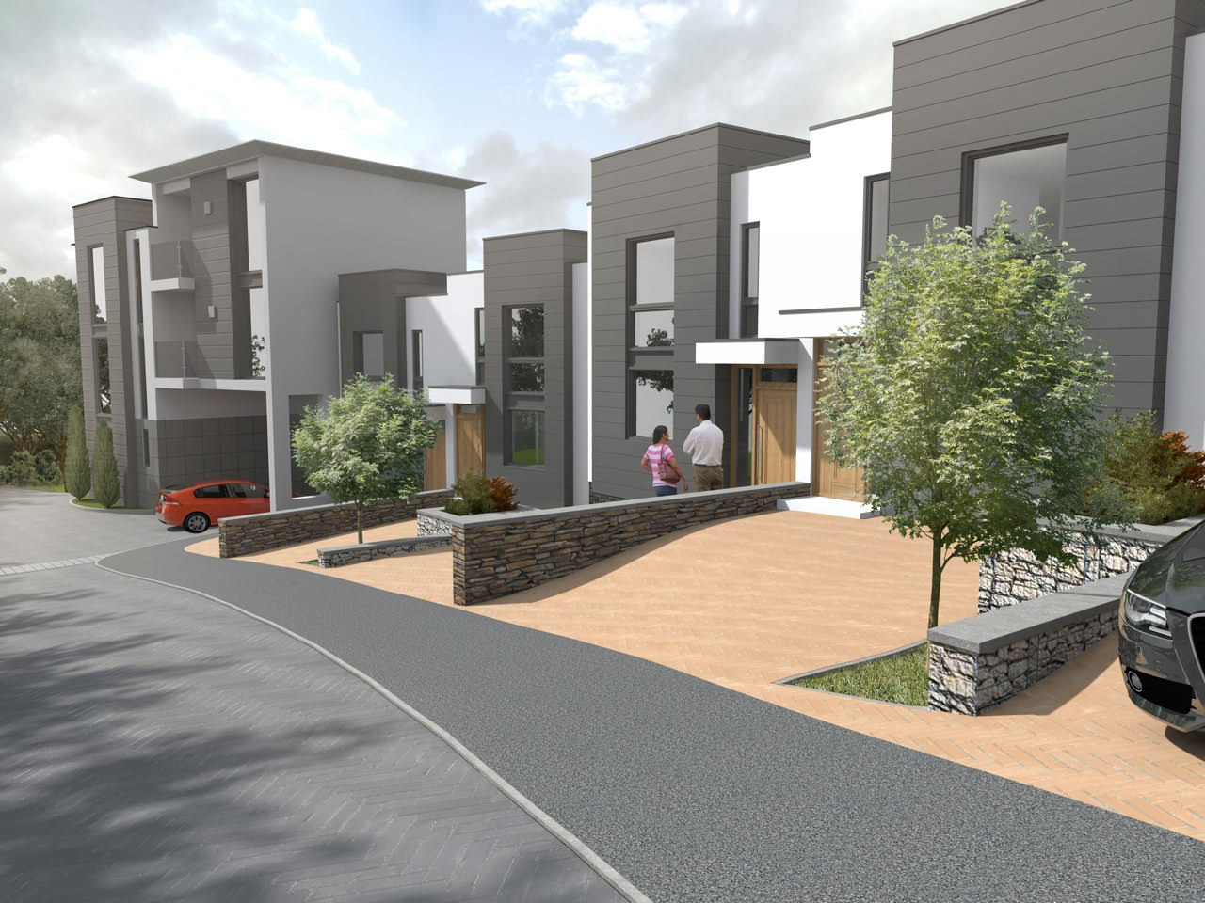
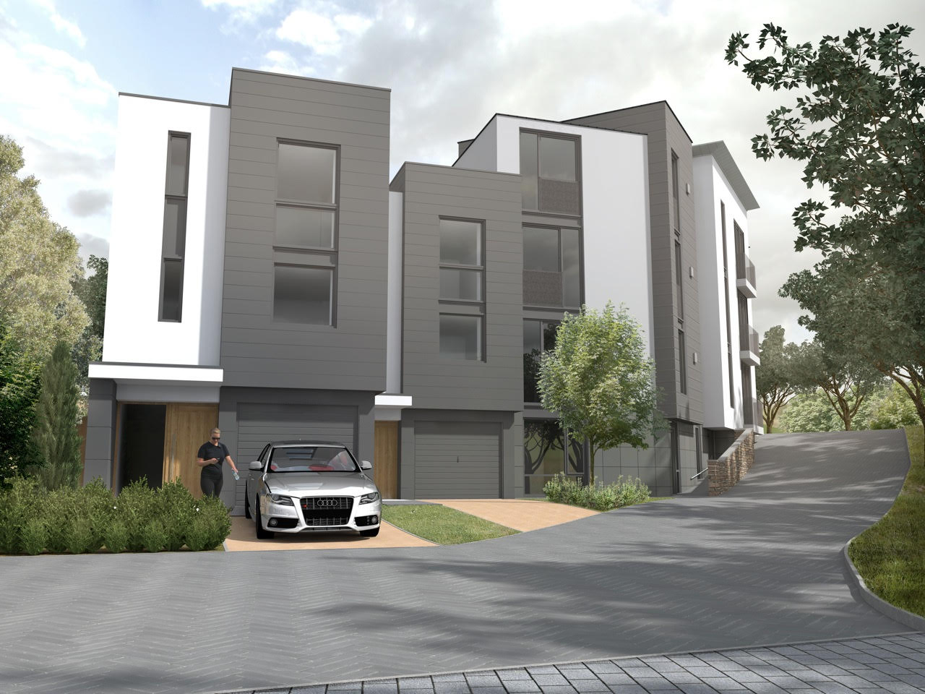
The Rentplus model

Slide 5
Rentplus: how does it work?
Homes built to building regulations and Rentplus standards
25% of Rentplus homes are sold at years 5, 10, 15 and 20
Rentplus homes leased to local partner Registered Providers (RP) for up to 20 years
Homes initial let at 80% market rent or LHA (incl. service charges) to meet both LA affordable housing & market demand
Homes funded by institutional investors
As homes are sold, Rentplus intends to replace them to maintain numbers of affordable homes

Slide 6
Rentplus: managing the tenancies
Tenants supported and enabled to move into home ownership by RP
S106 cascade allows for substitute tenant, RP discounted purchase or sale on open market
Tenant agrees at sign-up when their home is available to purchase; 5-year renewable tenancies until then
10% OMV gifted deposit provided by Rentplus for tenants at purchase
RP partner manages Rentplus homes including repairs service, collects rent
Rents increased by CPI +1% annually; rebased every 5 years

Slide 7
Rentplus: working in partnership
Rentplus
Local Authorities
Housebuilders and Land promoters
Registered Providers
Funders/
HCA
Partnership to identify suitable sites for Rentplus homes
Rentplus homes included in new developments to improve the mix of tenures – currently through s106
Rentplus homes can increase the % and range of affordable tenures on new developments
“Plan B” for Starter Homes programmes; opportunity to use RTB receipts

Slide 8
Rentplus: status
Already an NPPF compliant affordable housing tenure
Meets the test of in perpetuity over 20 years
Best endeavours to replace on one to one basis in each LA area
Supported by government as an affordable housing tenure
Complements existing models of affordable housing and home ownership offering greater range of tenures & choice
Fully funded by institutional investors – no public subsidy or grant required
Pre-requisites for delivery:
Local authority inclusion of rent to buy tenure in affordable housing provision in s106 agreements
Registered Provider partner to lease and manage our homes
Funding

Slide 9
Rentplus: the benefits

Slide 10
Rentplus: overview
A significant increase in the number of homes available at affordable intermediate rents and inward investment into local economy, jobs and training
De-risks schemes with viability issues, unlocks stalled developments, ensures delivery of local affordable housing policy
Promotes mixed tenure and accelerates delivery of supply to meet local housing needs
No deposit required, unlike Starter Homes/other LCHO products which prevents local people from accessing home ownership
Allocation of homes to local people in accordance with local authority requirements
Facilitates best use of existing affordable housing stock and mitigates impact of right to buy/pay to stay e.g. Rentplus homes to households in existing social housing, freeing up homes for other families in need
Government focus on home ownership now softening. Rentplus is lobbying the DCLG and HCA to ensure that a Rentplus-type affordable rent-to-buy model is included as a valid alternative in the Starter Home initiative

Slide 11
Rentplus: Delivering affordable housing in Kent
Kent has a diverse housing market, house prices vary hugely across the county, demand for affordable homes far exceeds supply
Opportunities to build on Kent’s strong track record in creating cross-sector and innovative partnerships to deliver county-wide objectives including housing, promote inward investment to enable delivery of new affordable housing, work with RPs to increase portfolio, efficiencies and grow income
Ebbsfleet Garden City currently in construction to deliver 15,000 homes; opportunity to include a range of housing tenures to meet the needs of all local households
Rentplus can support emerging Local Housing company(ies) and/or ALMOs to deliver social rented homes cross subsidised by the s106 Rentplus homes
Supporting SME developers/contractors to bring forward stalled sites through forward funding of affordable housing and accelerate delivery

Slide 12
Rentplus: Local Authorities
Significant increase in the number of affordable homes available and New Homes Bonus payments
An approved s106 affordable housing tenure with scope to increase levels of affordable housing
Local lettings plan agreed with LA; applications made through local CBL scheme or agreed alternatives
30%+ of Rentplus tenants moved from existing social housing, freeing up homes for households on the housing register; further 30+% housed through CBL
Opportunities to unlock stalled developments; accelerates delivery to meet local housing needs
If the home is sold on the open market, 7.5% of sale proceeds given to LA to invest in future affordable housing
MOU to maintain pipeline of properties to replace sold homes
Bespoke strategic partnership opportunities

Slide 13
Rentplus: Registered Providers (RPs)
Working in partnership with local RP partner(s) to deliver great customer and landlord services for Rentplus tenants:
Partnership based on framework agreement and site specific 20 year operating leases
Off balance sheet – no requirement for additional borrowing or using financial capacity to grow/consolidate portfolio; in addition to planned development programme
Bringing sites forward, with joint appraisals and bids, to create a pipeline of future homes
Control over allocations, in accordance with LA requirements
Additional income stream from retained rent income, project management & introduction fees, estate management service delivery
VfM and efficiencies through consolidation of stock portfolio and reduction in overheads
Opportunities to purchase properties with 10% discount if tenant unable to proceed with their purchase

Slide 14
Rentplus: Tenants
Offers a route to home ownership for working/in training low income households who can’t get on the housing ladder
Opportunity to build credit history to help mortgage application and to save with Help to Buy or Lifetime ISA
Provides real opportunity for people in housing need who aspire to home ownership and are unable to save a deposit
New home at an Affordable intermediate rent with support to achieve home ownership
No repairing obligations during the rental period
Gifted deposit of 10% of the open market value of the property at the time of 100% purchase

Slide 15
Rentplus: delivery

Slide 16
Rentplus: delivery
Ambitious business plan approved to deliver an initial 5,000 completed homes by March 2020 as part of an 8,500 home programme nationally; scalable to deliver government home ownership targets & growing across the South, East, Midlands and into London and South-East.
The first affordable housing product to attract significant institutional investment
Finances upfront delivery of affordable homes on new developments, giving housebuilders confidence to build, unlocking stalled developments and meeting demand
Discussions with HCA under specific Rent to Buy programmes to support housing delivery
“Plan B” for Starter Homes programme
The Rentplus model can be grown significantly, at scale and pace through further investment of capital, to meet government or LA objectives

Slide 17
Rentplus: delivery
For institutional investors: a sustainable and robust financial model with a blended rental yield and capital return
For government: supports momentum in delivering 1m homes; the model is robust against market correction; protects against risk of reduced appetite for home ownership
For local authorities: certainty of delivery of s106 Affordable housing obligations by developers & housebuilders. Facilitates best use of existing affordable housing stock – typically more than 30% of Rentplus tenants come from existing social housing freeing up homes for other families in need. Bespoke strategic partnership with LA Local Housing Company and /or council housebuilding programme.
For RPs: complementary to existing development programme, growth and income generation without additional borrowing or sales risks, or impact of a reduced appetite for shared ownership and open market sales.
For housebuilders: competitive prices, improved viability to unlock stalled sites, certainty of purchase for Affordable housing; upfront financing; de-risks Starter Homes programme (“Plan B”); doesn’t compete with open market sales

Slide 18
Q&A discussion

Slide 19
For further information or questions please contact:
Sue Coulson
Director of Partnerships
Mob: 07402 064415
scoulson@rentplus-uk.com
Shirley Heapy
Partnership & Enabling Manager
Mob: 07397 554586
sheapy@rentplus-uk.com
Rentplus office
Tel: 01752 388940
www.rentplus-uk.com

