Slide 1
Bespoke / Custom Build Mortgages
Cecilie Booth, CPFA, cbooth@arlingclose.com Tel 07557 650852

Slide 2
Local Authority Mortgage Scheme (LAMS)

Slide 3
Local Authority Mortgage Scheme (LAMS)
National launch in March 2011 and has now come to an end
112 Local Authorities signed up and the Scheme is available in 68 Local Authority areas with 98 live schemes
To the end of May 2016, 4,400 mortgages, £435m lending
No repossessions to date
Blackpool and Warrington were first to launch in July 2011, these schemes have now come to an end

Slide 4
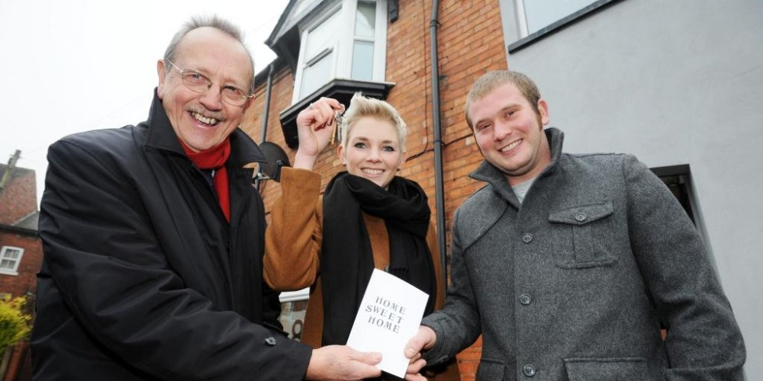
LAMS - Outcomes
“It was great that we didn’t have to wait another year”
Charlotte Bowie and Sean Brand, Broxbourne Borough Council and Hertfordshire County Council
“We could afford the mortgage but not the deposit”
Joanne and John McKie,
Isle of Wight Council
“We were in limbo, paying rent but unable to save our deposit, the mortgage is now cheaper than our rent”
Lizzie Bruzas and Henry Rundle, City of Lincoln Council

Slide 5
Local Authority Mortgage Scheme (LAMS)
Developed to respond to shortage of mortgage funding, the depressed economy and housing market, and to support Local Authorities to develop innovative new schemes to address local issues
A true partnership between Local Authorities and residential mortgage lenders
Designed for people who can afford the repayments but not the deposit
Provides financial assistance to enable 95% LTV mortgages to first time buyers on similar terms to 75% LTV
Similar to the Help to Buy Guarantee scheme, which closes at the end of 2016

Slide 6
Local Authority Bespoke / Custom Build (BCB)

Slide 7
Custom and Self Build – what is it?
Self Build – generally refers to an individual buying a plot of land and building a house themselves or engaging with a contractor to complete the house to their own design and specification
Custom Build – generally refers to a number of houses on a site which have been built by one or more developer, which are bespoke in some manner. Must include a choice of internal layout. This is generally facilitated through a developer / framework
BCB enables a Local Authority to provide self build and / or custom build solutions through a single scheme where the Local Authority is in control from start to finish. BCB provides up to 95% LTV mortgages, both on land they own and on land owned by a third party

Slide 8
BCB – How does it work? (1)
Local Authority makes a decision to implement the scheme and ‘signs up’ to the national scheme
Local Authority will be able to focus on local needs and support the local economy
We provide step by step actions, all standard documentation / templates and support to enable the Local Authority to proceed
We support the Local Authority with the implementation plans
Local Authority seeks member approval to proceed and we support the required governance arrangements
The participating Local Authority retains overall control throughout

Slide 9
BCB – How does it work? (2)
Local Authority markets the site
Local Authority selects suitable partners from a panel or interested parties, including architects, brokers, estate agents, lenders etc.
Sale off-plan
Applicant secures 95% LTV mortgage from a lender on the Panel
5% non refundable deposit payable to the Local Authority
LAMS mortgage approval in place at the outset. Firm approval is required, valid for 6 months followed by a review to extend it for up to a further 6 months to allow for potential delays

Slide 10
BCB – How does it work? (3)
Once the deposit is paid and the mortgage approval is in place, build can commence
Local Authority can enter into building contract on Council owned land, or provide financial assistance on land owned by a third party
Building work takes place with Building Control inspections at each stage
Local Authority's own Building Control team utilised (quality assurance)
Local Authority funds the cost of build right to the point of completion
Building Control issues the Completion Certificate
Lender values the property

Slide 11
BCB – How does it work? (4)
On build completion, the pre-approved 95% LTV mortgage will be completed, the Local Authority will recover costs and ownership transfers to the new owner
Capital receipt is received
The LAMS arrangements will be the same as for the standard LAMS scheme (but without the MO personal indemnity requirements (Lloyds only))
The indemnity / guarantee will be on a non cash basis (no matching deposit with the lender)
The LAMS mortgage will remain in place for 5 years with the (up to) 20% indemnity
The overall relationship is the same as for LAMS

Slide 12
BCB – Benefits for Local Authorities
Flexibility on meeting local needs and priorities
Local Authorities are familiar with LAMS and he way it works
We provide national templates, legal papers, accounting papers etc.
We support the approval process
Additional New Homes Bonus and Council Tax
Overall control is maintained by the Local Authority from start to finish
Better value for land and properties as better mortgages are available
Opens the market to people who would not currently be able to embark on a self \ custom build project
Key risks have been mitigated through partnership with lenders

Slide 13
BCB – way forward
Legislation and Regulations are now in place
Current mortgage availability for self build projects, more options are needed
Risk management and mitigating controls
Are developers willing to allocate land to self / custom build?
Planning policy?
Are lenders prepared to advance mortgages and make necessary changes to open up this niche market to a wider market?
Will developments stack up financially?
We aim to bring together a range of stakeholders, i.e. Local Authorities, Lenders, Mortgage Brokers, National and Local Landowners and Housebuilders to reduce risk for all parties and to make self build and custom build mortgages available to the wider market of aspiring self builders.
We also aim to help all parties to deliver the new legislation and government policy
Some lenders are interested and / or already on board – e.g. Lloyds, Ipswich BS
Some vanguard Local Authorities have already signed up

