Slide 1
Askival
A new approach to development and regeneration

Slide 2
Who is Askival?
Askival is a group of experienced professionals, all with director-level experience, who have come together to provide a client-based approach to development productivity.
Malcolm Ward
Mike Nestor
Tony Draper

Slide 3
What does Askival do?
Askival is a dedicated programme delivery agency, a first in the social housing world.
Our approach is distinct:
  We have a programmatic relationship with our clients rather than one based on individual projects.
  Given the extended timescales of regeneration and development projects, our approach is to develop long-term partnerships rather than in simply getting things started.
  We provide an end-to-end delivery service, and can provide an initial scoping exercise or pick up at any point on the way to practical completion.
  We offer CPO expertise and acquisition experience to secure vacant possession.

Slide 4
Typical Askival Activities
Project Organisation
Project appraisal
Consultation
Vacant possession
Procurement
Askival instructs and manages the technical team, including:
  Architect
  Planning consultant
  Employer’s Agent
Project Delivery
Scoping and prioritisation
Design and consultation
Acquisition (incl.CPO)
Legal
Construction
Handover
Sales management
Finance

Slide 5
Where do we work?
For the past few years we have been working within the development team of Poplar HARCA in LB Tower Hamlets.
This team has delivered a transformation of many housing estates in one of the most deprived areas of the country. Since 2009 nearly 2,000 new homes have been built, with over 1,000 more on site or contractually committed in phased developments.
We also currently deliver projects for:
  London Borough of Lambeth
  Thrive Homes
  Eastbourne Borough Council
  Lewes District Council

Slide 6
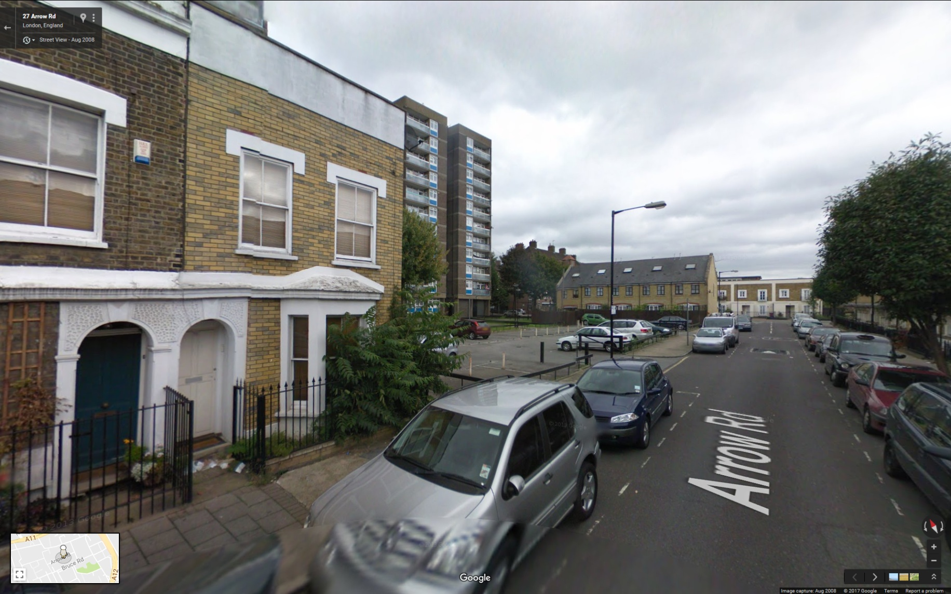
From this…

Slide 7
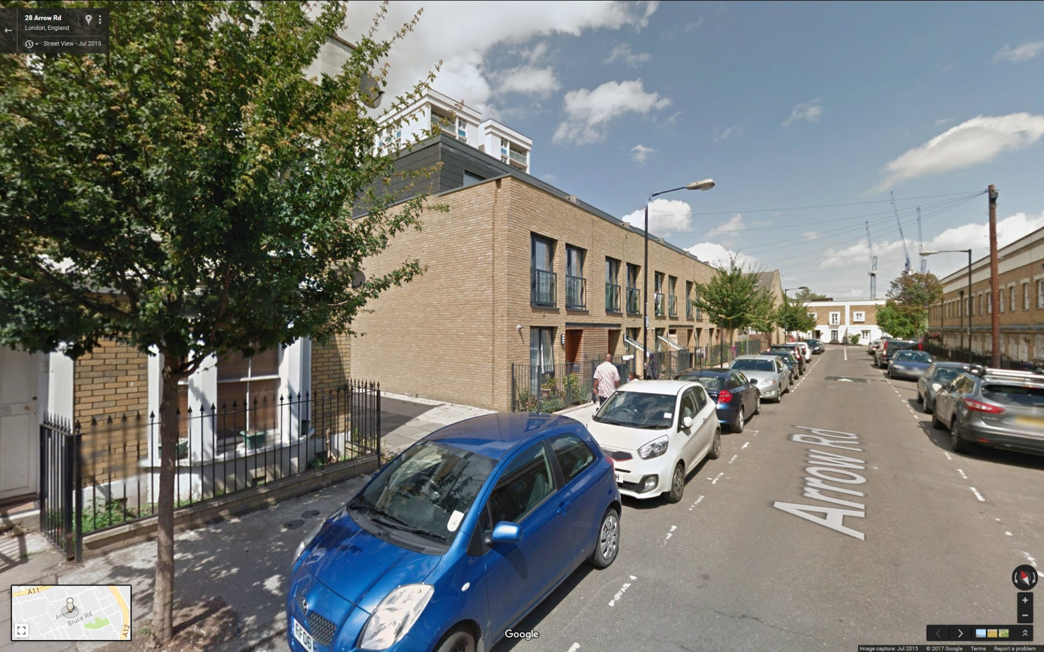
To this…

Slide 8
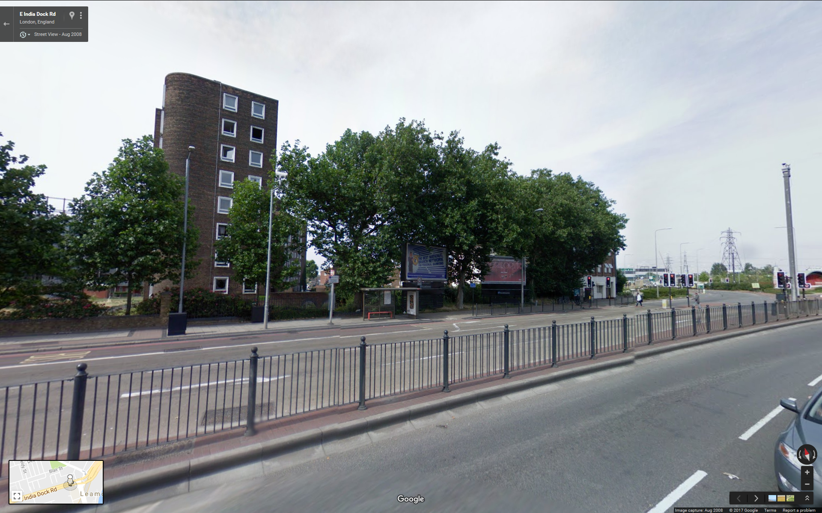
From this...

Slide 9
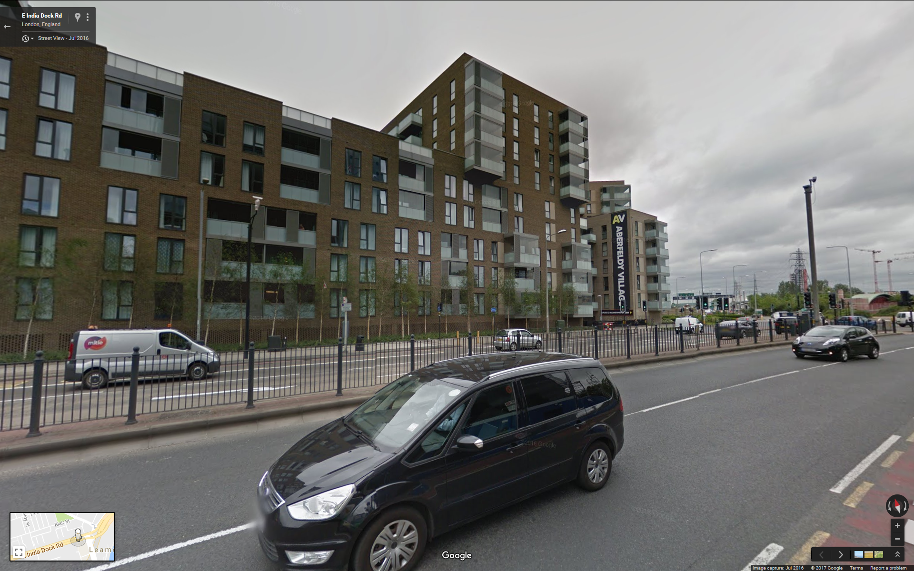
To this...

Slide 10
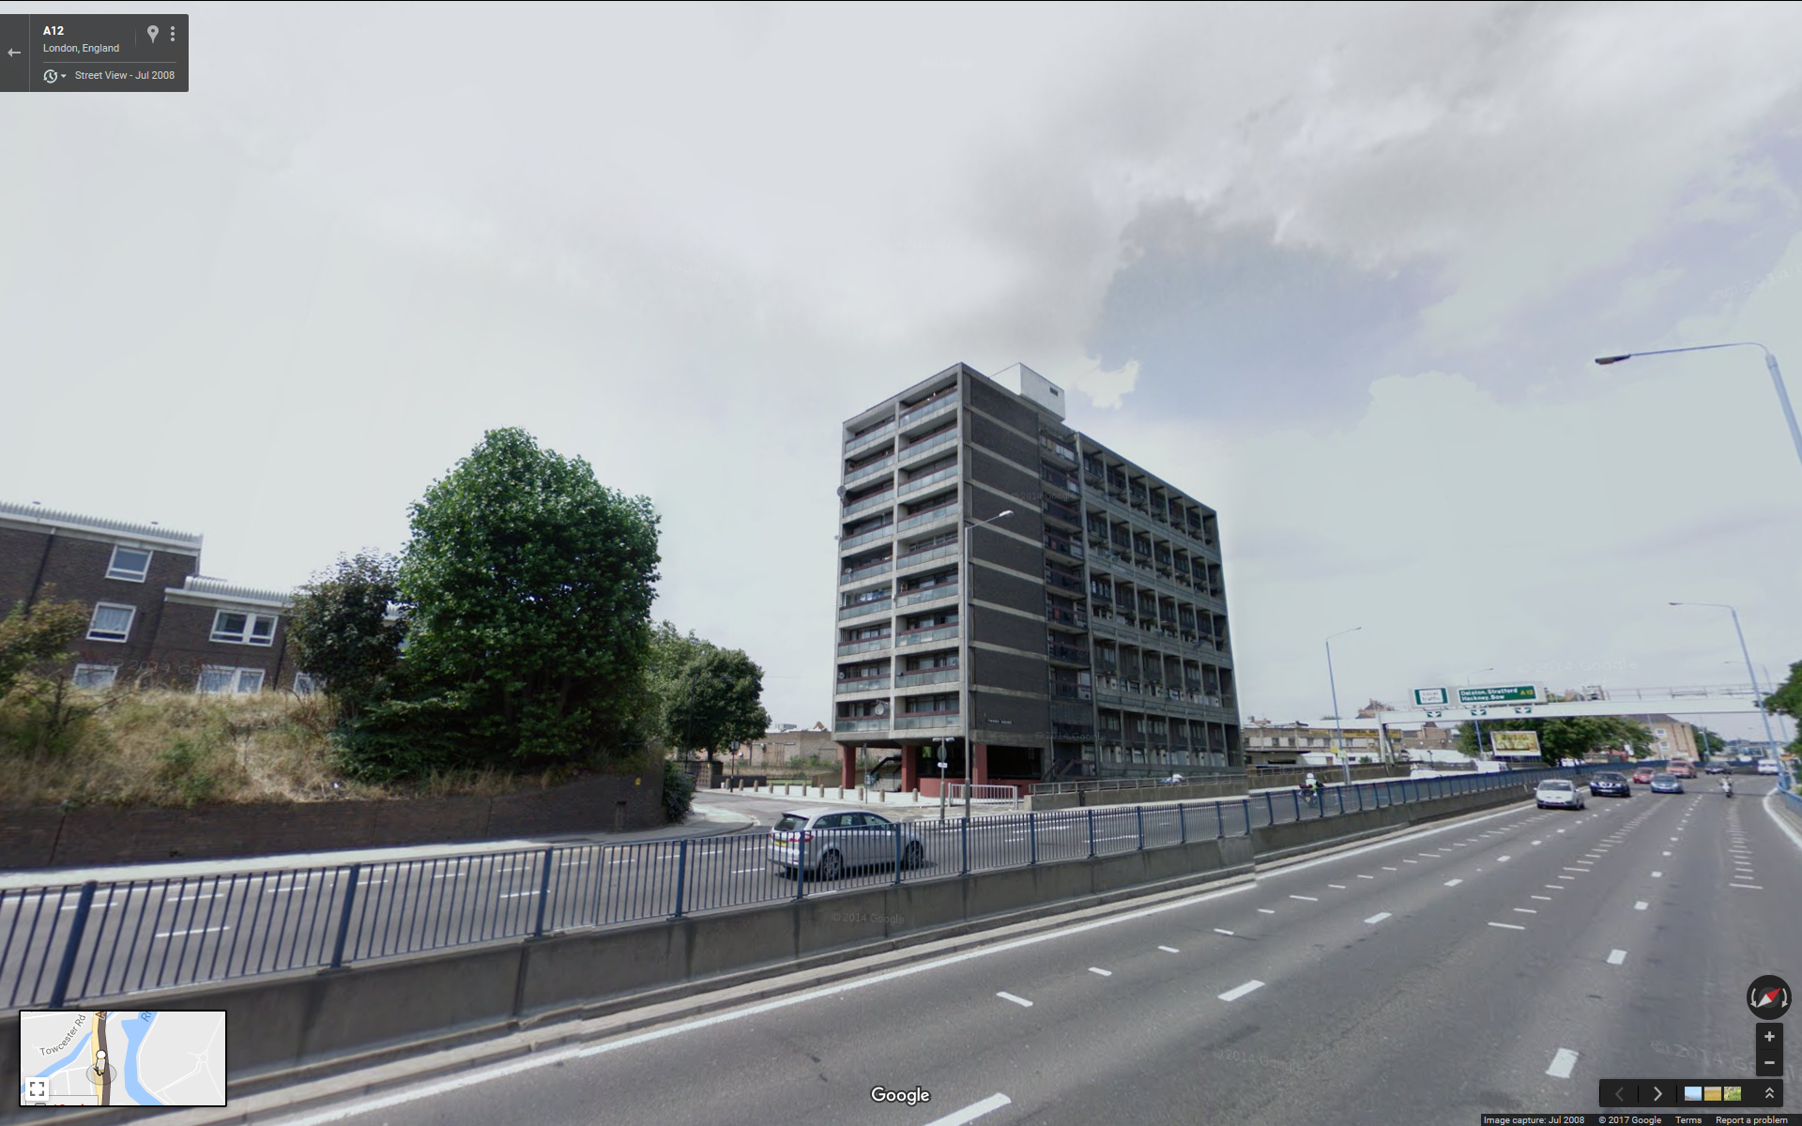
From this...

Slide 11
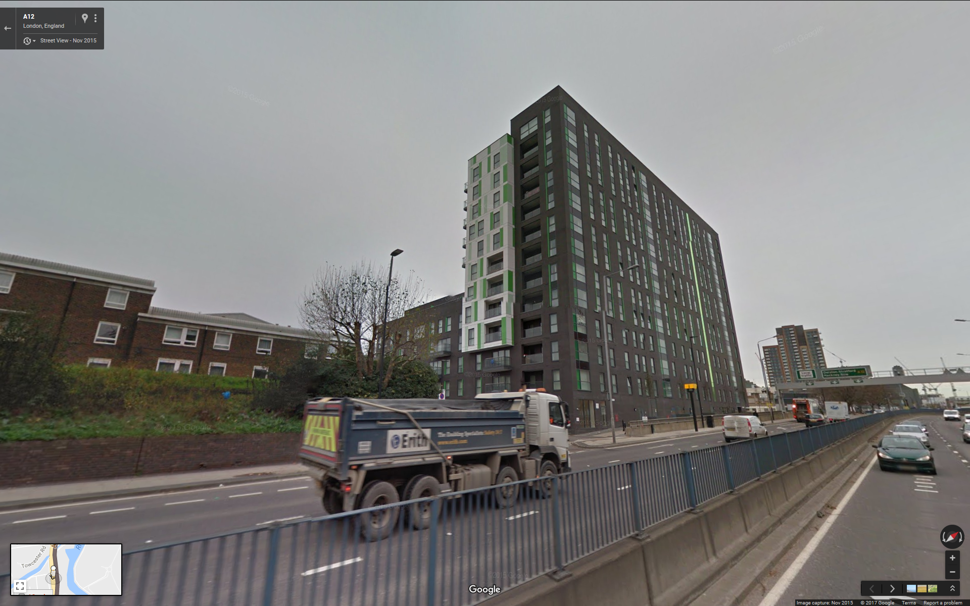
To this...

Slide 12
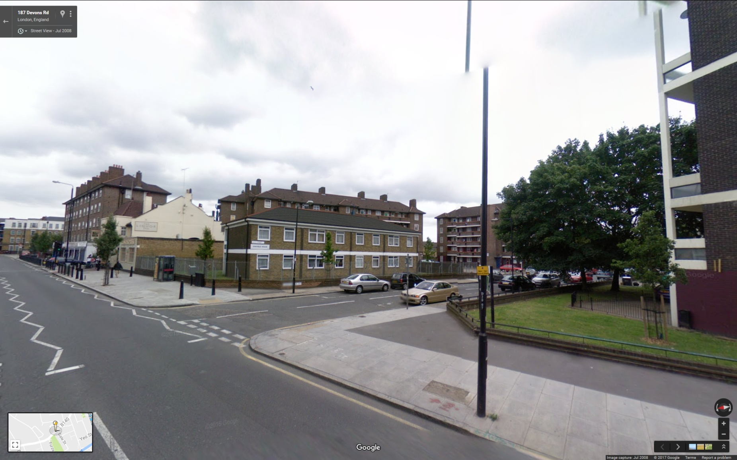
And from this...

Slide 13
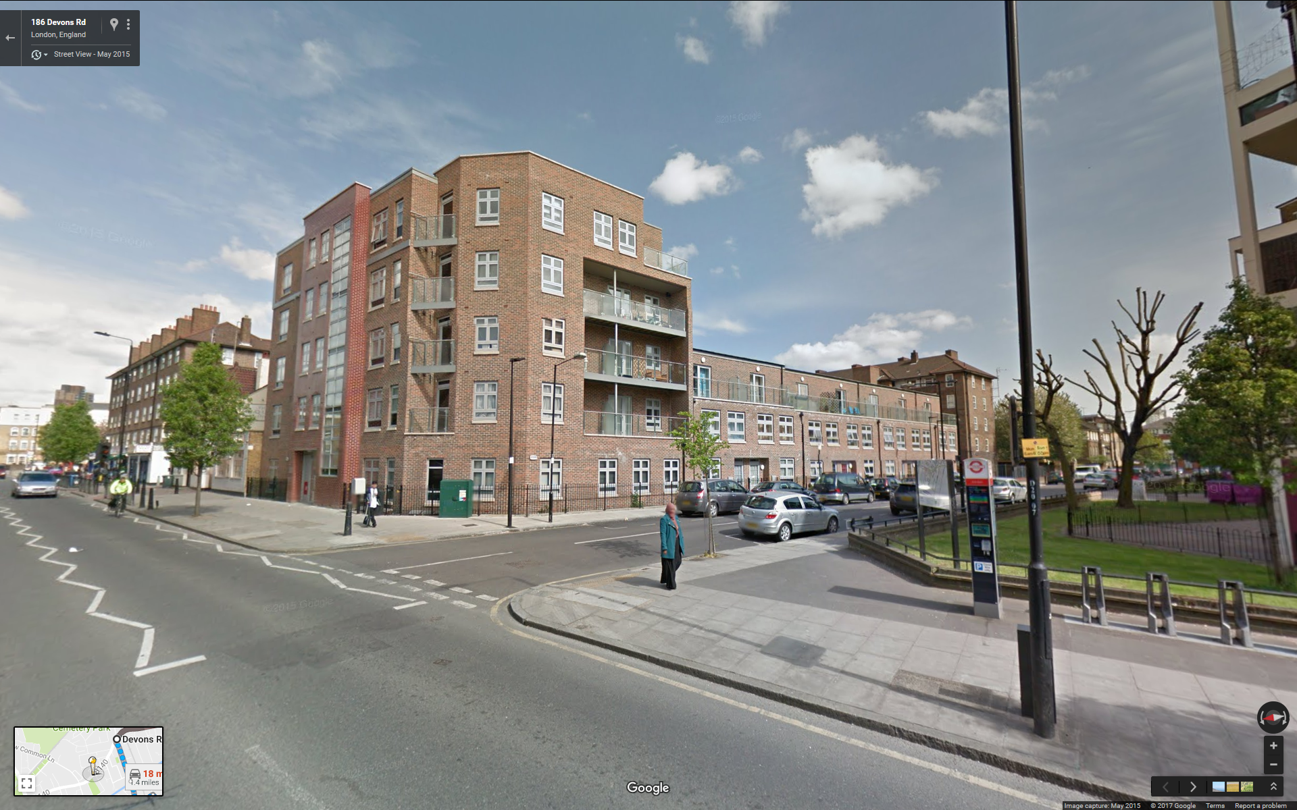
To…

Slide 14
What can Askival do for you?
Strategic review of assets and prioritisation of delivery options
Development planning and delivery for schemes using RTB and S106 receipts
Project appraisal of estate regeneration schemes
Apply for Askival funding as capacity building through the 2016/17 Estate Regeneration Programme – so a self-funding approach

Slide 15
Questions
Name | E mail | Contact No.
Malcolm Ward | Malcolm.Ward@askival.org | 07872 449542
Mike Nestor | Mike.Nestor@askival.org | 07984 611410
Tony Draper | Tony.Draper@askival.org | 07878 160306

