Slide 1
Lets Make Every Contact Count – All You Have To Do Is Ask

Slide 2
Making Every Contact Count and Housing
Sarah Jewell - HEE
Sarah Ward – Maidstone Borough Council

Slide 3
What is MECC?
Making Every Contact Count (MECC) is an approach to behaviour change that utilises the millions of day to day interactions that organisations and people have with other people to support them in making positive changes to their physical and mental health and wellbeing.

Slide 4
What is MECC?
Is about organisations and workforces and services
It aims to equip staff with the necessary competencies and skills to support raising the issue of health and wellbeing
It aims to meet the challenge set out in the NICE guidance (2014)
The ambition of the MECC approach is to recognise public facing sectors contribution in improving health

Slide 5
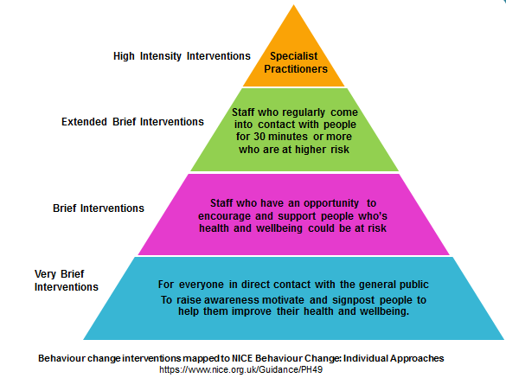
What is MECC?
Notes:
Roughly speaking these levels can equate to the NICE PH guidance 49 Behaviour Change: individual approaches
Starting at the top....
ORANGE - Behaviour change service providers and practitioners providing high intensity interventions (typically these last more than 30 minutes and are delivered over a number of
sessions) for people they regularly work with. Examples include Health Trainers, alcohol teams, smoking cessation advisors and IAPT workers.
GREEN - Health and social care staff dealing with the general public to provide an extended brief intervention to people they regularly see for 30 minutes or more who are involved in risky behaviours (for example higher risk drinking), have a number of health problems, have been assessed as being at increased or higher risk of harm, have been successfully making changes to their behaviour but need more support to maintain that change have found it difficult to change or have not benefited from a very brief or brief intervention. More intensive behaviour change training such as Health Coaching or Motivational Interviewing would equip people with the necessary skills to be able to support people.
The bottom 2 levels, pink and blue, represent MECC
PINK - Staff who regularly come into contact with people whose health and wellbeing could be at risk to provide them with a brief intervention. A brief intervention involves oral discussion, negotiation or encouragement, with or without written or other support or follow-up. It may also involve a referral for further interventions, directing people to other options, or more intensive support. Brief interventions can be delivered by anyone who is trained in the necessary skills and knowledge. These interventions are often carried out when the opportunity arises, typically taking no more than a few minutes for basic advice.
BLUE – for everyone in direct contact with the general public - very brief intervention to motivate people to change behaviours that may damage their health. The interventions should also be used to inform people about services or interventions that can help them improve their general health and wellbeing. Examples include paramedics, receptionists.
Triangle illustrates smaller proportion of staff and people they work with as you progress up the pyramid.

Slide 6
Who is MECC for?
Traditionally has developed within healthcare
But is really about everyone
Individuals who have contact with the public
Individuals who have contact with individuals who experience health inequalities
Individuals who may have an opportunity to talk about health and wellbeing to others

Slide 7
Why MECC?
Tobacco use
Harmful use of alcohol
Physical inactivity
Unhealthy diet
High Blood pressure
Obesity
Cardiovascular diseases
Respiratory disease
Cancer
Diabetes
Liver disease
Notes:
Conditions that cause premature death in the UK include are commonly known as the 'five big killers'; cancer, heart disease, stroke, respiratory disease and liver disease.
These conditions impact on quality of life and lead to both physical and emotional illnesses and account for more than 150,000 deaths a year among under-75s in England alone
In 2012:
62,000 people died of cancer
33,000 died of cardiovascular diseases
14,000 died of respiratory diseases and
8,000 died of liver conditions under the age of 75
Many of these chronic diseases are closely linked to behavioural and lifestyle factors. Changes in behaviours such as stopping smoking, improving diet, increasing physical activity, losing weight and reducing alcohol consumption can help people significantly reduce their risk of disease
2 in 10 adults are smokers
7 in 10 men and 6 in 10 women are overweight or obese
A third of people have drinking patterns that could be harmful
Half of women and a third of men do not get enough exercise
A recent King’s Fund report found that 25 per cent of the overall proportion of the population in 2008 engages in three or four unhealthy behaviours. Multiple unhealthy behaviours have an increasing effect on health. Someone in mid-life who smokes, drinks too much, exercises too little and eats poorly is four times more likely to die over the next 10 years than someone who does none of those things. Inequalities exist in this area with the rate of multiple unhealthy behaviours higher in the poorest parts of society

Slide 8
Why Housing?
Everyone is responsible for health and wellbeing
Can be the first point of contact for many people
Trusted source
Can help prevent people reaching crisis point by completing just one referral
Notes:
All organisations responsible for health, wellbeing, care and safety and have the opportunity to impact on people’s mental and physical health and wellbeing.
Housing is just one of these.
Housing can be the first point of contact for many people as everyone needs a place to live, whether it be in a house, flat, caravan etc. Housing Officers often see people before their GP as many people don’t access healthcare services, particularly those who need the most help. Housing Officers can provide a pathway to services.
Maidstone Borough Council’s Housing and Health team have embedded ‘Making Every Contact Count’ into their every day work. We believe it should be at the core of an organisation’s design and service by using every opportunity. It isn’t about creating extra workloads but providing residents the opportunity to improve their health and wellbeing.
Many organisations are already supporting people to make and maintain positive lifestyle behaviour change and it is hoped that the ambition to Make Every Contact Count (MECC) will encourage others to follow.
Interventions aren’t always easy and sometimes are not appropriate on a first visit. It is down to you as Officers to decide if an intervention is suitable. Rather than think of it as an intervention, think about having a ‘healthy chat’ with someone. It should just be a conversation, not dictating to someone how they should or shouldn’t leave.

Slide 9
Rent paid
Reduction in anti-social behaviour
Improving health and preventing illness
Continue independent living
Engaging the disengaged
Improved housing conditions
The Benefits
Notes:
There are many benefits to Housing Services whether in the public, private or social sector by improving resident health.
One of the biggest is that rent is paid on time and in full. Through engagement and referrals (if appropriate), a reduction in outgoings on purchasing cigarettes, alcohol and potentially drugs will see residents having the money to pay their bills. This in turn will improve their security and sustainability of their tenure.
By seeing a reduction in use of cigarettes, alcohol and drugs, there will be a reduction in anti-social behaviour and improve community cohesion.
By improving housing conditions, repair bills will be reduced saving your organisation money and illnesses can be prevented (removal/treatment of damp and mould). By improving health, it will contribute to residents independent living and remaining in their own homes for longer. This in turn will improve their wellbeing by reducing stress, anxiety and depression.
By using Making Every Contact Count it is an opportunity to engage the disengaged by accessing residents who may not be utilising health care and providing them with a positive experience. You could be the only people they see on a weekly or fortnightly basis so make your conversation count.
This is very much a partnership approach, by working together, housing and health providers can improve people’s health, and reduce the pressure on acute services by acting fast to prevent health problems before they arise.

Slide 10
Putting MECC into practice
Healthy Weight
Stop Smoking Intervention
Children’s Centres
Falls Prevention
Handyman Service
Smoke Alarms
Notes:
Examples
Maidstone Borough Council’s Housing and Health Officers undertake a range of visits from damp/mould complaints, overcrowding, disabled facilities grants, temporary accommodation inspections etc. As part of all visits we do ask residents ‘if there is anything else we can help with’, here are a few examples of interventions taken place:
I visited a resident who applied for a Disabled Facilities Grant to have ramped access in and out of their property. Through conversations with the resident they informed me they had not left their property for 12 months. This lead to conversations about their eating habits, family members, financial information. The resident lived on takeaway, had no relatives and gave their bank card to a neighbour for them to draw cash from their bank account. With consent, I referred the resident to Brighter Futures (service available for Older People) to support with food shopping and transport, Befriending service to provide companionship and completed a referral to V-Team to assist with some small-scale DIY (curtain pole above the resident’s chair was hanging of the wall) .
I visited a resident who complained of damp and mould in her property. This case was known to us previously due to a water leak but this had since dried out and the landlord had completed the necessarily repairs. The resident lived at the property with her teenage son and she was worried about damp/mould in her son’s bedroom. She made the decision for her son to live in her bedroom and for her to sleep on the sofa. The resident suffered from COPD and her son from asthma and she was worried about the effect the damp/mould was having on their health. On inspection, there was no damp/mould present. The resident indicated she was a heavy smoker and she was smoking more due to the damp/mould at her property. A stop smoking intervention took place with the resident – she decided that she could not give up smoking at present due to other factors but leaflets were left with which signposted her to the NHS Stop Smoking Service for when the time was right.
A colleague visited an 88 year old, blind lady living in her own property to look at the possibility for a home improvement grant for her roof. Whilst at the property the lady was interested in finding out what else is available in the local area which she could join as wanted to get out and about more. Through conversations and the inspection it was noted that smoke alarms were present at the property. With consent, a referral was made to Kent Fire and Rescue Service and the vulnerable person’s team completing regular checks on the lady and installed smoke alarms at the property.
The team completed some door-to-door work within a particular area of Maidstone. Our visits were unannounced and it was to check that residents were happy with their living condition (majority were privately rented), if they had any housing concerns and if there was anything else we could assist with, as part of this work some referrals took place to:
Maidstone Children Centre’s for a young mum recently moved into the area and didn’t know what was available for her and her young child.
Falls Prevention, an elderly lady was regularly suffering falls inside and outside the home as was unsteady on her feet. She was worried about hurting herself and wanted to learn to fall safely. Brighter Futures
Height Weight Programme, a lady was worried about her weight but didn’t want to join the gym as she found it too intrusive. Housing and Health Officer explained the range of programmes Maidstone has to offer, referral was completed and the resident attended our Counterweight programme which looks at behaviour change and lifestyle factors rather than exercise/dieting.
We recognise interventions aren’t always easy and its not about adding another job to already busy working days. It’s about having the opportunity to help improve residents health and wellbeing.

Slide 11
What We Have Done
What We have Done
21 individuals received MECC training
Underpinning knowledge:
Why MECC
What is health
Intro to behaviour change
Is the contact suitable for a healthy conversation
Introduction to skill:
10 commandments for effective listening
Conversation starters
Signposting to a behaviour change expert

Slide 12
Impact of Training
Change in knowledge about:
What MECC is about
Definition of health and well-being
Effective listening
Open ended questions
Conversation starters
That MECC is not advice giving
Use of new knowledge with customers

Slide 13
Issues That Emerged
How can we record activities so that the impact/outcome can be captured to show the difference it is making
Access to signposting resources
Who are the main agencies Housing need to know about
Asking about health is going to intefer with my relationship with the customer
Notes:
MECC recording is subject to local policy on confidentiality and consent

Slide 14
Activity
In groups:
Read the scenarios used in the MECC training (do you recognise these situations)
Answer the following questions:
Do you think this is a suitable opportunity to ask about potential health and/or well-being?
How could you make this contact count?
How can we resolve some of the issues that emerged from the training?

Slide 15
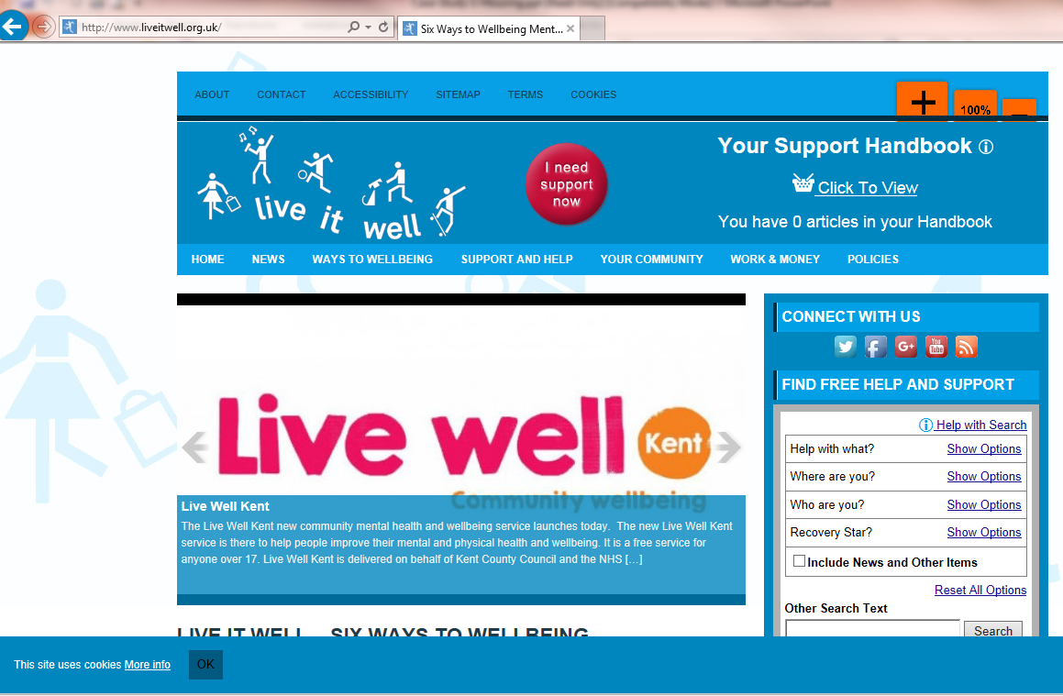
How do I know where to refer?

