Slide 1
Sheree Bell, Commissioning Officer
Emily Jones, Commissioning Officer
Emma Hanson, Head of Strategic Commissioning

Slide 2
Delivering Differently …. Devolution
Notes:
Government committed to decentralisation and to giving people more power to change things. Focus on community assets, physical and other
Local Government now has responsibility for things like Public health and health visiting and increasing control over budgets. Devolution deals potentially add a new dimension to this – even if many deals focus on economic growth, the focus on independence in terms of funding and revenue raising, and wider independence is important
Set against that:
Pressure on social care budgets and wider local government work.
Demographic change

Slide 3
Aim
Improve the case for neighbourhood devolution and develop better examples of what works in which services.
How
We were 1 of 24 local authorities looking to redesign services to deliver at neighbourhood level, working in partnership with local people and organisations

Slide 4
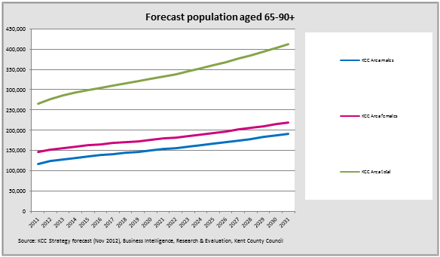
Challenge on an Unprecedented Scale
Budget reductions are tougher than any seen before
However, demand for services continues to increase
Health inequalities and rise of multiple long term conditions
Impact of our Ageing Population
Impact of Welfare Reforms

Slide 5
We have a duty to promote well-being
The Care Act:
Places well-being at its heart: and makes it the primary responsibility of local authorities to promote the wellbeing of both those with care needs and carers
It shifts responsibility from providing services to meeting needs
Focuses on the need for services to be preventative, and stresses the importance of using the existing strengths and assets of individuals and communities an assets based approach

Slide 6
A Life not a Service !
What does a good life look like for you and your family and how can we work together to achieve it?

Slide 7
Deficit Approach | Asset Approach
Identifies problems or needs | Identifies opportunities and strengths
People as service users | People with lots to offer and contribute
Does to people | Helps people to take control of their lives
Fixes people | Supports people to develop their potential
Focuses on individuals | Focus on communities and neighbourhoods

Slide 8
Outcomes
Support people to live as independently as possible for as long as possible
Create a win/win better care for less
Provision or brokerage of care for the community
Better support for family carers
A model for self funders too !

Slide 9
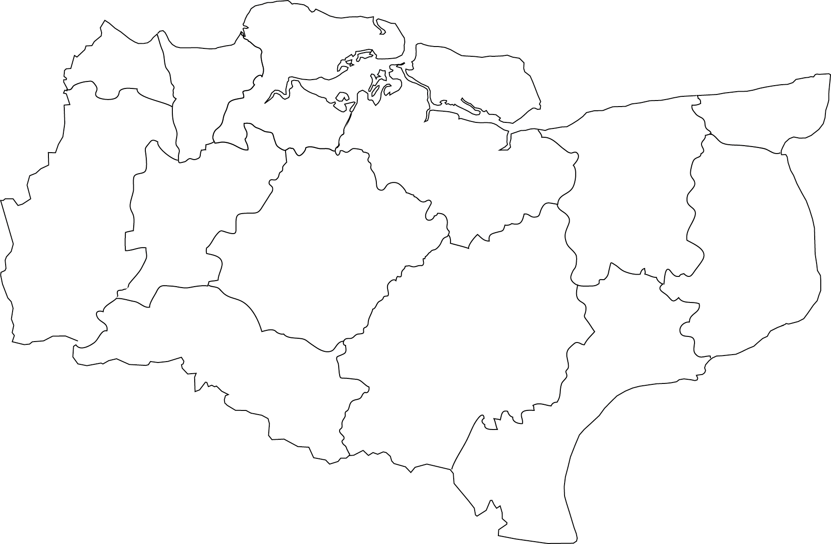
Delivering Differently….. where?
Newington
Big Local
Wye
Our Place

Slide 10
Tale of Two Communities
Newington | Wye
‘Urban & Deprived’ | ‘Rural & Affluent’
5044 residents | 2282 residents
702 residents are over 65 | 636 residents are over 65
18 people are 90 or over | 54 people are 90 or over.
34 people receiving an ongoing support package | 25 people receiving an ongoing support package.
The total annual spend is over £79,739 | The total annual spend is over £102,817

Slide 11
Our Place pmg (unincorporated)
OPW Community Interest Company
Social Care Co-operative (unincorporated)

Slide 12
So why the Social Co-operative Model….
‘A social cooperative is a multi-stakeholder group which brings together providers and beneficiaries of a social service as its members’
Equality
Diversity
Shared ownership and decision making
Notes:
Social Care Co-operatives: Are not-for-profit businesses owned and run by and for their members (customers, employees and residents).
As a minimum intention, we will explore whether the group can manage a system where assessment is undertaken, there is an increase in signposting activity and lower level support and preventative work can be offered e.g. befriending/preventing loneliness, facilitating attendance at community activities, providing information and advice.
However our aspirations may be broader and we will look to investigate whether the social care co-operative that we develop in Wye can begin to manage or deliver higher level social care in the home e.g. tasks of daily living and personal care.
The main aims are:
To work with a range of community stakeholders using co-production techniques to explore and understand what people need to remain active, well and connected to their communities:
To support self-management, enabling people to find their own care and support solutions and prevent or delay the need for statutory assessment and services.
To explore viable alternatives to traditional social care provision which are more locally accountable to the communities that they service, providing increased choice and control.

Slide 13
Questions asked….
Who works with older people in Wye?
What are the existing social structures?
What is the demographic of the people in Wye?
What are the care needs of people in Wye?
How is information currently communicated to the community?
What services are missing and what are the outcomes that you as a group would like to see
Notes:
Who works with older people in Wye:
Ashford Social Services
Wye Community Agent
Ashford Volunteer Centre
Ashford Care Navigator
Wye Surgery (inc Community Lead Nurse)
Wye Church (Inc volunteers)
Wye Library (inc volunteers)
Ashford Borough Council
Home care Providers
What are the existing social structures?
Churches
Parish Councils
Committees
Social Groups
What is the demographic of the people in Wye
Ex professionals
Older people
Younger people
Commuters
Int terms of assets this community is resource rich so why is there not a system set up already.
One of the main aims of the social care co-operative is to encourage the community to recognise the wealth of assets that already exist and how these can be coordinated by the deliverers and receivers of the services.
So in addition to looking at how communities might manage new budgets ie (social care or homecare budgets- the focus is also on how communities might coordinate existing budgets in a better way.
Eg- the volunteer centre already receives funding from KCC to deliver volunteering services to Ashford and district. 50% live in the town 50% live externally- little uptake from rural communities due to logistics.
What are the care needs?
How many people currently receive a care package?
What are the costs?
How many unpaid carers are there in Wye?
How is information currently communicated to the community?
Community Magazines?
Newsletters?
Websites?
Notice boards

Slide 14
Main focus of the Social Enterprise project in Wye
Reducing incidences of social isolation
Reduce loneliness in the village
Increase engagement
Improve communication
Community cohesion (especially across the ages)
Neighbourly ownership and involvement in providing “services”
Reducing incidences of calls upon GPs for non medical issues
Inward investment of capacity building in employable skills
Supporting family carers
Supporting people to live as independently as possible

Slide 15
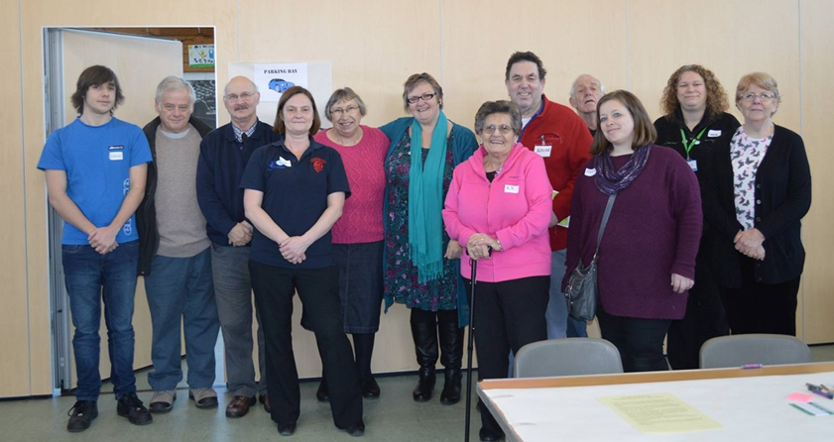
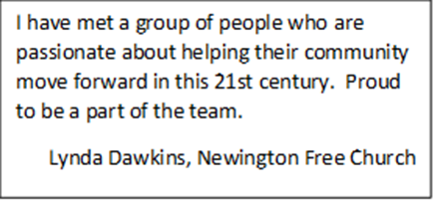
The Steering Group
Initiated in October 2015 and meets fortnightly. Membership consists of paid and unpaid representatives from:
Local Residents
Kent County Council
Newington Free Church
Ageless Thanet
St Christopher’s Church
Newington Community Centre
Newington Big Local
Kent Community Health Foundation Trust (Health Trainer)
Ramsgate Neighbourhood planning group
Fegans Family Centre
Ignite coffee morning
Thanet & Dover Carers Support

Slide 16
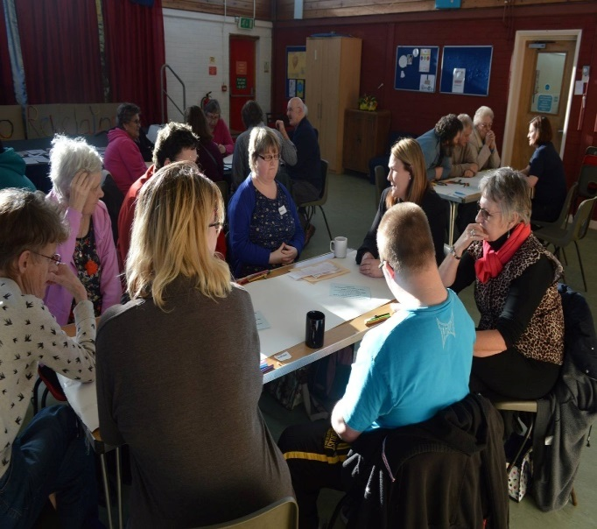
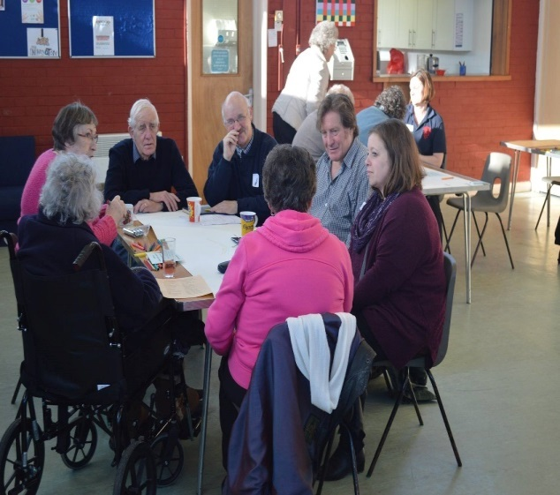
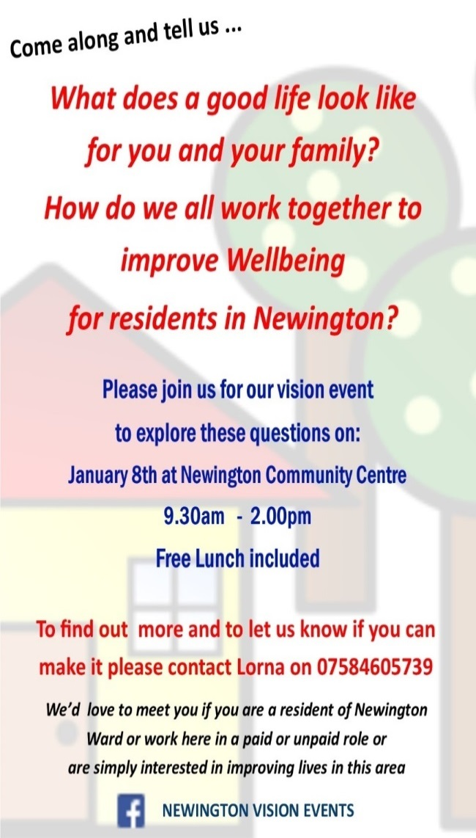
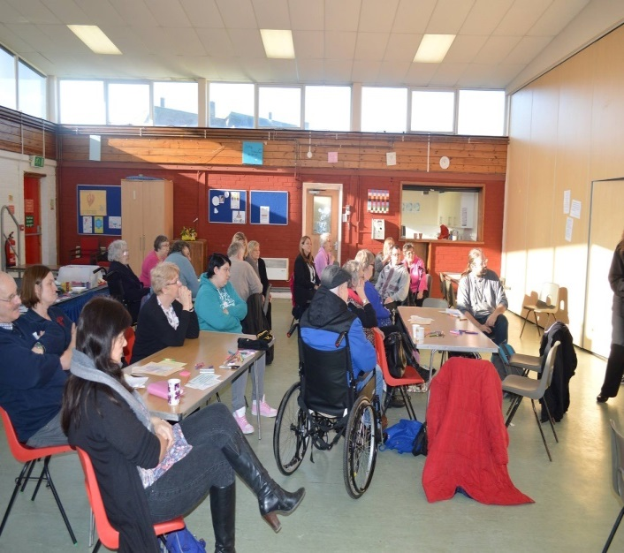
Vision Event January 2016
The visioning event had 35 participants register on the day and 3 who couldn’t attend but were interviewed afterwards, bringing the total of participants to 38.
They were a mix of local residents and workers, including older people, people with various disabilities and a small number of Carers.

Slide 17
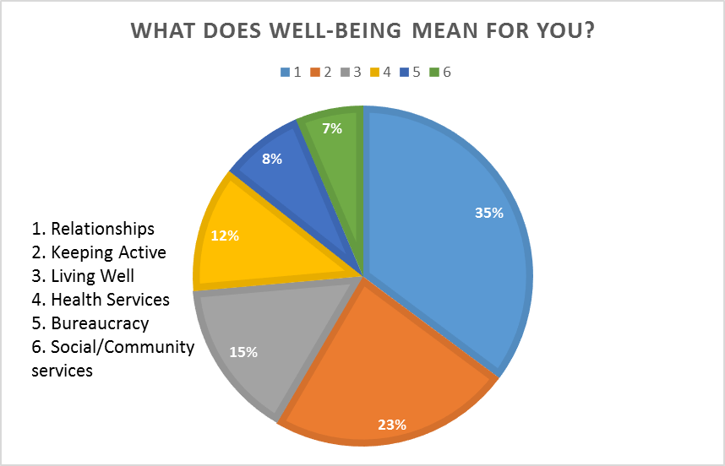
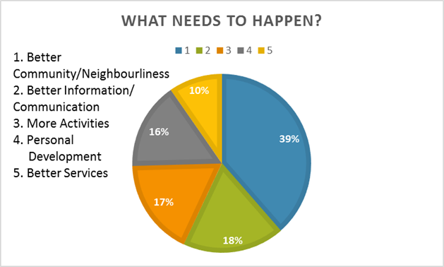
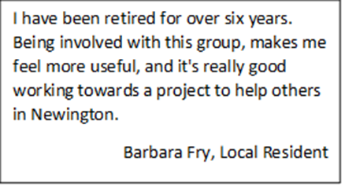
Improving relationships and community connections
Improving information-sharing and communication
Improving access to activities

Slide 18
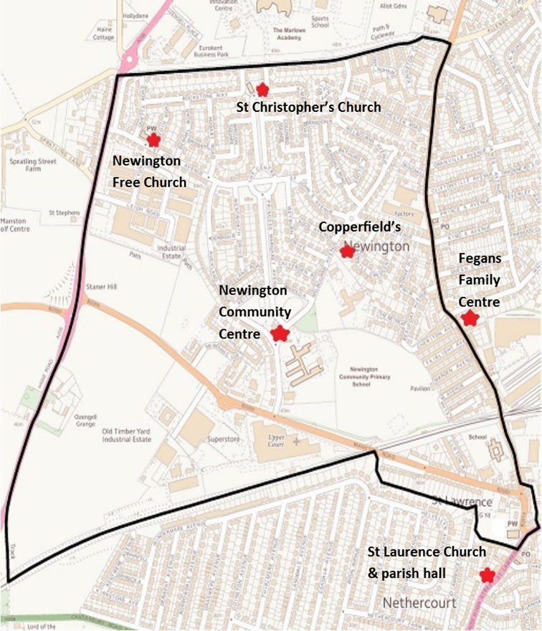
The Newington solution
The Wellbeing Network is overseen by the multi-stakeholder steering group
The steering group has overall responsibility for the co-ordination of the project
Each branch has representatives who facilitate neighbourliness & build relationships
Connections are made with vulnerable adults in the neighbourhood
Information flows through a regular information-sharing forum
Multiple forms of communication: Word of mouth, noticeboards, post boxes, newsletters, telephone trees, internet
Newington
Wellbeing
Network
Smaller areas are formed across the ward and each link into a community resource. These areas are called ‘Branches’.

Slide 19
The potential for increased wellbeing for vulnerable adults
who live in branches of Newington Wellbeing Network
Micro-enterprises: Low level social care, home maintenance, hairdressing, gardening, meal provision
Shared interests: Book clubs, film clubs, local history talks, Scrabble partners
Activity groups: Walking groups, ‘Walk n Push’ groups, keep fit, singing, dance
Local Exchange & Trading Schemes (L.E.T.S)
Local food growing schemes (Incredible Edibles)
Shop & share schemes
Social activities: Cook & share, theatre & cinema trips, parties & events
Increased Neighbourly Connections
Increased Community
Activity
and
Volunteering
Increased use of Community
Resources
Increased use of Local Businesses
Community Benefits

Slide 21
Key learning thus far ….
Understand and build on learning from existing and previous projects
Need an understanding of and an ability to work with:
Structures of hierarchy
Personalities and inter-personal dynamics
Need to:
ensure inclusion of all members
train people about co-production
empower people to make decisions
Communication, communication, communication !
Don’t under estimate Issues with obtaining and sharing data
This takes time … building trust happens slowly

Slide 22
Delivering Differently in Kent….
any questions ?

