Slide 1
Income Protection

Slide 2
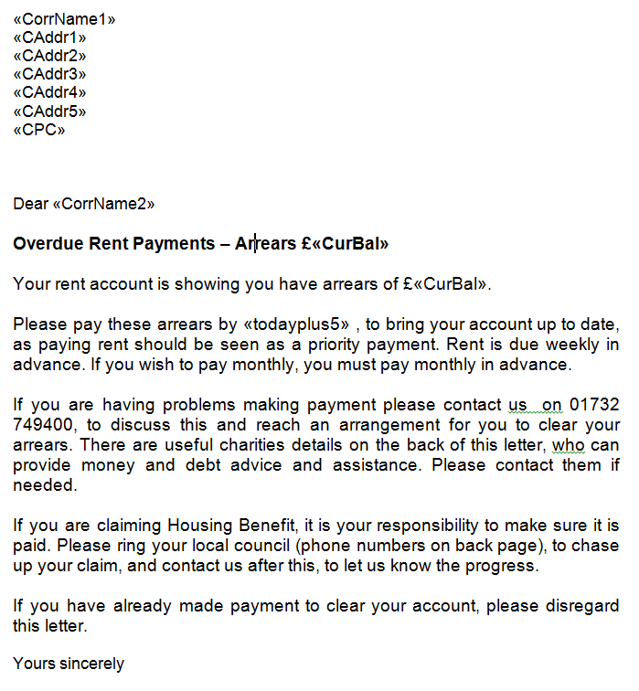
Notes:
Old letter

Slide 3
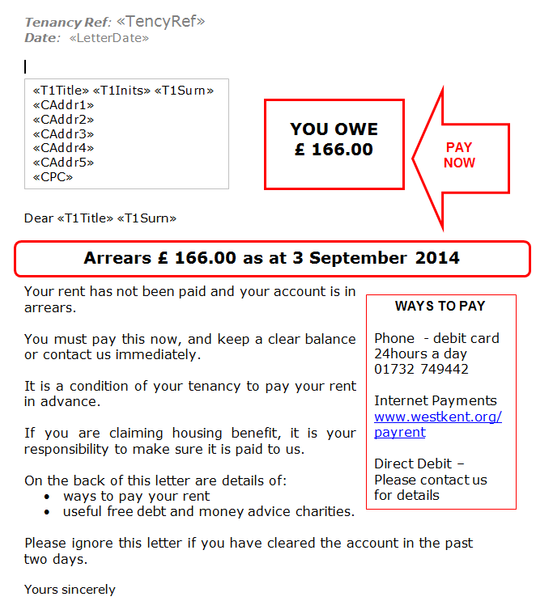
Notes:
Changed names on bottom as arrears progression escalates

Slide 5
Heather Day
Heather.day@wkha.org.uk
01732 749417

