Slide 1
Voluntary Right To Buy
Bob Heapy
Chief Executive
Town & Country Housing Group

Slide 2
Key principles of the agreement
Right to Buy discounts available for qualifying housing association tenants
Broad principles agreed nationally
Local Board control over which homes to sell, but a presumption in favour of sale
Full compensation at market value
Flexible one for one national replacement

Slide 3
Key principles of the agreement (continued)
Designed to allow access to home ownership for more people but not designed to meet every expectation
Qualifying tenants whose homes are excluded from sale will have a ‘portable discount’
Discounts (or portable discounts) contained in sector (i.e. cannot be used for open market purchase)
Government will publish ‘high level’ eligibility criteria (initially expected to be 10 years as a social tenant)
‘Claw back’ of discount for tenants who sell within 5 years

Slide 4
Timetable
September 2015
Launch of the Voluntary Right to Buy Deal
December–April 2016
Sounding Board, working group meetings and workshops
October–November 2015
Member engagement and sign up
May 2016
Royal Assent of Housing & Planning Bill
September– November 2016
Sounding board final discussions
TBC
Launch of scheme

Slide 5
Structure
DCLG ministers
Sounding Board
Chair: the Federation
14 housing association reps
DCLG, HCA, GLA and the
Housing Ombudsman
Workshops on portability, eligibility, LSVTs, CLTs, rural,
co-ops, supported housing
One for one working group
Chair: the Federation
Dep. Chair: DCLG
Applications and sales process working group
Chair: DCLG/HCA
Dep. Chair: the Federation

Slide 6
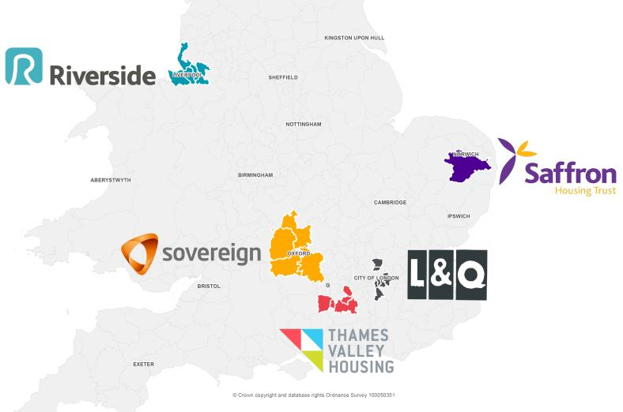
VRTB pilots
THAMES VALLEY HOUSING

Slide 7
VRTB pilots
Pilots are testing the application process, demand, and sales process
Not testing replacement and portability
Action learning – Sheffield Hallam
Inform the development of the main scheme

Slide 8
Outcome from the pilots
Expected levels of initial interest
Council of Mortgage Lenders (CML) supportive including the use of discounts as a ‘deposit’
‘Manageable’ levels of potential fraud, majority of issues benefit fraud
Lower levels of conversions into sales
Few complications in terms of process
Resource hungry in terms of managing expectations of tenants and process

Slide 9
Regulation
2016 Housing and Planning Act ‘expectation that housing providers will publish a home ownership offer’ – the VRTB will discharge that obligation
Providers that do not sign up ‘expected to publish an alternative offer’ – unfunded by government
Possible regulation and monitoring of home ownership offer as a new regulatory standard

Slide 10
The process
Work continues however…….
Fully digital
DCLG will operate a ‘national gateway’ the initial point of access
Tenants will register and the national gateway will be the first filter. Tenants will be required to pass certain criteria
Tenants that pass this criteria, if funding is available, will be given a URN
Tenants will then have 4 weeks to apply to their housing association with a formal application. Tenants that fail to apply within 4 weeks will need to re-apply

Slide 11
The process (continued)
The housing association will take a detailed review of tenants eligibility (including anti-fraud and affordability checks)
The housing association will consider if the property is restricted
If tenant passes and property is not restricted sale continues
If tenant passes but property is restricted a portable discount is offered
If tenant fails, process ends

Slide 12
You must consider applications and sales
Associations will need to develop a local sales policy by:
Understanding any contractual limitations on any sales which may be caused as a result of Section 106 agreements or other restrictive covenants in advance
Discussing with your Board how you intend to exercise your discretion and key principles by which you will operate VRTB in your local area
Publishing your local policy on how you intend to use your discretion so that it is clearly available to tenants when they apply

Slide 13
The application process
Consider how you will highlight key sources of information and advice to your tenants
Consider how your approach to VRTB can be integrated with your wider approach to home ownership
Consider how you will handle and respond effectively to tenant complaints

Slide 14
The application process (continued)
Think about how you would operate key elements of the application process. Would you prefer:
An online application form or paper application form?
Face to face interviews with tenants or home visits?
Consider developing your local RICS accredited list
Consider what checks and balances you could include in the process to help you identify fraudulent applications

Slide 15
Portability – key elements
Portability is offered where an association exercises their discretion not to sell one of their properties
Every housing association will need to develop a portability policy which should outline to tenants what a reasonable portability offer would look like

Slide 16
Portability - what we know
Part of voluntary offer so not open to legal challenge
Portability policy must be ‘reasonable’ and clear but will be different for different providers
Housing Ombudsman ‘do you have a policy, is it reasonable and have you applied it?’
Cannot be used in open market
Cannot be used for other housing associations or local authority stock (unless partnership agreement offered)
Can be used for housing associations own new build stock

Slide 17
What associations can do to prepare for portability
Consider which properties you are planning to exercise discretion not to sell
Consider what properties you will be offering to tenants with a portable discount
Develop your portability policy
If desired, establish partnerships with other housing associations

Slide 18
One for one replacement – key principles
National one for one replacement
Flexibility over the type, tenure and location of replacement home
Homes will be sold at market value and associations will be fully compensated
Presumption that replacement will be through building a new home
Open market purchase is an option

Slide 19
One for one replacement – recommendations made so far
When the delivery of replacements can start
What homes can be counted as replacements
The triggers for the payment of the discount
The principles that will underpin reporting
The type of data that will be reported on
The importance of development consortia
Other mechanisms that will help replacements

Slide 20
Outstanding issue
Funding (risk that RCFG or unallocated AHP funds may be redirected)
Sheltered and supported homes (differing opinions at NHF and VRTB Sounding Board)
Portable discounts, what is a reasonable offer?
Managing expectations of tenants who cannot buy due to central funding restrictions or unavailability of homes to port discount
One for one replacement, repayment of discount and backstop date
Potential to link with High Income Social Tenants (HIST)

