Slide 1
Housing Association Projects
5th September 2016 I Sophie Ward & Nicola File

Slide 2
Golding Homes

Slide 3
Golding Homes
Golding Vision is the community development arm of Golding Homes
Initial Consultation with young people in Marden led to an Archery Tag Project
January to March Pilot Project
10 weeks of activity across 4 areas of high housing stock in Maidstone
Cricket, Boxing, Fishing, Dance, Gymnastics
80 young people aged 5-18 engaged in the project
64% were female
Housing Association Project
Notes:
Golding Vision is the community development arm of Golding Homes which supports the work in developing sustainable communities and making a real difference to the quality of life of their residents. They aim to help our residents to make informed choices and improve their health and wellbeing.
Place shaping
Safer communities
Health and wellbeing
Financial inclusion

Slide 4
Golding Homes
Due to the success of the 10 week trial Golding Homes asked us to continue with a scaled up 20 week project.
Cricket, American Football, Dance, Archery Tag, Football, Boxing, Fishing, Gymnastics, Baseball/Softball
13 different sessions across the same four sites
At the midway check point 359 young people were engaged
Housing Association Project
Notes:
Golding Vision is the community development arm of Golding Homes which supports the work in developing sustainable communities and making a real difference to the quality of life of their residents. They aim to help our residents to make informed choices and improve their health and wellbeing.
Place shaping
Safer communities
Health and wellbeing
Financial inclusion

Slide 5
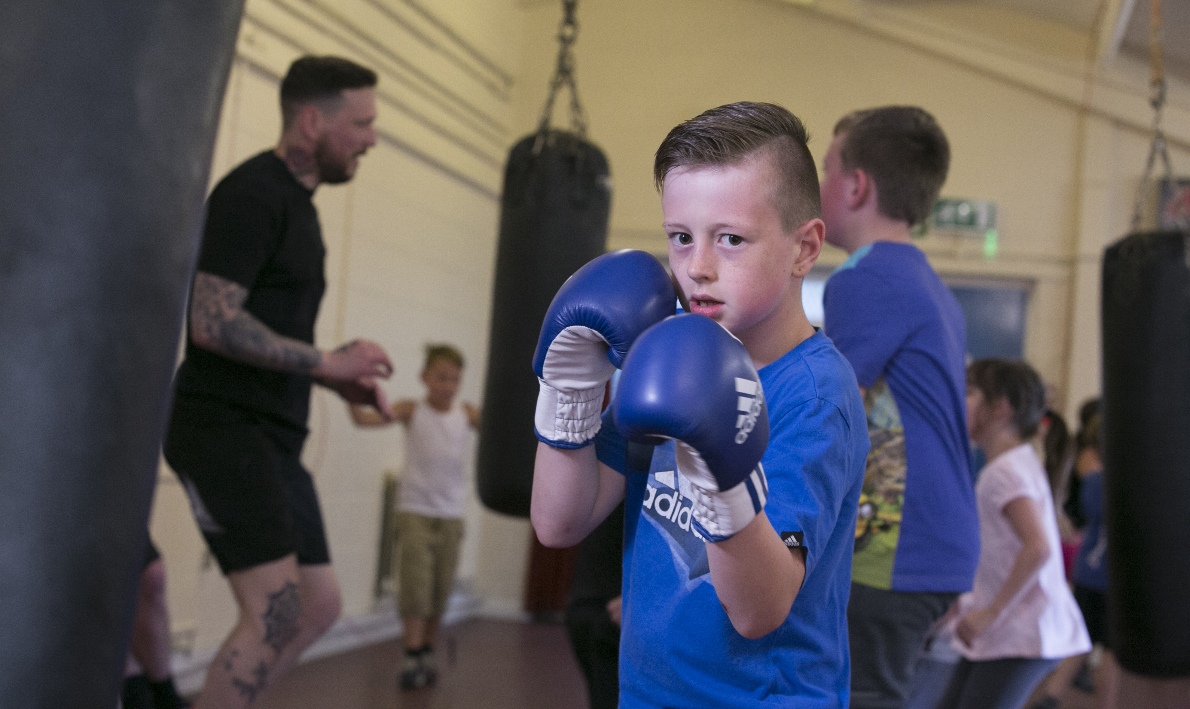
Golding Homes
Summary
359 young people engaged
Average of 13.4 per session
Throughput of 1156
£28,000 levered in to Kent for this project
Housing Association Project
Notes:
Golding Vision is the community development arm of Golding Homes which supports the work in developing sustainable communities and making a real difference to the quality of life of their residents. They aim to help our residents to make informed choices and improve their health and wellbeing.
Place shaping
Safer communities
Health and wellbeing
Financial inclusion

Slide 6
Proposal

Slide 7
Proposal
Due to the success of the programme we are now exploring the opportunity to expand and develop this offer by rolling it out across new areas in Kent.
Canterbury
Dover
Swale
Each project will be tailored to the needs to the area and outcomes of partners involved
Attending Kent Engagement group meeting on 18th Oct
Working to source external funding to support
Housing Association Project

Slide 8
Amicus Horizon

Slide 9
Amicus Horizon
October Half Term Programme of activity
Boxing
Cricket
American Football
Archery Tag
Football
Baseball
Using local authority sites and local clubs
Further 10 week project starting Jan 2017
Housing Association Project

