Slide 1
The Future of Housing in Kent and Medway 2016 & Beyond
Issues for a non stock holding authority
Satnam Kaur
Chief Housing Officer

Slide 2
Financial Pressures Significant Reduction in Core Funding
2019/2020
65% T&M
(National average 44% )

Slide 3
Financial Pressures
New Homes Bonus Consultation
Reduction in payment period - 6 to 4 years
Redistribution of payments to adult social care
Restricted Council Tax Increases
Cumulative affect circa 50% reduction in funding by 2019/2020
Larger funding reductions for District Councils compared with upper tier authorities

Slide 4
T&M Current Position
Affordability Issues
Circa 1,000 households on Housing Register
Increased homeless presentations & acceptances
- 50 % in last two years
Increased use of TA & length of stay
SHMA – 673 homes gross pa 2011-2031
SHMA – 277 affordable homes pa (70% rented, 30% shared ownership)

Slide 5
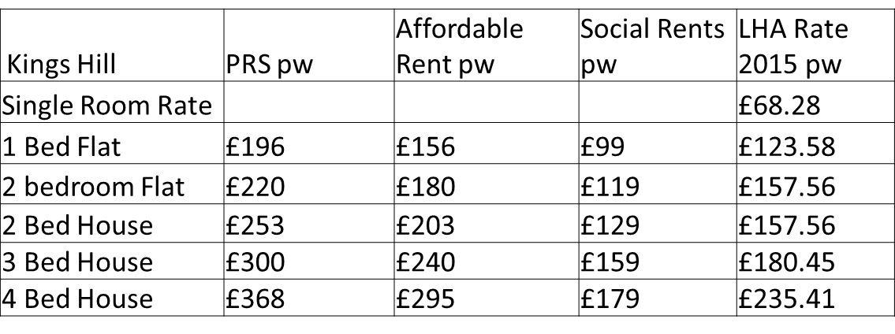
Affordability Pressures
Shared Ownership Example
2 bed end terrace OMV = £320K Mortgage pcm - £498
Household income = £56K Rent pcm- £513
% share purchased = 30% (£96K) Service Charge pcm - £25
15% deposit = £14,400 Total cost pcm - £1,036
Mortgage = £81,600

Slide 6
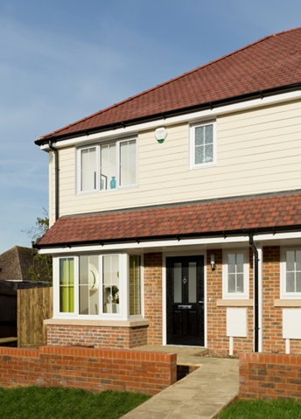
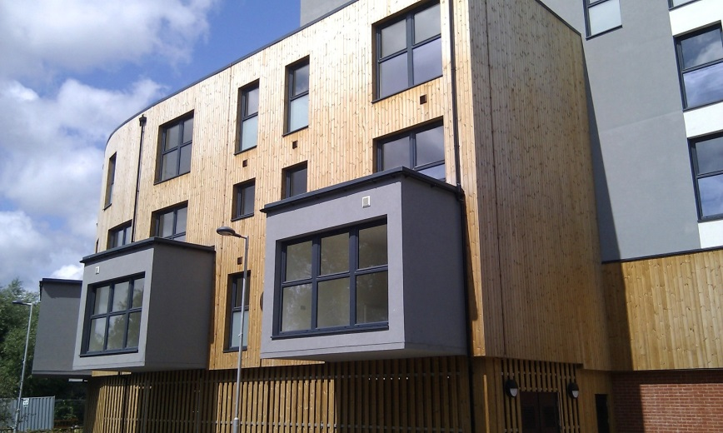
Affordable Housing Completions 2010-2015
628 new homes
456 rented homes
172 shared ownership

Slide 7
Headlines & Impacts
Proposed Changes to Planning Policy
Rent Restructuring
Right to Buy (Housing Association Tenants)
Pay to Stay
Benefit Cap Reduction
Freezing of LHA Working Age Benefits
End of Automatic H/B Entitlement for 18-21 year olds
Capping HB for social rents to LHA Levels

Slide 8
Summary
Stricter Affordability criteria – where will we rehouse vulnerable groups?
How and to whom will affordable homes be allocated?
How will LAs discharge statutory duties?
Likely increase in homeless presentations
How can we ensure that we are meeting local housing need?
How can we work in partnership to deliver both new and traditional priorities?

