Slide 1
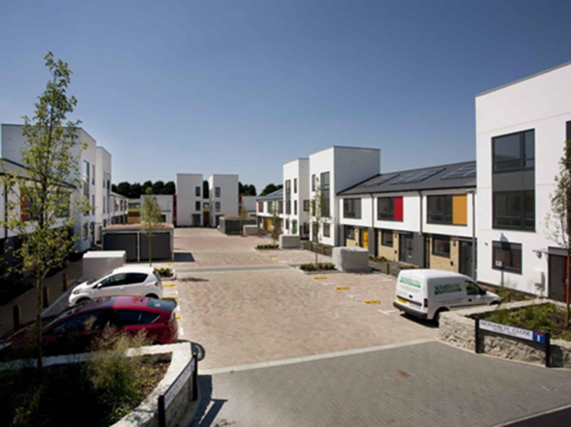
‘Survive to Thrive’ Golding Homes Response to Government Changes
Peter Stringer Chief Executive, Golding Homes

Slide 2
About us : a few facts
Treasury Borrowing £170m
Turnover £34.3m | Operating Surplus 31%
New Homes Programme 200 per annum | Staff 182
Executive Management Team 4 | Board 10

Slide 3
Business Strategy 2015-20
Priority 1 – Growing the number of homes we provide
Priority 2 – Investing in assets and communities
Priority 3 – Retaining our financial strength
Priority 4 – Delivering excellent customer service
Priority 5 – Developing awareness of our work amongst our people and partners

Slide 4
Impact on
GOLDING HOMES….
Notes:
Viability
Reduced HA income streams by £50bn over 30 ears
Growth
Reduces NPV heavily so immediately affected bids for land led and s.106 schemes

Slide 5
Impact: Business Plan
We assumed rent rise of 3% (CPI+1%) for each year
HOWEVER….
Income reduction by £1.2m in year one reduction by £5m by year five (-14%)
Asset valuation reduction by 30%
Borrowing capacity reduction by £60m
Annual surplus reduction to £5m from £10m
Bad debt costs increase by £1.5m
RTB2 and ‘Pay to Stay’ impact uncertain
Notes:
Rent reduction compares with assumed rise of 3% (CPI+1%) A for each year
Difference – 1.2m in year one rising to £5m (14%) less income per year by year five (2020-21)
Asset cover/valuations – reduces valuation by 30% and borrowing capacity by £60m
Annual surplus reduced to £5m (was £10m)
Bad debt costs increase by £1.5m – 500 households subject to benefit cap
RTB and ‘Pay to Stay’ unknown but will weaken plan further

Slide 6
Impact: Development of New Homes – 10 year programme
Tenure | Before |  | After
 | No | % | No | %
Social rent | 50 | 25 | Nil | 0
Affordable rent | 60 | 30 | 30 | 20
Shared ownership | 40 | 20 | 45 | 30
Market rent | 40 | 20 | 45 | 30
Outright sale | 10 | 5 | 30 | 20
Total annual programme | 200 | 100 | 150 | 100
Assumes £2.5m PA savings Assumes no RTB2 replacements Reduces new homes by 25% PA and no social rented homes!

Slide 7
Impact: Financial Plan - revised assumptions post-budget
Description | % Pre-budget 2015-2016 | % Post-budget 2016-2020
Rent increase | 2.2 | -1 *
Inflation | 2.3 | 2
Cost increases above inflation | 0.5 | 0
Employee cost increases | 0.5 | 0.5
Libor | 1.1 | 4
* Assume CPI only (2%) rent increases from 2020/21 onwards Assume 1000 new homes in management with no growth in staff headcount!

Slide 8
Big question for housing associations How do we replace loss of income?
Do we…….
Recover all lost income from savings?
OR
Absorb losses and stop developing new homes?

Slide 9
Can we grow our income?
Stock rationalisation – more acquisitions from other HAs
Homes for sale
Asset disposals
Services charges and new sources
Commercial activity (market rent, shops)
Stock transfer
Take over - smaller HAs
Notes:
Stock rationalisation – more acquisitions from other HAs
Homes for sale
Asset disposals
Services charges and new sources
Commercial activity (market rent, shops)
Stock transfer
Take over struggling smaller HAs

Slide 10
Can we reduce our annual operating costs by £2.5m?
Reduce interest costs
Smarter procurement
Asset management
Development strategy
Doing things differently
Lean thinking – things we should STOP DOING
Channel shift to Digital First
Strategic options (merger/service-sharing)
Staff structures
Notes:
Treasury and Covenants – reduce interest costs
Smart procurement
Asset management – maintenance and disposals
Development strategy – shift to home ownership products/higher returns
Doing things differently
Lean thinking – things we should STOP DOING
Channel shift to Digital First
Strategic Options – merger or shared services models
Staff structures - headcount and terms and conditions

Slide 11
Survive to Thrive: we will not…
Rely on uncertain revenue streams
Duplicate effort
Pursue customer satisfaction at all costs
Do projects that don’t support our vision
Ignore the link between investment in existing homes and overall customer satisfaction
Notes:
Pursue capital intensive schemes and products which rely on uncertain revenue streams
Duplicate effort and waste energy internally and externally (with our partners)
Pursue customer satisfaction where this means exponential increases in management costs
Clutter our business model with projects that don’t support our vision
Fail to recognise the direct link between investment in existing homes and overall customer satisfaction

Slide 12
Survive to Thrive: we will…
Recognise that scale is vital to future success
Put more emphasis on efficiency and resilience
Embrace organisational change
Consider deregistration?
Recognise the tension of being more ‘commercial’ against our ‘social purpose’
Segment our offer based upon customer intelligence
Notes:
Recognise that scale is vital to future success
Put more emphasis on efficiency and resilience
Accept organisational change
Consider deregistration option?
Recognise the tension between a need to be more ‘commercial’ and retaining our ‘social purpose’

Slide 13
Survive to Thrive: we will…
Favour more ownership initiatives and products
Manage risk
Focus on digital self-service
Create pathways to employment
Intervene (housing management) less and enable (community investment) more
Notes:
Favour more ownership initiatives and products
Manage risk and create resilience
Focus on digital self-service for most customers (80%) - safeguarded offer for most vulnerable
Create pathways to employment
Give less intervention (housing management) in favour of more enabling (community investment)

Slide 14
A few questions for discussion…
How do we manage the tension between a need to be more ‘commercial’ whilst retaining our ‘social purpose’?
What activities should we stop doing?
In the ‘drive to digital’ world, do we have smart customer intelligence that will allow us to segment our offer?
How might the deregulation of Housing Associations introduce new tensions in the relationship with Local Authorities?
Notes:
How do we manage the tension between a need to be more ‘commercial’ whilst retaining our ‘social purpose’?
What activities should we stop doing to create efficiencies that deliver more new homes and investment in existing housing stock?
In the ‘drive to digital’ world, do we have smart customer intelligence that will allow us to segment our offer by tenure type and vulnerability?

Slide 15
Thank you
Peter Stringer
Chief Executive, Golding Homes
0300 777 2600
Peter.Stringer@goldinghomes.org.uk
Twitter: @goldinghomes
www.facebook.com/goldinghomes

