Slide 1
The Royal British Legion Zoe Kirby Advice and Information Officer

Slide 2
Our Mission Statement
To be the No.1 provider of welfare, comradeship, representation and remembrance for the Armed Forces Community

Slide 3
Who is Eligible?
Notes:
Those eligible for our support can be summarised as people who are serving or who have served in the Armed Forces (having drawn 7 days’ pay), their dependants and carers.
'Dependants' can include children, spouses and partners (including widows or widowers)
It is estimated that over 6 million people fall into this category
Meeting our eligibility criteria entitles you to apply for our assistance – but doesn’t guarantee that support can be given. Some services have extra criteria (such as needing to be in receipt of means-tested benefits).

Slide 4
Our Area Team – South East

Slide 5
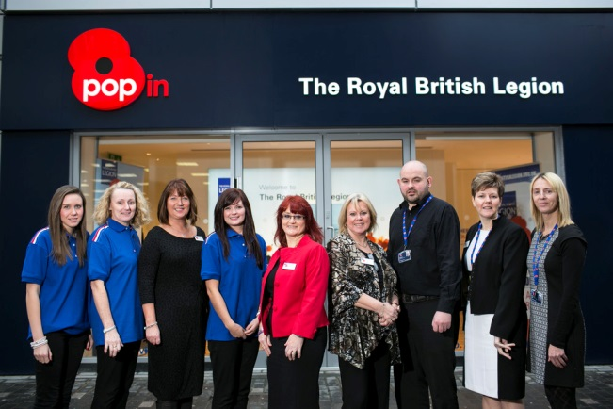
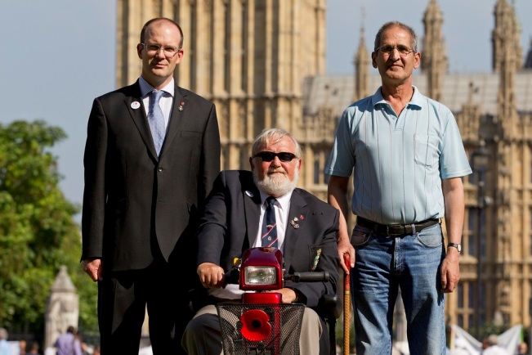
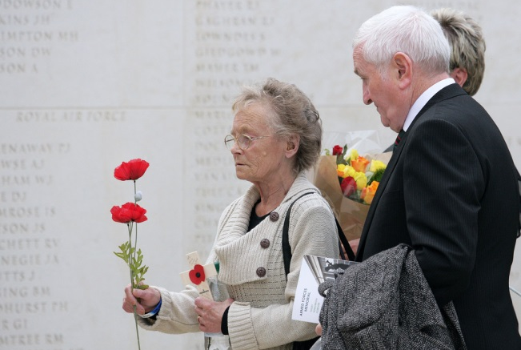
Three Core Areas
Information & Support
Advocacy & Campaigning
Remembrance
Underpinned by:
Membership
Fundraising
Central Services
Notes:
* The Legion’s work falls into 3 Core Arears
* We provide life-long help and support for the whole Armed Forces community.
* We work with politicians to improve the lives of that community and we have been involved in many campaigns on a range of issues the affect them.
* We are one of the UK’s largest membership organisations with over 270,000 members.
* We’re also the nation’s custodian of Remembrance, making sure that the sacrifice of the fallen and injured is never forgotten.

Slide 6
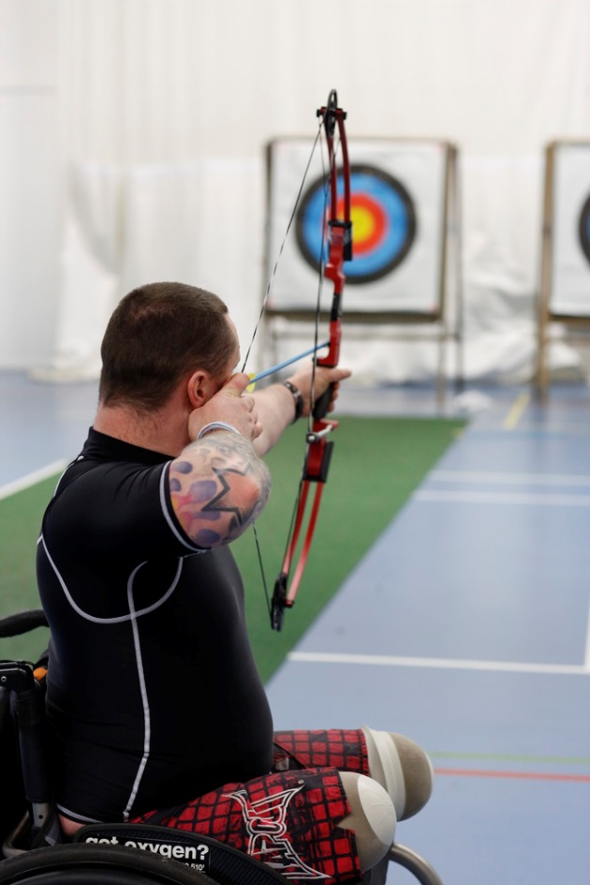
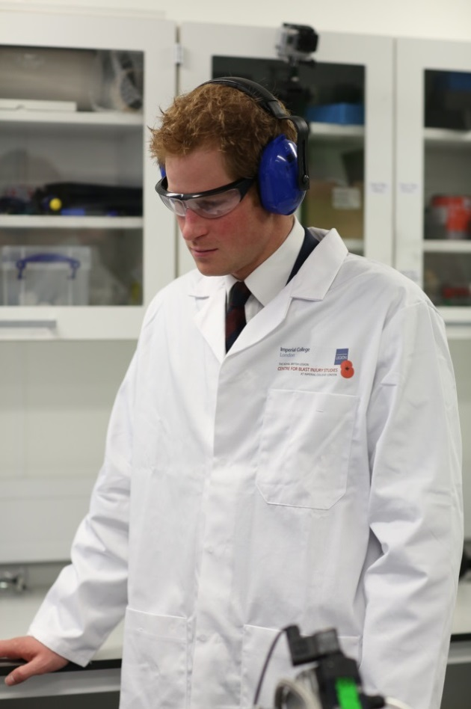
Big Projects
Defence Recovery Capability
The Battle Back Centre (Lilleshall)
Blast Injury Centre at Imperial College
Notes:
* Defence Recovery Capability:
The Legion has an ongoing commitment to the Defence Recovery Capability and these projects are just two of the ways we fulfil it.
The Defence Recovery Capability is a Ministry of Defence led initiative and managed in partnership with Help for Heroes and The Royal British Legion. It is designed to ensure wounded, injured and sick service personnel receive co-ordinated support. Recovery activity under the Defence Recovery Capability ensures that wounded, injured and sick personnel have access to all the key services and resources needed to help them either return to duty or make a smooth transition to an appropriately skilled civilian life. This care is delivered across the defence community by the combined efforts of the Services and the Service charities responding to carefully tailored individual recovery plans setting out a recovery pathway.
* The Battle Back Centre:
The Royal British Legion provided £27 million to establish and operate The Battle Back Centre, Lilleshall, as part of its commitment to support wounded, injured and sick Service personnel.
The Battle Back Centre is part of the MoD's Defence Recovery Capability programme and provides sports and adventurous activities for wounded, injured and sick Service people from across the Armed Forces. The Centre exists to help people achieve their best possible recovery and either return to Service duty or to make a smooth transition to civilian life.
* Blast Injuries Studies:
The Royal British Legion Blast Injury Studies Centre at imperial College was officially open by Prince Harry in October 2013. It is a joint project between the Legion and the College to carry out research into the effects of blast injuries caused by roadside bombs and other IEDs. The Centre aims to develop ways of reducing blast injuries as well as develop improved treatments for those that have suffered them.
* Personnel Recovery Units
If an individual’s case is particularly complex or recovery is likely to take more than 56 days, they could be transferred to a Personnel Recovery Unit (PRU). A PRU will ensure they receive a consistent and high quality command and care provision that will deliver the right outcome for the individual and the MOD, however long that takes.
There are 11 PRUs spread across the Regional Brigades, London and in Germany. Once transferred to a PRU, personnel are allocated a Personnel Recovery Officer (PRO) who will be is their military point of contact. The PRO will provide support throughout the period of recovery whilst in service, including regular home visits.

Slide 7
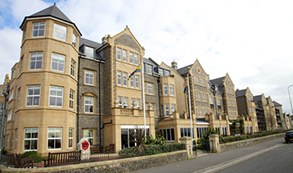
Break Service
Break Centres –They offer a quality, hotel styled breaks to beneficiaries
Family Holidays – Offer families a chance to enjoy a family holiday in either a Holiday Park or Break Centre during school holidays
Adventure Holidays – Offered to children between 8 and 17
Poppy Pods - The Pods provide residential holiday/respite facilities for service personnel, veterans and their families. The Pod Village has been designed with accessibility in mind
Notes:
Breaks Service: The Royal British Legion offers beneficiaries the chance to escape the pressures of daily life through 3 types of welfare break.
* Break Centres – The Legion offers much-needed breaks to ex-Service and serving personnel and their families. If you or a member of your family is recovering from an illness, bereavement, social isolation or other life-affecting event, the Legion can provide a comfortable and enjoyable break.
* Family Holiday’s Service – The Legion provides families of serving and ex-Service personnel the chance to take a break and get away from the stresses and strains of everyday life. These break can take place at Our Break Centres, Parkdene or Haven Holiday Parks or Centre Parcs.
* 3. Adventure Holidays – The Royal British Legion offers FREE week-long Adventure Breaks to children of men and women who are currently serving, or have served in the Armed Forces.
Adventure Breaks are a great opportunity for young people to enjoy themselves, meet new people, have new experiences, improve their self-esteem and most of all have fun, while giving parents a well-earned break.The Legion’s Adventure Breaks are provided in partnership with Xplore the World (formerly KG Adventure). Adventure Breaks are available from 13 to 20 August 2016

Slide 8
Care Homes
6 Care Homes
4 with specialist dementia care
Maurice House, Callis Court Road Broadstairs, Kent CT10 3AH
Notes:
The Legion has six care homes to provide short and long term care for serving and ex-Service people and their dependants. Situated around the country, they offer a wide range of services including four with specialist dementia care.
Private nursing homes – not funded
Respite care can also be provided according to availability

Slide 9
Independent Living Advice
Advice, support and advocacy for beneficiaries living with long term illness, continuing care or disabilities, or caring for someone with these conditions.
Help to access statutory support and advocate with care agencies
Challenge decisions made by their local authority
Reduce social isolation amongst beneficiaries
Provide on-going Support
Notes:
The new service will provide advice, support and advocacy for beneficiaries living with long term illness, continuing care or disabilities, or caring for someone with these conditions, helping them to access statutory support where necessary.
Advocate with care agencies when problems arise
Challenge decisions made by their local authority in relation to care packages, disabled facilities grants, personal budgets, direct payments etc.
Reduce social isolation amongst beneficiaries
Provide advice and support to the Royal British Legion’s Area Teams and other specialist teams
Support is on-going

Slide 10
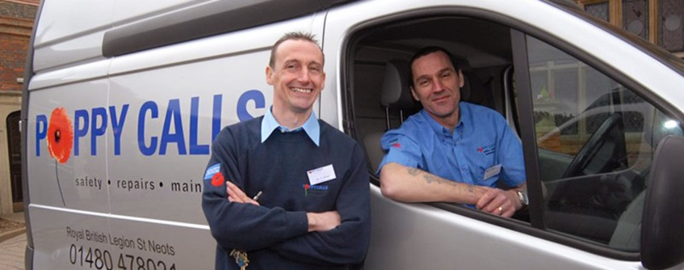
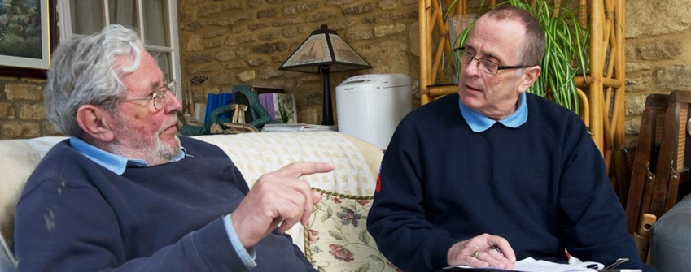
Handy Vans
Free household checks for physical security, winter warmth and fire safety
Low level or minor repairs
Adaptations and falls prevention
Mobility aids
Notes:
Free household checks for physical security, winter warmth and fire safety
Assess a property for resilience to burglary or break in
Check property is fully fire tested
Fit smoke and carbon monoxide detectors as standard
Provide winter warmth packs to vulnerable beneficiaries
Low level or minor repairs
Replacing lightbulbs
Erecting flat pack furniture
Installing spyholes, door chains or door viewers
Repairs such as replacing bath and sink taps, replacing locks and latches
Adaptations and falls prevention
Install internal and external grab rails
Construct timber, brickwork or slabbed step access
Fasten loose carpet, rugs or runners
Mobility aids
Install toilet seat risers
Install chair/sofa raisers
Install floor to ceiling post support
All Handy Van Fitters can provide advice and information on all Legion Services and are aware of other service providers in the local area.
Work is free of charge to beneficiaries receiving a means tested benefit or aged 70 or over (includes war pension and Armed Forces Compensation)
All Handy Van Fitters are:
DBS Checked
Carry full identification at all times
Drive a Legion branded vehicle and wear a Legion branded uniform
Trained to the recent Health and Safety guidelines
Work to a customer Charter
The Handy Van Service is accredited by Trustmark.

Slide 11
Benefits, Debts and Money Advice
Support to those facing debt problems
Specialist advice and support to those dealing with complex benefit issues
Delivered face to face and over the telephone
Work with the Armed Forces to promote better money management and the Moneyforce website
Notes:
The Financial Capability Service is made up of the Benefits and Money Advice Service and the War Pensions and Compensation Service:
Benefits, Debt and Money Advice Service:
Specialist advice and support to those facing debt problems.
Types of cases include acting as a Debt Relief Order intermediary, representing at County Court to defend possession proceedings or money claims, negotiating with creditors and challenging debts.
Specialist advice and support to those dealing with complex benefit issues, which could include providing advice on welfare benefit decisions, challenging welfare benefit decisions and representing at Tribunal.
BDMA advice will be delivered face to face and over the telephone, with Connect Assist providing the telephone based service.
Area Office will continue to commission the service through the Regional Lead.
Face to face BDMAs will also link in with the Armed Forces to promote better money management and the Moneyforce website.

Slide 12
War Pensions and Compensation
Specialist advice on War Pensions and compensation awards and deterioration claims, including entitlement and award disputes
Representation at Tribunal
Advice on merits of the case
Advice on supplementary allowances
Notes:
War Pensions and Compensation Service:
Specialist advice on War Pensions and compensation awards and deterioration claims, including entitlement and award disputes
Representation at Tribunal
Advice on merits of the case
Advice on supplementary allowances
All appellants are encouraged to attend an advice clinic to discuss the case prior to their Tribunal.
There is no selection process and, if the appellant wants TRBL to represent them, we will do so, regardless of likelyhood of success.

Slide 13
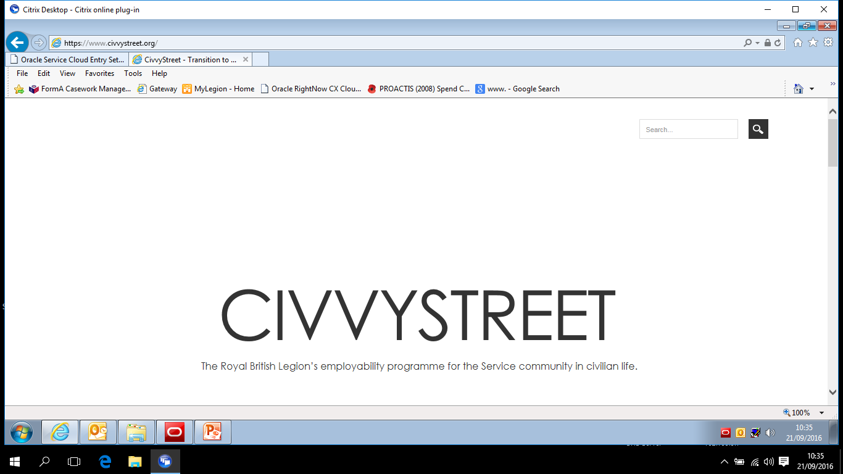
Employability
Notes:
Our Civvy Street website at www.civvystreet.org is designed to help you adjust to life on civvy Street and kick-start a new career.
if you register for free, you can get access to a collection of online training courses that you can personalise to fit your needs.
You can also use our CV builder, which is an easy way to create the best CV you possibly can - completely free.
Civvy Street lists up-to-date job vacancies that are easy to search, and you can even search for jobs specifically for ex-Service personnel.
resources that can help you prepare for interviews
call our helpline for free on 0800 169 4073.
Employment Support Grants:
The Legion’s Employment Support Grant Scheme is designed to help low skilled and unemployed Legion beneficiaries with assistance to achieve sustainable employment.
An Employment Support Grant can be used to:
Fund skills development courses
Pay for costs associated with attendance on a course
Pay for costs associated with a job offer, such as clothing, equipment and travel costs.
SORTED! comprises of seven well established charities, which provide a wide range of employment related services and support for the Forces community (including spouses/partners and dependents) to find and stay in work. These services have now been integrated into seamless employability support and guidance.

Slide 14
Outreach Support
Increase support to the most vulnerable and socially excluded
Complex or multiple needs
On-going support
Improve quality of life and maximise opportunities
Collaborative work with
specialist agencies (statutory and voluntary sector)
Notes:
* The Service supports beneficiaries and their families who either are or may be at risk of becoming vulnerable and or marginalised as a result of complex or multiple needs/issues relating to,
alcohol dependency, substance misuse, domestic violence, homelessness, physical health, mental health, safeguarding, offending and POVA.
* We work together usually for a period of 3 months. Create Individual Support Plan, Set goals for clients and ourselves and Engage those who can make a difference and secure positive outcomes.

Slide 15
Grant Giving
Crisis Grants
The Scheme doesn't provide cash, but can provide essentials for you and your household in times of need.
Notes:
A grant might be to cover the costs of something like:
* A funeral
* Furniture and household appliances
* Essentials, like food and clothing
* Mobility vehicles
* Adaptations to your home for a disability
* Help getting into rented accommodation.
However, we are not able to help with:
Where state assistance or statutory services are available
* Repayment of business debts
* Legal expenses, such as county costs and solicitors' fees
* Loans, other than Property Repair and Be the Boss loans
* Medical care.

Slide 16
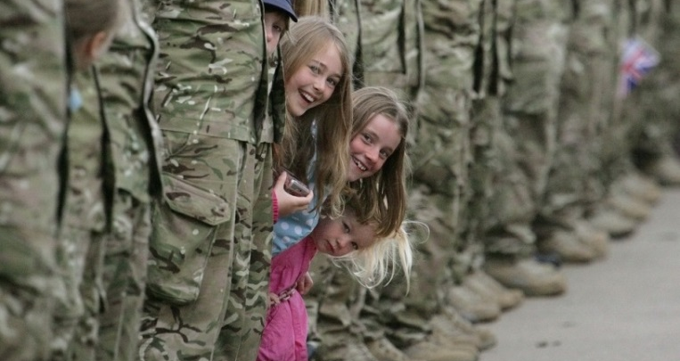
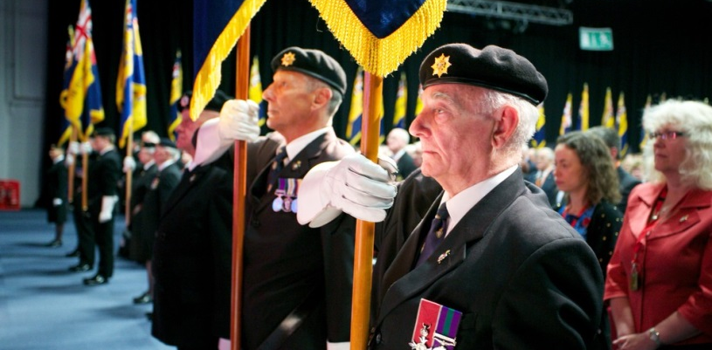
Membership
270,000 members
2,500 branches
Over 2 million Facebook fans
Over 120,000 follow @PoppyLegion on Twitter
Notes:
* The Legion has over 270,000 members and 2,500 branches many of whom help organise the Poppy Appeal every year, as well as bringing the good work of the Legion to their local community.
* Our social media presence is growing all the time, our Facebook page, Maximum Respect for the British Armed Forces, has over 2 million fans and our Twitter account @PoppyLegion has over 120,000 followers

Slide 17
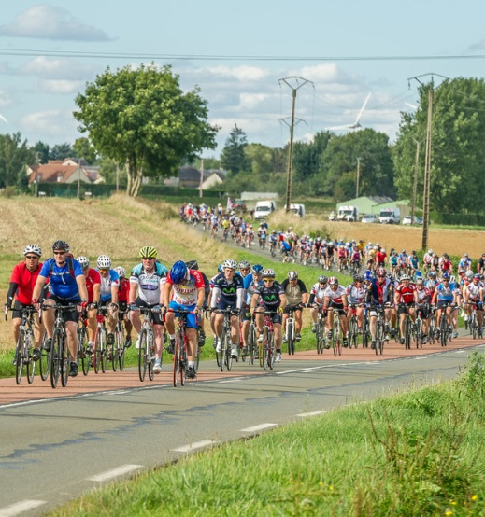
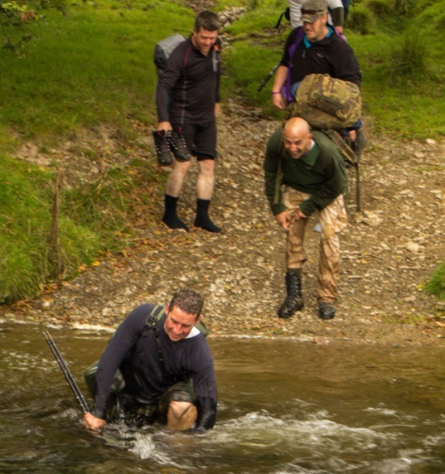
Fundraising
London Marathon
Pedal to Paris
Challenge Events
Notes:
* Thousands of people across the country raise millions of pounds for us each year taking part in sporting events such as the London Marathon, our London to Paris bike ride Pedal to Paris or extreme challenges such as the Exmoor 30:30 or Freedom Trail.
* Many more help secure the future for Service people and veterans a like by leaving us a legacy, or gift, in their will. FREE WILLS SERVICE

Slide 18
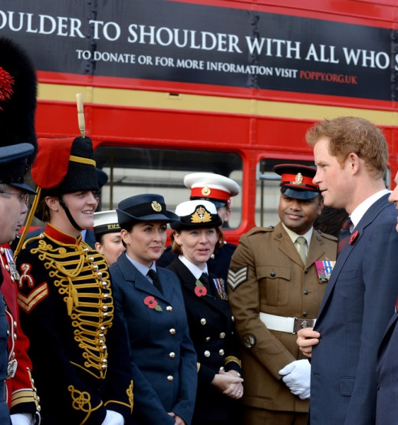
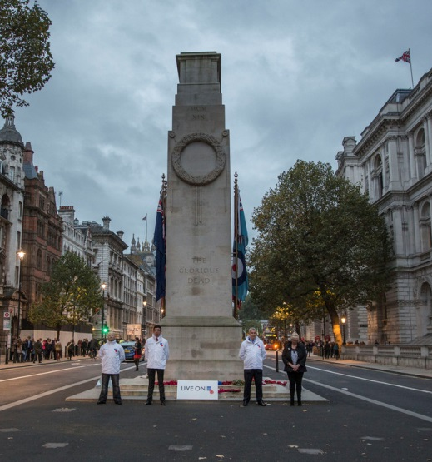
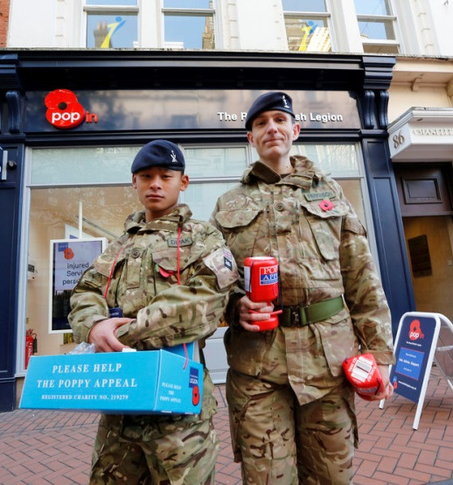
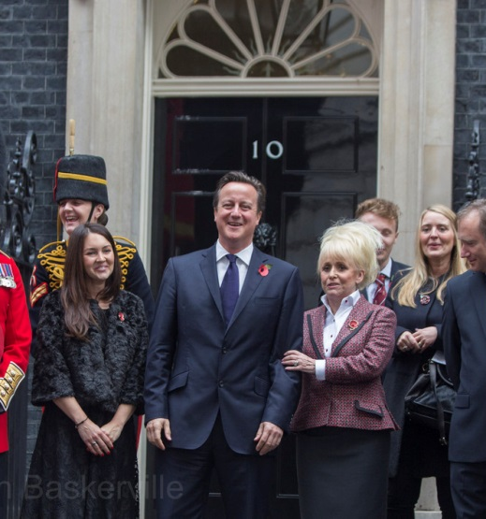
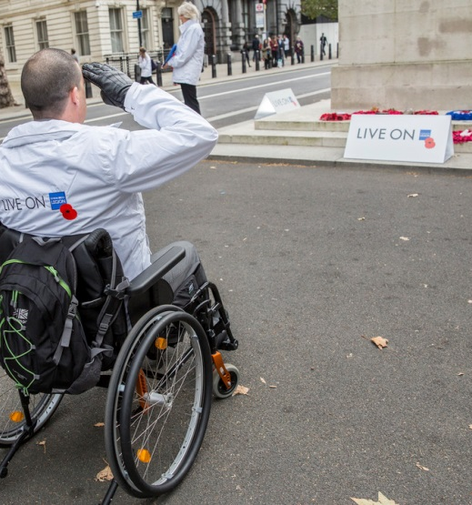
Poppy Appeal
Notes:
* Every year the nation comes out in force to support the Poppy Appeal during October and November.
* London Poppy Day is a well-established part of the Appeal, increasing its fundraising total every year, and this time the 2000 uniformed and civilian collectors that flooded the streets and stations of London raised a staggering £1.25 million in a single day! Inspired by success in the capital the ‘Poppy Day’ theme was rolled out across England and Wales with events taking place in Birmingham, Bristol, Manchester and Plymouth to name a few.
* Kent 2015 Poppy Appeal - £1.4 million

Slide 19
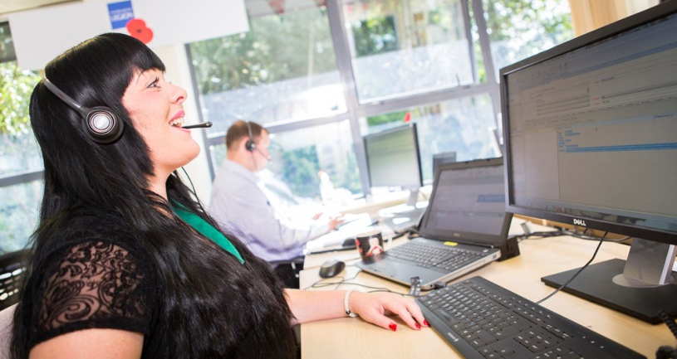
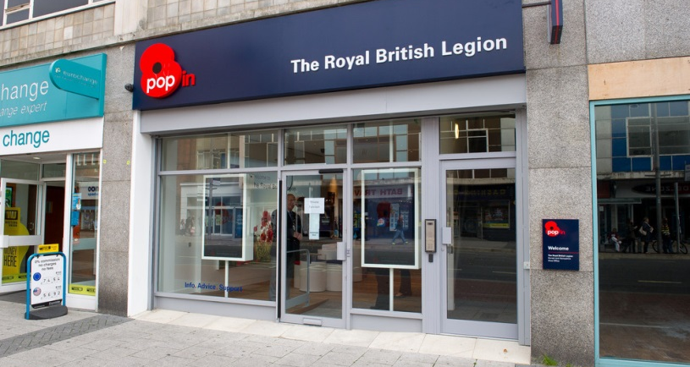
How to Contact Us
Phone - 0808 802 8080
Face to face at Pop In centres
Online - www.britishlegion.org.uk

Slide 20
THANK YOU

