Slide 1

Accommodation Strategy for people with Learning Disabilities:
Your Life Your Home
Kent Housing Group – 20th January 2016
Paula Watson – Commissioning Manager
Notes:
HOLDING SLIDE

Slide 2
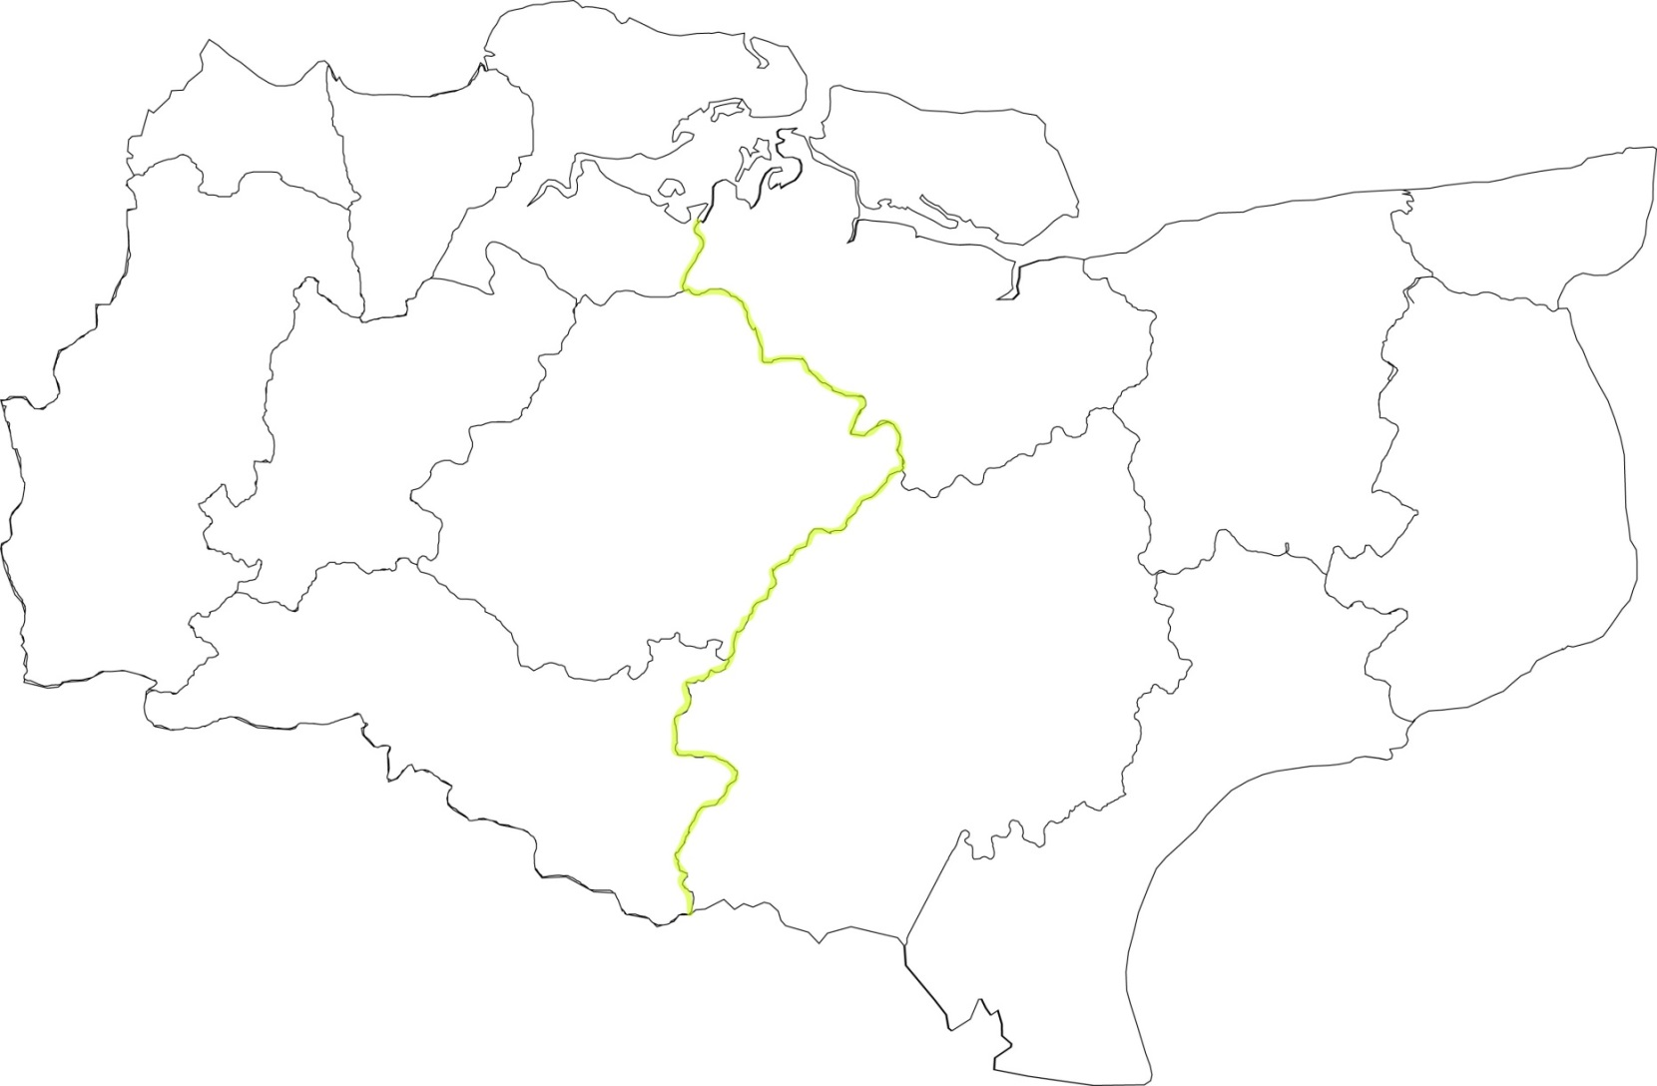
People with Learning Disabilities Summary
R | 9
S | 18
Sh/I | 9
R | -60
S | 13
Sh/I | 6
Reduce 1209 residential beds across the County
Develop Shared Lives accommodation
R | -136
S | 33
Sh/I | 16
R | -101
S | 29
Sh/I | 14
KCC fund 55%
R | -197
S | 59
Sh/I | 28
R | -43
S | 9
Sh/I | 4
R | -11
S | 12
Sh/I | 6
Range of tenancies
R | -61
S | 22
Sh/I | 10
R | -168
S | 67
Sh/I | 31
204 In East Kent,
55 In West Kent
Are we commissioning care and support for supported living in the best way?
R | -119
S | 36
Sh/I | 17
R | -94
S | 24
Sh/I | 11
Housing Related Support
259 care homes
R | -230
S | 60
Sh/I | 28
Choice of Accommodation with correct support – day time, night time, technology
LD | EXISTING | 2021 | +/-
R | 2038 | 829 | -1209
R (autism) | 150 | TBA | TBA
Supp | 570 | 952 | +382
Sh/I | 280 | 460 | +180
R = Residential
S = Supported Housing
Sh/I = shared/independent

Slide 3
People with a learning disability – Supp Acc
Dartford
Gravesend
Northfleet
Isle of Sheppey
Margate
Swanley
Herne Bay
Quex
Broadstairs
Sittingbourne
Whitstable
Ramsgate
East Malling/
Larkfield
Faversham
Canterbury City
Kings Hill/
West Malling
Maidstone
Sandwich
Sevenoaks
Aylesham
Tonbridge
Deal
Edenbridge
Coxheath
Ashford Town
Southborough
Ashford Villages
Hawkinge
Tunbridge Wells
Dover
Ashford Rural
Hythe
Folkestone
Under provision
TW Villages
Adequate provision
Romney Marsh
Over provision

Slide 4
People with a learning disability – Care Homes
Dartford
Gravesend
Northfleet
Isle of Sheppey
Margate
Swanley
Herne Bay
Quex
Broadstairs
Sittingbourne
Whitstable
Ramsgate
East Malling/
Larkfield
Faversham
Canterbury City
Kings Hill/
West Malling
Maidstone
Sandwich
Sevenoaks
Aylesham
Tonbridge
Deal
Edenbridge
Coxheath
Ashford Town
Southborough
Ashford Villages
Hawkinge
Tunbridge Wells
Dover
Ashford Rural
Hythe
Folkestone
Under provision
TW Villages
Adequate provision
Romney Marsh
Over provision

Slide 5
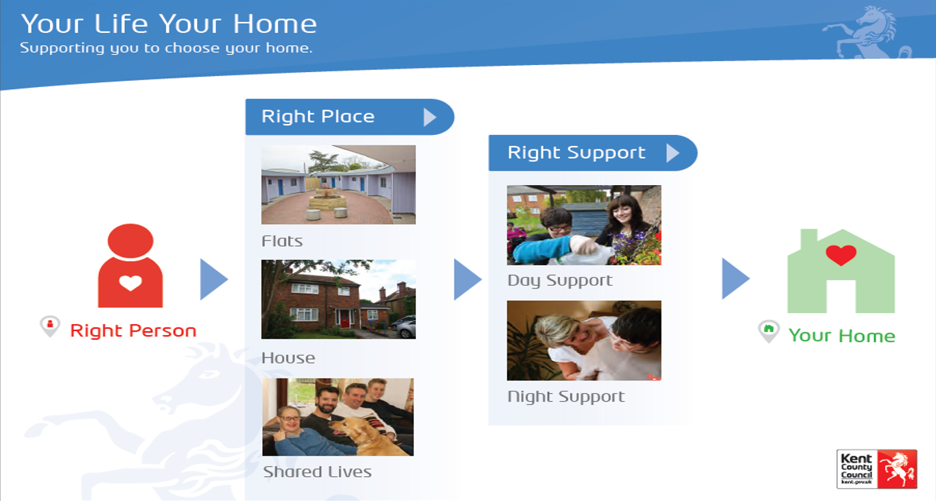

Slide 6
What are we doing?
Reviewing the opportunity for a number of people with a learning disability that currently live in residential care, to live in alternative settings that will allow them to lead more independent lives.
Why are we doing it?
We believe that ‘people with learning disabilities are entitled to the same aspirations and life changes as other people’.
Aligning the care delivered on behalf of KCC in line with Government Legislation, as detailed in the ‘Valuing People Now’ report.

Slide 7
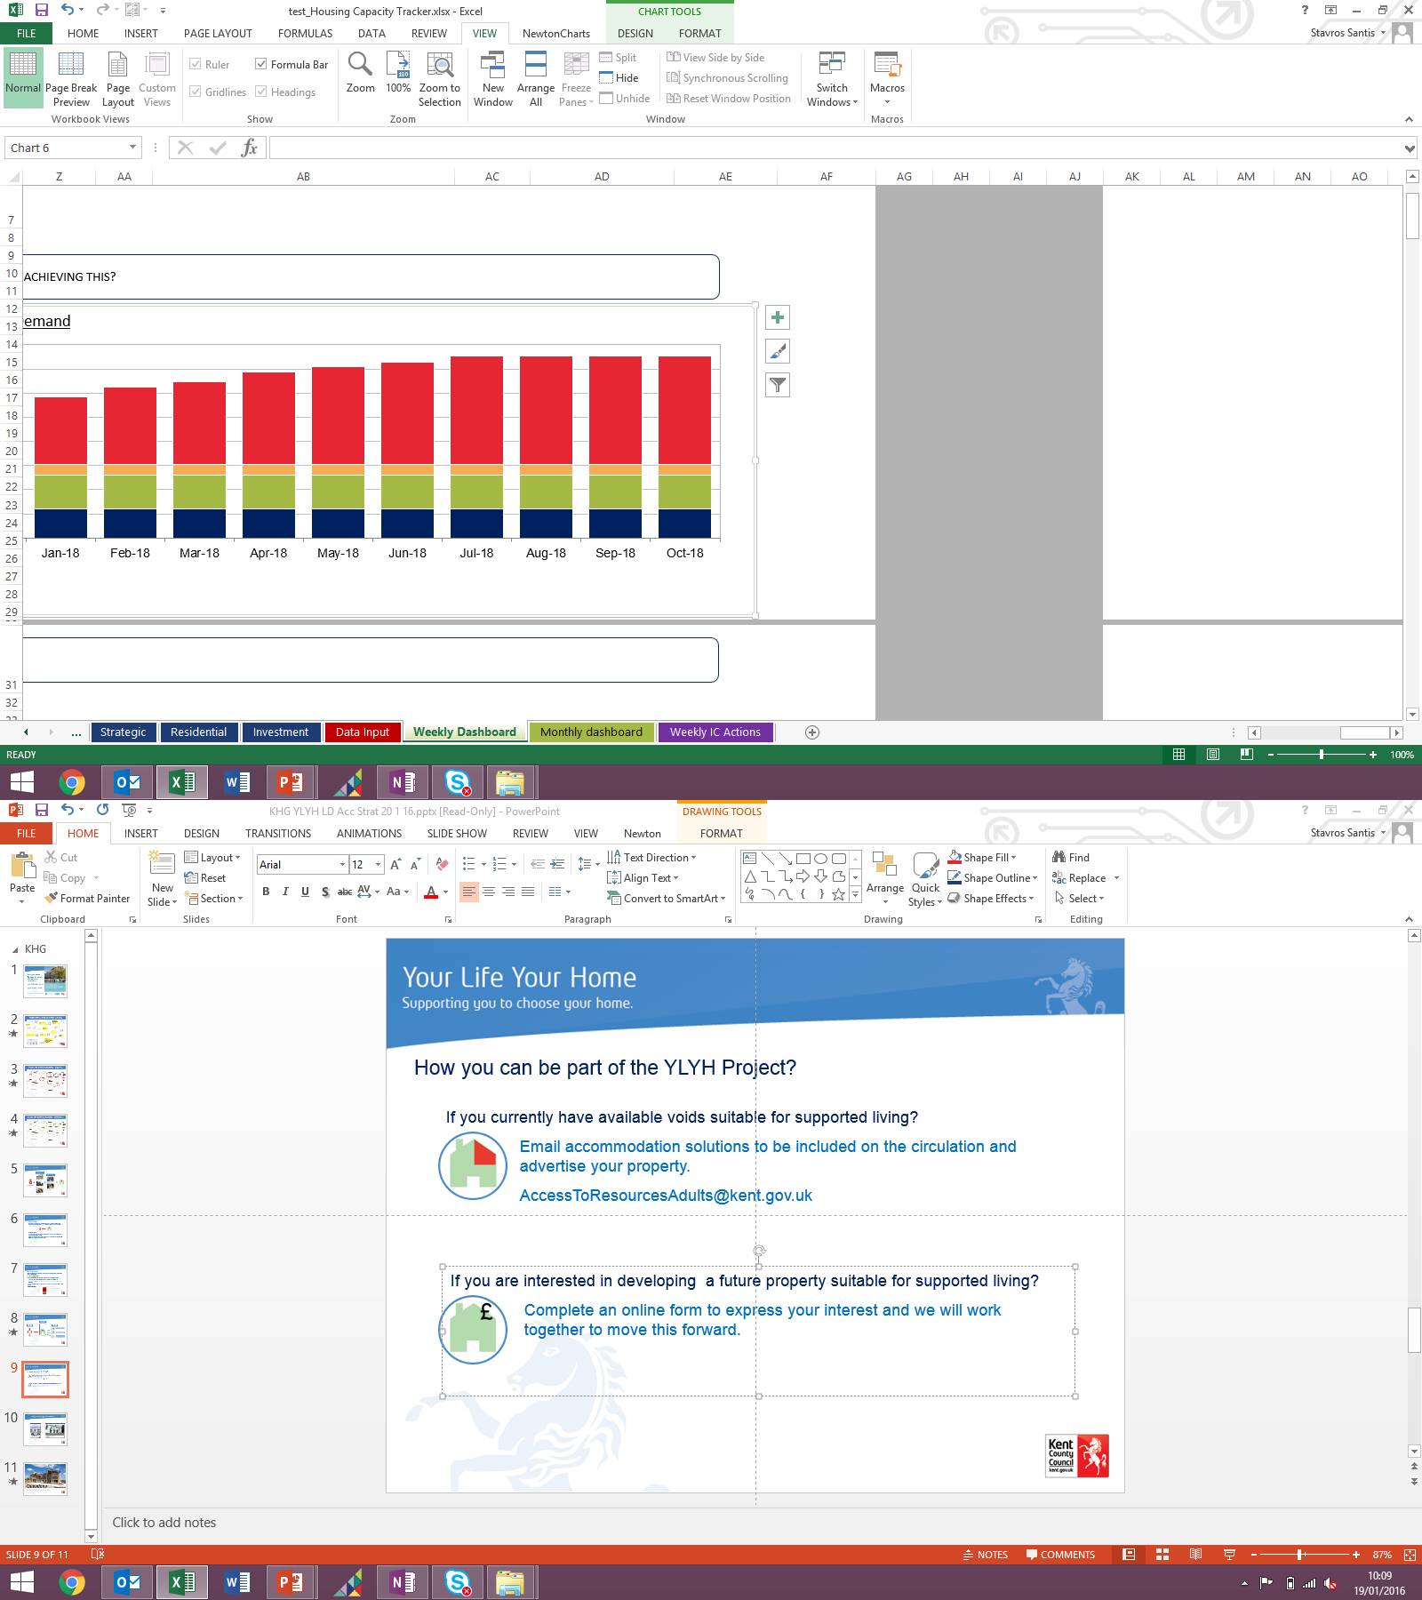
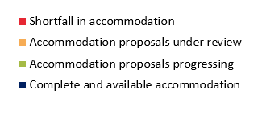
What we want to achieve?
Our vision is to move approximately 350 people from Residential Care into supported living by October 2018.
How are we progressing?
Pilot in Ashford & Shepway and South West Kent completing end of January.
People are being identified and progressing towards being placed in SL.
60+ available Supported Living accommodations advertised on the Accommodation Database.
If the pilot is successful, we are looking to roll YLYH out to the remaining localities early this year.
To meet forecast demand we require investment in SL accommodation for April 2017.

Slide 8




Buy
Accommodation Database
Identifying the right people
Creating the right home
Voids in existing properties
Investment in new properties
Deregistration of residential homes

Slide 9


How you can be part of the YLYH Project?
If you currently have available voids suitable for supported living?
Email KCC to be included on the circulation and advertise your property.
AccessToResourcesAdults@kent.gov.uk
If you are interested in developing a future property suitable for supported living?
Complete an online form to express your interest and we will work together to move this forward.
link - https://kentcc.firmstep.com/default.aspx/RenderForm/?F.Name=bt5vK57infR&HideAll=1

Slide 10
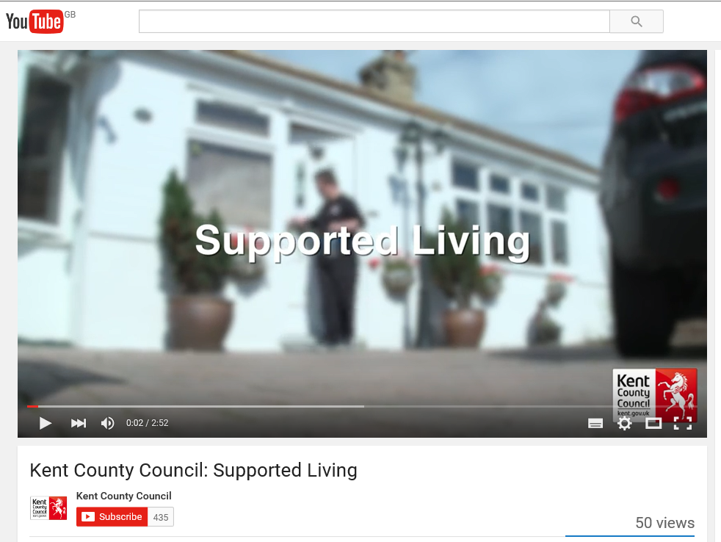
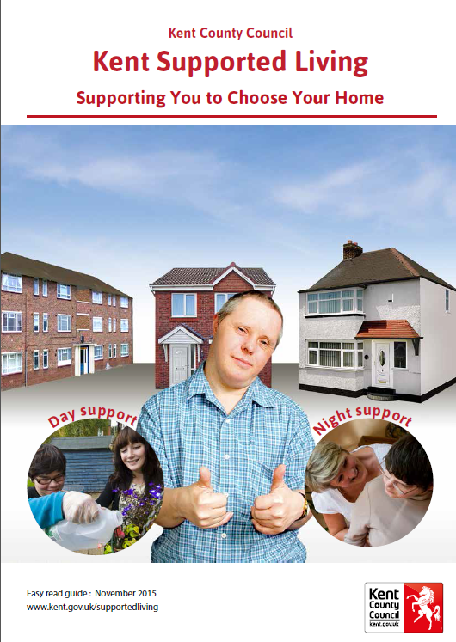
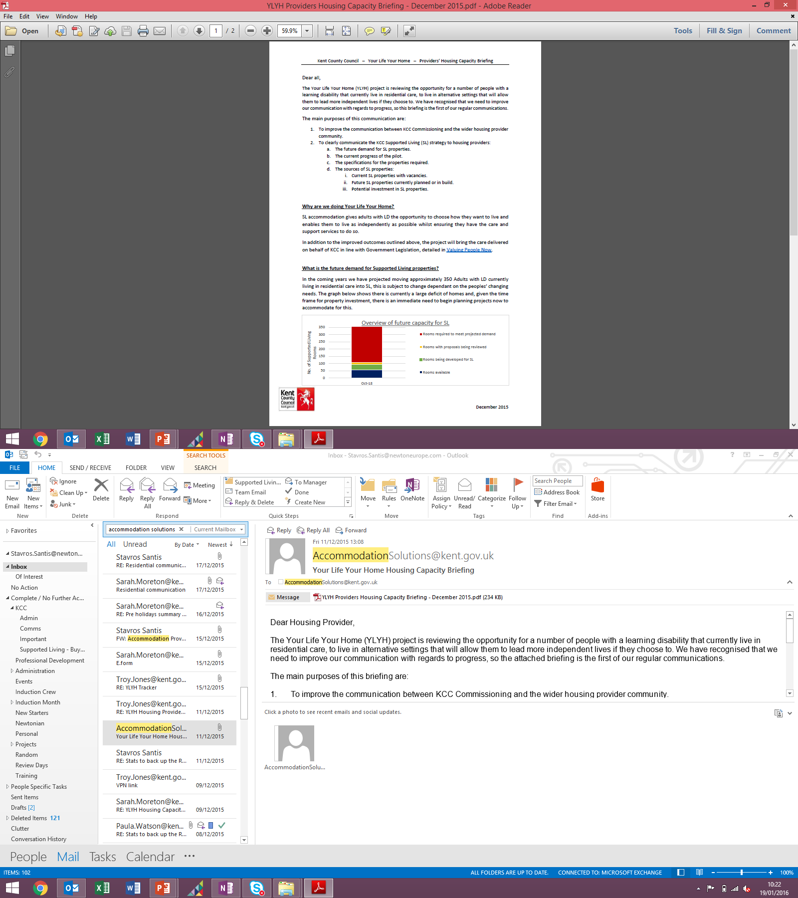
Supported Living Communications
Supported Living You Tube video
Supported Living Brochure
Providers’ Housing Capacity Briefings

Slide 11
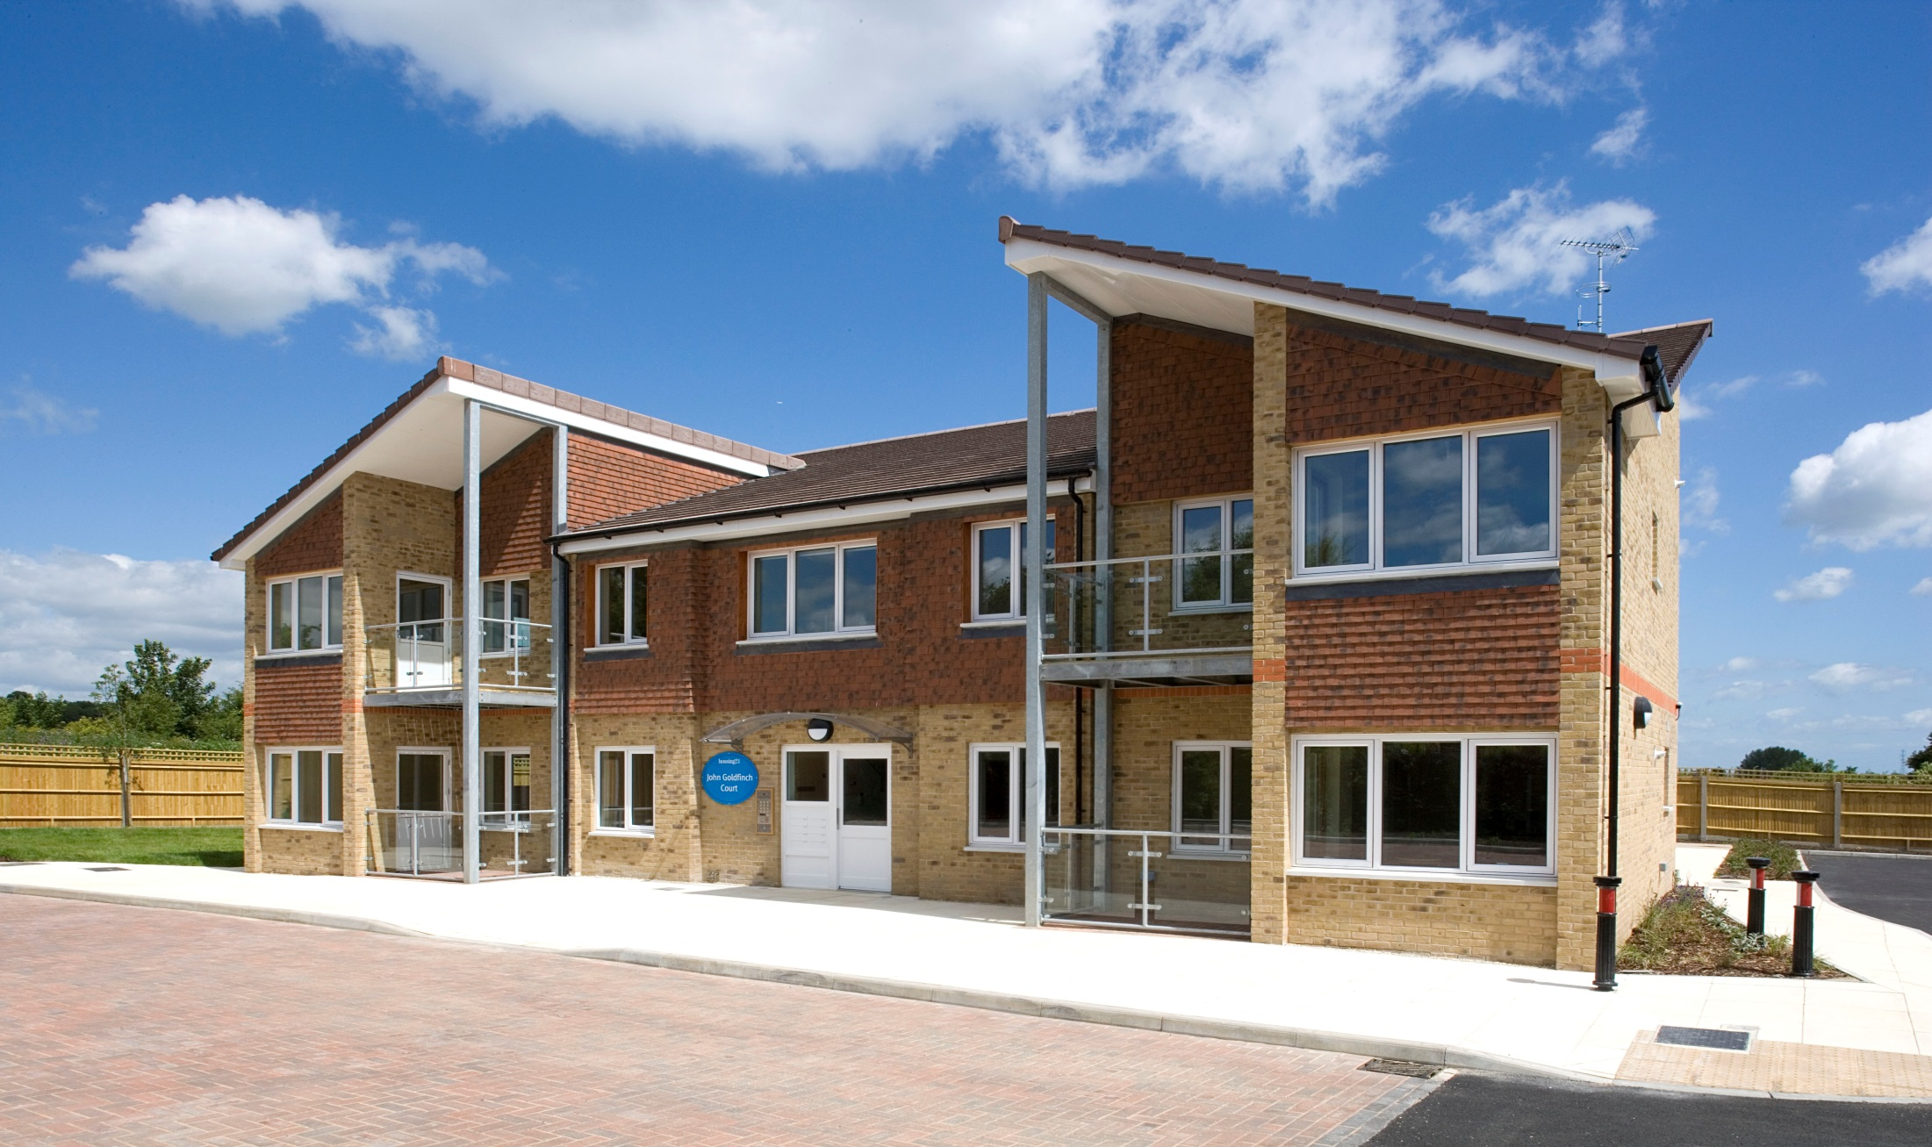
John Goldfinch Court, Faversham
King Edward Court ,Herne Bay
Questions
Questions
Paula Watson – Kent County Council – Paula.Watson@kent.gov.uk

