Slide 1
Rebecca Reynolds Family Nurse Supervisor (South Team)
October 2016

Slide 2
Thank you for
your time today

Slide 3
The importance of investing in the first few years of life
It’s important that we work to address the root causes of social disadvantage…
By ensuring additional support is available for those that need it most early on…
Enabling individuals to reach their full potential… and
Preventing use of costly interventions later down the line e.g. going into care
Notes:
The case for improving outcomes for young parents and their children
Even though there has been a 48% reduction in teenage conceptions the rate in England remains one of the highest in western Europe
Young teenage parents need to be supported in an environment in which they feel comfortable and supported. Adult centred services may not achieve this without additional teenage focused services
Poor child health outcomes
21% higher risk of preterm birth and 93% higher risk for second pregnancies
15% higher risk of low birth weight
A third higher risk of stillbirth and 41% higher rates of infant mortality
Affected by …
Late booking for antenatal care (on average 16 weeks)
Three times higher rate of smoking during pregnancy
A third lower rate of breastfeeding
Poor maternal nutrition
Poor emotional health and wellbeing outcomes
Three times the rate of post-natal depression of older mothers
Higher rates of poor mental health for up to 3 years after the birth
Higher risk of partnership breakdown and isolation
More likely to live in poor quality housing
Affecting the well being of their children and contributing to:
Higher accident rates - such as from falls and swallowing substances
More behavioural problems - conduct, emotional and hyperactivity problems
Poor Economic Wellbeing
21% of all young people not in education, training or employment are teenage mothers or pregnant teenagers
By age 30, 22% more likely to be living in poverty than mothers giving birth aged 24 or over
Much less likely to be employed or living with a partner
Which also affects the economic well being of their children who have:
63% higher risk of living in child poverty
Lower academic attainment
A higher risk of unemployment and low income in later life

Slide 4
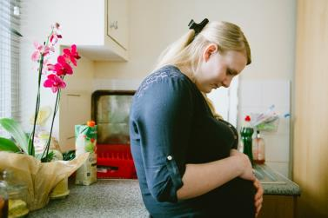
The Family Nurse Partnership (FNP) is a prevention and early help programme
Programme
60 home visits over 2.5 years
Supported by theories, tools and techniques based on 30 years of international research
Developed as a safeguarding programme to help prevent child maltreatment the programme focuses on improving three goals in partnership with other services:
Improved maternal health during pregnancy
Better child development
Increased maternal economic self-sufficiency
High take up and engagement with the full length of the programme*
Feedback shows the programme is valued and helps clients feel more confident as parents
Client
Family nurse
Trained in establishing a trusting, therapeutic relationship with clients which can help to effect behaviour change
Specialist training in addition to nursing qualifications
The management and supervision model provides a focus on outcomes, ensures fidelity to the programme, encompasses safeguarding and enhances practice. Client feedback and the live information system are key components
Supervisor & management
* Please see Appendix
Notes:
The FNP programme is based on 3 theories of self efficacy, attachment and human ecology. These theories are woven through every visit and as you can see there's a potential for 60 visits in the 2.5 years the client is on the programme.
Focusing on the three main goals have been shown to safeguard children, build a clients self efficacy and self sufficiency .
In order to build a long term therapeutic relationship nurses are trained in communication skills based motivational interviewing techniques which are focused on behaviour change. In addition, and despite this being a manualised programme, the FNP is delivered in a very individual and authentic way for each client meaning the nurses can be solution focused, ensuring attention is given to the goals and aims of the programme, as well as those based on the nurse’s assessment as well as the client’s hearts desire.

Slide 5
FNP shines a light into the dark corners and works to safeguard the wellbeing of two vulnerable populations
Teenage mums…
…and their babies
Vulnerable; often feel judged and services find it hard to engage with them
Often entering a cycle of deprivation; more likely to be at risk of abuse; more likely to end up in care, at risk of poor education, health and development outcomes and at risk of engaging with crime later in life.
46% clients ever abused by someone close to them
63% clients are NEET at enrolment onto the programme
40% report ever having mental health problems
63% with very low income or living entirely benefits
76% of teen mums offered FNP take it up and 79% of this number engage in the programme for 2.5 years.
24% clients reported physical or sexual abuse in the last year.
52% lived away from home for more than 3 months before 18

Slide 6
Family nurses receive specialist training to engage this highly vulnerable group who normally shun services for fear of being judged
We make this high risk population more VISIBLE and work in partnership with other services to EFFECT CHANGE
Notes:
The nurses attend a blended learning programme which lasts approximately 14 months. Each face to face element is prefixed with some team based preparation, as well as the same to consolidate learning. The face to face elements are more experiential, the team based more information rich. This begins with FNP Foundations, then 2 days building on FNP communication skills, FNP in Infancy which includes PIPE (Partners in Parenting Education) the parenting element of the programme, DANCE (Dyadic Assessment of Naturalistic Caregiver Child Experience) and FNP in Toddlerhood.

Slide 7
FNP works intensively with teen mums and their babies to effect behaviour change…
Personal health
Access to services
e.g. substance use and abuse, mental wellbeing
e.g. engagement with social care/ use of children centres/ sexual health services
Maternal role
e.g. caregiving attitudes and behaviours
Environ-mental health
e.g. Homelessness and residential instability
Life course
Family and friends
e.g. maternal education and work
e.g. Unsafe family/ friends network
Notes:
As previously said the work of FNs is intensive, focused, based on theories and solution focused. Because the programme is designed to support the therapeutic relationship nurses are able to address issues in a deeper but respectful way:
Personal health, by addressing the clients substance muses, mental health etc, supporting the client to understand why certain behaviours are unhelpful for her and potentially dangerous for her baby the nurse and client are able to plan for change.
Maternal role, this is a key area where nurses can support the client to consider her parenting of her baby, its one of the greatest areas nurses can influence. For the client to reflect on her past and then to consider what sort of mother she wants to be as well as understanding what sensitive responsive care looks like.
Life course, where does the client want to be in a year or two’s time- work, education etc.
Family and friends, is the clients family helpful, supportive or not, are they unsafe?
Environmental health, what's the client’s home/ community like?
Access to services, is the client making good use of all services, how can the nurse support the client to access these services? it is imperative that the nurse works closely with all other professionals.

Slide 8
…which results in improved child health and development
Child health
and development
Personal health
Access to services
SAFEGUARDING:
Reduced childhood injuries
Maternal role
SCHOOL READINESS:
Improved language development
Environ-mental health
Maximise cognitive development
Life course
SCHOOL PERFORMANCE:
Emotional/behavioural regulation
Family and friends
Notes:
Then by focusing on all of these areas (discussed in the slide before) the nurse is safeguarding the child, ensuring s/he is at the centre of the work which can lead to all the outcomes on the right here. In addition its helpful to note that many of the clients are children and the nurse aims to safeguard her too.

Slide 9
FNP helps teenage parents to access and engage with other local services…
Financial assistance
Smoking
cessation
Children’s
centres
Developmental
referral
Healthcare services
Breastfeeding
support
Social care
Education
services
Notes:
how FNP promotes self-efficacy, self-sufficiency and provides sustainability for young mums/families.
Financial assistance – CIB, legal services, housing
Healthcare services – Community support, Connexions, sexual health
Substance abuse – Social care, childcare, domestic violence
Developmental referral – educational programmes, job training
Breastfeeding support
Key Priorities for LA Early Years that FNP can positively contribute
Children’s Centre Registrations (a limiting judgement in Ofsted Inspections) FNs can register clients at visits
Registration and take up of the 2 year offer (LAs are judged on offer and take up)
Troubled Families – FNP can be included as evidence of “turning families around”

Slide 10
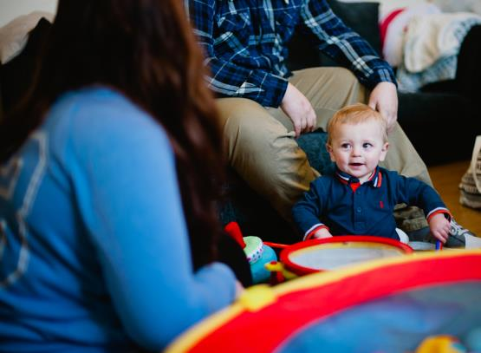
Improved life chances for teen mums, often trapped in a cycle of disadvantage
FNP works to improve economic self-sufficiency and self-efficacy of the family; releasing innate potential in families often written off
Child more likely to contribute to society from age 18 in the long term
FNP raises the aspirations that mums and dads have for their own and their children’s lives
Notes:
Navy box: ‘Child more likely long term to contribute to society from age 18’ – this is taken from US evidence.
Importance of support for young parents – lessons learned from Ofsted/Serious Case Reviews –
“In too many cases: there had been insufficient support for young parents”
Young teenage parents need to be supported in an environment in which they feel comfortable and supported. Adult centred services may not achieve this without additional teenage focused services
Both parents need to be supported. The father is as important as the mother and they need support to help them become good parents
⬥ There should be a joined up (multi-agency) approach to teenage pregnancy and teenage parents with every agency understanding their role within it.
⬥ Planned and coordinated transfer of care between midwifery services, health visitors and GPs is critical
FNP can deliver this
The importance of involving young fathers:
84% of fathers of babies born to women <20 are under 24 (33% under 20 and 51% 20-24)
75% of babies to teenage mothers are jointly registered with the father; only 20% are sole registrations
Young fathers have a strong influence over young mothers’ attitudes and decisions about smoking and breastfeeding
A good relationship with the baby’s father and supportive behaviour by him is a protective factor for postnatal depression
Highly involved fathers (even if the couple don’t remain together) is associated with better outcomes for the child - emotional, behavioural and educational
Young fathers: a vulnerable group
Young fathers are more likely than older fathers, and than other young men:
To have been subjected to violent forms of punishment at home and are twice as likely to have been sexually abused
To have pre-existing serious anxiety, depression and conduct disorder
To drink, smoke and misuse other substances
To have poor health and nutrition
To have double the risk of being unemployed at age 30 – even after taking account of deprivation

Slide 11
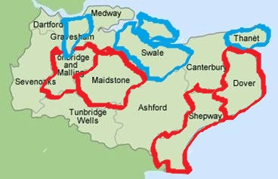
FNP Kent has two teams-
North Team:
1 x Supervisor
6x Family Nurses
South Team:
1 x Supervisor
6x Family Nurses

Slide 12
Thank you for
your time today

Slide 13
Any questions?

