Slide 1
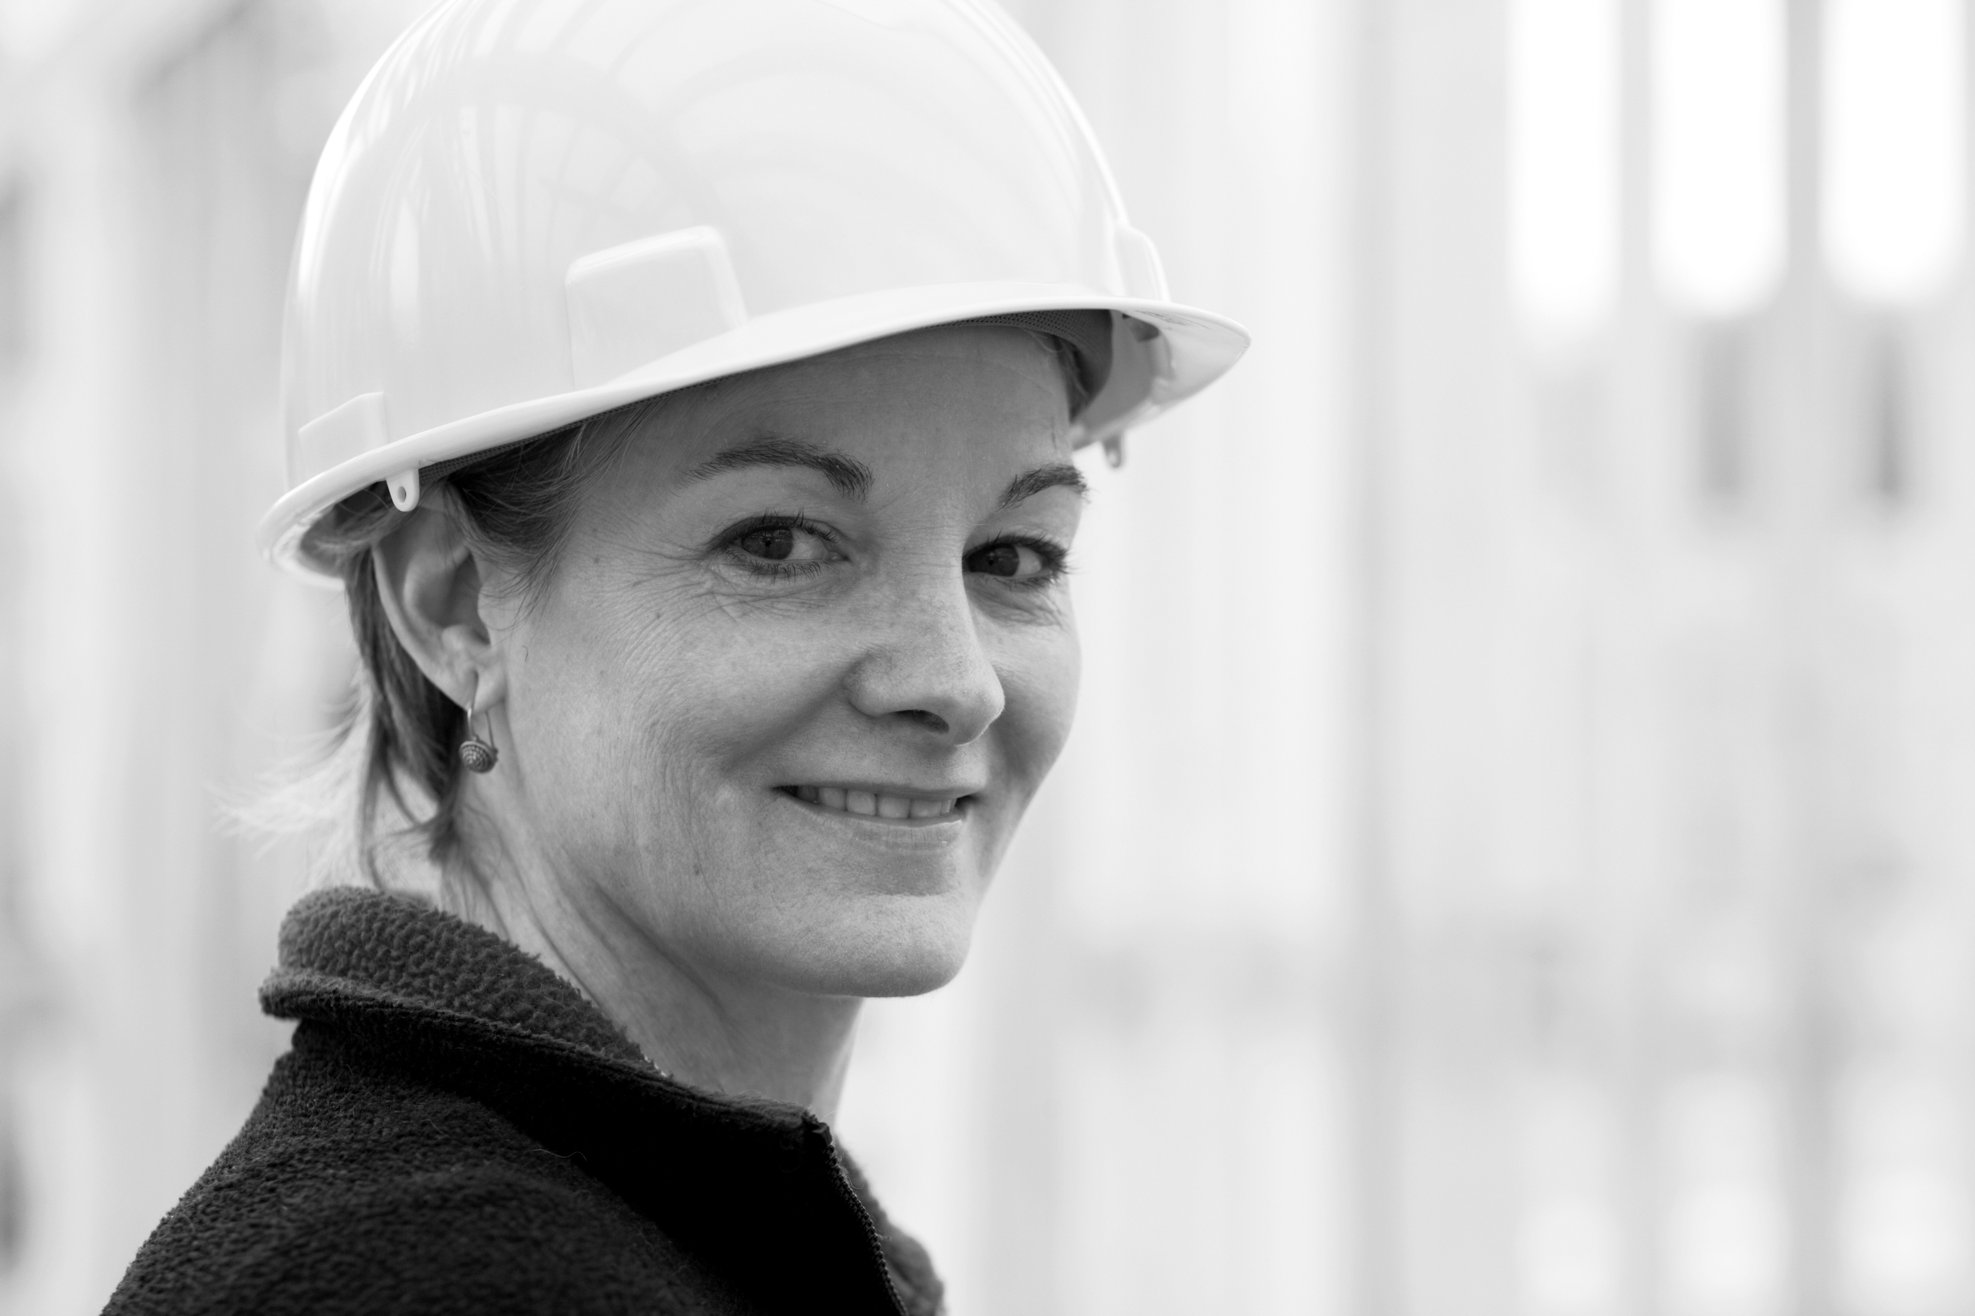
B&CE
Giving back to construction
Nicola Sinclair
Charitable Trust Manager
April 2016
Notes:
Hello, I’m Nicola Sinclair
I’ve been the Charitable Trust manager since 2014, taking up the post after 11 years as a relationship manager for B&CE
I love working for the Trust because it makes a real difference in people’s lives.
I’m here today to tell you about the Charitable Trust and how it can help your members

Slide 2
A bit about B&CE Not-for-profit: member focused
Notes:
But first, a brief introduction about B&CE
We were founded in the 1940s
1951 - over 1m benefiting from our holiday pay scheme
1963 - purpose built offices, Manor Royal, Crawley, opened
1975 - death benefit scheme launched
1982 - lump sum retirement benefit introduced
2001 - introduction of EasyBuild, our stakeholder pension scheme
2011 - launch of The People’s Pension, our award-winning solution to automatic enrolment
And there you can see, in 1991, we founded the Charitable Trust, to offer support to construction workers and their families
The Trust is our way of giving back to construction.
It makes payments for the benefit of workers in the construction industry, and their families, to help alleviate individual financial strain and hardship.
Half of the board of trustees have direct experience of working in the construction industry - one is your very own Development officer, Stephen Murphy

Slide 3
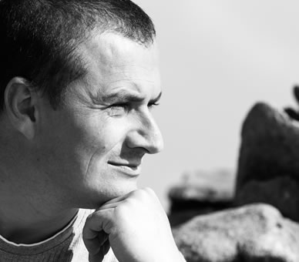
What does the Charitable Trust do?
Three aims
B&CE’s Charitable Trust aims to provide:
financial help for people in times of need
grants towards education, training and retraining
grants towards occupational health and safety initiatives
w
Nearly £3 million paid out so far
Notes:
The Trust has three clear aims.
To provide:
Financial help for people in times of need, such as unemployment, poverty, sickness or distress
Grants towards education, training and retraining for operatives, past operatives, and young people wanting to move into construction
Grants towards occupational health and safety initiatives in the building and civil engineering industries
Since 1991, we have paid out more than £2million to people in need.
‘we’re making a difference’…

Slide 4
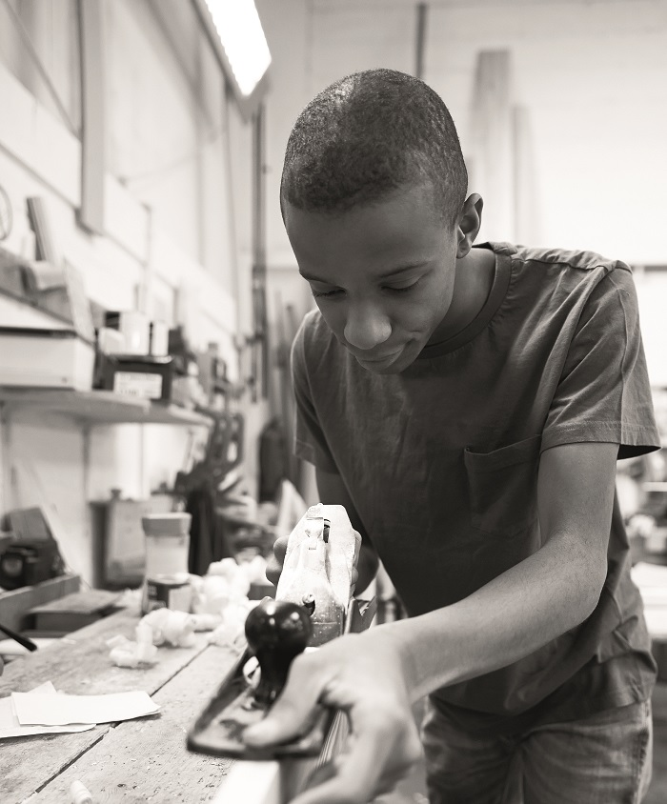
How the Charitable Trust helps
What our beneficiaries say
w
Notes:
We’re very proud of the work the Charitable Trust does, and this is reflected in what our beneficiaries told us.
Here are just a selection of testimonials from people and organisations we’ve helped.
Keep an eye out on our website for more testimonials and case studies in the future.

Slide 5
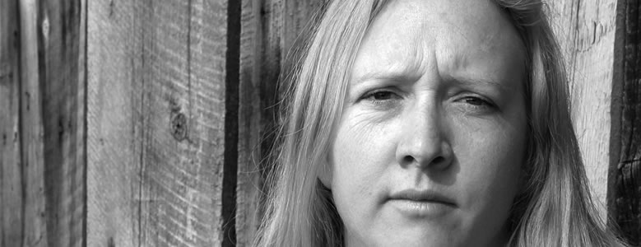
For times of need
Helping individuals suffering financial hardship
Life doesn't always go to plan. The B&CE Charitable Trust is here to help.
Giving back to construction
Notes:
The first aim of the Trust is to help individuals in times of need.
When financial difficulty strikes – perhaps as a result of redundancy or a period of unemployment – it can have a devastating impact on individuals and their families.
If you know of someone, or an organisation or employer who wants to nominate someone in need, the B&CE Charitable Trust is here to help.
Anyone who has worked as a construction worker within the construction industry, or is financially dependent on someone who does, could be eligible for help. In the past, the Trust has lightened the load for people who are struggling financially in a number of ways.

Slide 6
Grants for health & safety initiatives
Working towards a safer construction industry for all
Needless to say, health and safety is a top priority for the construction industry.
Giving back to construction
Notes:
The second aim is to provide grants for health and safety initiatives.
As an active supporter of health and safety initiatives, the Trust is happy to consider applications for grants in this area.
The Trust supports groups with a focus on workers’ health and safety, ensuring they can live and work in a safe environment.
It works in partnership with trade unions, federations and other organisations, such as Mesothelioma UK, who deal with occupational health and safety initiatives in the building and civil engineering industries.

Slide 7
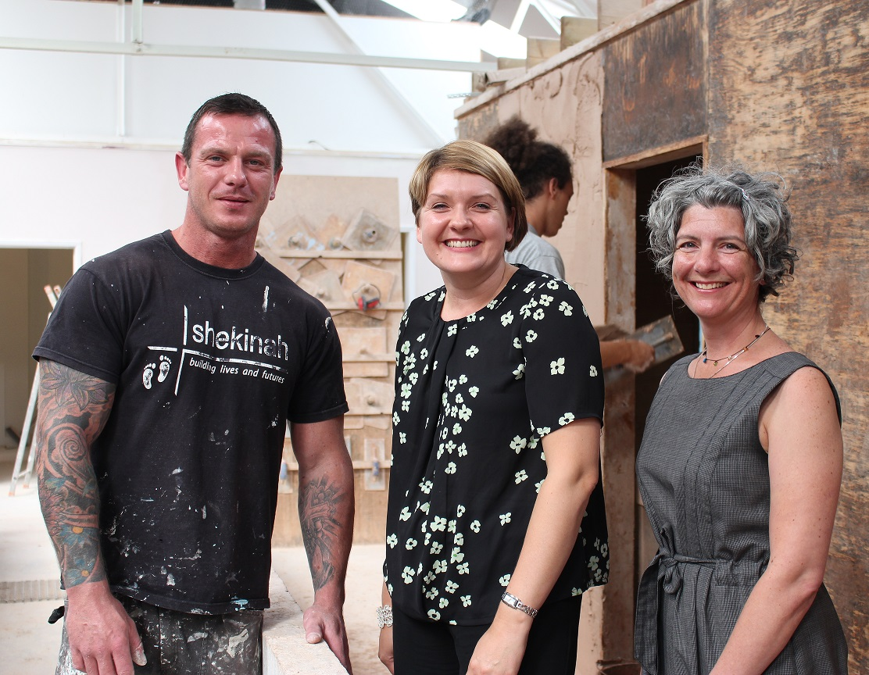
The Mowlem Award
Recognising achievements in training and the promotion of health and safety
w
w
£20,000 annual scholarship
Presented to organisations involved in training and made a significant difference to the construction industry
Last year’s award was presented to Shekinah Mission – read their case study online
Notes:
As part of the Charitable Trust’s activities with helping training and health and safety in the construction industry, the Trust presents a worthwhile organisation with the Mowlem Award.
The Mowlem Award is an annual scholarship of £20,000 given to organisations that demonstrate achievements in training or the promotion of health and safety in construction. It furthers the work of the RI Beck Trust – a charity set up in 1983 by the construction company, Mowlem. The RI Beck Trust was pleased to extend it’s scope and join with B&CE’s Charitable Trust to support their shared aims and objectives.
The first award was presented to Shekinah Mission, which you’ve already seen in the video. If you want to read more about the great work they do and how the Charitable Trust has helped them, read their case study on our website.

Slide 8
Help for education and training
Supporting personal development within construction
Education and training can help build a strong future for the UK’s construction industry and for the people who make it work.
Giving back to construction
Notes:
The third and final aim of the Trust is help with education and training – and we support it with individuals and organisations alike.
If a construction worker is forced to take a fresh look at their skills after occupational health issues such as, an illness or an injury, the Trust can help by contributing to the cost of their retraining and helping them gain industry accreditation.
The Trust also helps individuals, who have been long-term unemployed, gain the entry level qualifications needed to work in the construction industry. This applies to individuals who are either joining the industry for the first time or those who have worked in the construction industry in the past.
Organisations that help individuals coming into the construction industry may be eligible for support from the Trust as well.

Slide 9
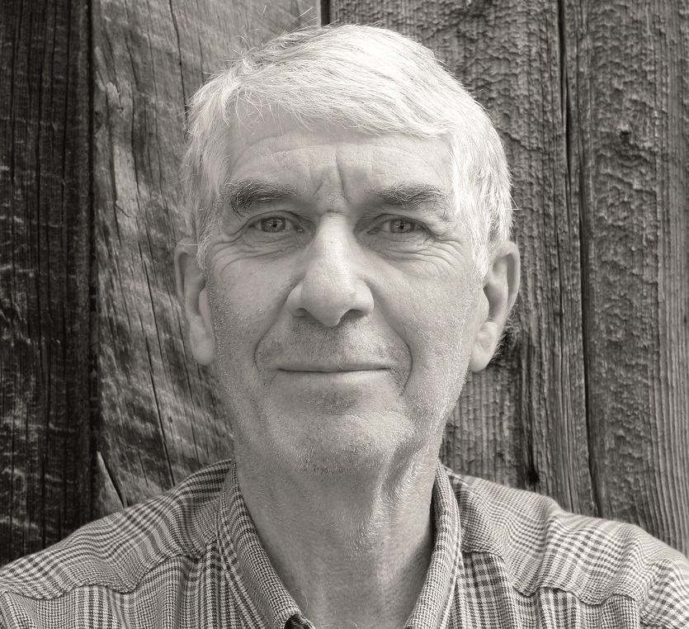
How to apply
Get in touch – we’ll be happy to help
Our claims specialists are experienced and treat queries with compassion and confidentiality.
The Trustees carefully assess each application received on its own merit.
w
To apply:
Email: charitabletrust@bandce.co.uk
Call: 0300 2000 600
Notes:
So those are the Trust’s objectives and what we do.
Think about your members and organisation. Is there anyone who may need our help?
We know that life doesn’t always go to plan. And when financial difficulty strikes, perhaps because of redundancy or a period of unemployment, it can have a devastating impact on individuals and their families. The Trust can help them get back on track, both financially and in terms of retraining.
But it’s not just about financial hardship. If you have members wanting retraining, or looking for apprenticeships, get in touch to see if we can help. And if you are looking for funding for health and safety initiatives, again, get in touch.
Applying on someone else’s behalf is straightforward. Just email or call us and our trained and compassionate claims specialists will take you through the process. But your members can also apply directly to the Trust, by just calling or emailing.
As a reminder, people seeking a grant to alleviate financial hardship or an education grant, should:
be currently employed, have previously worked, or seeking employment as a construction worker in the industry
And you can apply if you'd like to nominate someone or know of an organisation who needs the Trust's help

Slide 10
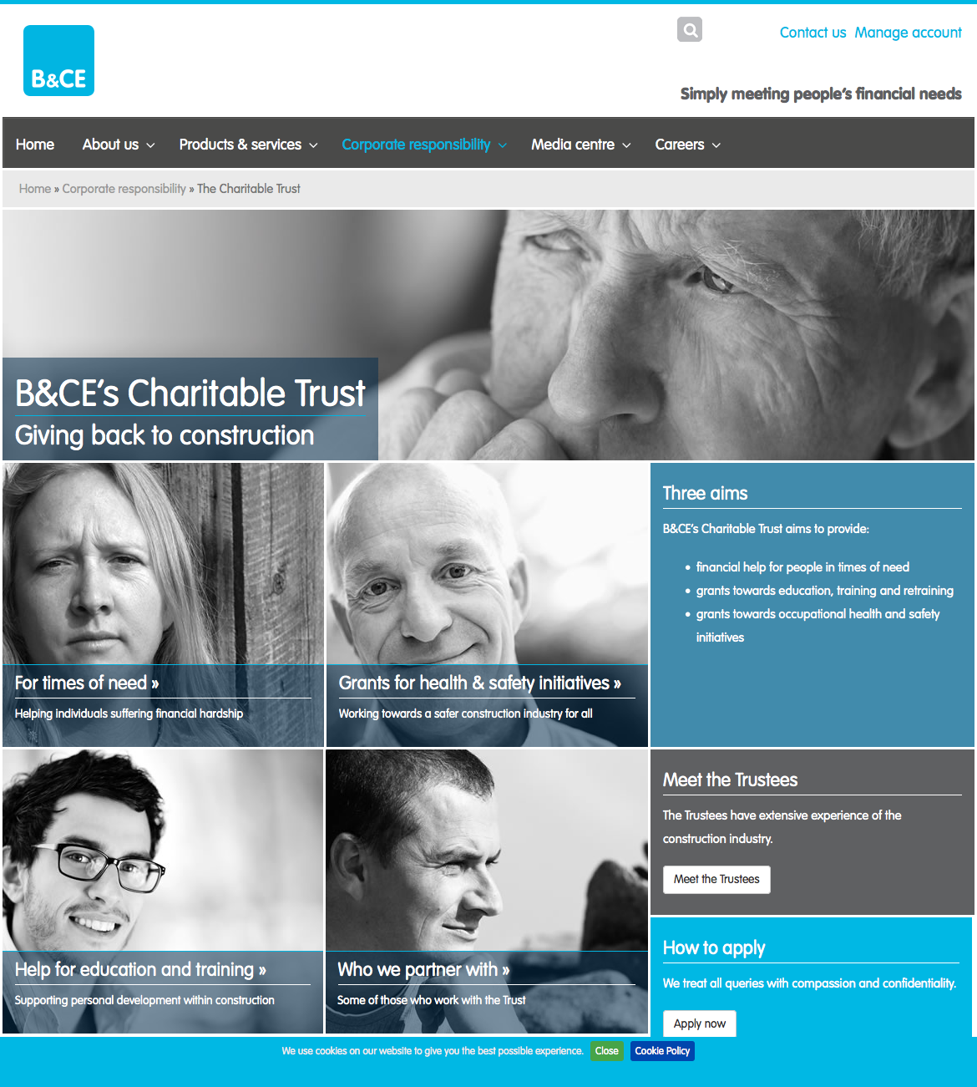
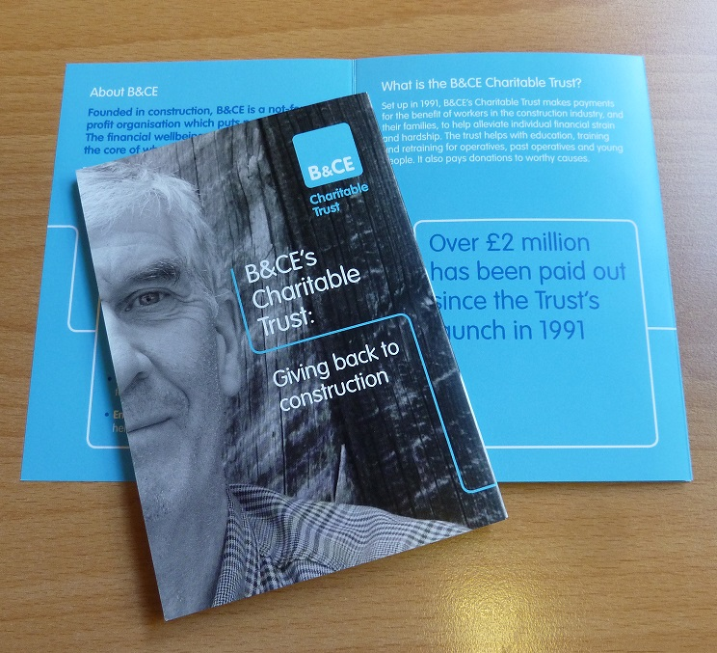
We all have the same goal…
To support the construction industry
…so please tell people about B&CE’s Charitable Trust!
Mention it across your organisation.
w
We can help with communications.
Notes:
We all have the same goal – to support the construction industry.
So please tell people about B&CE’s Charitable Trust!
Mention it in your newsletters, Put up notices on notice boards, Make sure your reps know about it, put up a link to the Charitable Trust web pages on your website
We can help you by supplying you with article wording and communications materials…
By working together, we can help support the construction industry.

Slide 11
To apply:
charitabletrust@bandce.co.uk
0300 2000 600
Thank you. Any questions?
For more information: www.bandce.co.uk/charitable-trust
Giving back to construction
Notes:
You can get find out more information on our website.
And if you think you know of a worthy applicant, - get in touch! Email or call our team
Thank you for your time. Is there any questions?

