Slide 1
Health, Housing & Social Care – Carers
Suzanne Coates
Head of Service Development
Carers’ Support – Canterbury, Dover & Thanet

Slide 2
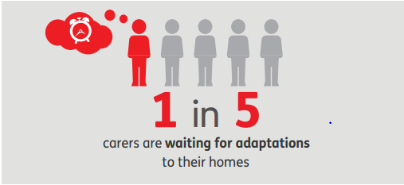
Carers UK - Caring Homes Report, 2016
95% UK Properties not accessible
Homes not always suitable for adaptations
Disabled Facilities Grants – means tested
Landlords sometimes withhold approval
Moving often not an option
Lack of availability of housing

Slide 3
Nearly 10% of Carers said that their home was in poor condition, from damp or disrepair, rising to 15% in the private rented sector
Damp, unfit and cold housing exacerbates or increases risk of a range of health problems and hazards in the home.
Fuel poverty – costs increased by damp or disrepair

Slide 4
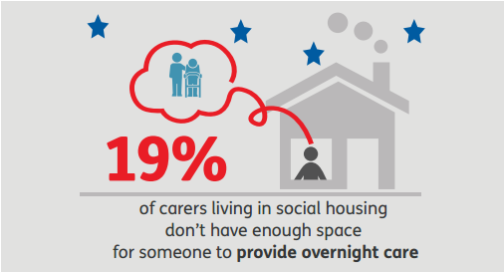
13% of carers said that as a result of caring there isn’t enough space to live comfortably
15% of carers said that there isn’t enough space for others to stay to provide support that they need (e.g. overnight care workers, family members who help with caring)

Slide 5
Fuel Poverty - higher utility bills as a cost of caring, further
increased when living with the person they care for
Home ownership Issues
pressure on Carers to continue to work to meet mortgage payments
Limited financial support with mortgage payments if unable to work
Risk of loss of home if cared for needs residential care
Delayed implementation of care cap forcing sale of property to cover care costs
Social Housing Issues:
Bedroom tax
Lack of security with tenancies increases stress/anxiety

Slide 6
How do we support Carers?
Information, support and advocacy relating to entitlements and rights:
e.g. welfare benefits, Council Tax reductions, Disabled facilities grants, housing options
Assistance with applying for benefits, grants (inc charitable grants), applications for social housing etc
Referrals for adaptations (occupational therapy, Home Improvement Agencies), handyman services, fire safety service etc
Information and support to access energy efficiency schemes, energy grants,
Carer’s Needs Assessments
Emotional Support

