Slide 1

East Kent Substance Misuse Service
Out There Everywhere
An outline of the service for partners and stakeholders

Slide 2
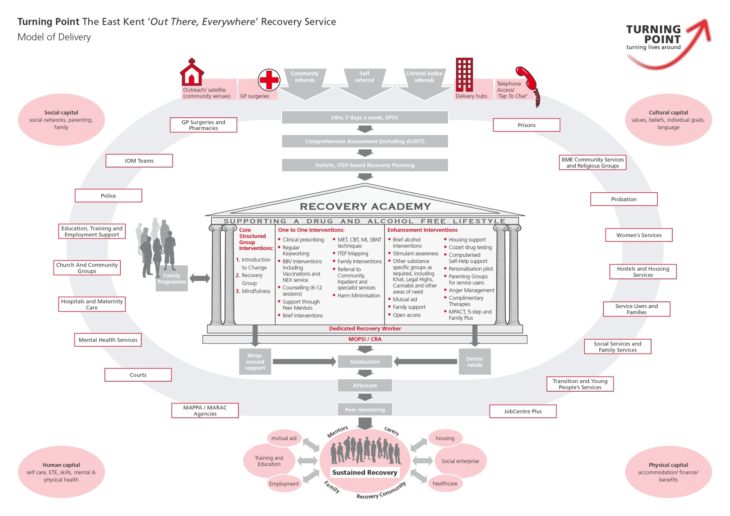

Recovery Model
turning lives around in East Kent _{www.turning-point.co.uk}
OUT THERE EVERYWHERE

Slide 3
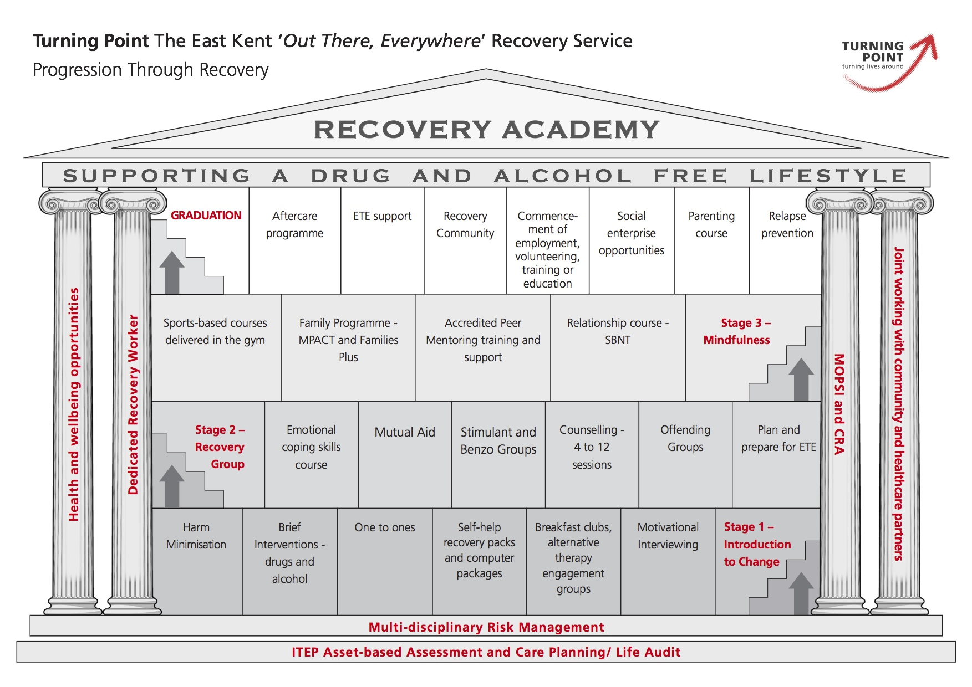
Recovery Academy
turning lives around in East Kent _{www.turning-point.co.uk}
OUT THERE EVERYWHERE

Slide 4
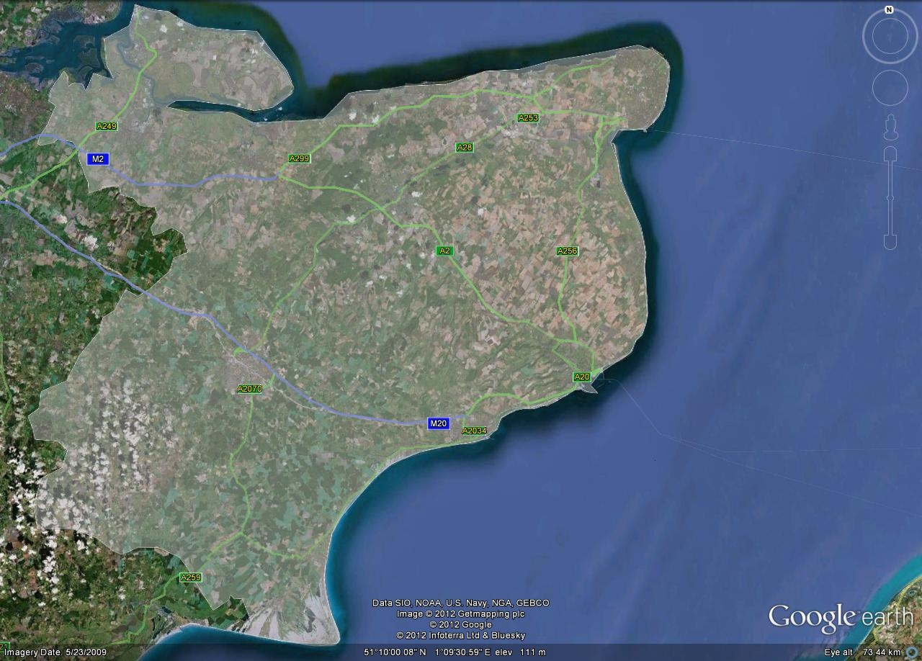


Delivery locations
Delivery sites
Sheerness
Margate
Sittingbourne
Canterbury
Ashford
Dover
Folkestone
turning lives around in East Kent _{www.turning-point.co.uk}
OUT THERE EVERYWHERE
Notes:
6 main hubs plus 1 smaller in Sheerness
Topped up by Roving Recovery Vehicles - supported by workers going out to different locations, street work etc
Further supported by yellow dots – outreach delivery locations – eg GP surgeries

Slide 5
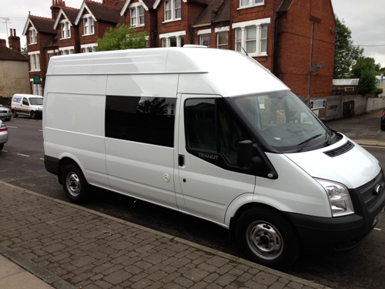
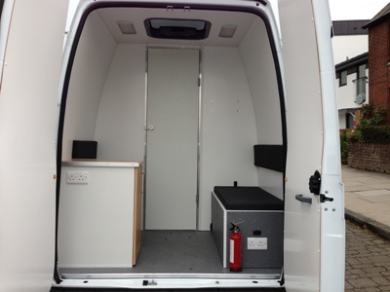
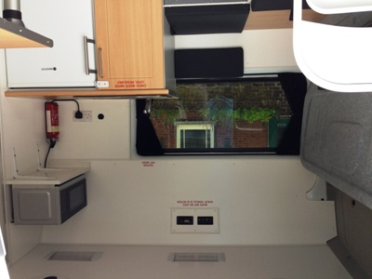
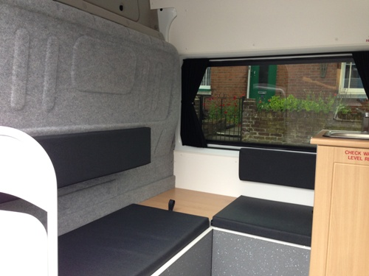
Roving Recovery Vehicle
turning lives around in East Kent _{www.turning-point.co.uk}
OUT THERE EVERYWHERE

Slide 6
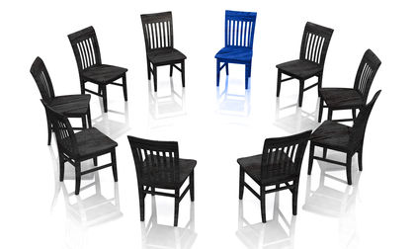
Working in partnership
Working in partnership
Satellite services
Targeted outreach
Single Points Of CONTACT
Information sharing
Joint initiatives
turning lives around in East Kent _{www.turning-point.co.uk}
OUT THERE EVERYWHERE

Slide 7
Services offered to service users residing in Shepway area

Slide 8
Drop in at Maybrook House Every day 1 – 4.30pm
Satellite service at Royal Victoria Hospital
Satellite service at JCP 4 afternoons a week
Mindfulness group at JCP, Folkestone, Friday
Needle exchange at pharmacies in Shepway area
Home visits offered to qualifying clients in Shepway
Health Trainer appointments
Titration clinics
Multi agency meetings

Slide 9
Comprehensive assessments
Community alcohol detoxes
BBV testing and Hepatitis B vaccinations
Welcome session
Medical appointments
Naloxone dispensing

Slide 10

Treatment journey
ANY referral to services – clients consenting to referrals
No referral form required!!!!!
Clients seen for assessment
Care plan developed with client
Health trainers – offer health and wellbeing sessions to provide holistic care to address health inequalities
Key-working/medical appointments

Slide 11
Single Point of Contact managed 24/7
0300 123 1186
Contact us
turning lives around in East Kent _{www.turning-point.co.uk}
OUT THERE EVERYWHERE

Slide 12
Any questions?
turning lives around in East Kent _{www.turning-point.co.uk}
OUT THERE EVERYWHERE

