Slide 1
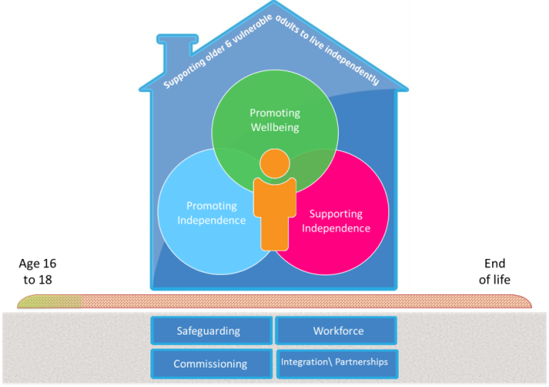
Housing Related Support
Mel Anthony, KCC Strategic Commissioning

Slide 2
Housing Related Support
Commissioned services that aim to develop or sustain a vulnerable person’s capacity to live independently in accommodation.
Not statutory health, social care or personal care services.
Wide range of services for vulnerable groups including rough sleepers, vulnerable homeless people, domestic abuse and offenders.
Support plans target wellbeing and health outcomes alongside housing
Supported Housing
Specialist integrated schemes designed to provide both housing and support together. To access the support, you must live at the scheme e.g. women’s refuges, sheltered housing.
Floating Support
Peripatetic service that is tenure neutral. Most commonly for those in unstable housing situations e.g. at risk of eviction, sofa surfing, rough sleeping
Home Improvement Agencies
Repair, maintain or improve their home, Advice and information, Disabled adaptations (DFGs)

Slide 3
Housing Related Support in the SKC area
Older People 900 households
Mental Health 16 households
Learning Disability 93 households
Young People 34 households
Vulnerable Homeless 24 households
Domestic Abuse 13 households
Offenders 20 households
Substance Misuse 18 households
Generic 500 households
Young People 75 households
Vulnerable Homeless 24 households
Domestic Abuse 84 households
Offenders 35 households
(Service covers all of east Kent)
Covers Ashford, Dover and Shepway
Over 370 enquiries to the Dover and Shepway HIAs per quarter
268 people being helped in Shepway in any 1 quarter, 155 Dover

Slide 4
Future of Housing Related Support
Transform services to improve outcomes
Supporting wider transformation
Design services together; share evidence, share results
Pooled resources
Flexible, integrated commissioning with partners
Tackling gaps and simplifying access
Integrated provision – step up, step down

Slide 5
Future Commissioning – a case history
Domestic Abuse Provision
Domestic abuse provision was fragmented
Range of services and interventions in place –
Refuges,
IDVA (Independent Domestic Violence Advocate) service,
MARAC (multi-agency risk assessment conference)
Floating support,
Sanctuary schemes, support groups, one stop shops
All commissioned, or funded by different agencies, covering areas that differ in size, scope and geography, operating in isolation in cycles that differ in duration
The result was patchy, uncoordinated coverage, significant gaps and duplication, a lack of consistency and complex pathways for service users and professionals to navigate
Most services, and most of the funding, was aimed at high risk victims
These disparate funding streams and commissioning arrangements had resulted in limited strategic oversight of the sector
Grant funding is short-lived and unsustainable, made performance management difficult

Slide 6
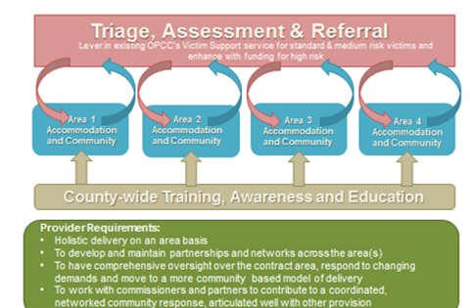
Future Commissioning - a case history
Year 1
Year 2
Year 3
Year 5
Year 4
5 year flexible outcome focussed contract that will evolve and develop over time
Devolution
VAWG Strategy
Health and social care integration
Stage 1 Select Area Leads, fix current issues,
establish basic networks and baseline measures
Stage 2 Co-design outcomes framework
and incentivisation scheme; Opportunity
for further integration
Stage 3 Review progress and network;
Develop and broaden where necessary.
Consider redistribution of investment.
Prepare consider and co-produce for next
model of commissioning

Slide 7
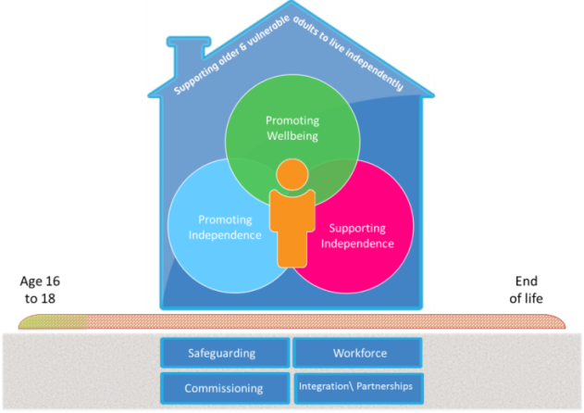
Housing Related Support
Any questions?
Mel Anthony, KCC Strategic Commissioning
melanie.anthony@kent.gov.uk

