Slide 1
Integrated Accountable Care Development
Overview
v1.8 DRAFT

Slide 2
Our story
Introduction
FOR TODAY
Agreement on service design principles
Introduction & Overview
Locality Service Model
Pending agreement on Locality Service Model
Under development
Technical Service Specification
(Scheduled and Unscheduled Care)
Delivery Arrangements

Slide 3
Vision
Introduction
To support people to be well and healthy in their own homes
Deliver a model for health and care service out of the acute hospital, wrapped around the patient and co-ordinated by their GP; designed and delivered around local patients in 4 neighbourhoods, supporting people to be as independent as possible. Ultimately delivering one service which is provided by one team, with one budget

Slide 4
Introduction
South Kent Coast
Integrated Accountable Care
A partnership of health and care providers with a shared purpose – to support people to be well and healthy in their own homes in
Deal, Dover, Folkestone and Hythe & Rural Localities.
Integrated commissioning to improve health and care outcomes - SKC Health & Wellbeing Board
How will care be reorganised?
To ensure high quality out of hospital care is available to all by mobilising support around practices:
1. Practice Partnerships supported by Primary Care Teams
2. Dedicated Multidisciplinary Locality Teams (without organisational boundaries)
3. Supra Locality Services offering more specialist provision
What will care look like in the new system?
One service, one team, one budget
Organise services more effectively in relation to settings of care
– scheduled / unscheduled care
Virtual teams – Health and care professionals work in flexible networks
across organisational boundaries
Enablement, Preventative and proactive care - promote multidisciplinary care planning for vulnerable, frail and elderly patients as an alternative to hospital
Freed up GP time – to offer longer appointments for Long Term Conditions
Specialist interfaces – Consultants input into case conferences as an alternative to Out-Patient clinics and provide ‘hot clinics’ for rapid assessments
Self-care - proactively involve patients in their own care planning
Coordinate access to voluntary sector – provide more practical and social support - via Care Navigators
Enablers
Integrated IT systems – all professionals can read/write onto One Care Plan to reduce multiple assessments
Adopt digital innovation – promote virtual consultations / interoperable systems
Federated care - share resources / partnerships between practices
New approaches to accountability
Commission for outcomes and quality
Integrate Executive governance and planning systems

Slide 5
Introduction
Reasons to transform local care
the aging population and burden of long term conditions has led to rising demand for care, which coupled with workforce pressures, can result in hospital or long term care being the default setting of care

Slide 6
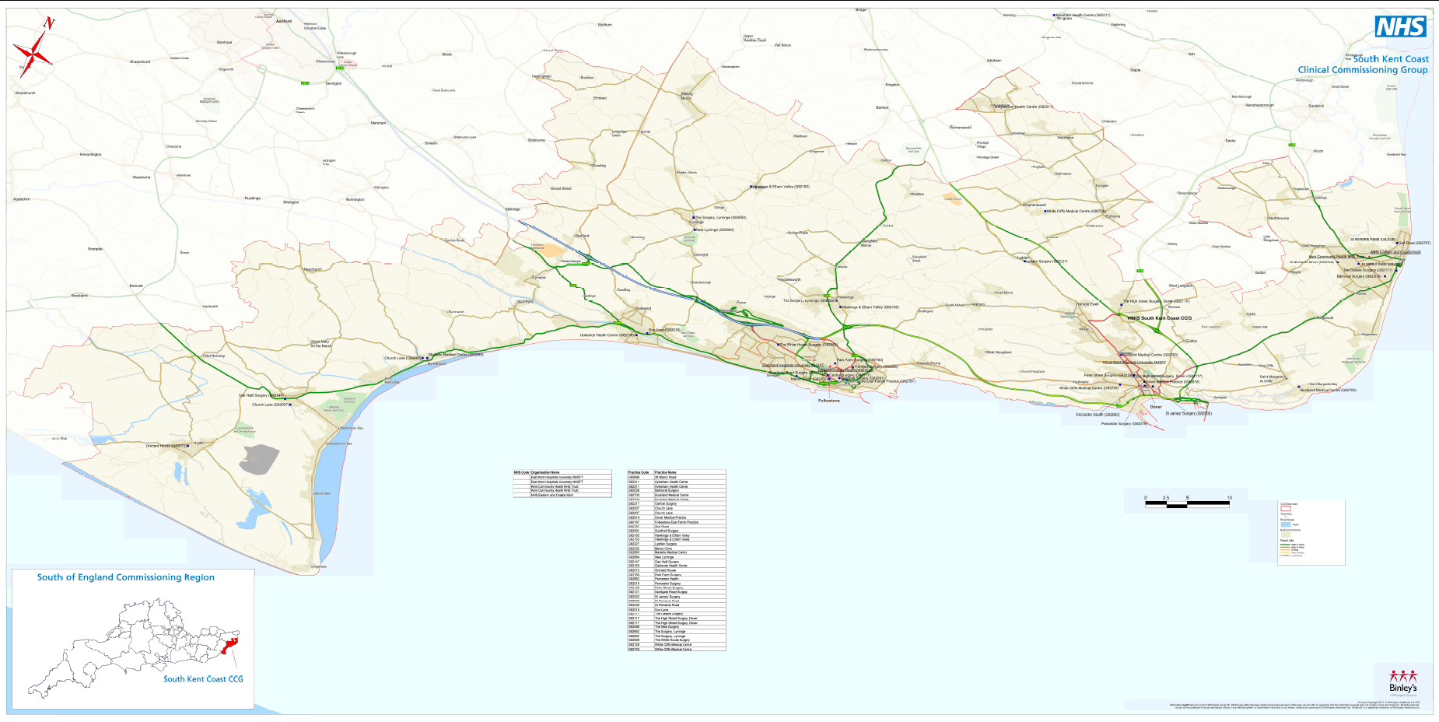
Redesigning out of hospital care for 200,000 patients in 4 Localities
Deal
Dover
Folkestone
Hythe & Rural

Slide 7
Introduction
Deprivation and health inequalities
Main Issues
Young adults in private rented accommodation
Particularly high levels of shared dwellings and overcrowding
Particularly pool living environment with high crime rates
Low incomes
High levels of out-of-work benefit claimants
Poor scores for education
Particularly high levels of movement / transiency
Health Risks / Behaviors
High smoking prevalence
Low levels of wellbeing
Health Outcomes
High premature mortality rates
Alcohol-related premature mortality and from ‘external causes’ particularly high
South Kent Coast CCG covers the areas of Shepway and Dover, which include the main towns of Folkestone and Dover respectively.
Deprivation statistics are higher than the
Kent average and the England average, with generally worse health outcomes.
The towns have an important location on the South Coast of England, with major transport routes between mainland Europe and London.
19 LSOAs feature in the most deprived
decile for deprivation in Kent, 8 in Shepway (around Folkestone) and 11 in Dover (around Dover town).
There is another pocket of deprivation in the village of Aylesham.
SOUTH KENT COAST CCG - Analysis of Deprived Areas
In the most deprived decile for Kent (Kent Public Health Observatory, 2016)

Slide 9
East Kent Strategy emerging thinking for ‘out of hospital’/community-based services - for discussion
Introduction
Our approach to delivery of East Kent Strategy and STP
Greater focus on helping people to lead healthier lifestyles, stay well, and self-care where possible. Support to prevent ill-health and the worsening of existing conditions
SKC approach: Our Out of Hospital service model is being developed ‘bottom up’ and aligned with the East Kent Strategy and the Kent and Medway Transformation Plan to ensure we have robust care systems to provide more care in the community at pace.
This includes alignment with the Kent County Council transformation programme around social care.
Self-care and prevention - all
Delivering enhanced primary and social care services, possibly 8am - 8pm, 7 days per week.
Services could include: community nursing, GPs, counselling and psychological therapies; social /domiciliary care; occupational therapy, physio, speech and language therapy; voluntary sector support; intermediate care including rapid response; urgent/same day care; community paramedics; longer appointments for patients with complex cases; carer support/peer support; palliative care; health visitors; health trainers; access to beds in the community to support step up/short term crisis care; and annual health care check services.
?16 x locality ‘hubs’ serving 30,000 to 60,000 population
24 hour, 7 days per week services as well as specialist services for those with more acute conditions.
Services could include: rapid response/link with acute services; diagnostics, eg enablement, MRI; higher acuity ambulatory care, including mental health crisis; specialist end of life; specialist dementia care; specialist nurses; community geriatrician, cardiology and respiratory support; outpatient services; community midwifery; minor injury units and specialist mental health including perinatal mental health services, nurse led outcome focused domiciliary care. Could include community beds.
?4 x ‘super-hubs’ serving
> 120,000 population
Acute hospitals serving 700,000 population

Slide 10
Better outcomes for the whole population
further discussion is required on how best to support the needs of the whole population with available resources
this includes clinical decision making on when best to involve more specialist expertise in patients care

Slide 11
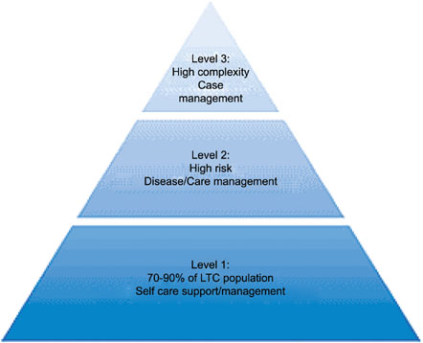
Our approach to delivering outcomes for the whole population
Introduction
National policy has advocated for using risk stratification to identify the top 2% of people with long-term conditions at high risk of frequent hospital admissions (2,000 people in SKC) (Direct Enhanced Service, Admissions Prevention).
In some localities this will be significantly more due to the gap in life expectancy.
However, further clinical discussion is required in view of evidence on ‘regression to the mean’. See next slide.
NHS & Social Care LTC Model (2008)

Slide 12
Introduction
Evidence
Any case-finding method needs to be able to identify individuals at high risk of future emergency admission to hospital.
Patients who are currently experiencing multiple
emergency admissions typically have fewer emergency admissions in future – a phenomenon known as ‘regression to the mean’ (Roland et al 2005; Nuffield Trust 2011).
Therefore, offering case management to patients who are currently experiencing emergency admissions can be inefficient.
If a patient can be identified before they deteriorate, there is more potential to reduce admissions. Figure 1 above shows the pattern of admissions among a cohort of people with an intense year of admissions.

Slide 13
Introduction
Implement
Test
IACO
2019/20
Integrated Accountable Care Organisation
SKC IACO Timeline
2018/19
Build
Design
2017/18
Continue shadow ICO
Decommissioning
Procurement of ICO
ICO specification written
New emergent workforce in place
Start shadow running of ICO
2016/17
Business plan for ICO
Shadow commissioning HWBB in place
Leadership of place established
Shadow place based health budgets
Capitated budget defined
Evaluation framework in place
Future workforce plan complete
Integrated information sharing platform
Community hub(s) design model complete
Social care transformation complete
2015/16
Embryonic IACO – 4 Localities
Integrated health and social care commissioning established
New contracting model
Options appraisal of what’s in scope of ICO
Compact agreement in place
HWBB developed for Integrated Commissioning
Integrated finance model developed
Strategic workforce plan agreed targeting skill gap
Integrated IT strategy agreed
Integrated health and social care dashboard
Comms and engagement plan
System modelling complete
Locality delivery groups
Local leadership
Evaluation
Culture Change
Stakeholder Engagement
Notes:
We are approaching the build/test phase of our programme and have agreed to have an IACO in place by 17/18.

Slide 14
Integrated Accountable Care
Development
Locality Service Model
v1.8

Slide 15
What’s the big idea?
to refocus resources on preventative and proactive care by re-organising care more effectively
at the centre of the model is the conscious uncoupling of scheduled and unscheduled Primary Care
social outcome based care focused on promoting and supporting independence and wellbeing.
this will avoid the inevitability of unscheduled care being a daily add on due to the current model which is overstretched

Slide 16
Introduction
Our approach to developing a service model
VISION
To ensure high quality out of hospital care is available to all by mobilising support around practices
THE MEANS
To enable multidisciplinary working and care coordination
OPPORTUNITY
To refocus resources on preventative and proactive care
IMPACT
To improve outcomes and reduce inequalities for all patients
Creating the environment where all our practices are resilient and sustainable so that high quality out of hospital care can be offered to all.
For example:
Widening the scope of Primary Care as part of the foundations of a fully integrated out of hospital system
Greater resource sharing and partnership working between practices
At present there are multiple levels of care coordination which have the right intention, but can result in confusion.
An agreed system of multi-disciplinary working at a practice and locality/town level, will enable better care coordination.
This has the potential to reduce duplication and prevent avoidable admissions to hospital.
The aging population and burden of Long Term Conditions has led to rising demand for care, which coupled with workforce pressures, can result in hospital being the default setting of care.
Redesigning unscheduled care may free up clinical time to offer a proactive approach:
Longer GP appointments for patients with chronic conditions
Proactive management of patients to prevent the development of chronic conditions
Enhanced care packages for vulnerable and highly complex patients that require community, mental health and acute services, wrapped around the practice.

Slide 17
New Ways of Working
to plan for what type of care needs to be available out of hospital through an inclusive approach with professionals and patients
to promote new ways of working based around multidisciplinary care planning that leads to integrated care
to establish a Primary Care Team of health and care professionals around the patient

Slide 18
Locality Service Model
What types of care will be provided for a locality?
Planned Care
Unscheduled / Same Day Services
Mental Health
Prevention &
Voluntary Sector
Patient Participation
Care Coordination
Intermediate health and care
Community Diagnostics*
Prescribing
Our engagement sessions have proposed what care should be available in each locality.
It would be beneficial for all practices to work in partnership with providers as part of one Primary Care Team.
Each locality requires a Hub, such as a Community Hospital, that will provide diagnostics, same day services (illness and trauma) and other out of hospital services
A Specialist Interface, with consultants, working out of hospital to support Primary Care Teams and prevent avoidable hospital admissions.
*Including Social Care- functional Occupational Therapy assessments, use of equipment and assistive technology
Practice
Practice
Practice
Practice
Practice
Specialist
Interface
HUB
(Community Hospital)

Slide 19
Introduction
Locality Model: New Ways of Working
Locality Service Model
Learning Disability
Our engagement sessions suggest care should be organised at 3 levels in a locality and around the GP list:
Consultant Hot Clinics
Autism and sensory services
Community Pharmacist
1. Practice Partnerships supported by a Primary Care Team
2. A dedicated Multidisciplinary Locality Team (without organisational boundaries) based on trusted relationships and one care plan
3. Supra locality services with more specialist provision due to small patient numbers and specialist professionals (across localities, East Kent or South East England)
Best practice pathways be followed at each level, but not resulting in fragmented care, or service gaps
Professionals work in loose networks / clusters across Primary Care and MDLT (colour coding is indicative of which professionals may work closely together)
* See Social Care slide.
Community Specialists
NHS111 / OOH Model
Consultant Out-Patient clinics
Optometrists
Ambulatory Care
SECAmb 999
GP & PATIENT
Advice & Guidance Referral Support
Practice/
District Nurses/
HCAs
Minor Injury Unit
Clinical Pharmacists
Physician Associate
Physios
Paramedic
Intermediate Care
GP
Health Visitors
End of life care & hospice
Care Navigators
Midwives
Geriatrician
Receptionist
Continuing care
Enablement*
Social Care*
MH Support/ IAPT
Nursing & Care Homes
Domiciliary Care Workers*
Spec Dementia Nurses
Patient Transport
Vol Sector
Community
Mental
Health
`Memory
Clinics
Extra Care Housing
Dementia Enablement
Community Equipment and Assistive Technology Services
Secondary
Care
Mental
Adapted from DH Integrated Care (2011)

Slide 20
Thoughts on what would a Primary Care Team would look and feel like to work in?
Locality Service Model
Health and care professionals working as one team to support a practice / group of practices
A holistic approach – to address health, mental health and care/lifestyle needs of the person
Primary Care Nurse – develop one role for out of hospital nursing care as part of the Primary Care Team – this encompasses the traditional roles of both practice and district nurses
Case Manager- The team agrees the most appropriate professional to be the care coordinator (not the GP wherever possible)
One care plan - held by the GP as the senior responsible doctor – which all professionals can read/write to
Virtual network of professionals - readily offering assessments, consultation, advice, guidance and treatment as one package of care
Employment and governance - Professionals can be employed by a range of organisations but agree to work to the principles of one locality service model
GP
& PATIENT
Clinical Pharmacists
Practice/
District Nurses/
HCAs
Physician Associate
Physios
Multidisciplinary care planning at practice and locality level for more complex patients requiring specialist input
No ‘send and receive’
- Referrals are made in person, in team meetings, wherever possible to promote joint working, reduce unnecessary referrals; supported by single points of access in each organisation.
Health Visitors
Care Navigators
Receptionist
Social Care
MH Support/ IAPT
Peripatetic working - in practice, community hubs, home settings of care, but can also have a team base with their employing organisation.
See Social Care slide

Slide 21
Locality Service Model
Options for meeting patients needs in different settings of care
Service Specification
Scheduled Care |  | Unscheduled Care
Practice | Locality | Locality/Hub
Managed Care
Tier 1 – Primary Care
Tier 2 - Secondary Care in the community (Allied Health Professional Specialists)
Tier 3 – Consultant
Chronic Disease
Management &
Prevention
Multidisciplinary care planning and delivery
Named Care Coordinator
GP extended appointments
for LTCs
Advice & Guidance from Consultant
Complex & Vulnerable
Patients requiring dedicated case conference and case management via a Virtual Ward, who may otherwise default to hospital.
Led by Locality GP and multidisciplinary team
Supported by Consultant Interface
Home Visits
Patients requiring same day visits at home / care homes
Response times 2-4 hours
GPs,
Paramedics,
Allied Health, Professionals, Intermediate care
Minor illness
Patients currently seen in practice or A&E minors
All same day access in one hub?
Streaming/triage via one number?
Co-located with Minor Injury Units?
8-8?
GP led & Nurse led
Secondary Care
in the Community
Care Delivery –
Practice &
Primary Care Team
Locality Case
Conference:
Step up to Virtual Ward
Home
Visiting Team
Primary Care
Access Hub

Slide 22
Uncouple scheduled and unscheduled Primary Care
to create the right environment for Primary Care to thrive
to consider options for meeting patients same day care needs - Primary Care Walk In Hubs and Home Visiting Service
to free up GP capacity to lead multidisciplinary care planning and offer longer appointments for patients with chronic disease
to manage demand for health and care through self management and services that support independence and self management .

Slide 23
Multidisciplinary care planning & coordination
to mobilise the right support, at the right time around the patient
to prevent avoidable hospital admissions through multidisciplinary care planning
for all practices to offer and be supported by care planning system
to provide enhanced care for vulnerable patients with complex needs on a virtual ward with support from specialists

Slide 24
Locality Service Model
Our approach to multidisciplinary care planning – what will it look like in the future?
References: Kings Fund (2010); NW London (2012); Nuffield Trust (2013). Developed via 4 Clinical Design Groups in SKC Localities (2016)
Register
Risk
Stratification
2
Care
Planning
3
Care Delivery –
Primary Care Team
4
Locality Case
Conference
(Virtual Ward)
1
GP
PC Nurse
Care
Navigator
Community Mental Health
Pharmacist
Acute/MH Specialist
Social care
(see slide)
At practice level: (Chronic Disease Management)
At Locality Level (Complex patients)
Consultant Interface
Each Practice holds a register of all patients who are in need of enhanced care (vulnerable, frail, elderly, LTCs etc).
Each patient is then given One Care Plan
All professionals can read/write onto CP
(using interoperable GP systems and MIG)
Patients receive a coordinated package of care.
Professionals decide most appropriate care coordinator
(only the GP if essential)
Frees up GP time for longer LTC appointments
For complex patients requiring dedicated case conferences, who may otherwise default to hospital.
Localities agree the trigger point for referral to case conference to enable fair share of intensive resources.
Led by Locality GP(s) supported by Consultant interface in liaison with Practice GP
The system enables effective use of consultant input into case conferences:
Advice & Guidance
Video conferences
Hot Clinics / diagnostics

Slide 25
Mental Health and Dementia Care in the IACO

Slide 26
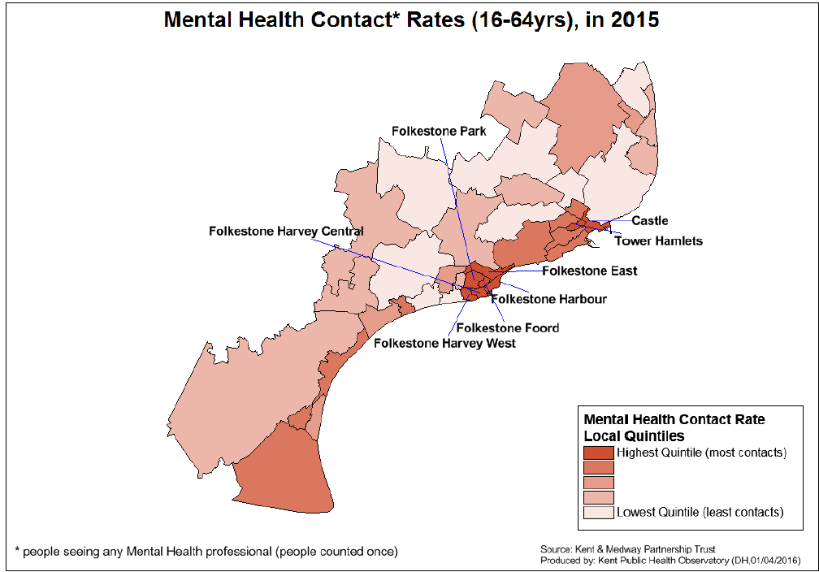
Mental Health need in SKC
There are 16,658 people estimated to be on a GP register for CHD and/or Diabetes and these people are likely to be significant risk and co-morbidity with mental health problems.
Adults with depression known to GPs: Patients with depression as % of all patients on the GP register 11,952 people 7.5% (England 7%).
Psychotic disorder: Estimated % of people aged 16+ (2012) Number = 645. Rate = 0.38%. (England Average = 0.40%).
There are an estimated 3% of the South Kent Coast Population who are in touch with Mental Health Services.
Number of people with SMI known to GPs: % on register (2015) - 83% This is somewhat lower then expected. (England Average 0.88%)
There were 70 deaths from Suicides from 2012-2014 in South Kent Coast. There are higher rates for men. The rate is 22 per 100,000 deaths for men and 13 per 100,000 deaths for women. Trends in A&E attendances for self harm continue to be the highest in Kent and are also rising year on year (0.28% = 458 people, compared to 0.12% Kent average).
Sources ONS, HSCIC, PHE, Kent PHO

Slide 27
What’s the big idea for mental health and dementia?
to refocus resources on prevention, early intervention and proactive
care by organising care more effectively
to provide access to mental health and dementia expertise in the practice
to support people in mental health crisis within their communities
to ‘connect’ all community resources (housing, employment, carer and peer support) together in a locality to facilitate recovery and living well with dementia
to provide a ‘whole person' approach to physical, mental health and dementia care

Slide 28
Mental Health and Dementia Care in the Locality Under development
Locality Service Model
The Primary Care Team will have Mental Health and Dementia Practitioners.
These professionals will support the GP offering advice, consultation, short term interventions and treatment guidance.
Practitioners will be the named care coordinator for patients with mental health issues, as appropriate.
More clinical triage will be undertaken in the Primary Care Team to avoid unnecessary referrals to secondary care.
There will be an aligned Consultant Psychiatrist and Older Adult Consultant Psychiatrist to each locality to support multidisciplinary care planning and to provide specialist advice and consultation to support management of mental health and dementia in primary care.
The gateway for community mental health services is via the MH Practitioner in the Primary Care Team and/or directly to Single Point of Access.
Community mental health is provided by a virtual integrated multi- disciplinary/multi-agency team including - IAPT, Live Well, Primary Care Social Workers, DWP Link Workers and Drug and Alcohol services (Dual Diagnosis).
For patients with dementia the Older Adult Secondary Mental Health team will work together with the Intermediate Care and Enablement teams to provide joint assessment and treatment. These teams will work closely with third sector partners to optimise community resources for the person with dementia and their carer.
Same Day Access for unscheduled mental health care is via the Primary Care Walk In Hub, which interfaces with the Primary Care team, A&E liaison service and the Mental Health Single Point of Access.
Patient
Secondary Mental Health Care Services, for younger and older adults, these teams will provide CPA based interventions and case management (including medicines management) for secondary complex and high risk need.
The Community Mental Health Team will provide ‘stepped up’ and crisis support for people who are in crisis through an integration of CRHT and CMHT capacity. This includes access to inpatient services.
Access to specialist services such as Forensic, Learning Disability and Eating Disorder services are provided pan county with locality aligned clinical staff.

Slide 29
Locality Service Model
Options for meeting the needs of patients with mental health concerns in different settings of care
Service Specification
Scheduled Care |  | Unscheduled Care
Practice | Locality | Locality/Hub
Emotional Difficulties
Access to IAPT
Navigator Connecting people to:
Public Health initiatives
Local council resources
Citizens Advice
Job Centres
Peer Support
Self Help
Drug and Alcohol services
Live Well
Complex & Vulnerable (Emotional Disorders and Psychosis)
Patients requiring dedicated case conferences, who are complex but stable where risk management is critical and who may otherwise default to hospital .
Led by Locality GP and including the wider multidisciplinary team
Supported by Consultant Psychiatrist
Crisis Referrals
Patients presenting in crisis which may require a same day response are triaged by the Mental Health Workers.
Response times 2-4 hours.
Referral to the CMHT or Single Point of Access for access to Crisis Resolution Home Treatment or ‘stepped up’ care.
Mental Health Escalation
All access in one hub, co-located with Minor Injury Units?
Minor Illness,
8-8?
Nurse and GP led including mental health screening.
Moderate Emotional Difficulties
Access to IAPT
Access to the Primary Care Team Mental Health Workers and Practice level Depot and Clozaril Clinics
Coordinated support to social care, 'Live Well 'and other voluntary sector services
Access to CBT and group work interventions and
support for LTC
^{Self Care and Prevention}
^{In the community}
Care Delivery –
Practice &
Primary Care Team
Locality Case
Conference
Virtual Ward
Crisis and Home Treatment Response
Primary Care Walk-In Hub including mental health screening

Slide 30
Locality Service Model
Options for meeting the needs of patients with dementia in different settings of care
Service Specification
Scheduled Care |  | Unscheduled Care
Practice | Locality | Locality/Hub
Dementia and Carer Support
Access to IAPT
Navigator Connecting people and their carers to:
Dementia community resources
Admiral Nurse Support
Voluntary Sector services
Dementia Diagnosis and Support
Pre and post diagnostic support.
Access to the Primary Care Team Dementia/Mental Health Workers
Coordinated support to social care services.
‘Dementia Drop-In’ providing coordinated support to voluntary sector services
Access to Cognitive Stimulation Therapy and group work interventions.
Complex & Vulnerable (Emotional Disorders and Psychosis)
Patients requiring dedicated case conferences, who are complex but stable where risk management is critical and who may otherwise default to hospital .
Led by Locality GP and including the wider multidisciplinary team.
Supported by Consultant Psychiatrist and Geriatrician.
Coordinated ‘End of Life’ care.
Crisis Referrals
Patients presenting in crisis who may require a same day response are triaged by the Mental Health Workers.
Joint Intermediate Care/Enablement Service assessment.
Response times 2-4 hours.
Referral to the CMHSOP or Single Point of Access for access to ‘stepped up’ and crisis support and inpatient services.
.
Intermediate Care
Access to
Intermediate care and Respite Care beds.
Coordinated ‘End of Life’ care.
^{Self Care and Support}
^{in the community}
Care Delivery –
Practice &
Primary Care Team
Locality Case
Conference
Virtual Ward
Crisis and Acute Care
Intermediate Care/Step up/Step Down beds

Slide 31
Locality Service Model
Our approach to multidisciplinary care in mental health and dementia planning – what will it look like in the future?
References: Kings Fund (2010); NW London (2012); Nuffield Trust (2013). Developed via 4 Clinical Design Groups in SKC Localities (2016)
Register
Risk
Stratification
2
Care
Planning
3
Care Delivery –
Primary Care Team
4
Locality Case
Conference
(Virtual Ward)
1
GP
PC Nurse
Care
Navigator
Social care
Pharmacist
Community Mental Health
Acute/MH Specialist
At practice level: (Chronic/Complex Disease Management)
At Locality Level (Complex/high Risk Patients)
Consultant Interface
Each Practice holds a register of all patients who are in receipt of care from multiple agencies and who’s needs are complex and where there may be associated risk.
Each patient is then given One Care Plan
All professionals can read/write onto CP
(using interoperable GP systems and MIG)
Patients receive a coordinated package of care.
Professionals decide most appropriate care coordinator
(only the GP if essential)
Frees up GP time for longer LTC appointments
For complex patients requiring dedicated case conferences, who may otherwise default to hospital.
Localities agree the trigger point for referral to case conference to enable fair share of intensive resources.
Led by Locality GP(s) supported by Consultant Psychiatry interface in liaison with Practice GP
The system enables effective use of Consultant Psychiatry input into case conferences:
Advice & Guidance
Video conferences
Hot Clinics / diagnostics

Slide 32
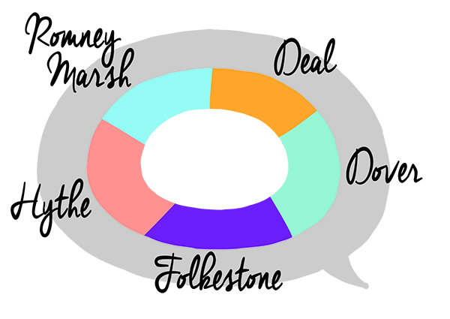
Questions and Discussion

