Slide 1
Resident Engagement, Involvement and Accountability.
Bruce Moore

Slide 2
Mind the Gap

Slide 3
White Paper

Slide 4
No Single Simple Solution

Slide 5
Boards Need Accountability

Slide 6
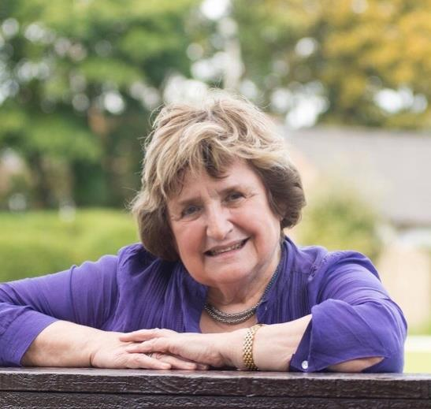
Resident on the Board

Slide 7
Collective Voice

Slide 8
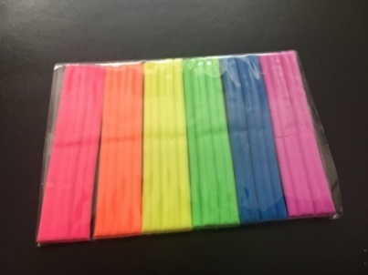
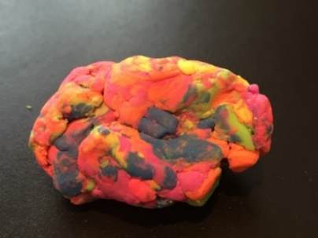
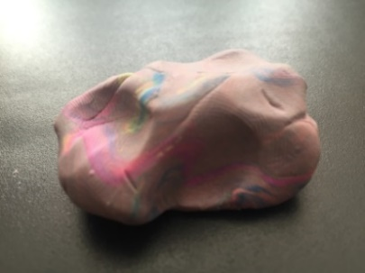
Milk and Plasticine

Slide 9
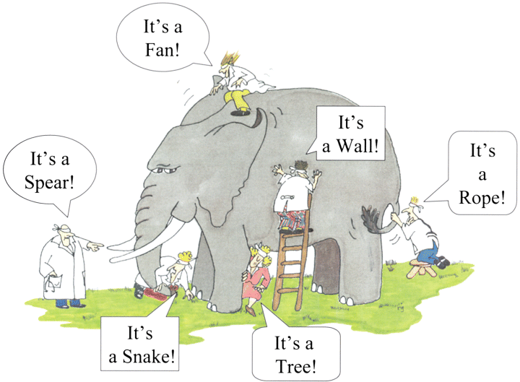
Different Experiences and Assessments

Slide 10
Devolved Decision Making

Slide 11
Collective Local Engagement

Slide 12
Many Methods and Means

Slide 13
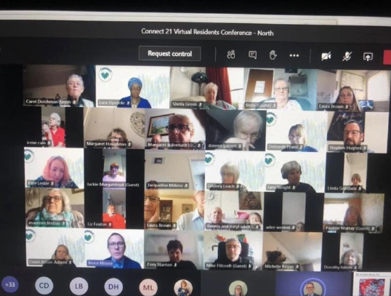
On-Line Forums and Digital Platforms

Slide 14
2 Way Conversations

Slide 15
Influence is Fundamental

Slide 16
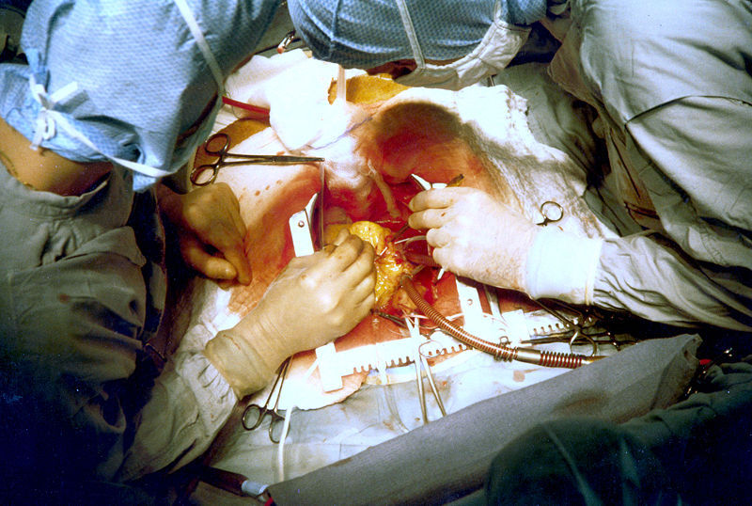
Residents At the Heart

Slide 17
Accepting and Learning From Mistakes

Slide 18
Encouraging Tension – An Opportunity To Reflect

Slide 19
What Gets Measured

Slide 20
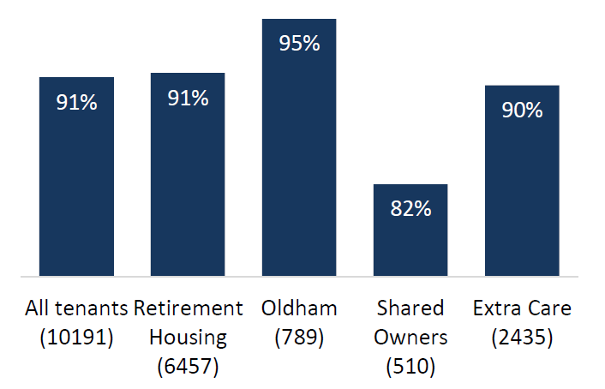
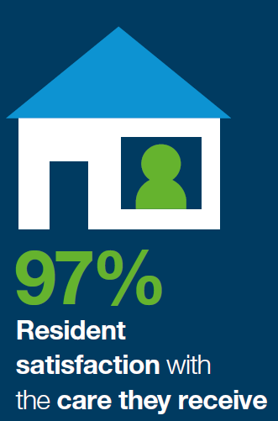
Resident Satisfaction

Slide 21
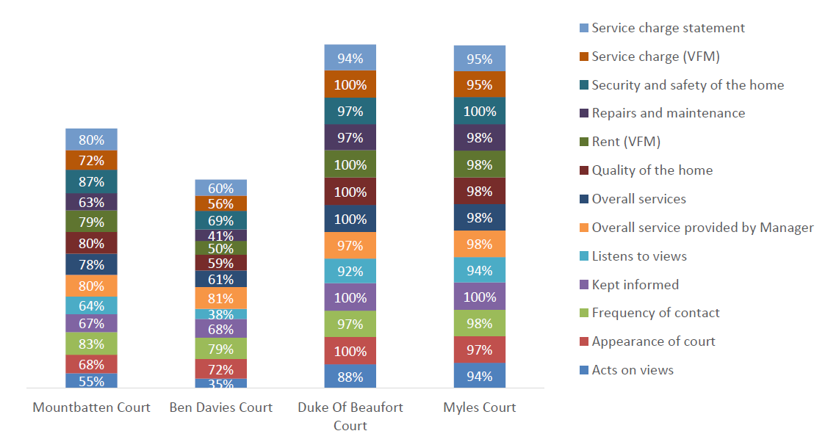
Court by Court Analysis

Slide 22
Insights

Slide 23
What Next?

Slide 24
Questions?

