Slide 1
NRLA where are we now September 2020
Marion Money
NRLA SE Representative and Trainer

Slide 2
Two Associations – One Vision
80,000 members 86,000 members Half million properties Importance of membership Accreditation Facilitates landlords keeping abreast of fast changing legislation Up to 2,500 calls to Advice line per week

Slide 3
Professional Board CEO Ben Beadle Mission Represent and reflect the views of members’ in the PRS and to campaign and influence government and policy influencers, including enforcement agencies, to effect policy which treats landlords fairly ​ Conduct research to inform policy and provide a service to others requiring access to the sector ​ Provide high quality services for members through innovation and partnerships

Slide 4
Coronavirus engagement
Meet with MHCLG officials once a week and in daily contact
Chair and chief executive sit on the judicial working group looking at the process for reopening the courts
In contact with special advisers at No 10 and MHCLG
Have met regularly with the Housing Minister, Christopher Pincher, during the crisis

Slide 5
Targeted Campaigns: Funding For Renters, Justice for Landlords
94 % of landlords are ‘small’ landlords
Many rely on their rental income for their livelihood
Majority of landlords and tenants working constructively to maintain tenancies
95% of tenants are paying their rent or have made an arrangement with their landlord
Concern over those who can pay but won’t pay
ASB and Domestic Violence
Less than 1/3 of tenants with arrears have been served with possession notices

Slide 6
Funding for renters
Interest free, government guaranteed hardship loans for tenants.
Providing tenants with a means to pay off COVID-related arrears will sustain tenancies and remove any risk of eviction as furlough is removed.
Tenant saver Loans – being introduced in both Wales and Scotland
These should be paid directly to landlords.
Income support for landlords. If a tenant refuses, or is unable, to take up a loan then landlords must be able to cover arrears through grants.

Slide 7
Justice for landlords
No further extension of the ban on possession proceedings.
Our data from surveys of landlords and tenants does not suggest there’s a ‘tsunami of evictions’ on the horizon
Closure means landlords cannot deal with antisocial behaviour or extensive pre-Covid arrears
Further extensions only serve to increase tenant debt and builds a longer queue for the courts to deal with.
Bottle neck in Courts ( mostly social landlords)
estimated S21 10,000 S8 14,000
Avoid the Courts at all Costs
Mediation?
Arrangement with tenant ( but risk intentionally homeless)

Slide 8
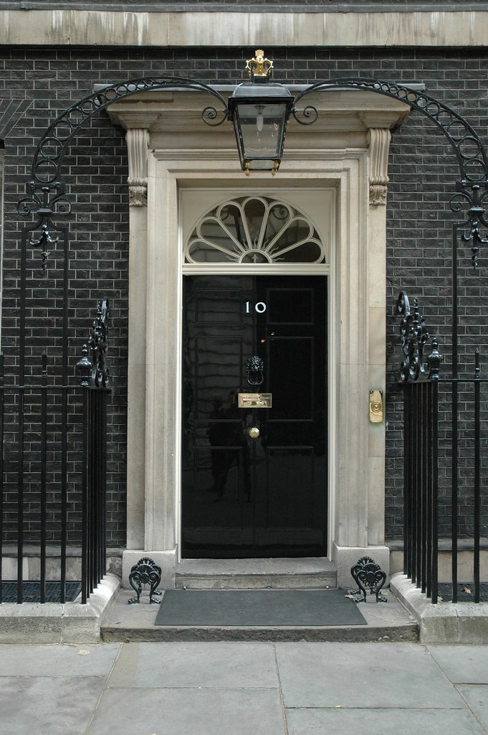
Funding for renters, justice for landlords
Political Action
Wrote to the Prime Minister (see news story on our website)
Met with the Housing Minister last week
Have highlighted our concerns in national media
Common Message
Co-signed a letter to Chancellor with
Shelter
Crisis
Citizens Advice
Generation Rent
ARLA
for further financial support for renters.

Slide 9
Collaborative Working
The NRLA
The Chartered Institute of Housing
The Property Redress Scheme
My Deposits
The Tenancy Deposit Scheme
ARLA Propertymark :
Toolkit for arrears management particularly during Coronavirus
Includes advice on early communication, and how to agree rent deferrals, reductions and suspensions
Provides support for tenants on applying for benefits and signposts to resources to help budget planning
Group committed to doing everything possible to sustain tenancies both through and beyond this period of crisis

Slide 10
Greater Strength
Partnership with Scottish Landlords Association
Landlords can pay a small ‘top up’ fee to join both organisations
Independent Advisory Board
Independent forum of individuals who represent a broad cross-section of stakeholders from the private-rented sector
Landlords associations representing different regions of England, plus SAL and a representative of the PRS in Wales
To share insights and discuss matters of relevance to the provision of the privately rented sector, inform and advise on our public policy and research work, and act as a multilateral communication channel between stakeholders and the NRLA.
Notes:
iHowz is one of the members of the Independent Advisory Board

Slide 11
Universal credit Key Asks
An end to the five-week wait for Universal Credit at the beginning of a claim,
with the advance payment currently made as a loan converted to a grant, so tenants do not automatically fall into debt at the outset.
Local Housing Allowance (LHA),
at minimum, the Government to commit to aligning LHA rates to the 30th percentile of market rents permanently, rather than as a short term response to the coronavirus crisis.
We are further calling for the Government to realign rents to the median market rents (50th percentile)
An end to the benefit cap so that tenants can receive the full LHA rate towards their rent.

Slide 12
Green Homes Grant – until 31 March 2021
£2 billion ‘Green Homes Grant’ scheme from end September 2020
Entitles homeowners (incl landlords) to a voucher for two-thirds of the cost of energy efficiency measures, up to £5k per property.
Need to include a ‘primary’ measure (insulation or low carbon heating) to be eligible for funding for ‘secondary’ measures.
Check what your property is eligible for using the online tool available at simpleenergyadvice.org.uk/pages/green-homes-grant

Slide 13
Dr David Smith, Legal Counsel, NRLA
David specialises in residential property rights and agency and has experience of a wide range of property litigation. David is a Partner at JMW Solicitors.
Notes:
Dr David Smith Legal Counsel, NRLA
David is the NRLA’s Legal Counsel and was the RLA’s Policy Director. David specialises in residential property rights and agency and has experience of a wide range of property litigation. David is a Partner at JMW Solicitors.

Slide 14
Contact Us
NRLA, 212 Washway Road, Sale, Manchester M33 6RN
0300 131 6400
https://www.nrla.org.uk/
Twitter: @NRLAssociation
Facebook: NRLANews
LinkedIn: NRLAssociation
Marion.money@nrla.org.uk

